Slide 1
Shutdown System
IFE 2018
Andrew Smith

Slide 2
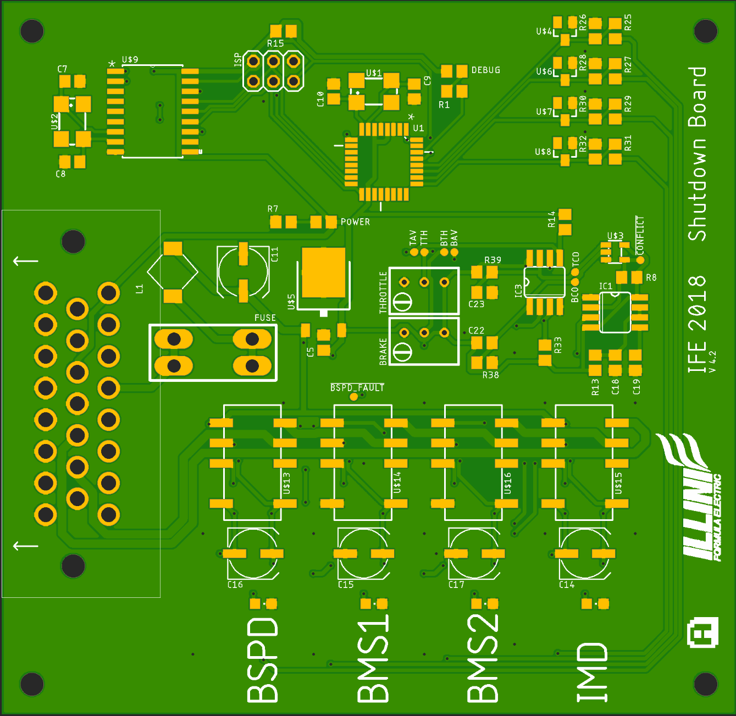
Overview
Physical separation of AIR line in case of fault
Indication of fault status
Must latch faults and maintain AIR separation until fault is resolved
Reset will reset all resolved faults

Slide 3
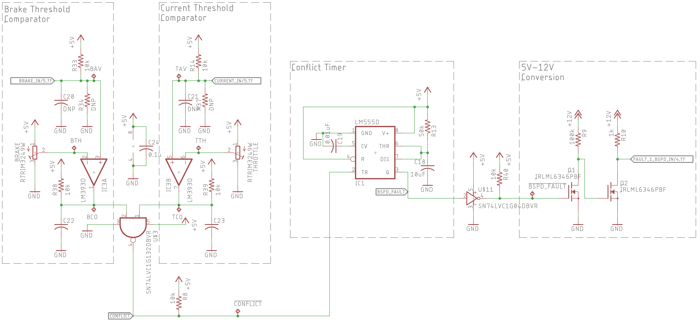
Fault: BSPD
The shutdown is required to disconnect AIR if BSPD fault condition is true.
This means ____kW Power Draw and ____% Brake Pressure

Slide 4
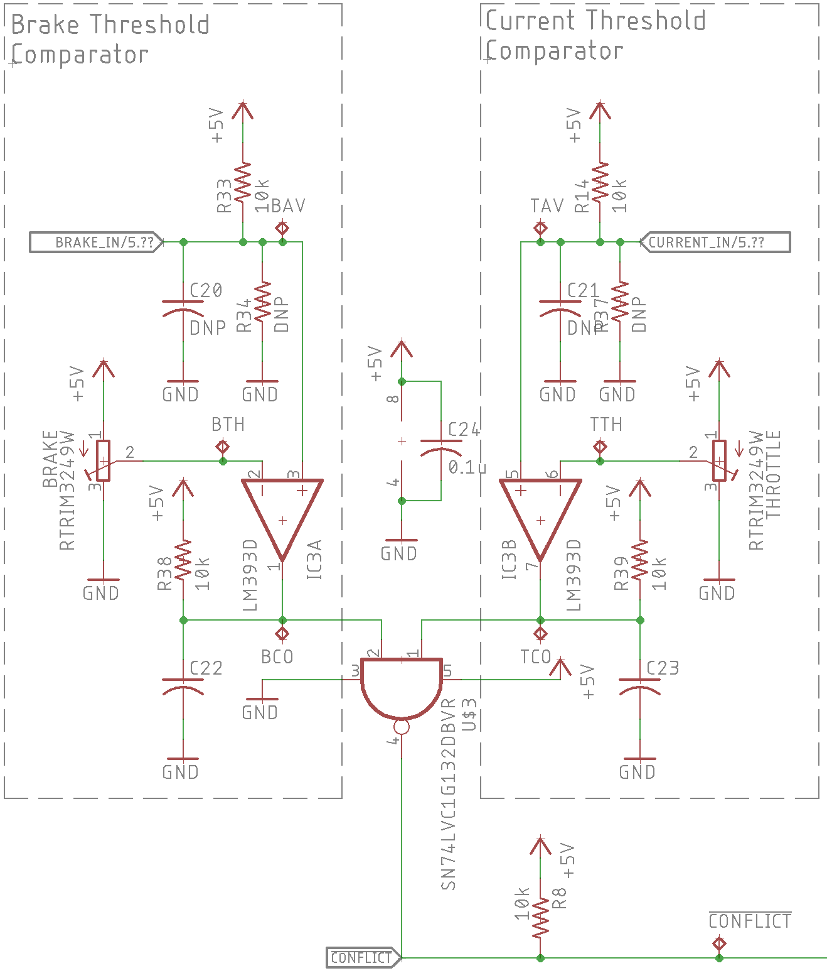
Fault: BSPD
The design compares brake pressure sensor signals with an adjustable threshold and outputs high when Vb > Vthb
Similar comparison for the bus bar current sensor, when its Vcs > Vthcs it outputs high
These signals are fed into a NAND gate which pulls low during BSPD conditions

Slide 5
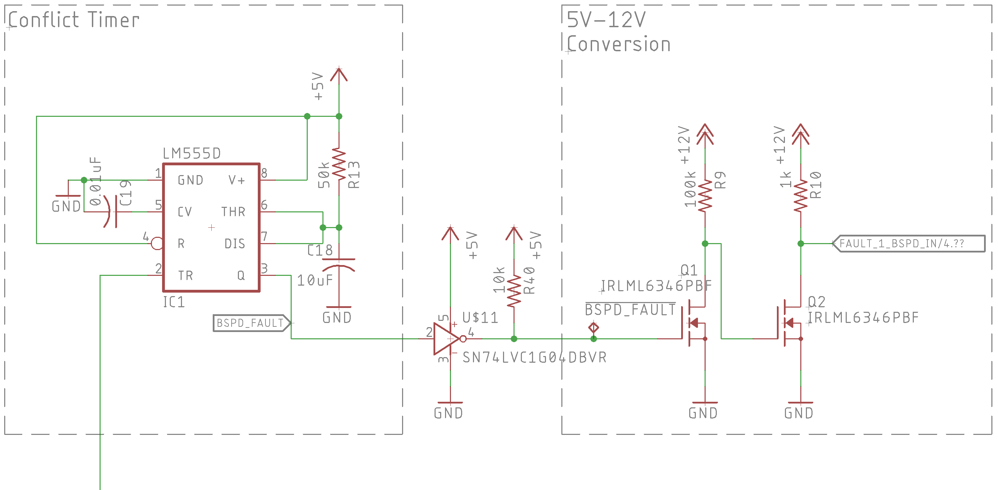
Fault: BSPD
When the output of the NAND pulls low it triggers a 555 timer in one shot mode to disengage the BSPD Fault Relay.
The output of the 555 timer is connected to a 2-Stage NMOS non-inverting amplifier to amplify the signal to 12V.

Slide 6
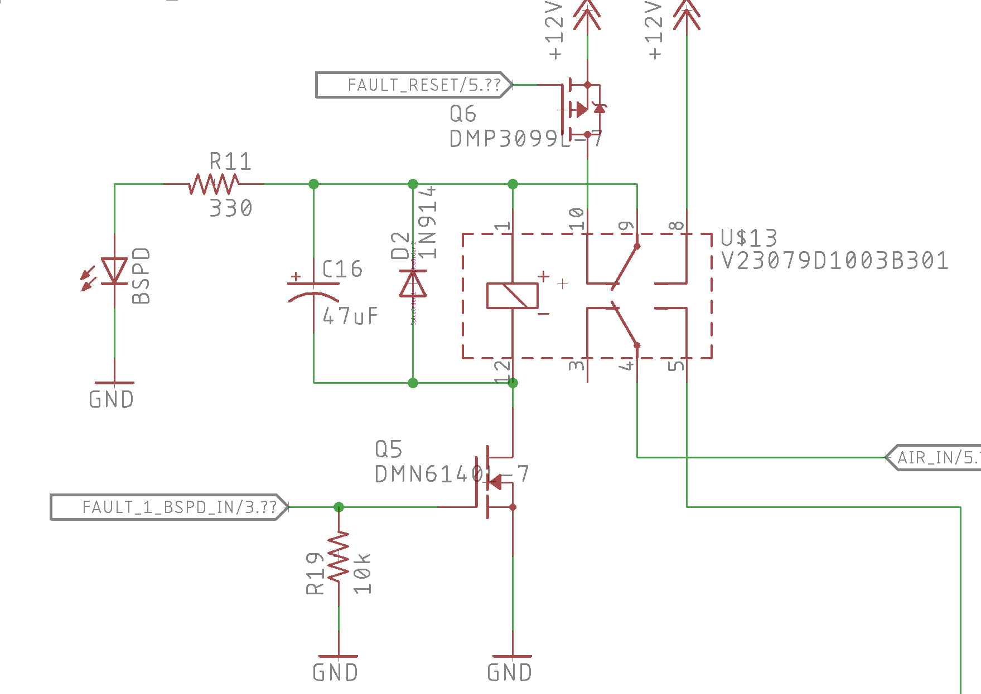
Fault: BSPD
This fault is then latched in a Relay separating the AIR line

Slide 7
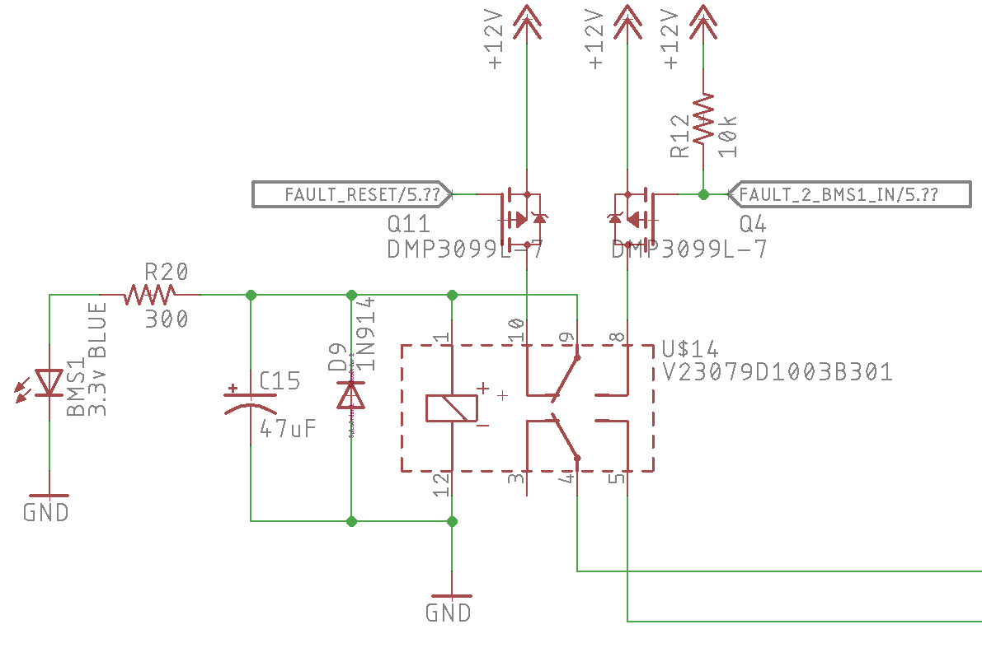
Fault: BMS 1 & 2
The BMS is an floating fault.
Pull up network on fault line triggers faults when the BMS fault line is floated.
Condition | Value
Good | GND
Fault | High-Z

