Slide 1
Display Driver Board
Low Voltage
Andrew Smith

Slide 2
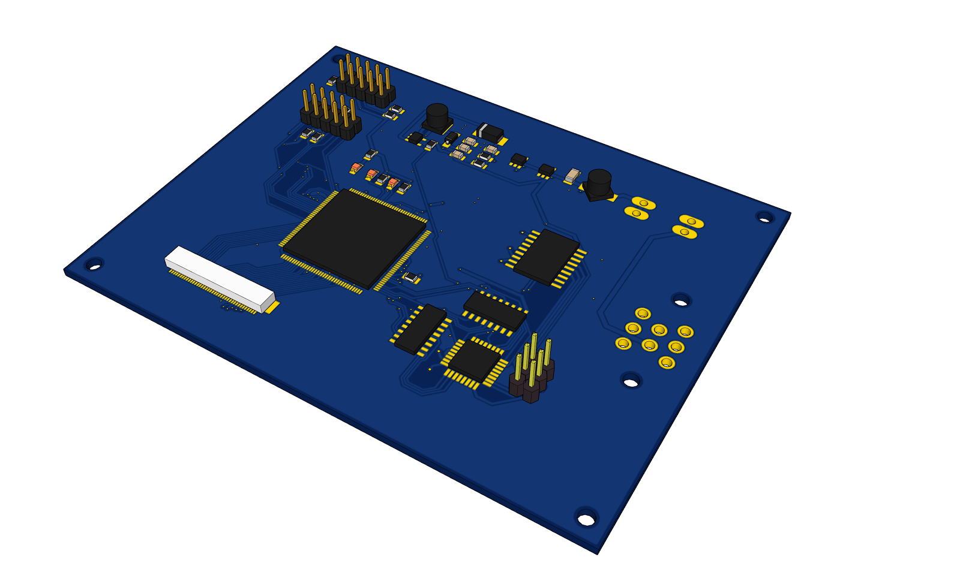
OVERVIEW
This board will drive a 5.0 inch backlit TFT display to display useful information to the driver.
Uses a FPGA to dive the display and a microcontroller to interface with the can network and control the sprites on screen.

Slide 3
Final Design

Slide 4
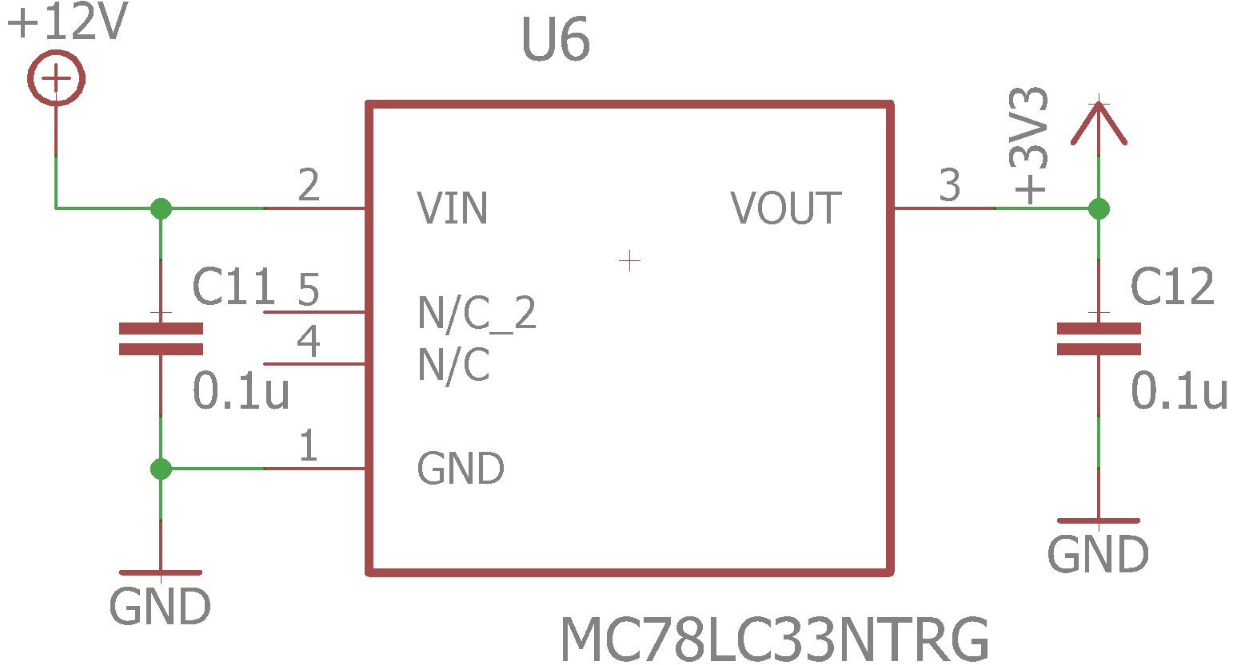
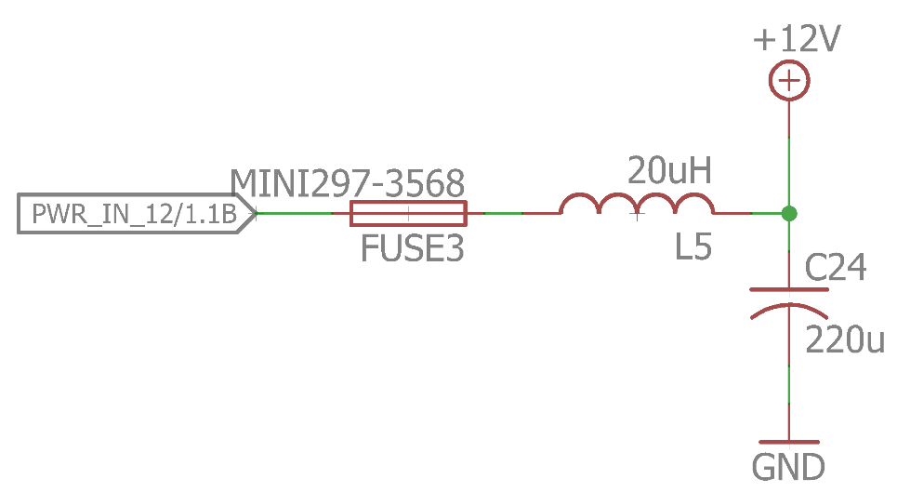
Power Supply
Linear voltage regulators generate the 5V, 3.3V and 1.2V power levels.
The FPGA also requires 1.2V supply for its logic elements which will be achieved with a 3.3V to 1.2V voltage regulator.
Input filter to filter EMI from motor.

Slide 5
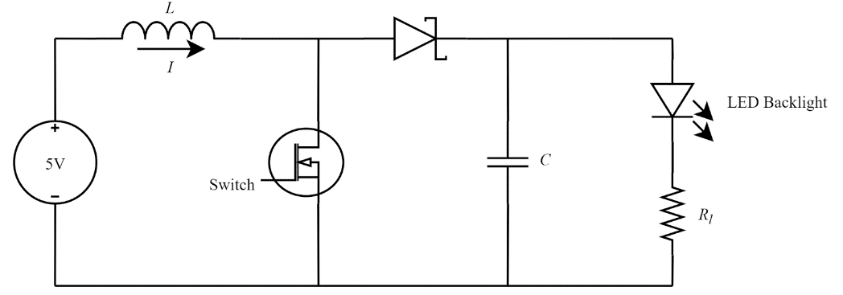
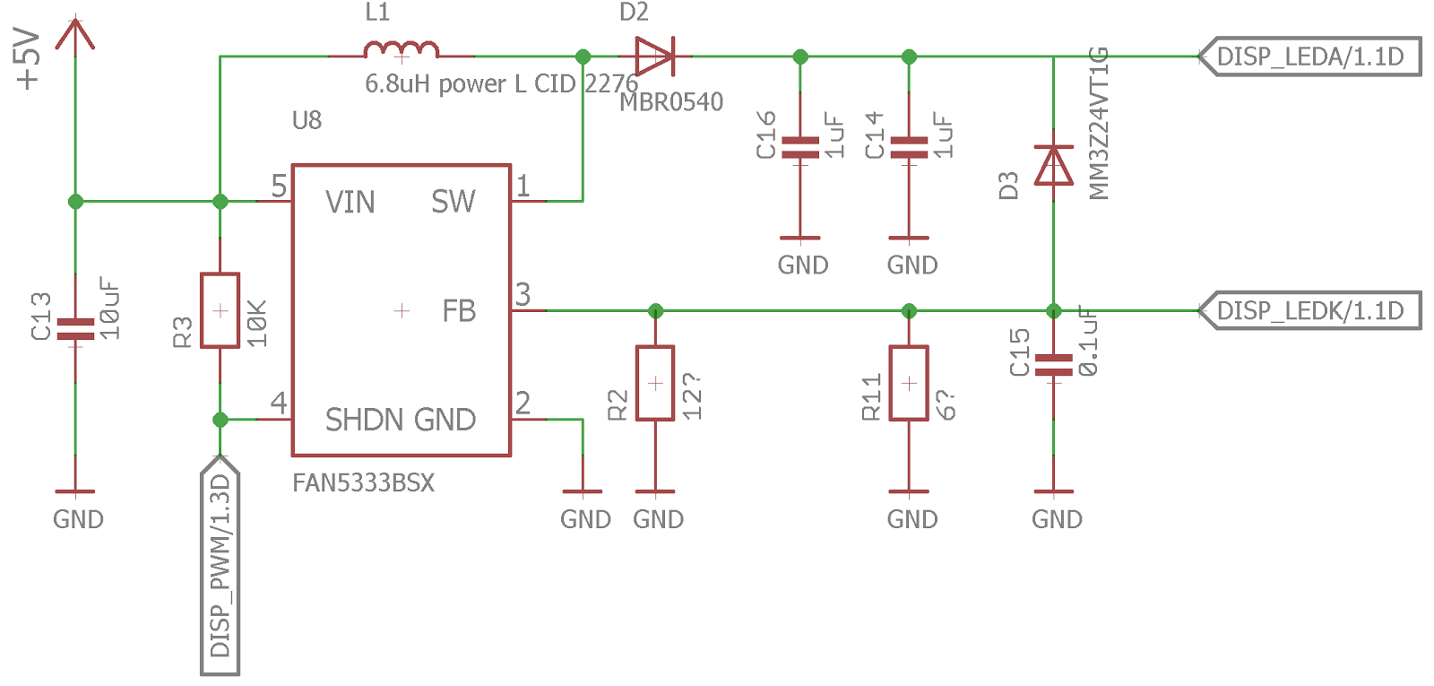
Backlight
Used a simple boost converter chip to boost the 5V supply to 24V to drive the LED backlight on the display.

Slide 6
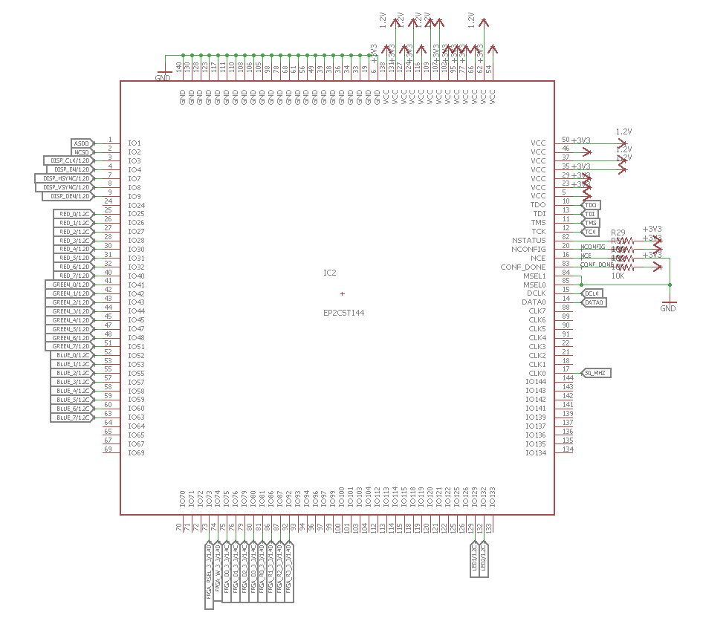
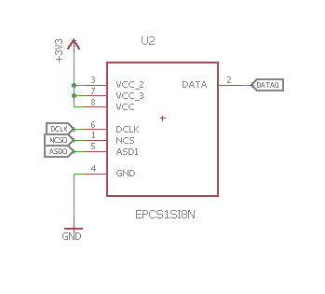
FPGA
I chose an FPGA to write to the display because I figured it would be easier to support custom graphics and be able to switch between different UI designs on the fly.
The FPGA is a basic Cyclone II from Altera and it will boot off of a configuration flash.

Slide 7
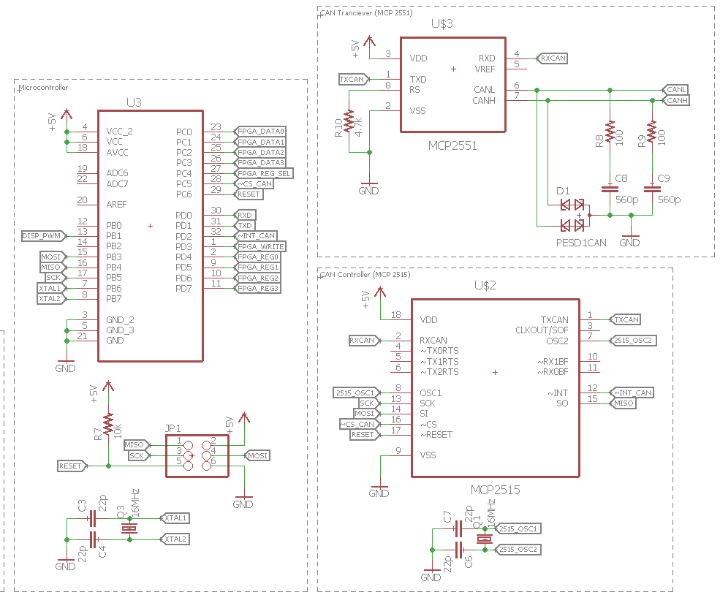
Microcontroller and CAN
I decided to go with an Atmega328P as the microcontroller because of its small footprint and its wide support in development tools.
It will interface with the FPGA over a custom communication protocol modifying potentially 256 – byte registers.
Standard SPI communications to the tested CAN Hardware.

Slide 8
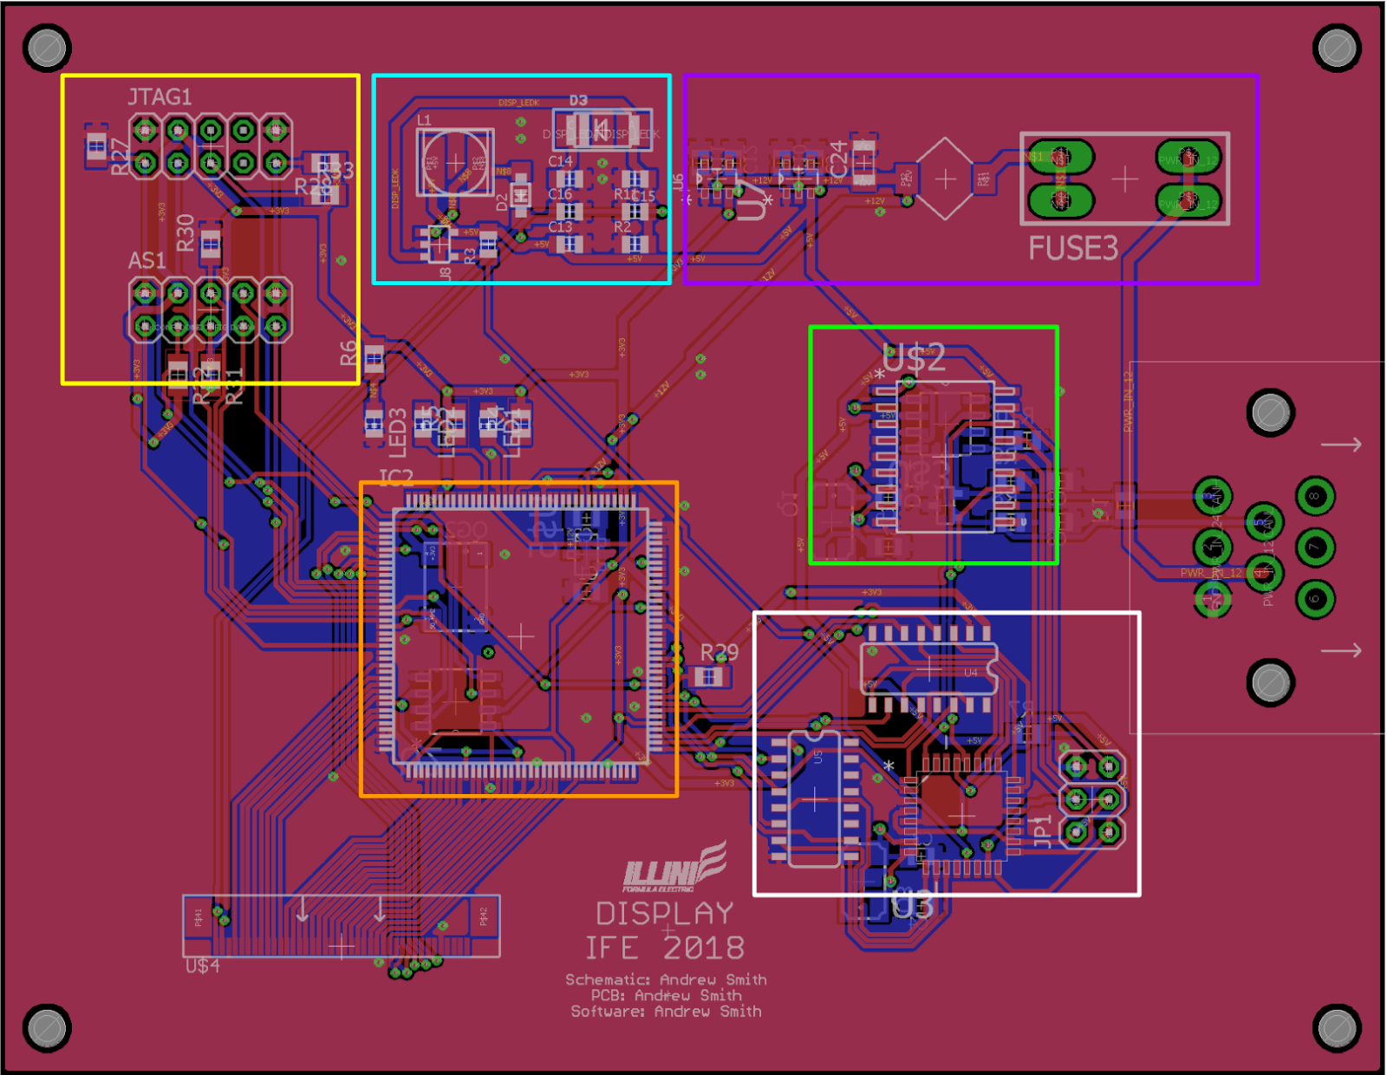
PCB
Current Hardware passes the ERC and the DRC tests on eagle for the Manufacturers 2 layer board specifications.

Slide 9
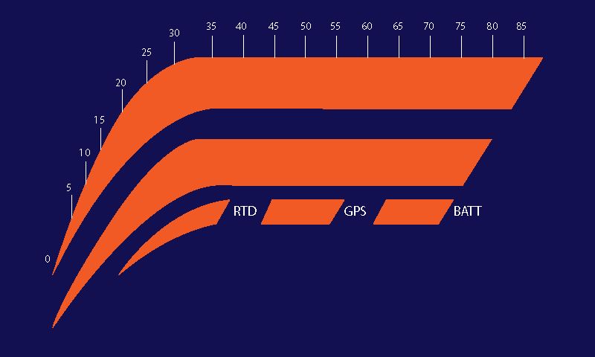
Software
Basic display modules written for the FPGA to display the IFE logo.
Will build on top of this framework to support the GUI and graphics.

