Slide 1
ARGO PROJECT
Methodology & Results
15/04/19
Sana Amri

Slide 2
M E T H O L O G Y
Assess GD(p=0) computed with Lax Friedrich solver + 2nd Scheme of Bassi Rebay
  Build Coarse Meshes ✓
  Run cases ✓
  Locate the shock, refine the zone ad run the code again ✓
Implementation
  Implement the Heat flux ⌛
  Implement sensor of shock (to avoid to locate manually) ✗

Slide 3
1-a Build Coarse Meshes - GEOMETRY
flow direction
v
inlet
u
Let’s recall the previous shape of the domain (used by Marc )
Wall
Outlet
No BC needed
Outlet
No BC needed

Slide 4
1-a Build Coarse Meshes - GEOMETRY
New domain
flow direction
v
Elliptic shape for the inlet (inspired by the meshes used in the article of Ray)
u
inlet
Wall
Outlet
Outlet

Slide 5
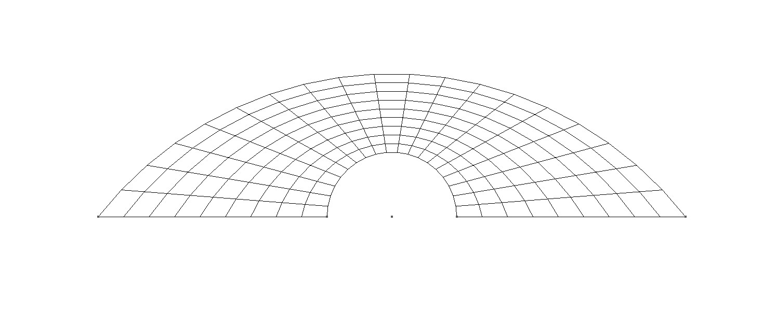
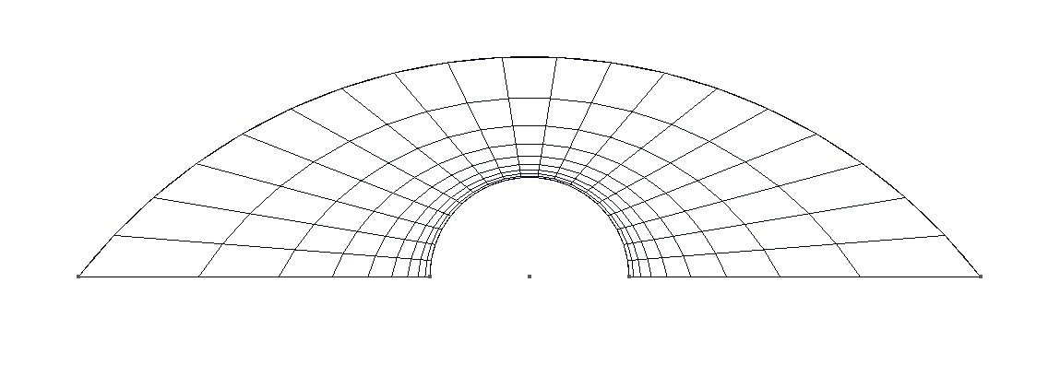
233 elements
Quadrangles (Uniform Repartition)
233 elements
Quadrangles (progression factor 1.5)
404 elements
Triangles (progression factor 1.5)

Slide 6
M E T H O L O G Y
Assess GD(p=0) computed with Lax Friedrich solver + 2nd Scheme of Bassi Rebay
  Build Coarse Meshes ✓
  Run cases ✓
  Locate the shock, refine the zone ad run the code again ✓
Implementation
  Implement the Heat flux ⌛
  Implement sensor of shock (to avoid to locate manually) ✗

Slide 7
Results
For more informations, all the results (input files, meshes, outputs) are HERE

Slide 8
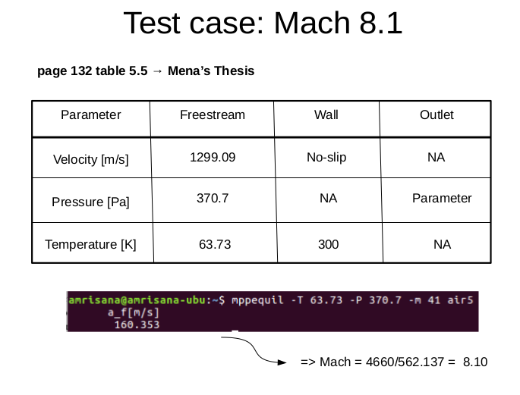

Slide 11
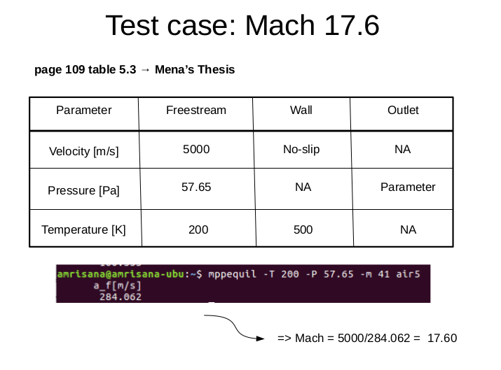

Slide 14
Residual (with tol 10⁽⁻⁸⁾) | Mach 8.2 | Mach 17.6 | Observation on the temperature solution
U1 | 4.66e-6 | 1.47e-4 | -This mesh tends to diffuse the solution far away from the boundary layer. It is not appropriate for our case.
PF1 | 1.17e-5 | 1.56e-3 | - good capture of the boundary layer ( but instable if we reduce the size of the mesh)
T1 | 1.75e-5 | 6.15e-3 | - good capture of the boundary layer - less precise than the quadrangles but more robust along the wall.

Slide 15
M E T H O L O G Y
Assess GD(p=0) computed with Lax Friedrich solver + 2nd Scheme of Bassi Rebay
  Build Coarse Meshes ✓
  Run cases ✓
  Locate the shock, refine the zone and run the code again ✓
Implementation
  Implement the Heat flux ⌛
  Implement sensor of shock (to avoid to locate manually) ✗

Slide 16
New geometry inside the domain (dividing the domain in 4 regions)
The inlet region is quite uniform that
Is why this zone can remain really
coarse
This region should capture
the shock. That is why, this latter
Is really refined.
I created this zone to reduce
the diffusivity of the solution.
A lot of transitions happen
in this region (supersonic/subsonic)
that is why it should still be refined

Slide 18
Circular shape of the shock
6280 triangles
5495 quadrangles
Triangles
quadrangles
Triangles
4251 triangles
4873 quadrangles
B-Spline shape of the shock
Triangles
quadrangles
Triangles &
Quadrangle
Triangles
Triangles
quadrangles

Slide 19
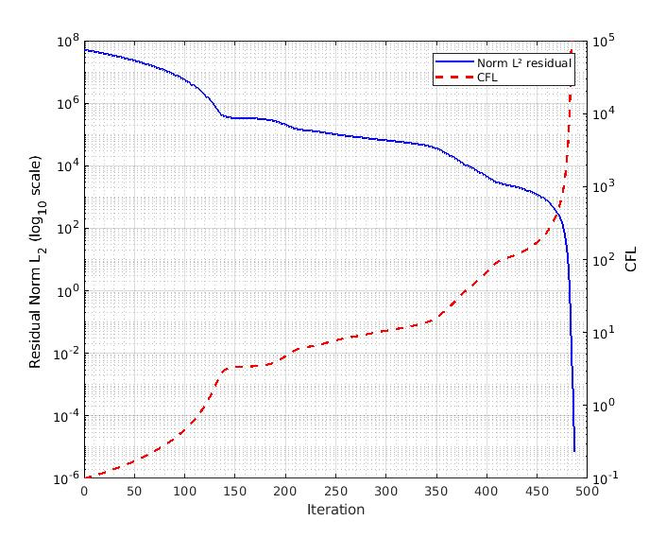
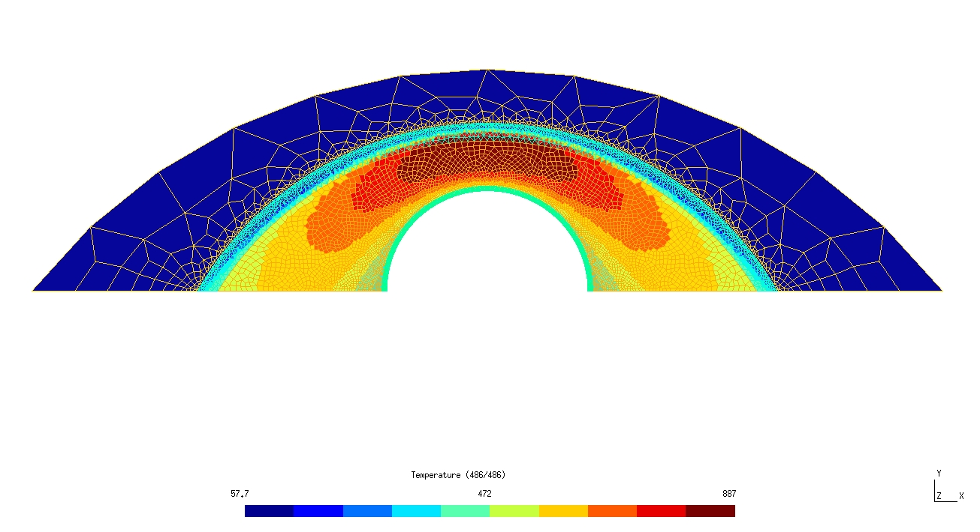
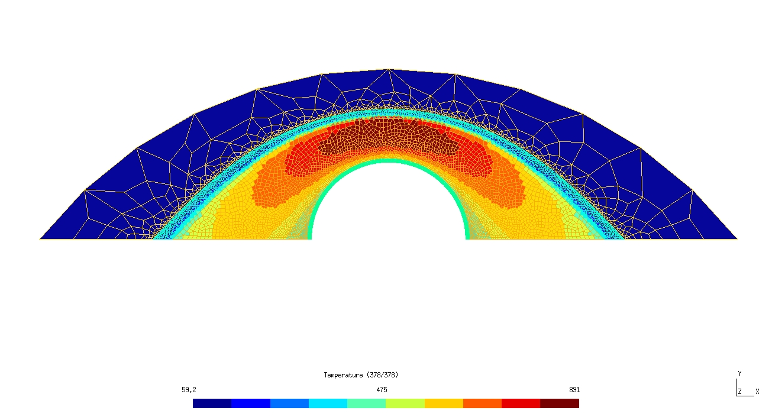
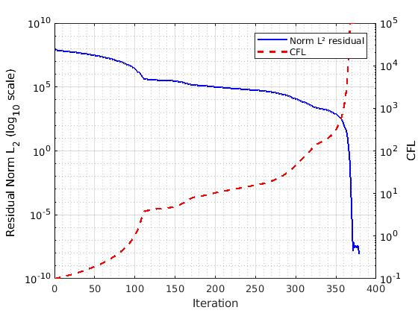

Slide 20
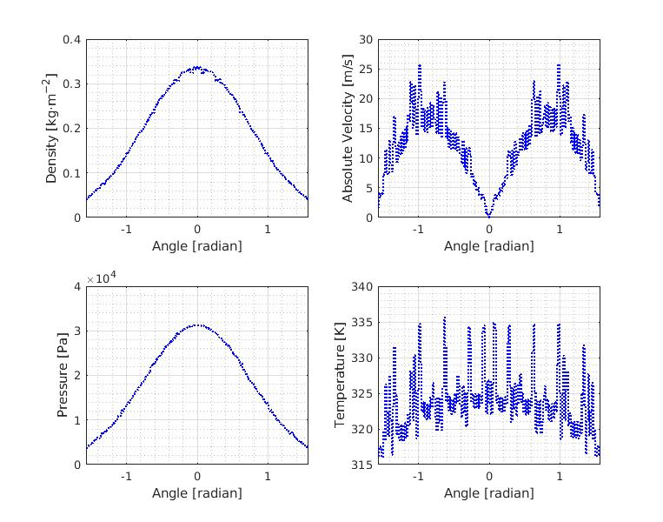
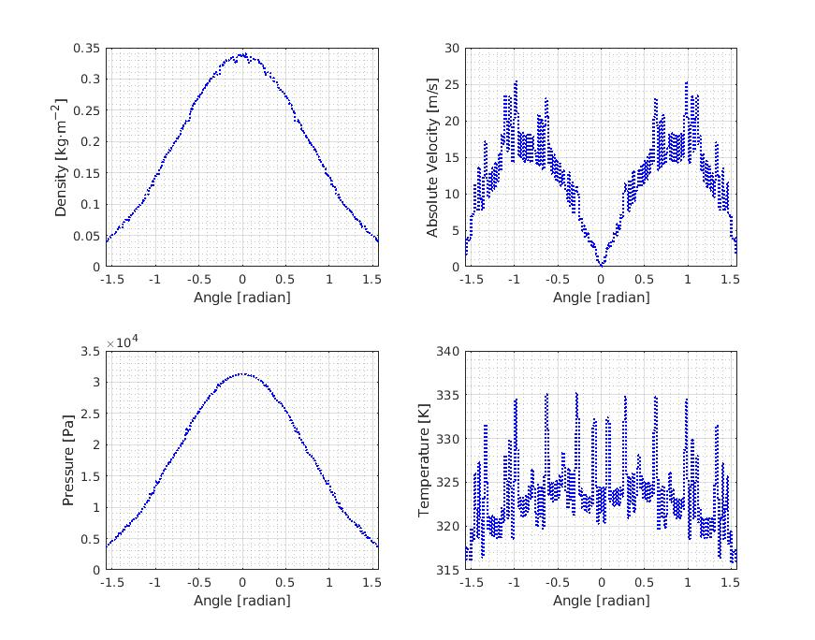

Slide 21
2329 triangles
4021 quadrangles
1123 triangles
2991 quadrangles

Slide 22
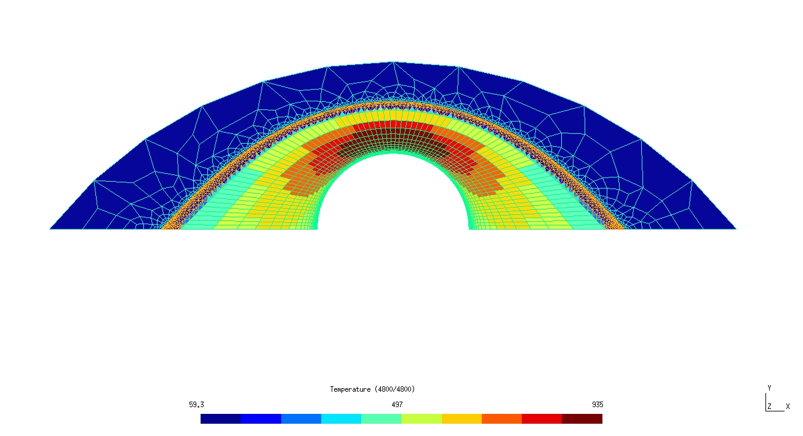
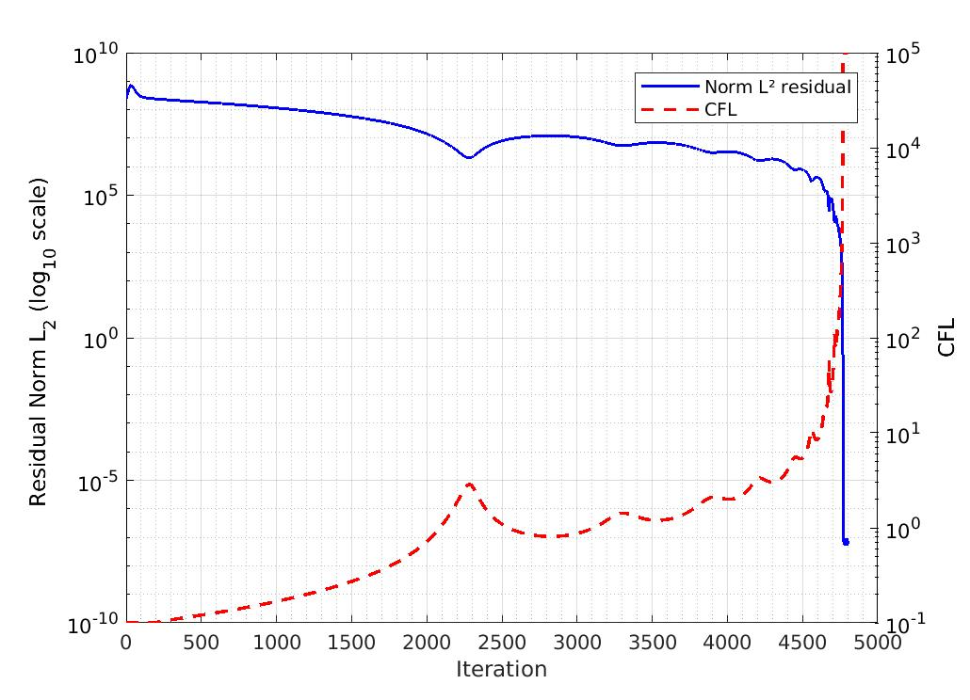
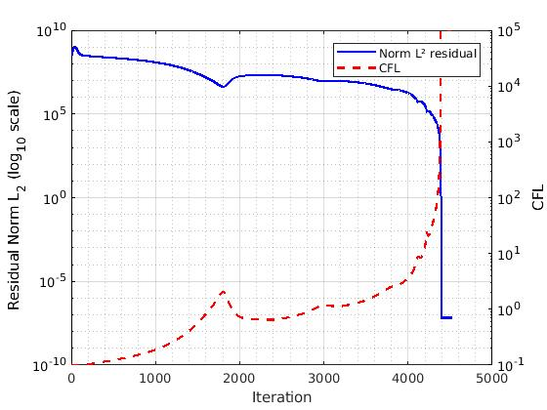
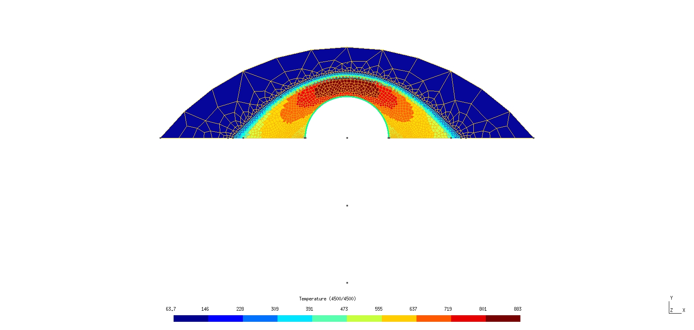

Slide 23
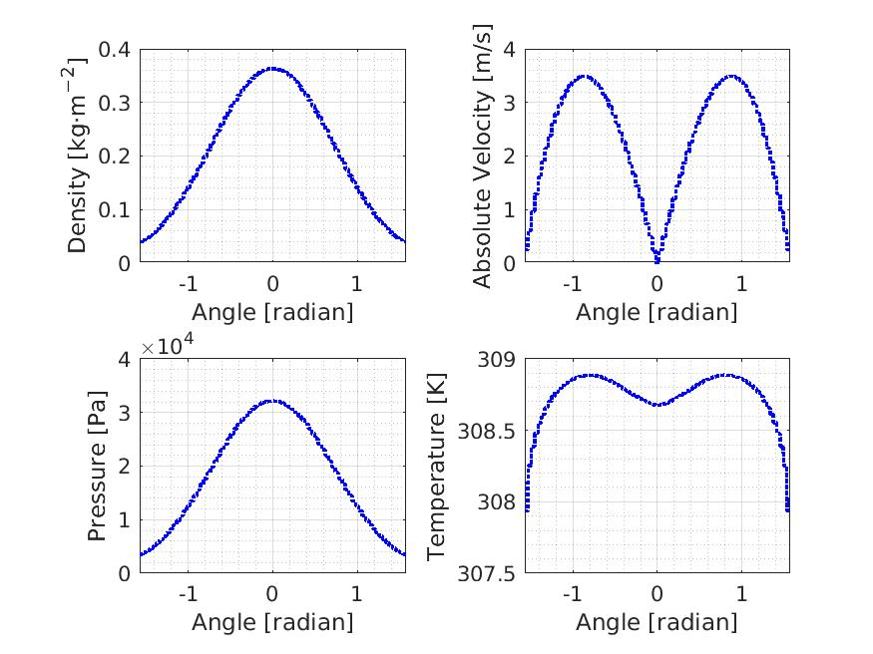
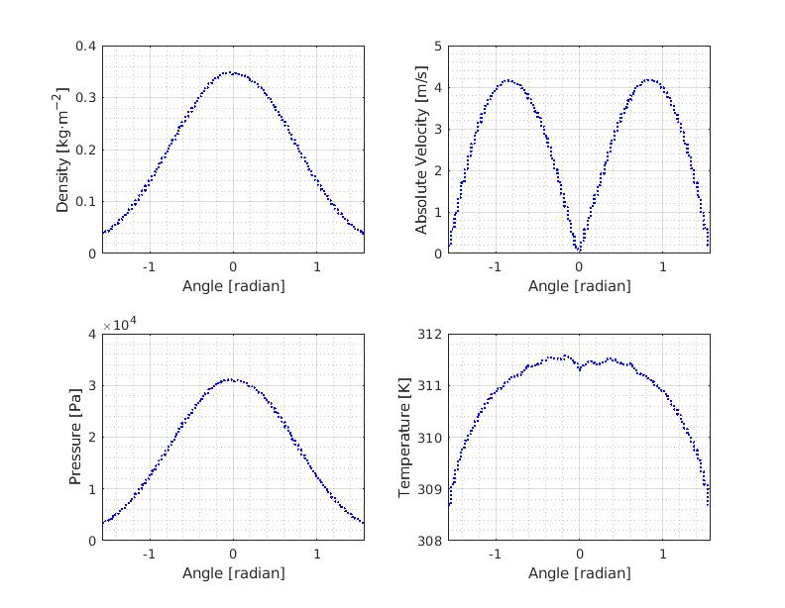

Slide 25
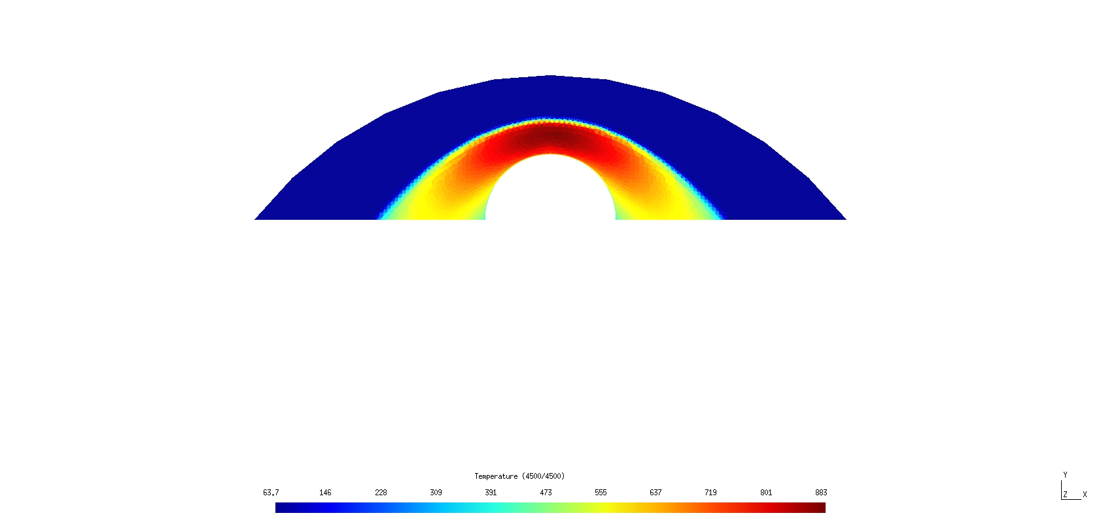
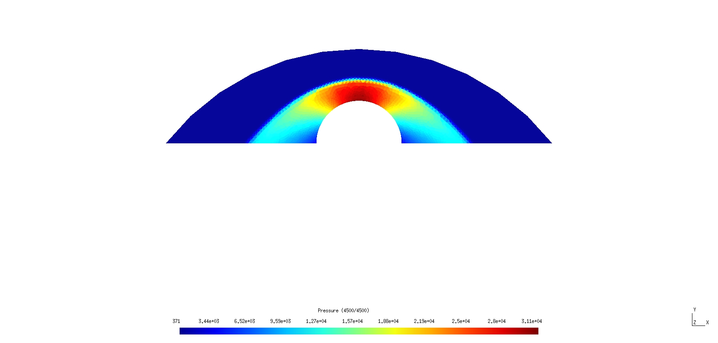

Slide 27
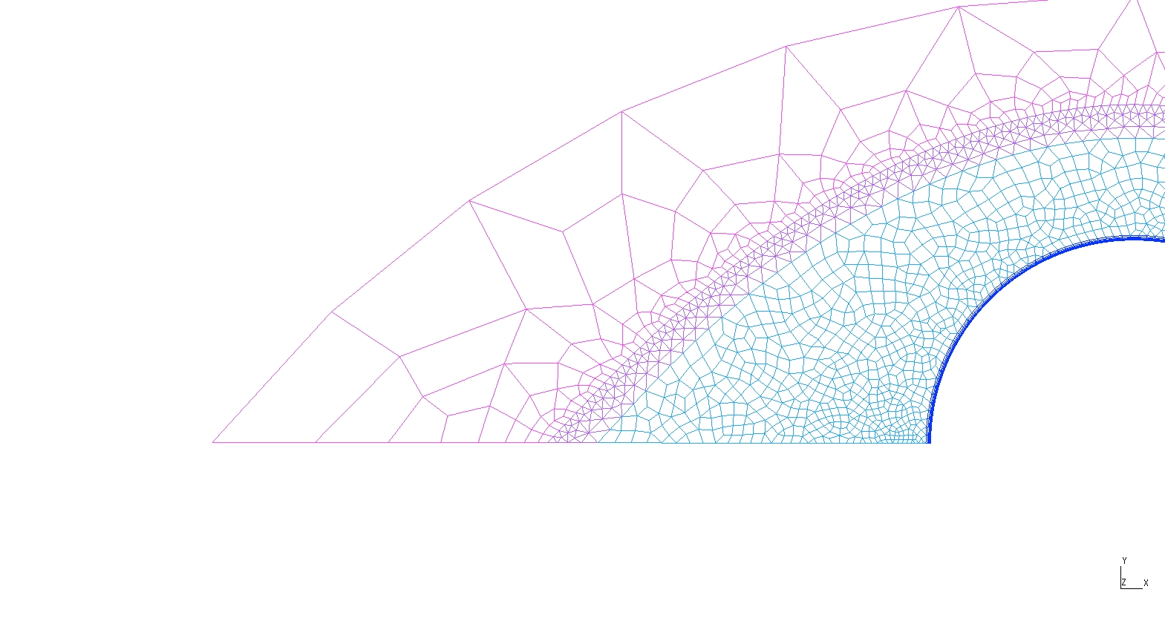
1245 triangles
3118 quadrangles
Quadrangles
(transfinite lines with PF)
Triangles
quadrangles
quadrangles
quadrangles
Triangles &
Quadrangle

Slide 28
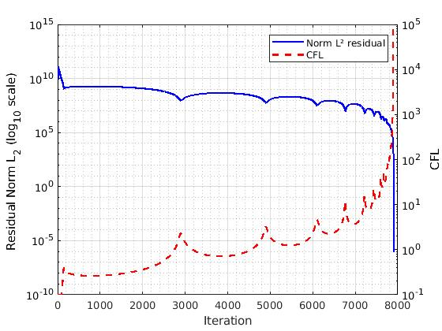

Slide 29
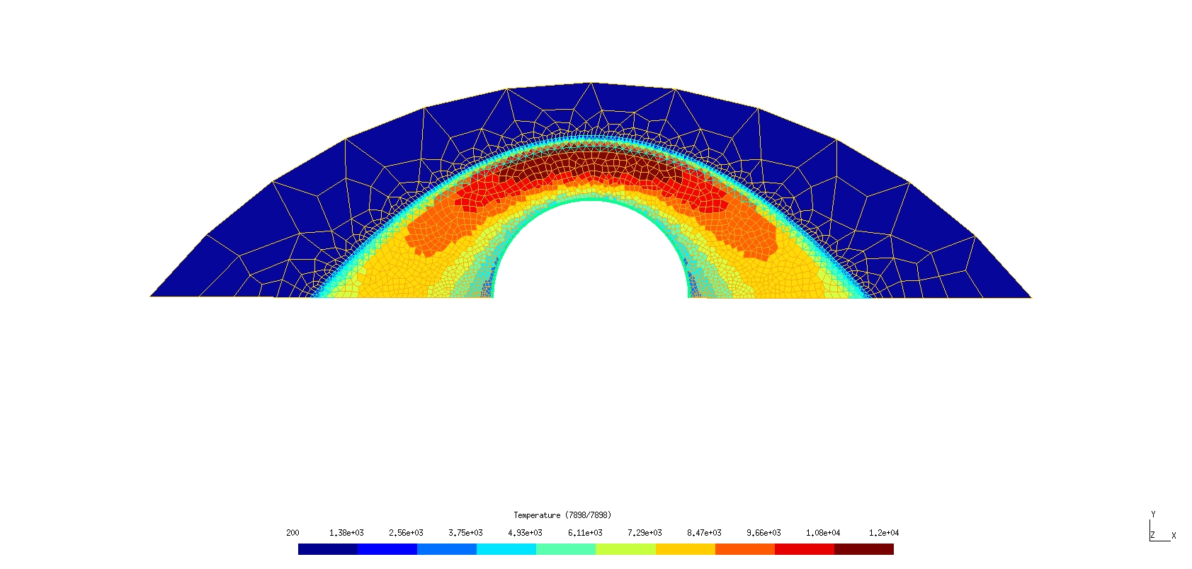

Slide 30
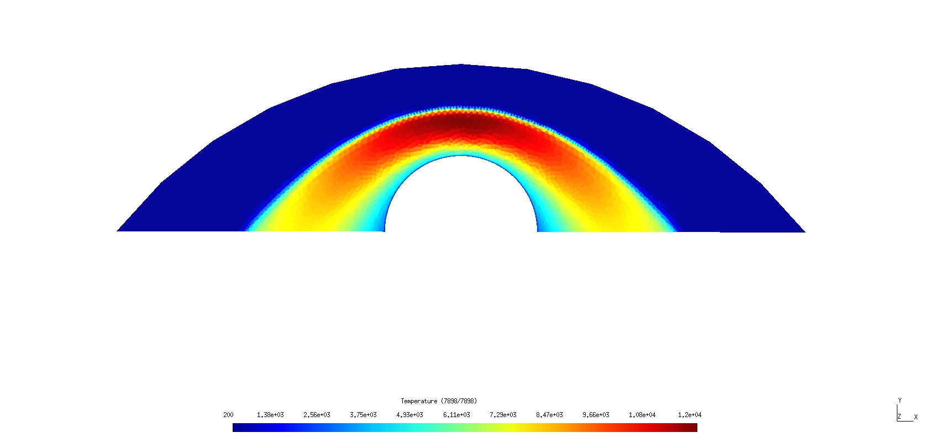
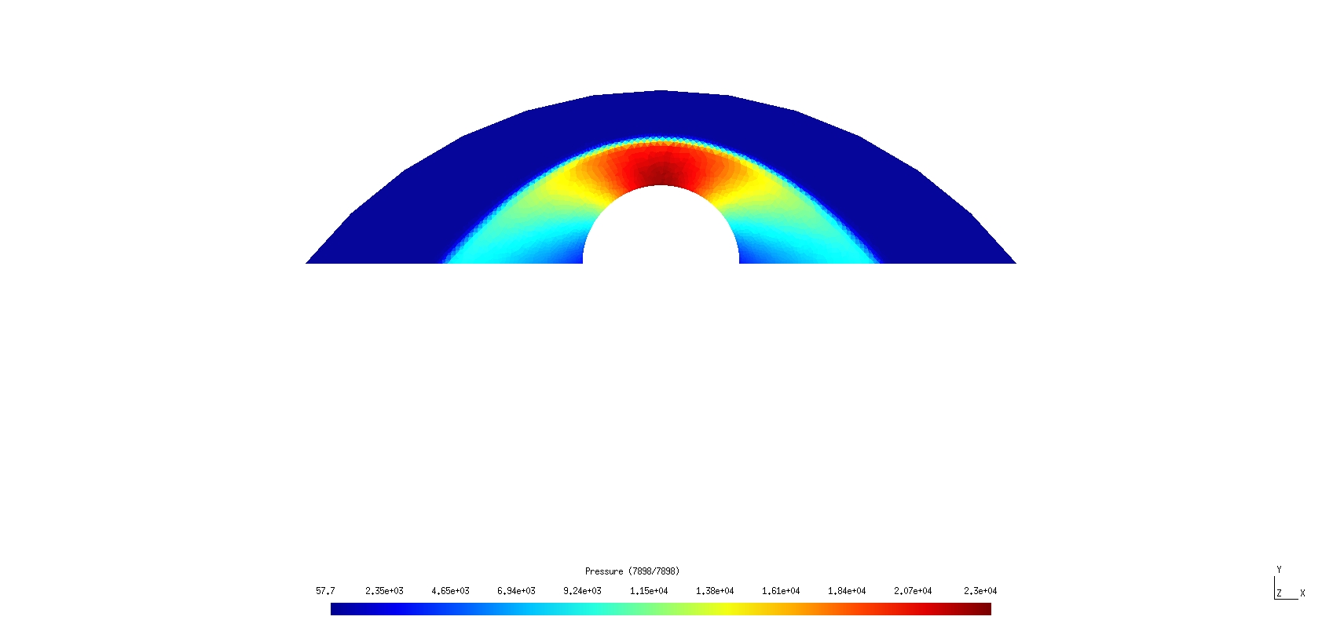

Slide 31
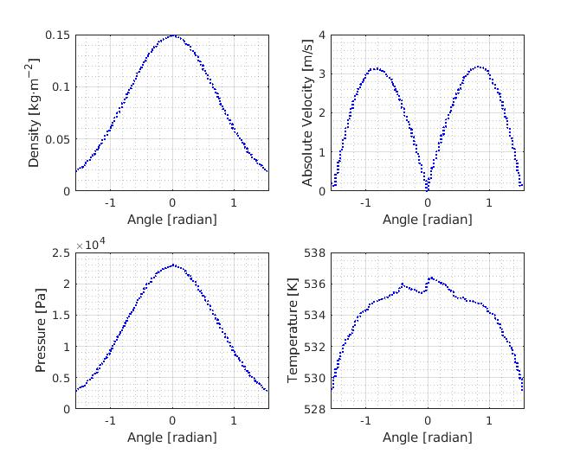

Slide 32


