Slide 1

Abaqus training
Keng-Wit Lim
Senior Staff II
Date

Slide 2
Abaqus Training Materials
Elementary tutorials on GitHub:
https://github.com/kengwitSGH/AbaqusTraining
Currently, we have 5 tutorials. Will develop more as time goes.
Intermediate (this presentation)
Advanced (in development)
Will find way to migrate to SGH internal server (GitLab)

Slide 3
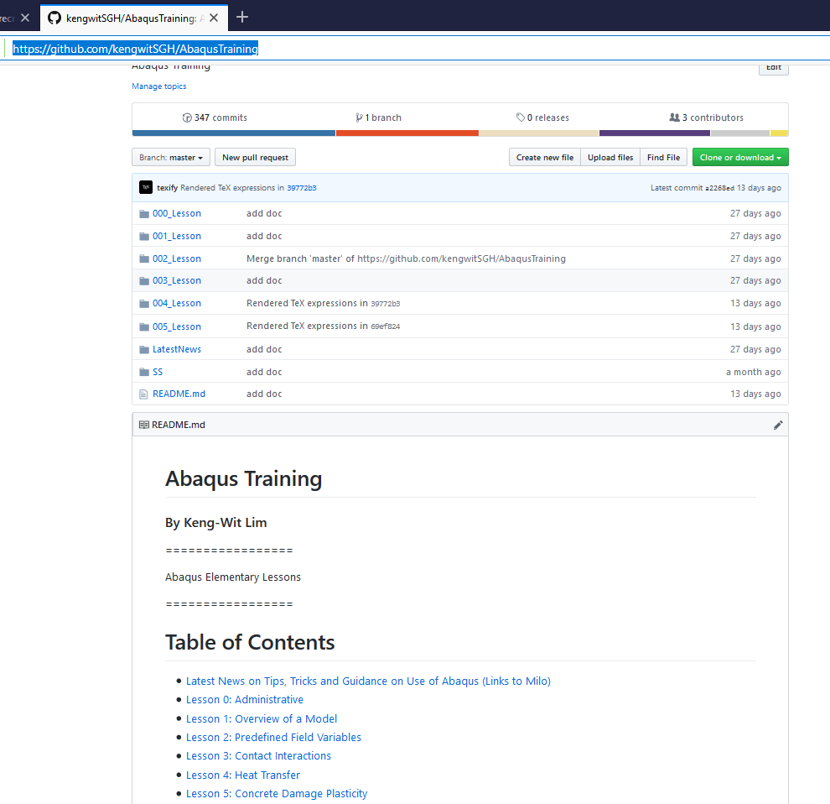
Elementary Tutorials on GitHub
Folders containing tutorial and associated input files

Slide 4
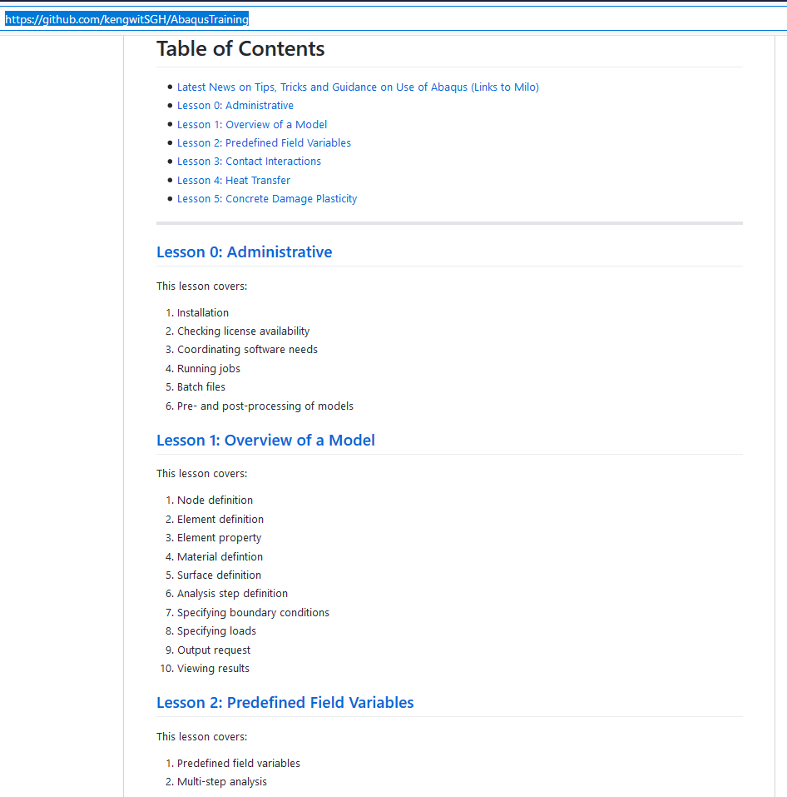
Elementary Tutorials on GitHub (cont’d)
General information
Lesson content

Slide 5
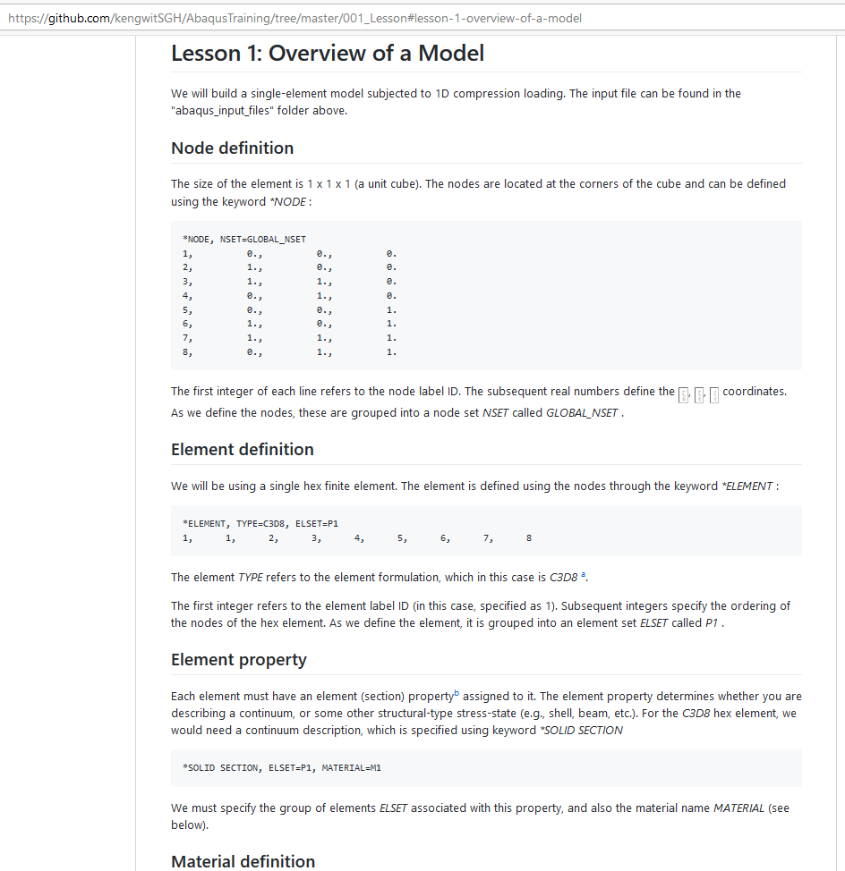
Elementary Tutorials on GitHub (cont’d)
Small examples (single to a few elements) to test features commonly used at SGH

Slide 6
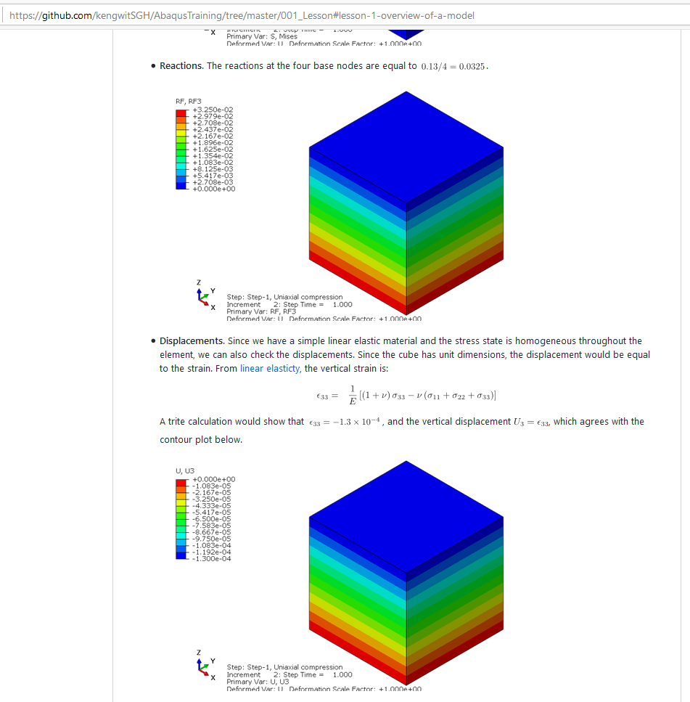
Elementary Tutorials on GitHub (cont’d)
Some checking or verification

Slide 7
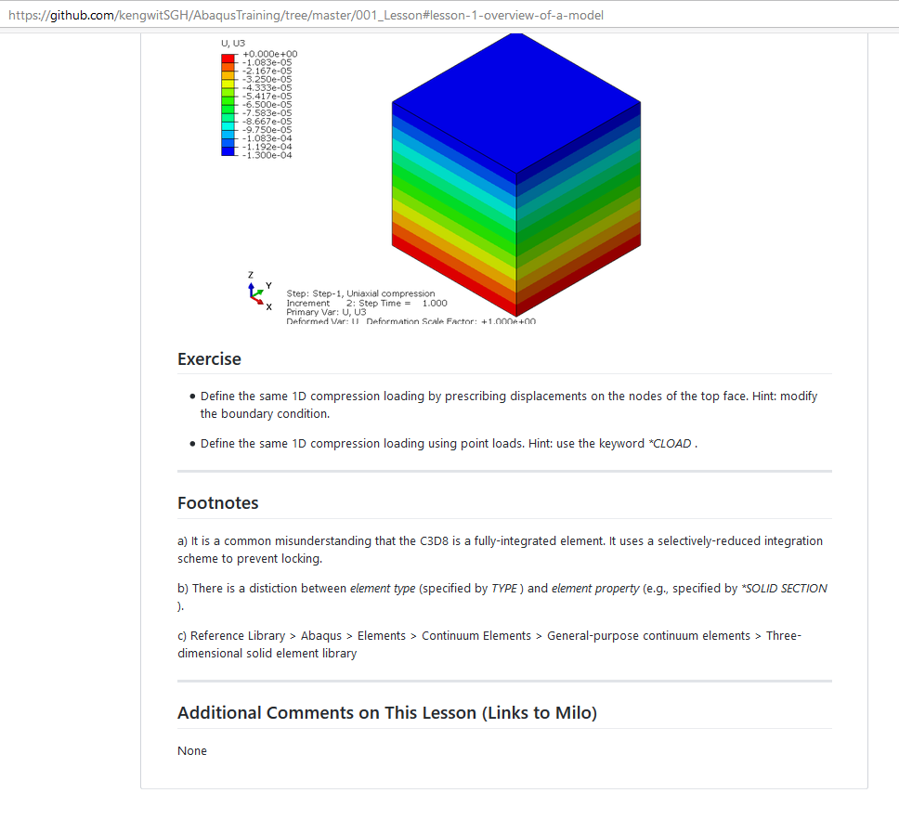
Elementary Tutorials on GitHub (cont’d)
Exercises
Additional notes
Links to comments (on Milo)

Slide 8
Goal of Today’s Training
This training – perform single element tests to test material response under triaxial stress states.

Slide 9
Performing elemental tests
Why is performing elemental tests important?
Gives insight into material response
See main features of material model
See how parameters affect response
See limitations of material model (VERY IMPORTANT)
Helps with interpretation of test data
Provides a common framework to discuss material response (as opposed to making weak analogies to “non-linear spring”, which is grossly incorrect)

Slide 10
Triaxial stress state
Common test used for probing stress-strain response:
Metals – uniaxial compression, uniaxial tension
Soil – confined triaxial extension/compression
Concrete – uniaxial compression, uniaxial tension
Not the only stress-state possible.

Slide 11


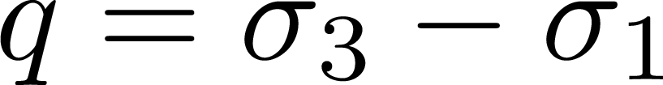
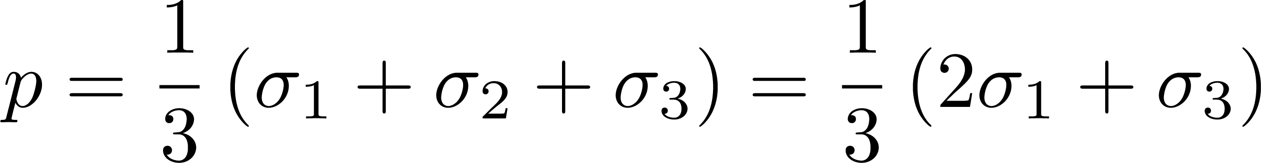
Triaxial stress state (cont’d)
Vertical stress
Lateral stress (constant; zero for uniaxial tests)
Shear stress (stress difference)
Pressure (mean stress)

Slide 12
Commonly Used Material Models at SGH
Commonly used models:
Metal plasticity
Concrete
Soil, granular media (Mohr-Coulomb)
Rate-independent model
Elastic-plastic materials
Quasi-static applications and monotonic loading (models are derived from tests)
For dynamics, ask others.

Slide 13
Metal Plasticity

Slide 14
Metal Plasticity
Yield function
Isotropic hardening

Slide 15
Mohr-Coulomb

Slide 16
Mohr-Coulomb
Yield function
Isotropic hardening

Slide 17
Concrete

Slide 18
Concrete
Yield function
Isotropic hardening

