Slide 1
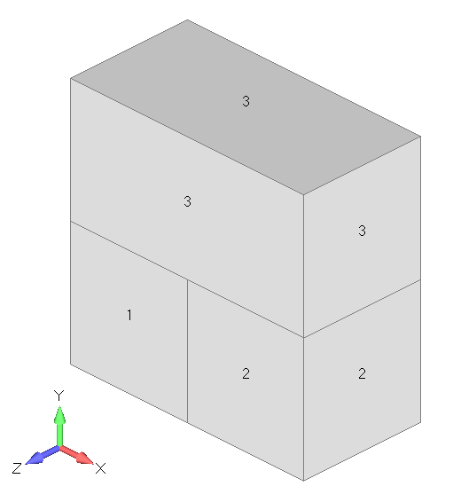
1 brick (DC3D8) element
2 brick (DC3D8) elements

