Slide 1

Abaqus training
Commonly Used Material Models in Abaqus
Keng-Wit Lim
Senior Staff II
Date

Slide 2
Why Training?
Train staff so that they can perform and use FE more effectively and intelligently, not just being “node pushers”.
Level 0 “Innovation” – focus on the fundamentals; it helps a long way.

Slide 3
Abaqus Training Materials
Elementary tutorials on GitHub:
https://github.com/kengwitSGH/AbaqusTraining
Currently, we have 5 tutorials. Will develop more as time goes.
Intermediate (this presentation)
Advanced (in development)
Find way to migrate to SGH internal server (GitLab)

Slide 4
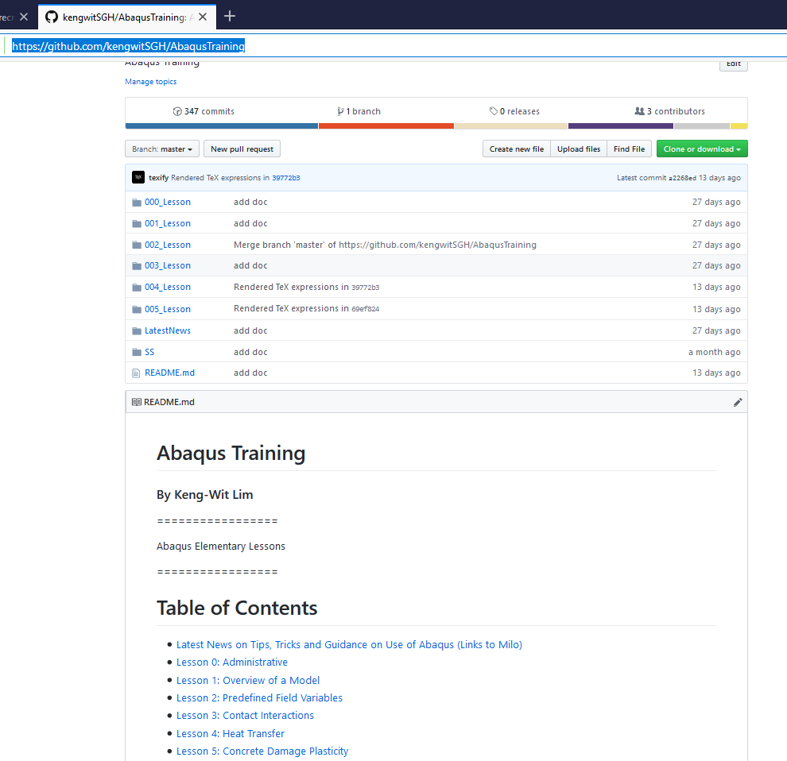
Elementary Tutorials on GitHub
Folders containing tutorial and associated input files

Slide 5
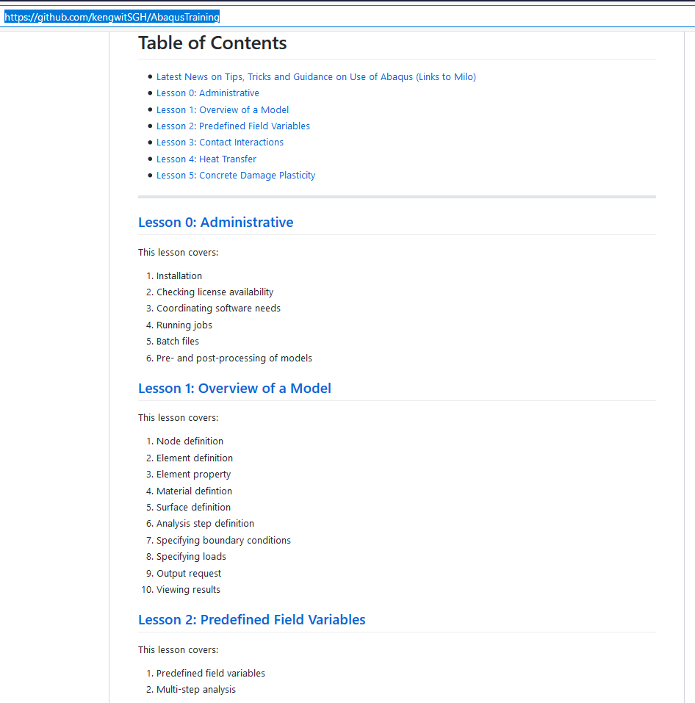
Elementary Tutorials on GitHub (cont’d)
General information
Lesson content

Slide 6
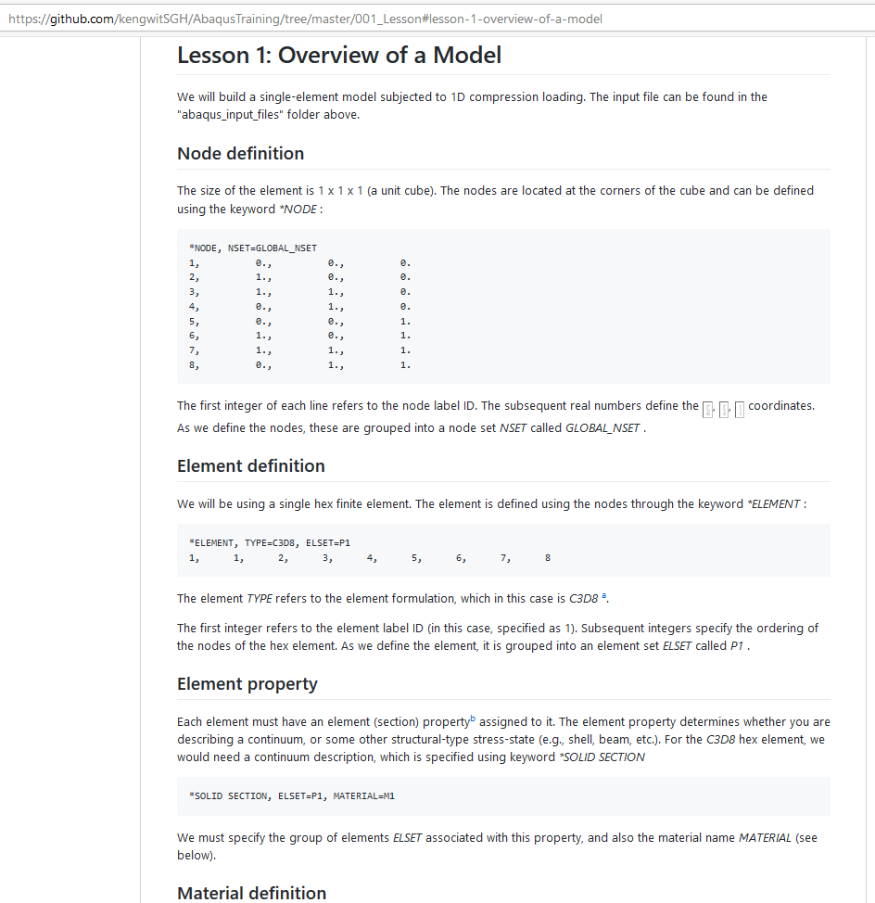
Elementary Tutorials on GitHub (cont’d)
Small examples (single to a few elements) to test features commonly used at SGH

Slide 7
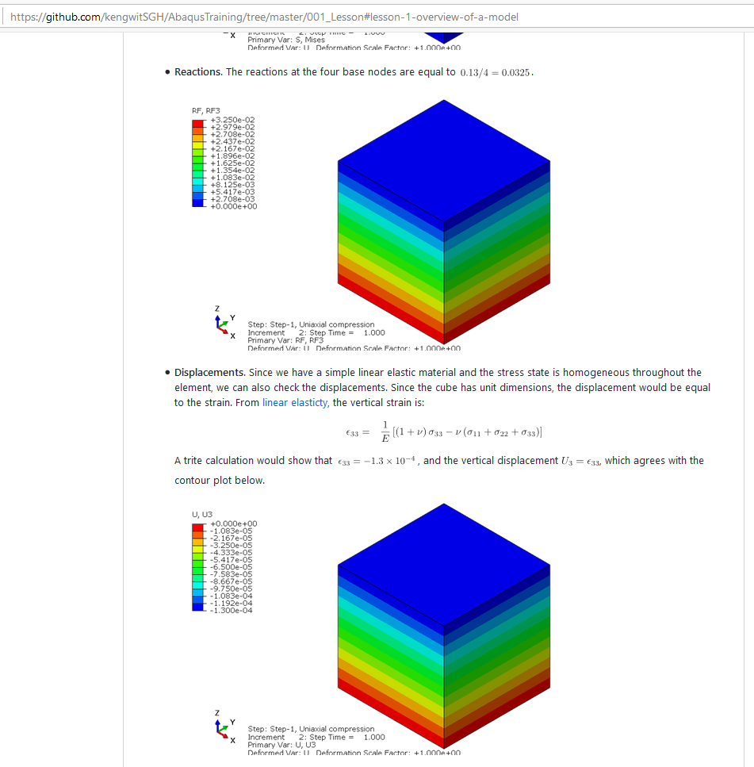
Elementary Tutorials on GitHub (cont’d)
Some checking or verification

Slide 8

Elementary Tutorials on GitHub (cont’d)
Exercises
Additional notes
Links to comments (on Milo)

Slide 9
Goal of Today’s Training
This training – perform single element tests to test material response under triaxial stress states.

Slide 10
Performing elemental tests
Why are elemental tests important?
Gives insight into material response
See main features of material model
See how parameters affect response
Helps with interpretation of test data

Slide 11

Performing elemental tests
Uncover limitations of a material model (VERY IMPORTANT)
You take the red pill—I show you how deep the rabbit hole goes. Remember: all I'm offering is the truth. Nothing more.
You take the blue pill—you keep making the most complicated-looking model, meshwise, and believe whatever you want to believe.

Slide 12
Performing elemental tests
Provides a quantitative framework to discuss material response:
Avoid making weak analogies to pseudo, imaginary materials (e.g., “non-linear spring”), which is grossly inaccurate
Qualitative terms (e.g., “soft”, “weak”, etc.) are meaningless
“Nonlinear”:
Not a straight line
I (or we) don’t know what it is

Slide 13
Triaxial stress state
Common test used for probing stress-strain response:
Metals – uniaxial compression, uniaxial tension
Soil – confined triaxial extension/compression
Concrete – uniaxial compression, uniaxial tension
Not the only possible stress-state

Slide 14



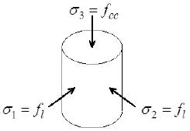


Triaxial stress state (cont’d)
Principal stresses are:
Vertical stress (varying)
Lateral stress (zero for uniaxial tests)

Slide 15
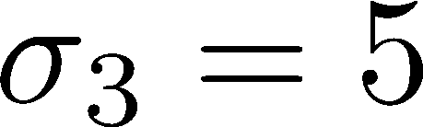
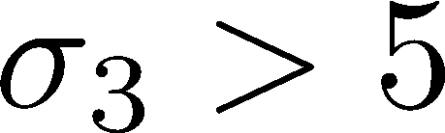
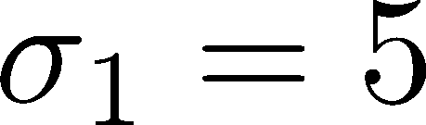
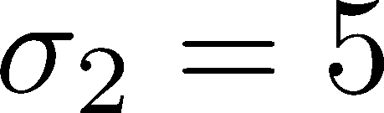
Triaxial stress state (cont’d)
Triaxial compression (TXC)
Initial confinement
Triaxial Shearing

Slide 16

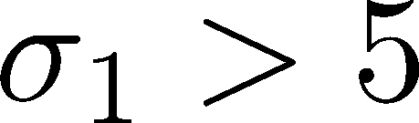
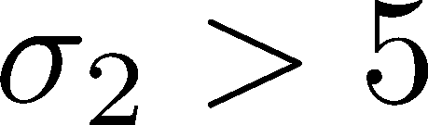
Triaxial stress state (cont’d)
Triaxial extension (TXC) (think “squeezing”)
Initial confinement
Triaxial Shearing

Slide 17
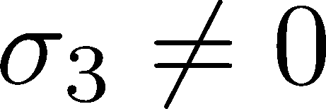
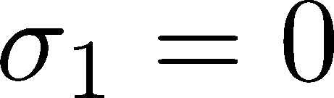
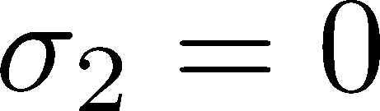
Triaxial stress state (cont’d)
Uniaxial

Slide 18
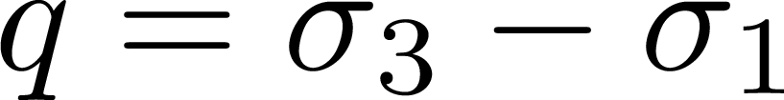
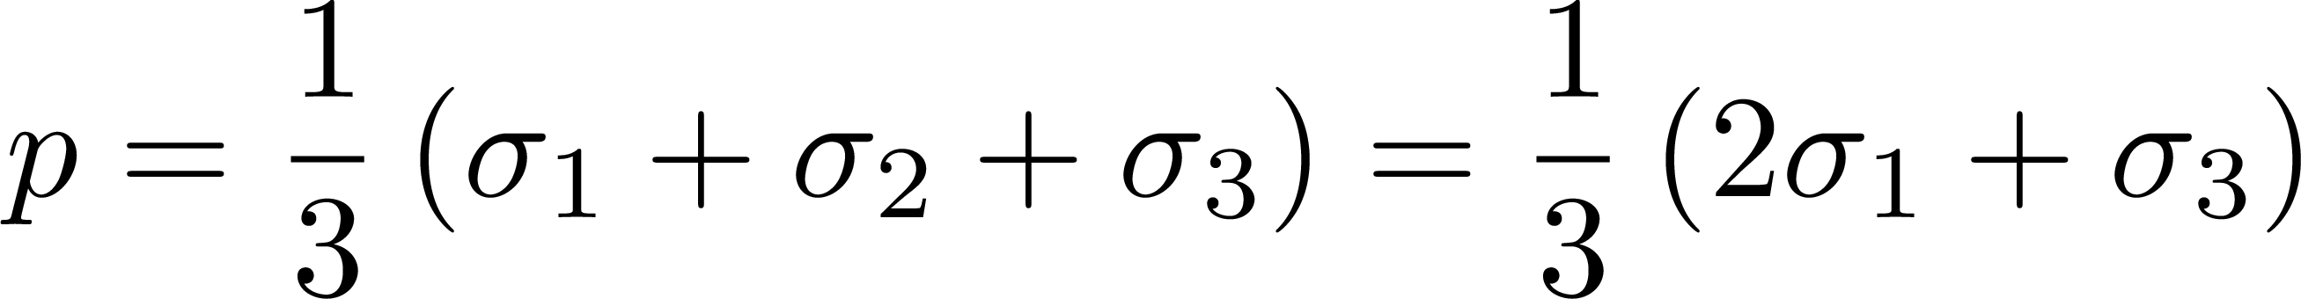
Triaxial stress state (cont’d)
Shear stress (stress difference)
Pressure (mean stress)

Slide 19
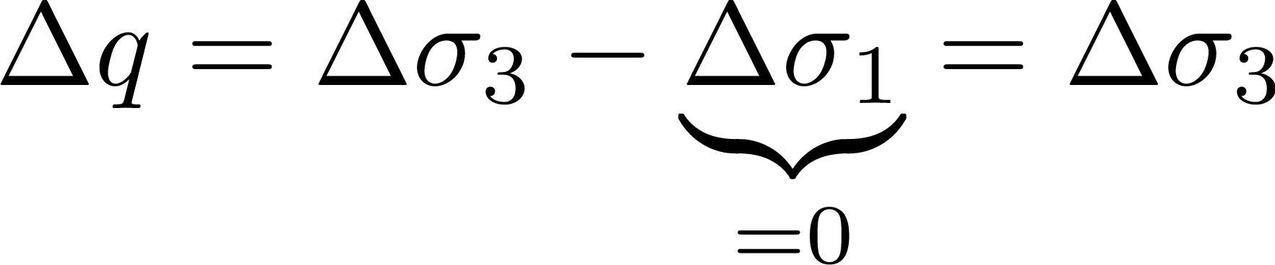
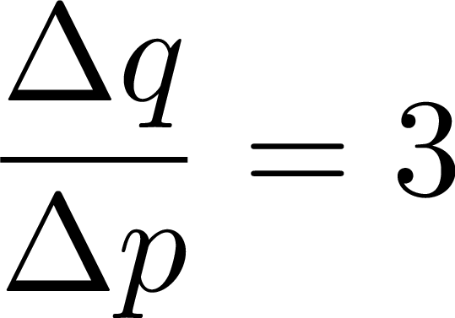
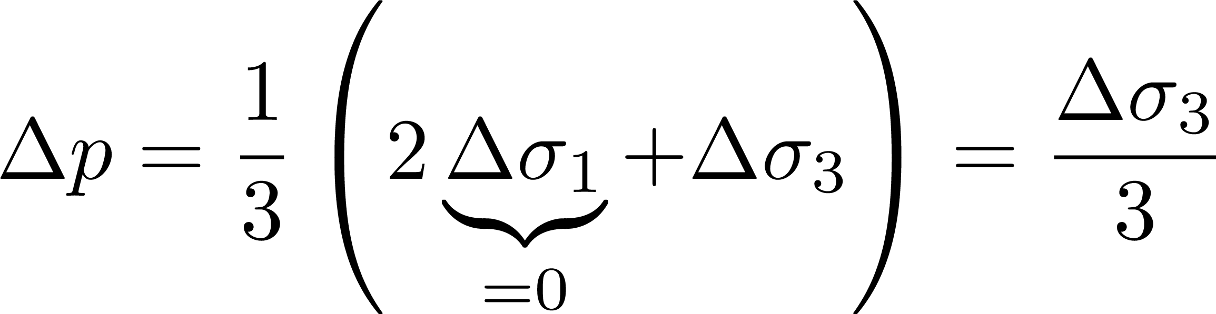
Triaxial stress state (cont’d)
Triaxial compression

Slide 20
Commonly Used Material Models at SGH
Commonly used models:
Metal plasticity (e.g., von Mises plasticity)
Concrete (e.g., Concrete Damage Model)
Soil, granular media (e.g., Drucker-Prager, Mohr-Coulomb)
Rate-independent model
Elastic-plastic materials
Quasi-static applications and monotonic loading (models are derived from tests)
For dynamics, ask others

Slide 21
Metal Plasticity

Slide 22
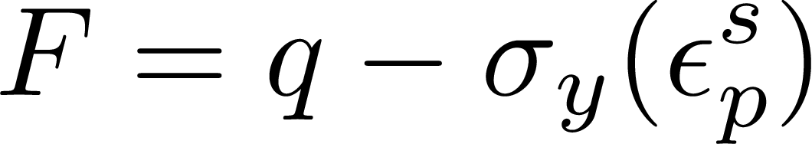
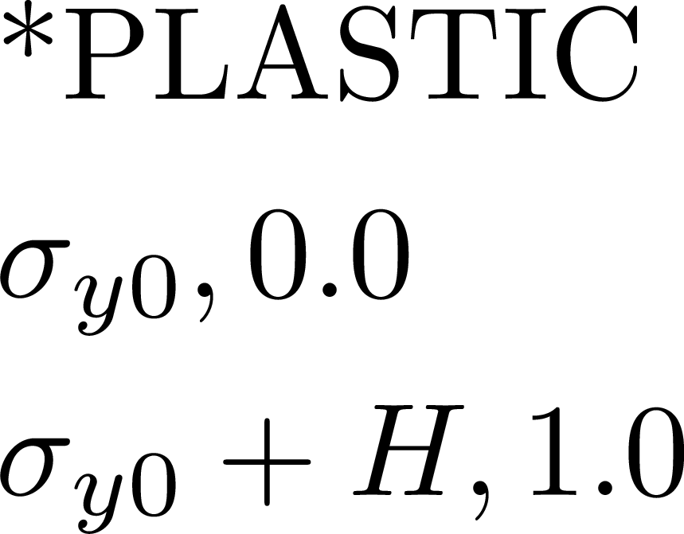
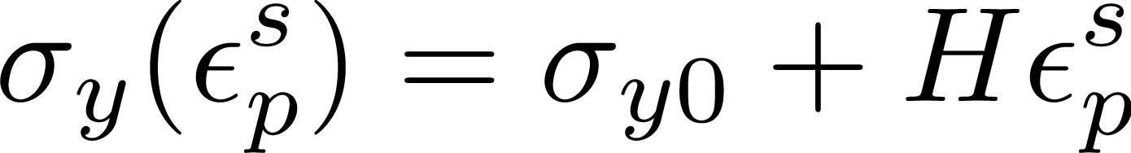
Metal Plasticity
Yield depends on only shear; no pressure-dependency
Yield function
Isotropic (linear) hardening
Hardening modulus
Initial yield stress

Slide 23
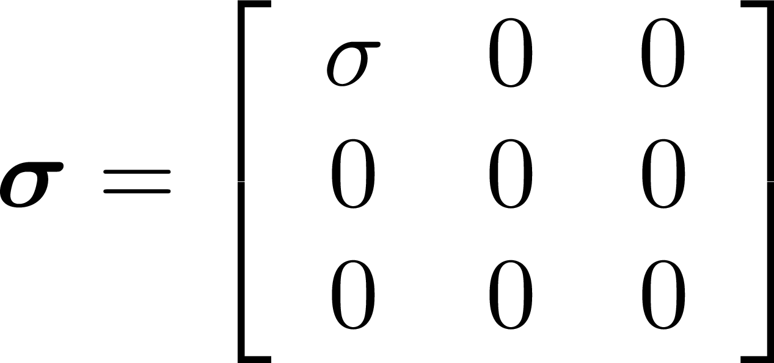
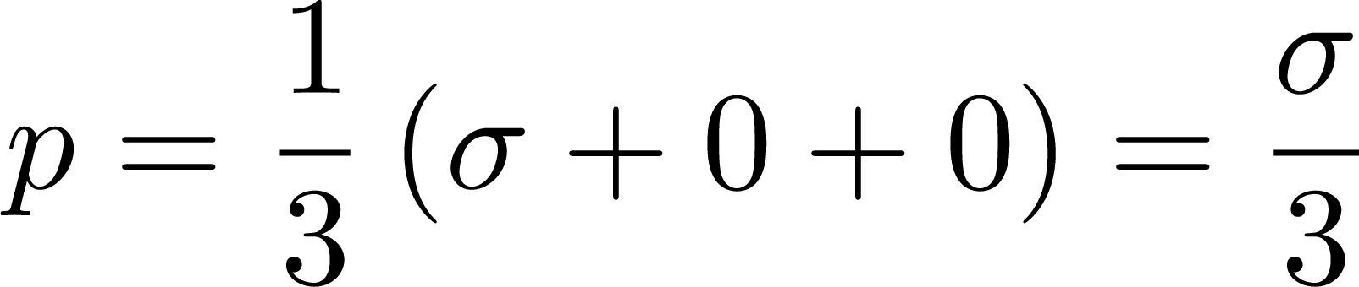
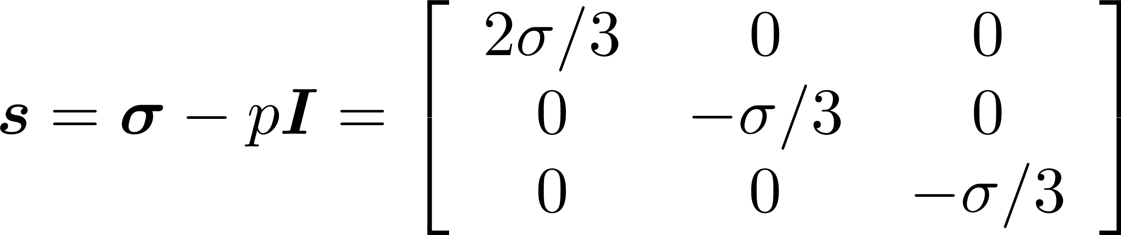
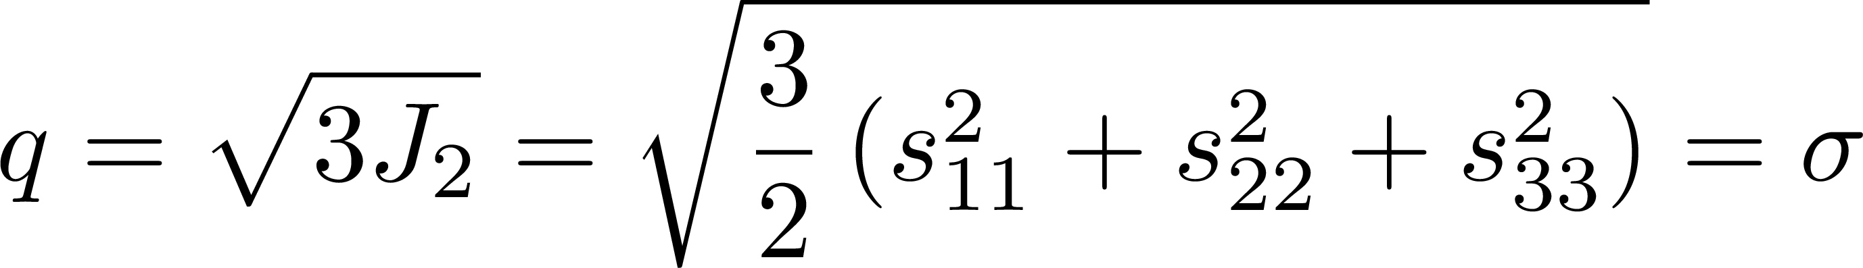
Metal Plasticity
Uniaxial stress
Pressure
Deviatoric stress
Shear stress
If material is yielding,

Slide 24
Metal Plasticity
Numerical example (Lesson 5 on GitHub)
Loading protocol:
Initial confinement
Triaxial Shearing

Slide 25
Drucker-Prager

Slide 26
Drucker-Prager
Prototypical “granular” or “soil” model. Simplest pressure-dependent material.
Yield function
Isotropic hardening

Slide 27
Concrete

Slide 28
Concrete
Yield function
Isotropic hardening

