Slide 1

Abaqus training
Keng-Wit Lim
Senior Staff II
Date

Slide 2
Why Training?
Train staff so that they can perform and use FE more effectively and intelligently, not just being “node pushers”.
Knowing how your tool works actually helps with EMI Visioning/Innovation.

Slide 3
Abaqus Training Materials
Elementary tutorials on GitHub:
https://github.com/kengwitSGH/AbaqusTraining
Currently, we have 5 tutorials. Will develop more as time goes.
Intermediate (this presentation)
Advanced (in development)
Will find way to migrate to SGH internal server (GitLab)

Slide 4
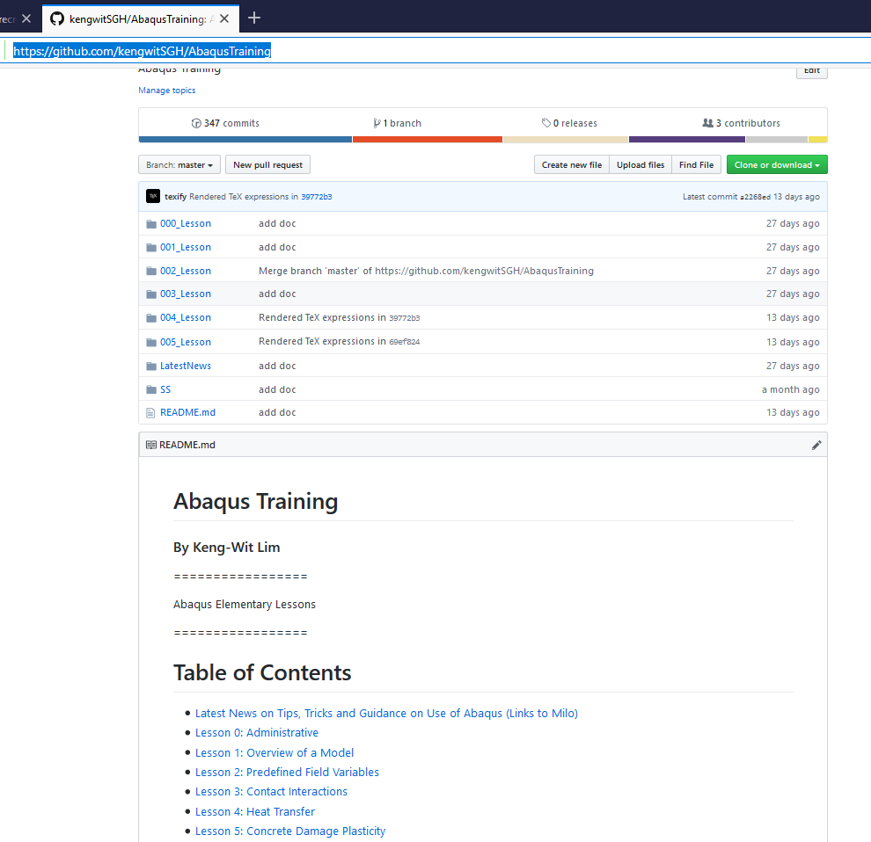
Elementary Tutorials on GitHub
Folders containing tutorial and associated input files

Slide 5
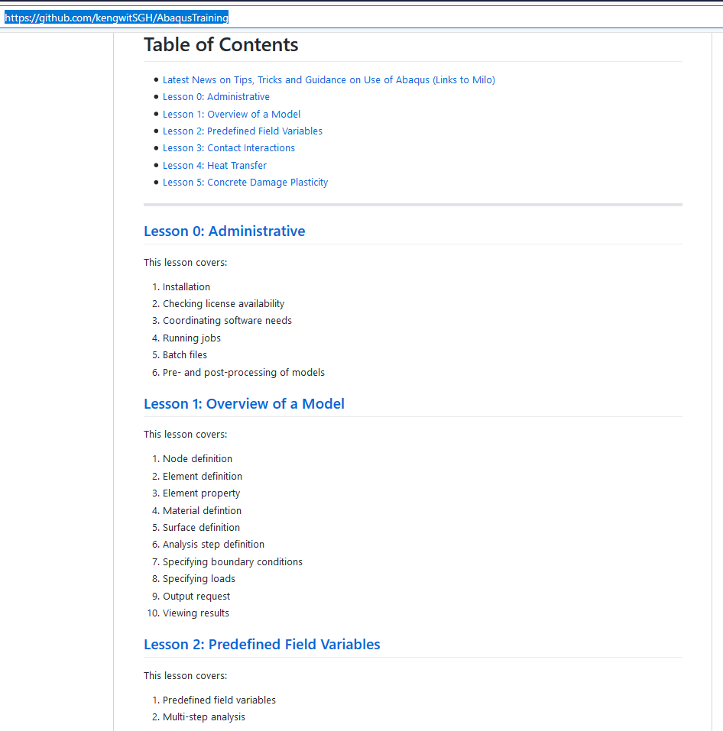
Elementary Tutorials on GitHub (cont’d)
General information
Lesson content

Slide 6
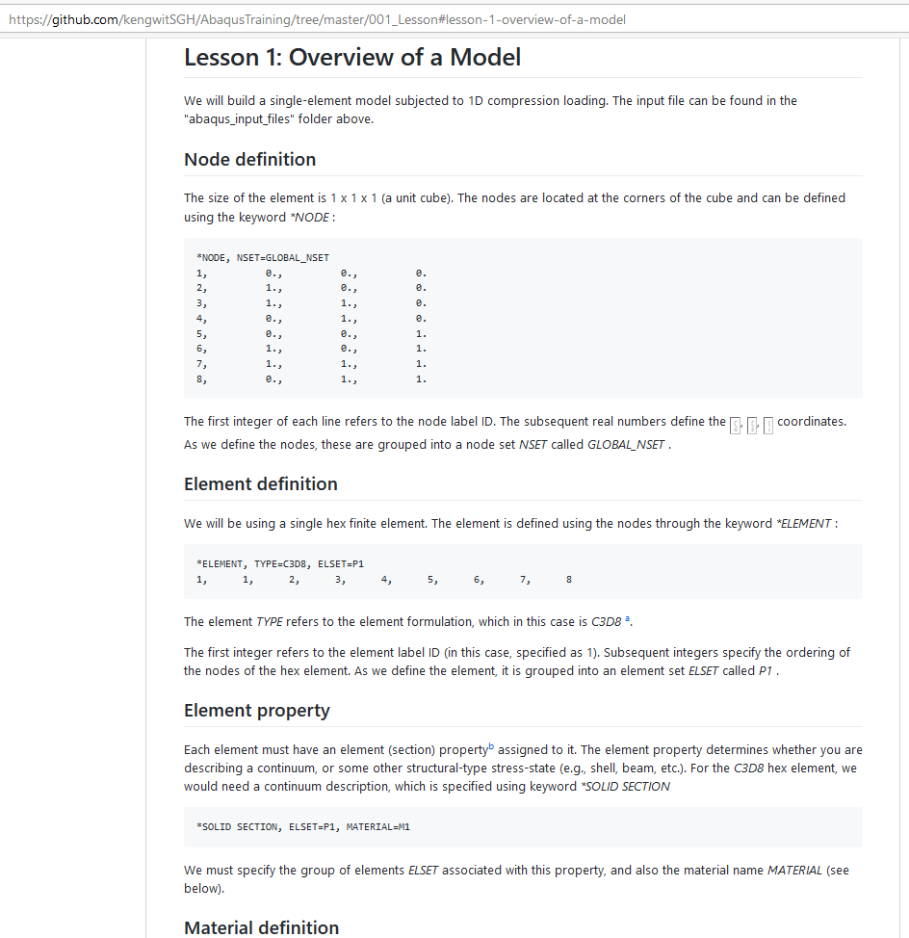
Elementary Tutorials on GitHub (cont’d)
Small examples (single to a few elements) to test features commonly used at SGH

Slide 7
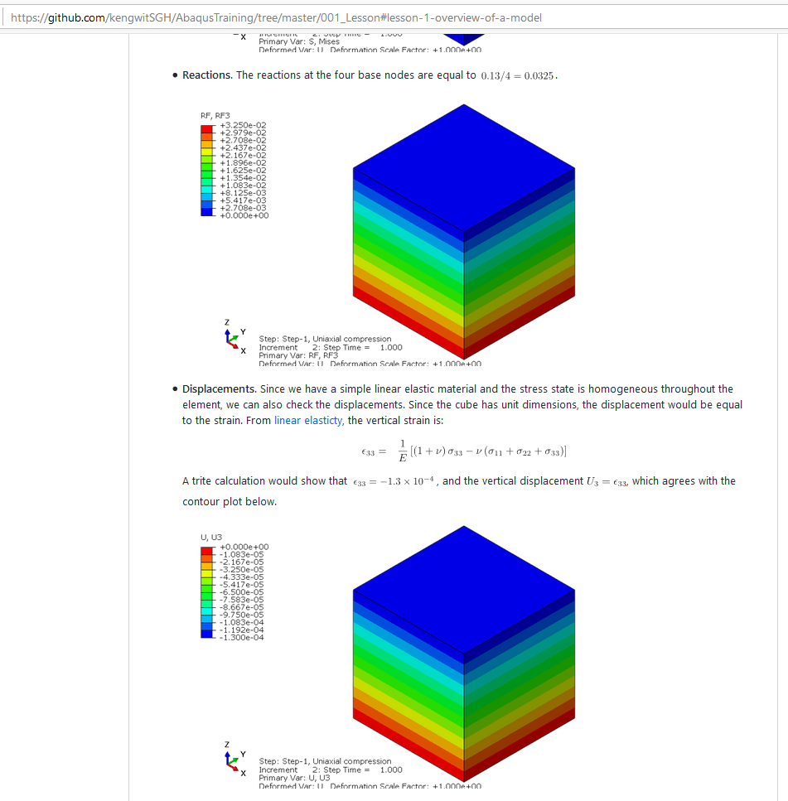
Elementary Tutorials on GitHub (cont’d)
Some checking or verification

Slide 8
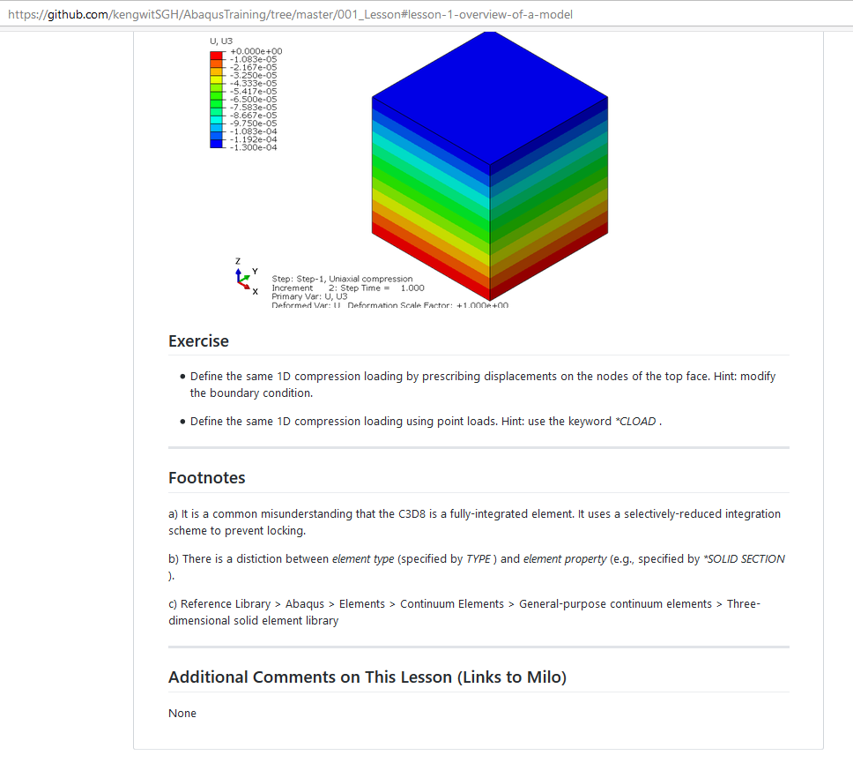
Elementary Tutorials on GitHub (cont’d)
Exercises
Additional notes
Links to comments (on Milo)

Slide 9
Goal of Today’s Training
This training – perform single element tests to test material response under triaxial stress states.

Slide 10
Performing elemental tests
Why is performing elemental tests important?
Gives insight into material response
See main features of material model
See how parameters affect response
See limitations of material model (VERY IMPORTANT)
Helps with interpretation of test data
Provides a quantitative framework to discuss material response:
avoid making weak analogies to pseudo, imaginary “non-linear spring”, which is grossly incorrect
saying that a material is “soft”, “weak”, etc., is meaningless

Slide 11
Triaxial stress state
Common test used for probing stress-strain response:
Metals – uniaxial compression, uniaxial tension
Soil – confined triaxial extension/compression
Concrete – uniaxial compression, uniaxial tension
Not the only stress-state possible.

Slide 12


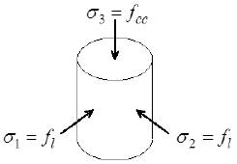
Triaxial stress state (cont’d)
Vertical stress (varying)
Lateral stress (zero for uniaxial tests)

Slide 13
Triaxial stress state (cont’d)
Triaxial compression (TXC), triaxial extension (TXE)
Vertical stress (increasing for TXC, constant for TXE)
Lateral stress (constant for TXC, increasing for TXE, zero for uniaxial tests)

Slide 14
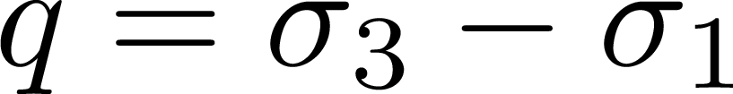
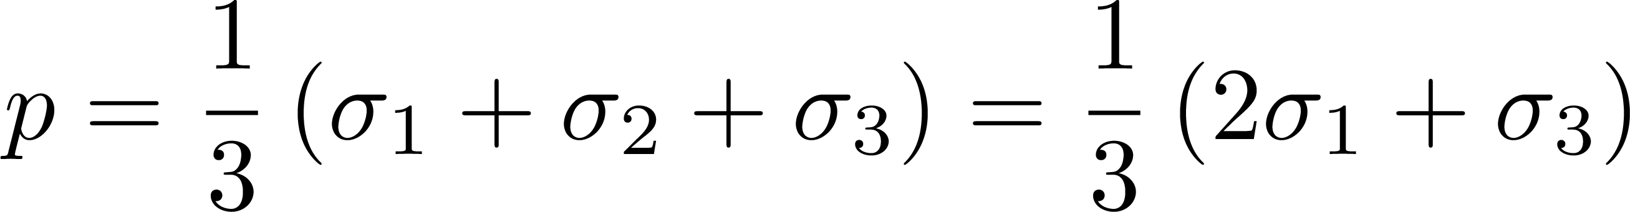
Triaxial stress state (cont’d)
Shear stress (stress difference)
Pressure (mean stress)

Slide 15
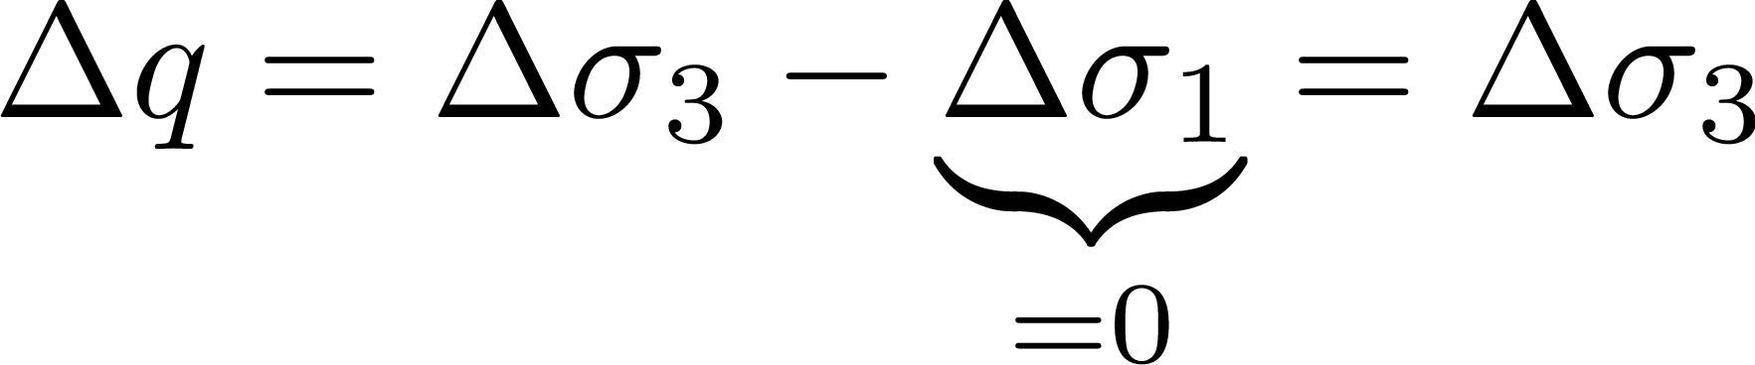
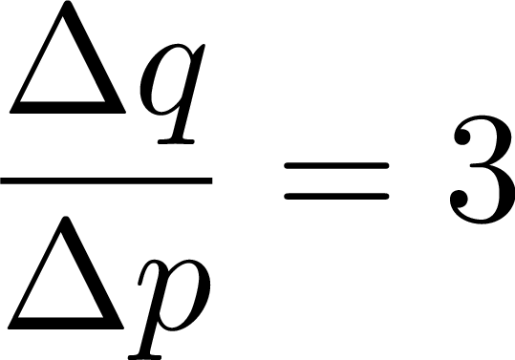
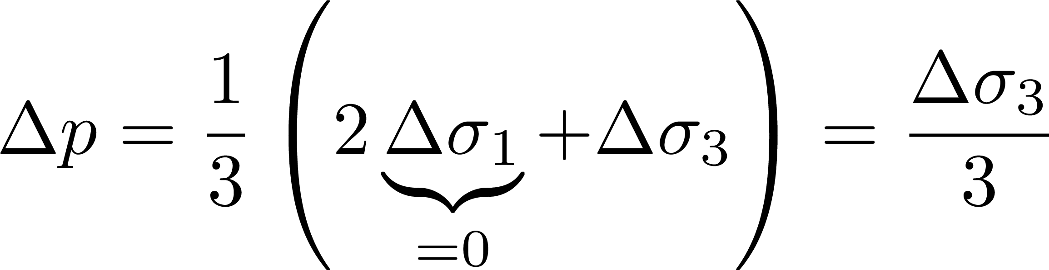
Triaxial stress state (cont’d)
Triaxial compression

Slide 16
Commonly Used Material Models at SGH
Commonly used models:
Metal plasticity
Concrete
Soil, granular media (Mohr-Coulomb)
Rate-independent model
Elastic-plastic materials
Quasi-static applications and monotonic loading (models are derived from tests)
For dynamics, ask others.

Slide 17
Metal Plasticity

Slide 18
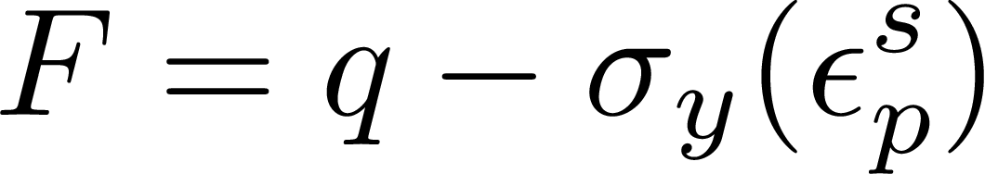
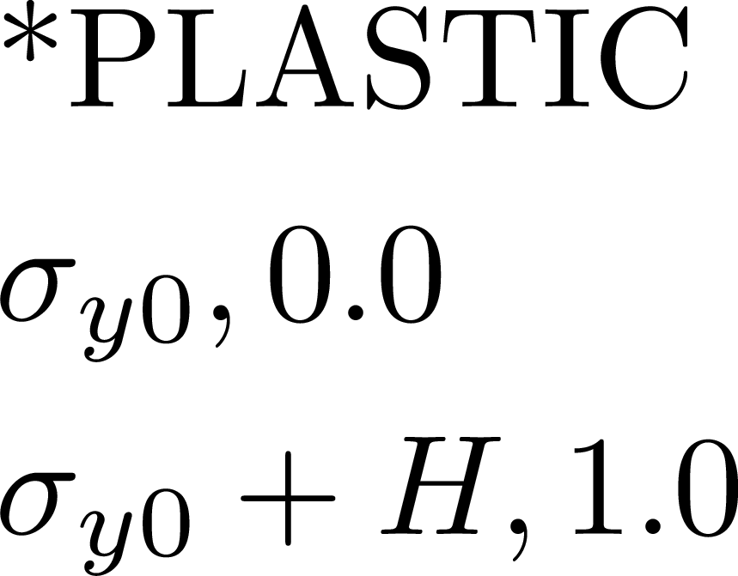
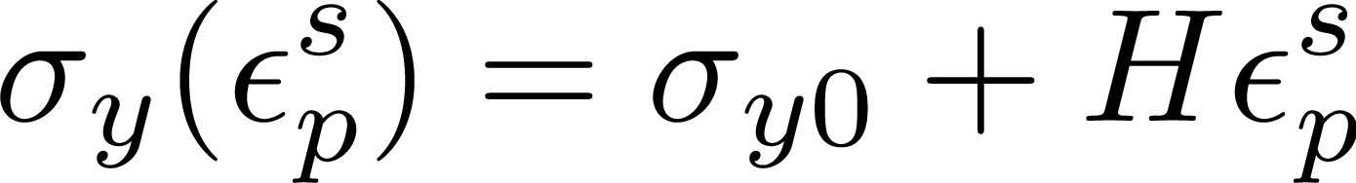
Metal Plasticity
Yield function
Isotropic (linear) hardening
Hardening modulus
Initial yield stress

Slide 19
Mohr-Coulomb

Slide 20
Mohr-Coulomb
Yield function
Isotropic hardening

Slide 21
Concrete

Slide 22
Concrete
Yield function
Isotropic hardening

Slide 23
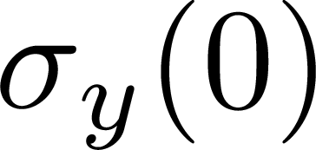
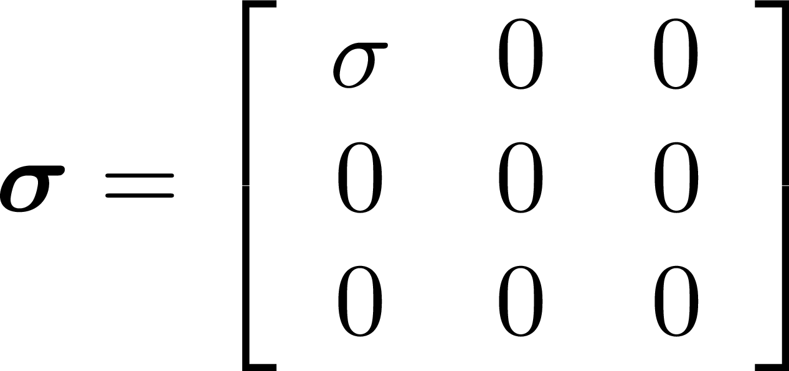
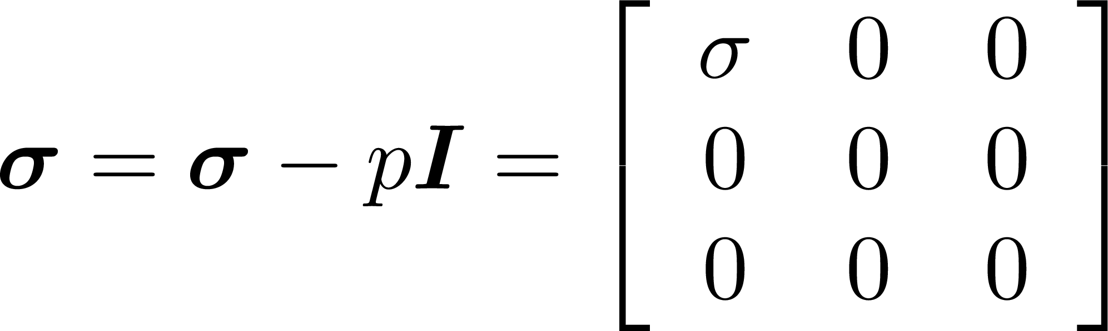
Metal Plasticity
Initial yield stress
Note: this is NOT the uniaxial stress from the tensile specimen!

Slide 24
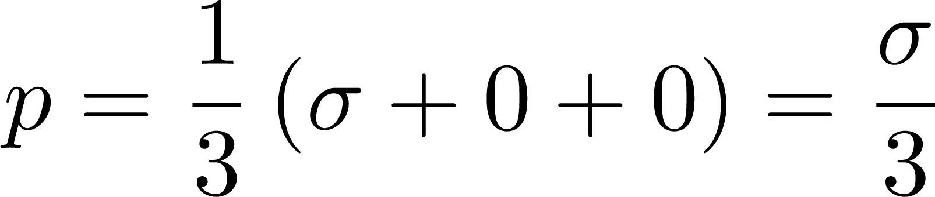
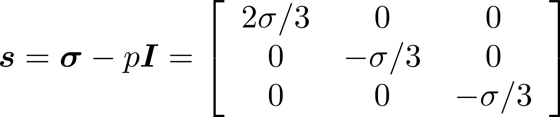
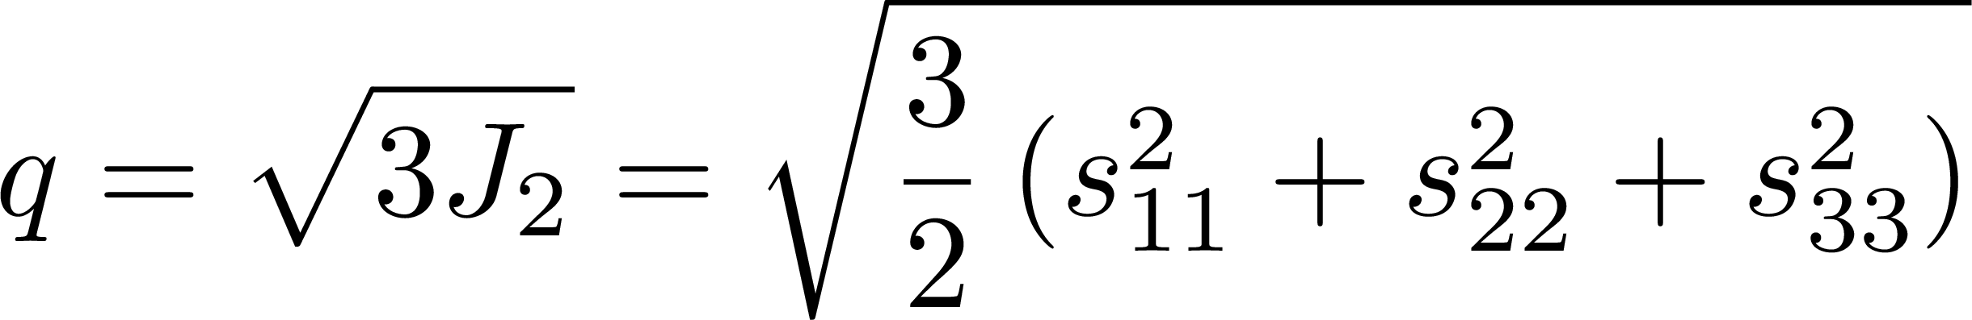
Metal Plasticity
Uniaxial stress
Pressure
Deviatoric stress
Shear stress

