Slide 1

Abaqus training
Commonly Used Material Models in Abaqus
Keng-Wit Lim
Senior Staff II
Date

Slide 2
Why Training?
Train staff so that they can perform and use FE more effectively and intelligently, not just being “node pushers”.
Level 0 “Innovation” – focus on the fundamentals; it helps a long way.

Slide 3
Abaqus Training Materials
Elementary tutorials on GitHub:
https://github.com/kengwitSGH/AbaqusTraining
Currently, we have 5 tutorials. Will develop more as time goes.
Intermediate (this presentation)
Advanced (in development)
Find way to migrate to SGH internal server (GitLab)

Slide 4
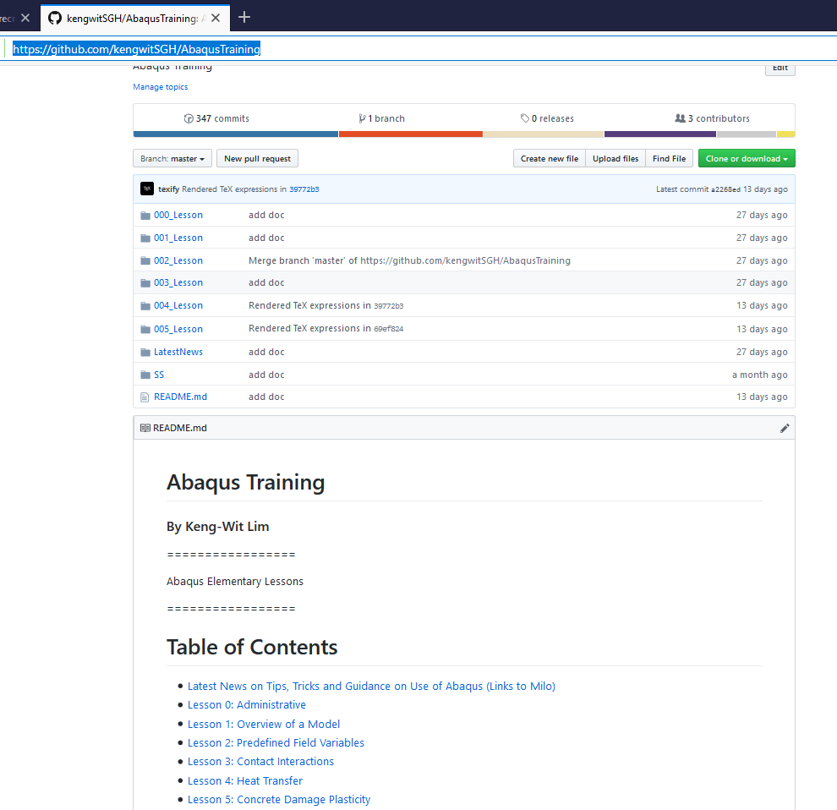
Elementary Tutorials on GitHub
Folders containing tutorial and associated input files

Slide 5
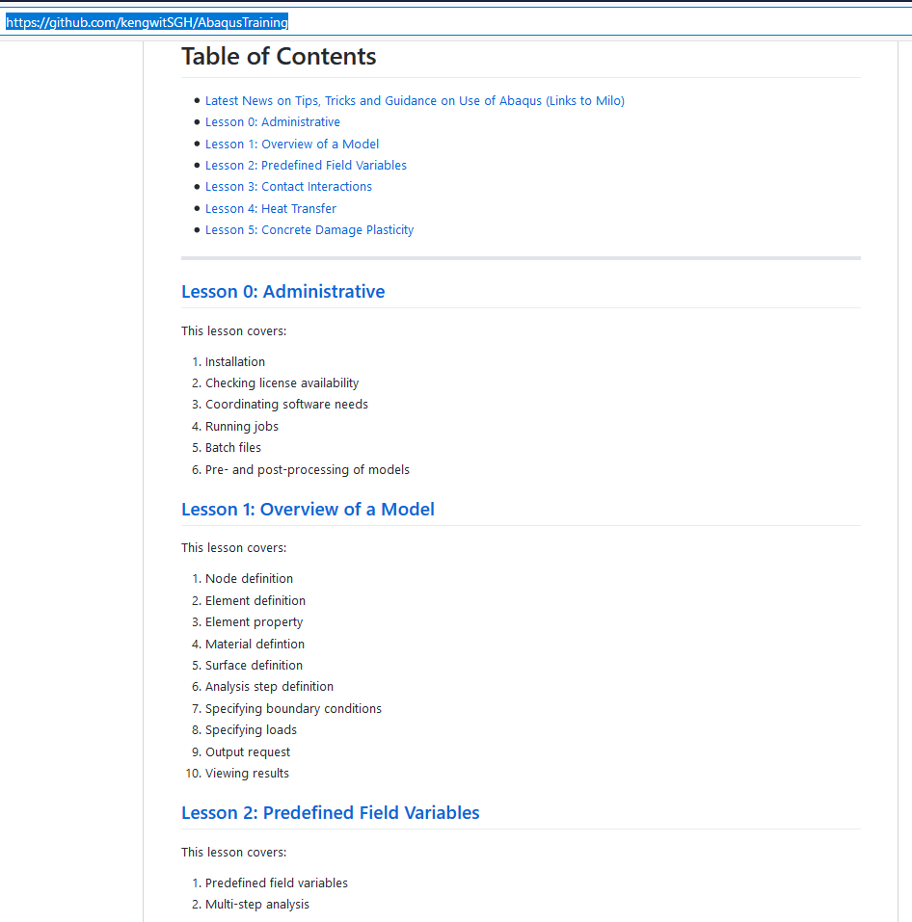
Elementary Tutorials on GitHub (cont’d)
General information
Lesson content

Slide 6
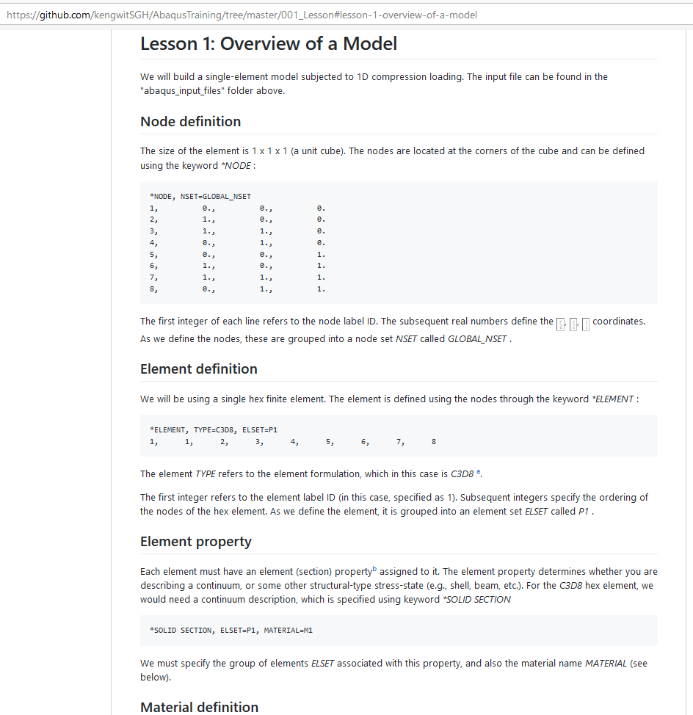
Elementary Tutorials on GitHub (cont’d)
Small examples (single to a few elements) to test features commonly used at SGH

Slide 7
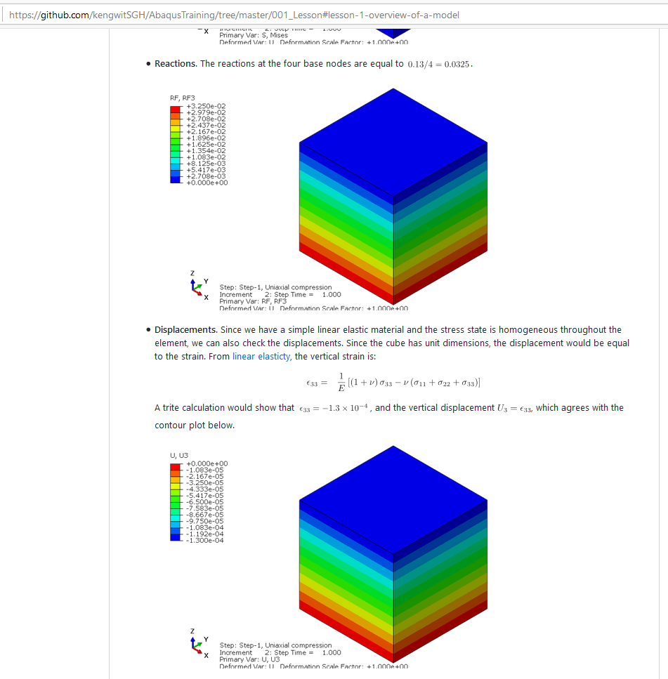
Elementary Tutorials on GitHub (cont’d)
Some checking or verification

Slide 8
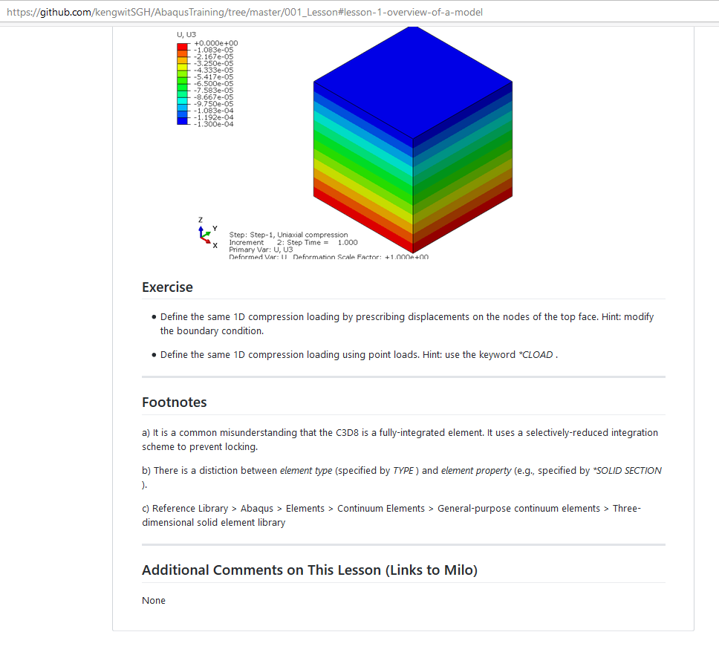
Elementary Tutorials on GitHub (cont’d)
Exercises
Additional notes
Links to comments (on Milo)

Slide 9
Goal of Today’s Training
This training – perform single element tests to test material response under triaxial stress states.

Slide 10
Performing elemental tests
Why are elemental tests important?
Gives insight into material response
See main features of material model
See how parameters affect response
Helps with interpretation of test data

Slide 11

Performing elemental tests
Uncover limitations of a material model (VERY IMPORTANT)
You take the red pill—Your material model may be the weakest link and your model may have no predictive power at all.
You take the blue pill—you keep making the most complicated-looking model (meshwise) and believe whatever you want to believe.

Slide 12

Performing elemental tests
Provides a quantitative framework to discuss material response:
Avoid making weak analogies to pseudo, imaginary materials (“nonlinear”), which is grossly inaccurate
Qualitative terms (“nonlinear”, “soft”, “weak”, etc.) are meaningless
“Nonlinear”
- Not a straight line
- I don’t know what it is, and you don’t know too
John Doyle, Professor of Control and Dynamical Systems Electrical Engineering, and BioEngineering, Caltech

Slide 13
Triaxial stress state
Common test used for probing stress-strain response in:
Metals
Soil
Concrete
Provides a homogeneous stress-state for elemental response (before failure)
Not the only possible stress-state

Slide 14
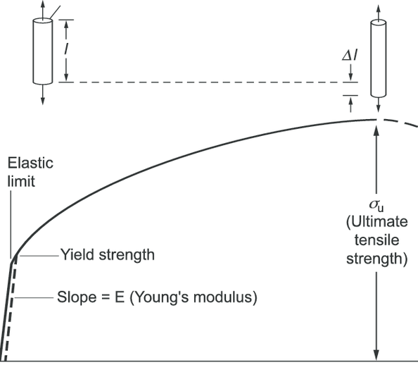
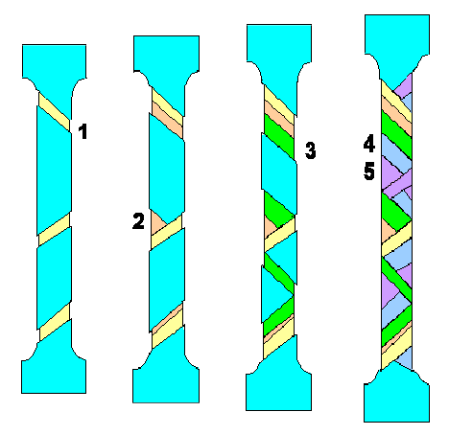
Side
1
2
3
4
Micro-structural changes (dislocations) during necking, resulting in an inhomogeneous stress state
Post-peak test data are not supposed to be used as input into a FE model

Slide 15



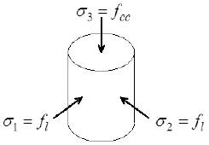


Triaxial stress state (cont’d)
Principal stresses are:
Vertical stress (varying)
Lateral stress (zero for uniaxial tests)

Slide 16
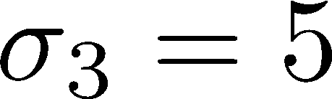
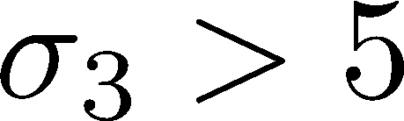
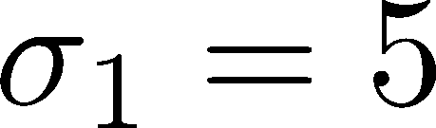
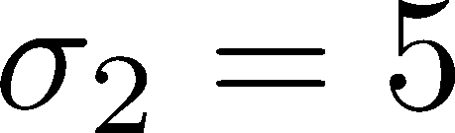
Triaxial stress state (cont’d)
Triaxial compression (TXC)
Initial confinement
Triaxial Shearing

Slide 17

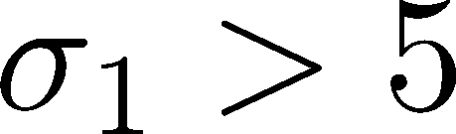
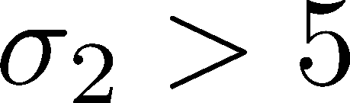
Triaxial stress state (cont’d)
Triaxial extension (TXC) (think “squeezing”)
Initial confinement
Triaxial Shearing

Slide 18
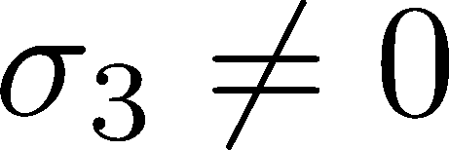
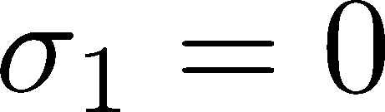
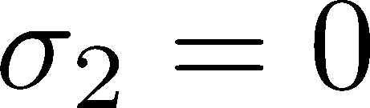
Triaxial stress state (cont’d)
Uniaxial

Slide 19
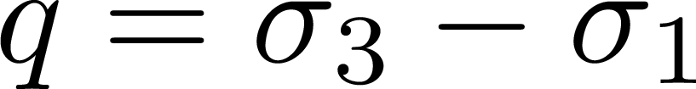
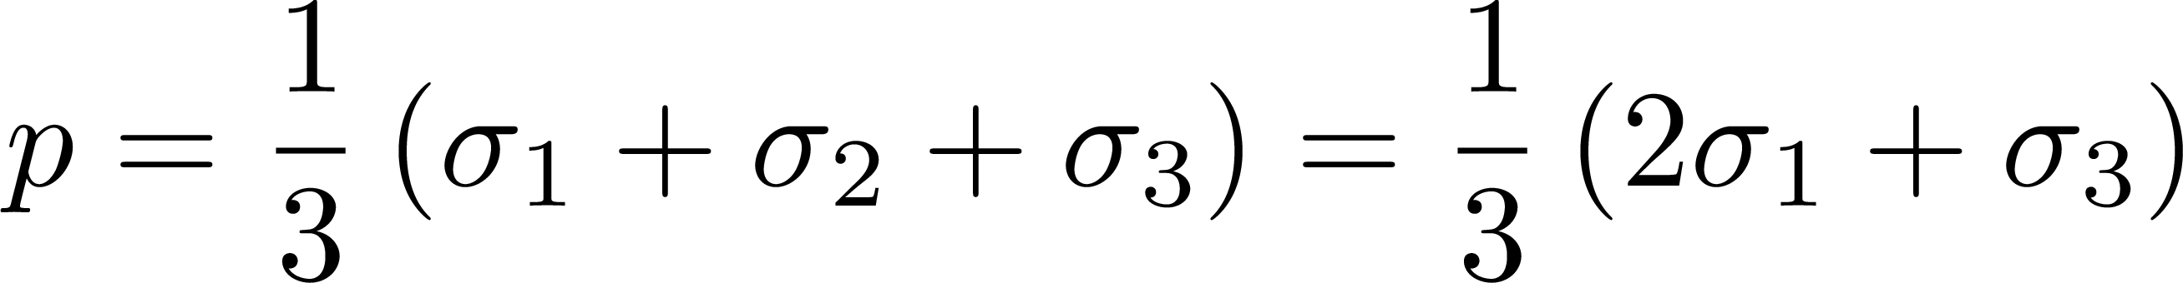
Triaxial stress state (cont’d)
Shear stress (stress difference)
Pressure (mean stress)

Slide 20
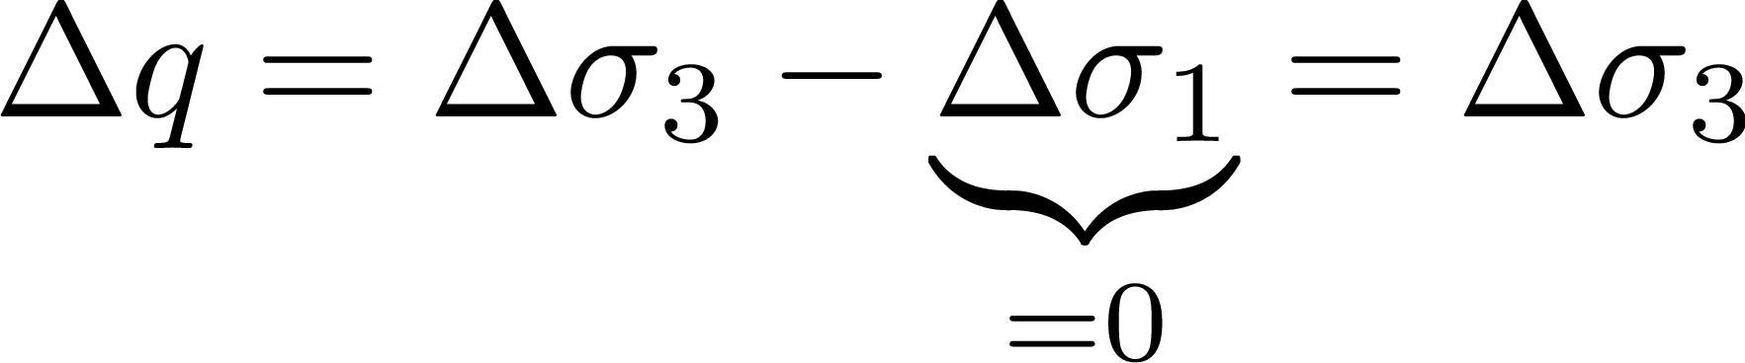
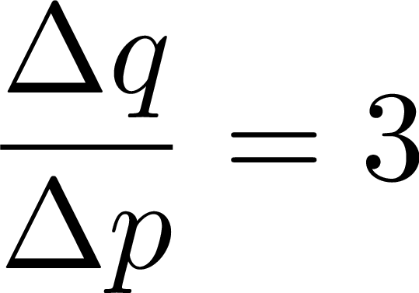
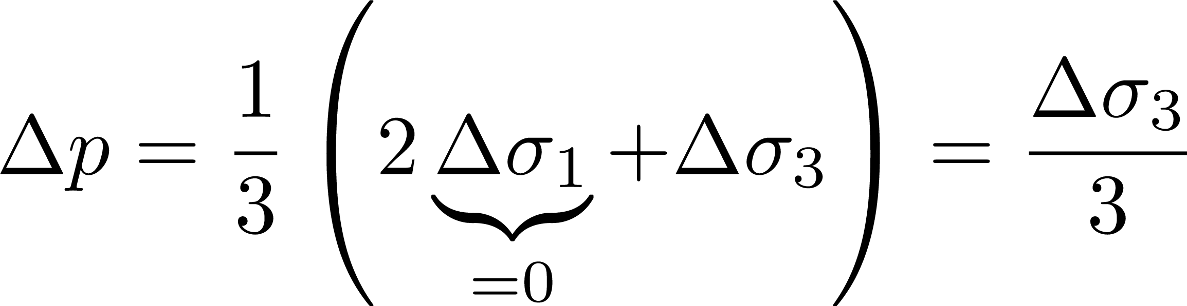
Triaxial stress state (cont’d)
Triaxial compression

Slide 21
Commonly Used Material Models at SGH
Commonly used models:
Metal plasticity (e.g., von Mises plasticity)
Concrete (e.g., Concrete Damage Model)
Soil, granular media (e.g., Drucker-Prager, Mohr-Coulomb)
Rate-independent model
Elastic-plastic materials
Quasi-static applications and monotonic loading (models are derived from tests)
For dynamics, ask others

Slide 22
Metal Plasticity

Slide 23
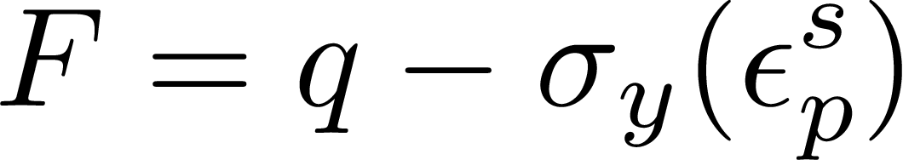
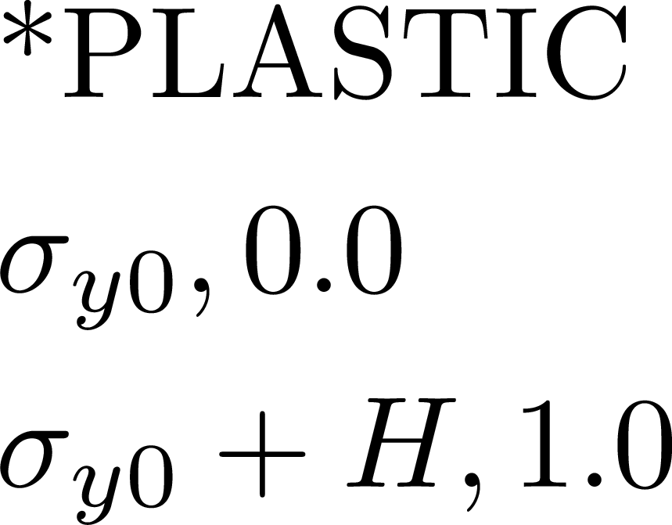
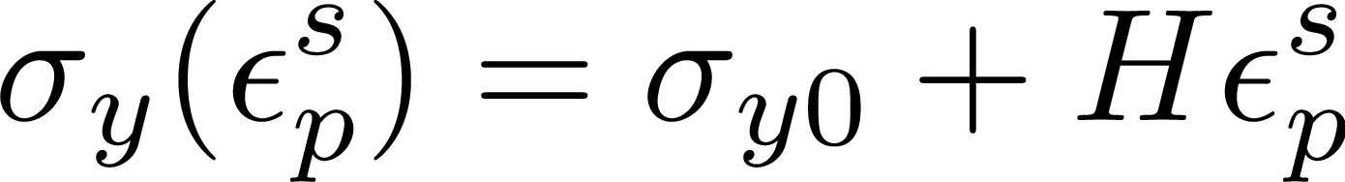
Metal Plasticity
Yield depends on only shear; no pressure-dependency
Yield function
Isotropic (linear) hardening
Hardening modulus
Initial yield stress

Slide 24
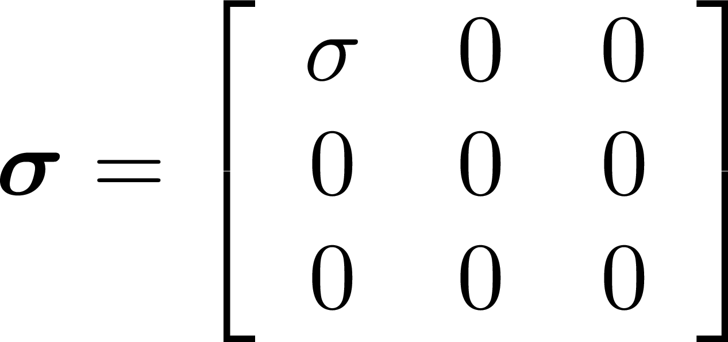
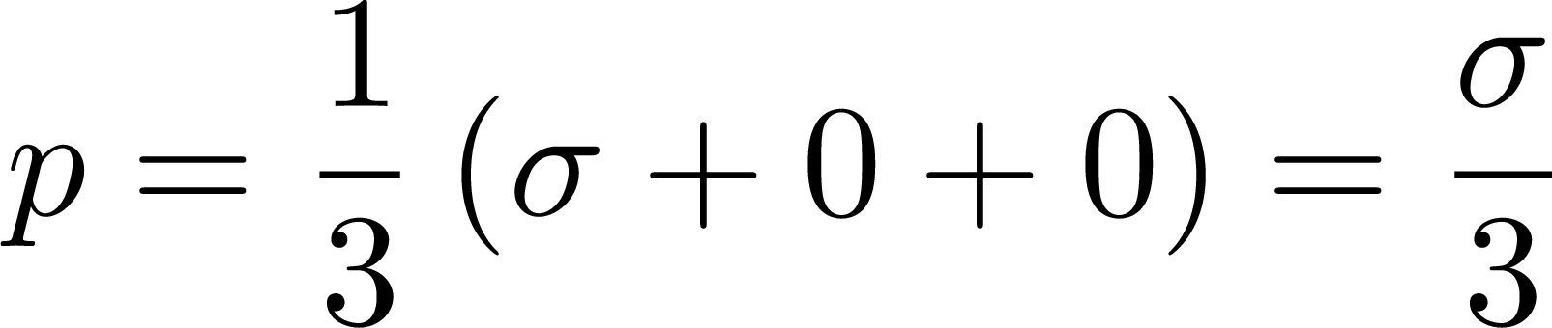
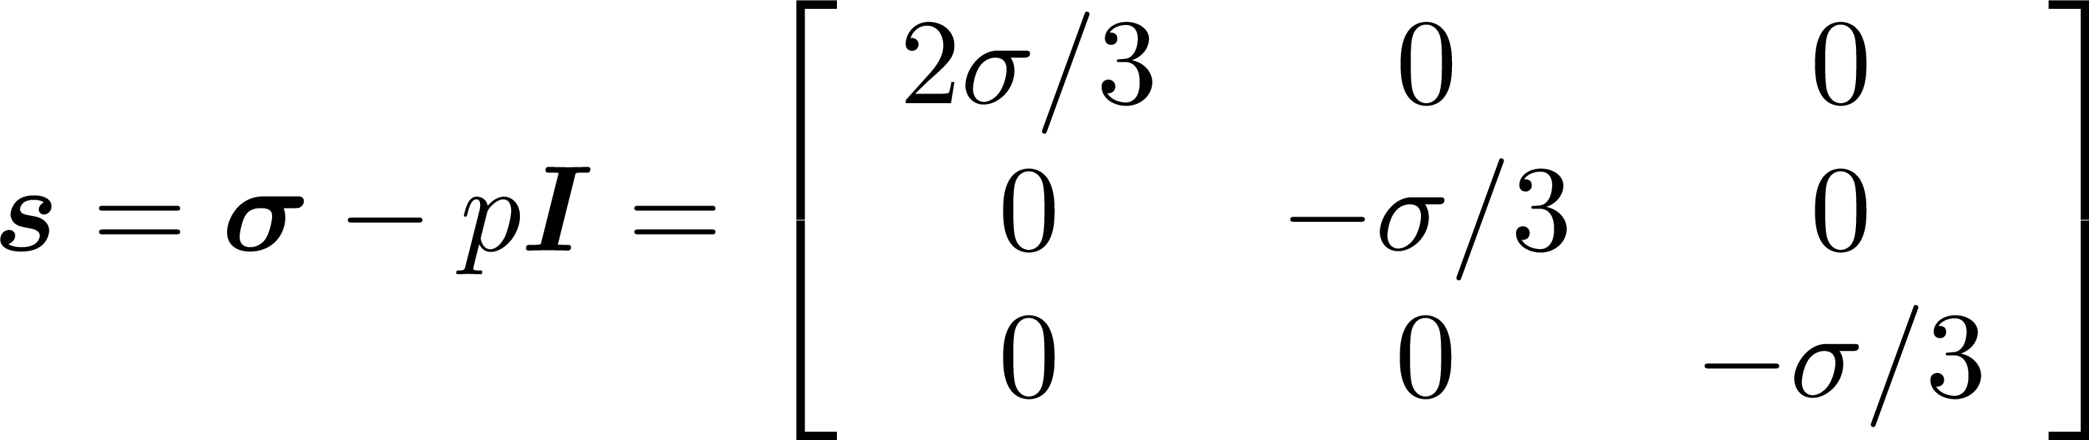
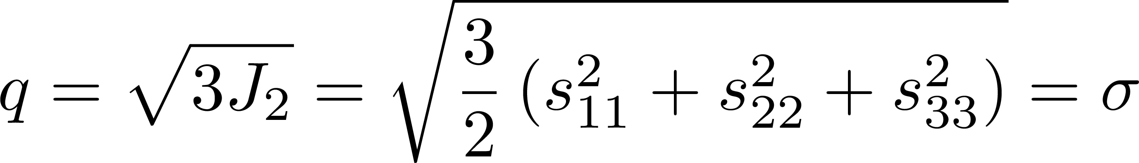
Metal Plasticity
Uniaxial stress
Pressure
Deviatoric stress
Shear stress
If material is yielding,

Slide 25
Metal Plasticity
Numerical example (Lesson 5 on GitHub)
Loading protocol:
Initial confinement
Triaxial Shearing

Slide 26
Drucker-Prager

Slide 27
Drucker-Prager
Prototypical “granular” or “soil” model. Simplest pressure-dependent material.
Yield function
Isotropic hardening

Slide 28
Concrete

Slide 29
Concrete
Yield function
Isotropic hardening

