Slide 1
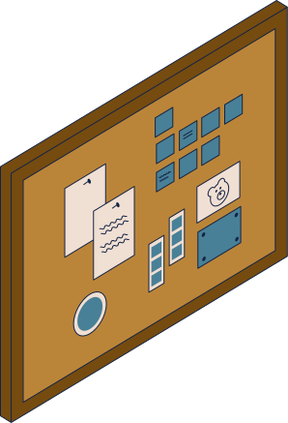

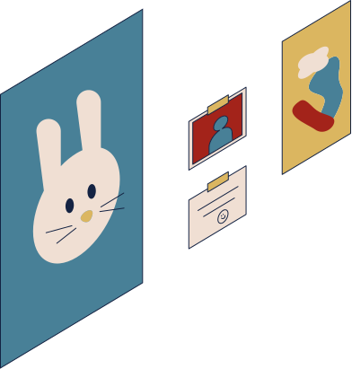



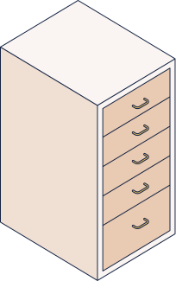

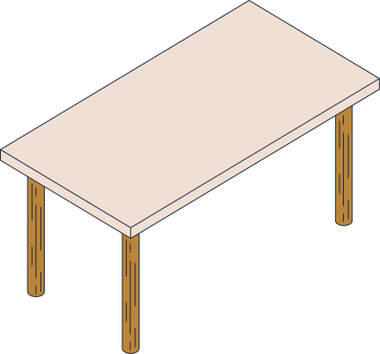
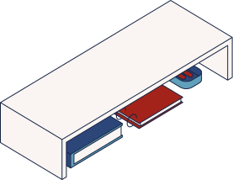

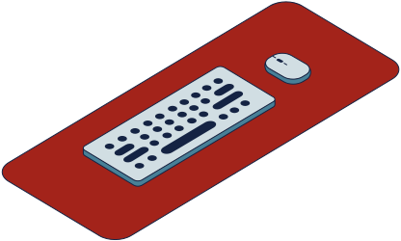
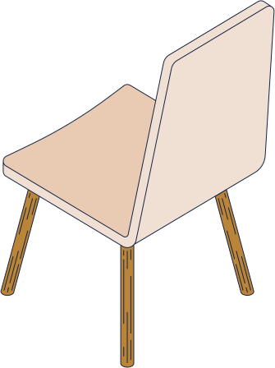
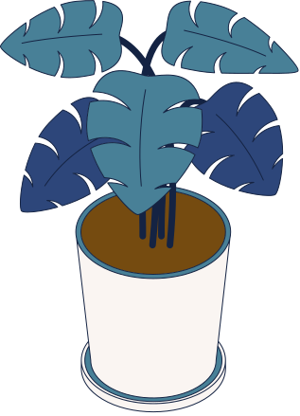
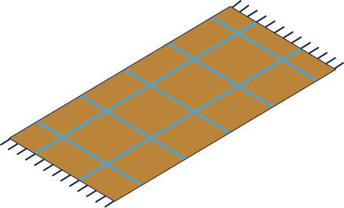
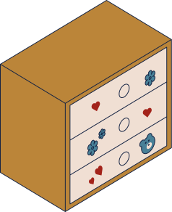
group Project 4
Story
Dr. Omniah H. Nagoor

Slide 2
Grpub member :
لجين الحبشي 443011980
ضي القرشي 443001661
جنى مدهر 442000261
ميساء الجفري 443014662
اعتزاز موسى 443009186
بتول السلمي 443000985

Slide 3
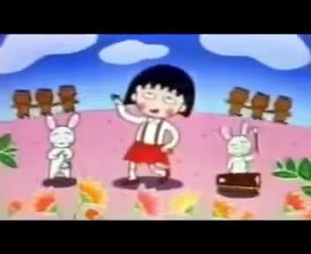

Slide 4
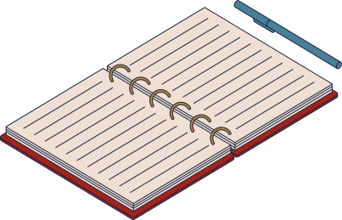
Introduction
The idea of our project is about the importance of time management and
Knowing how to manage time can be game-winning.
We made an animation of 10 parts. It tells the story of Maroco and how she realized
the importance of time management.

Slide 5

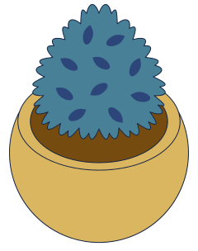
Why this topic?
We chose this topic because in our study life we ​​all went through the same experience as Maroco

Slide 6
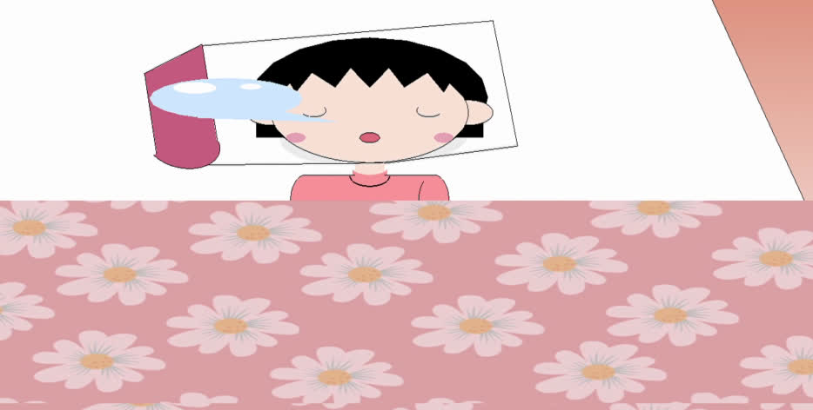

the run

Slide 7
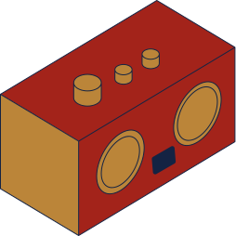
about the code

Slide 8
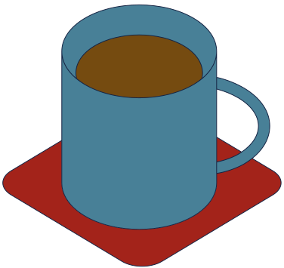
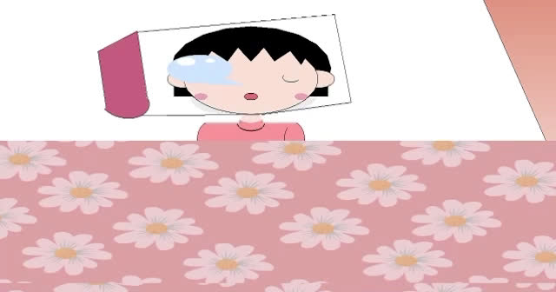
Guess how !

Slide 9
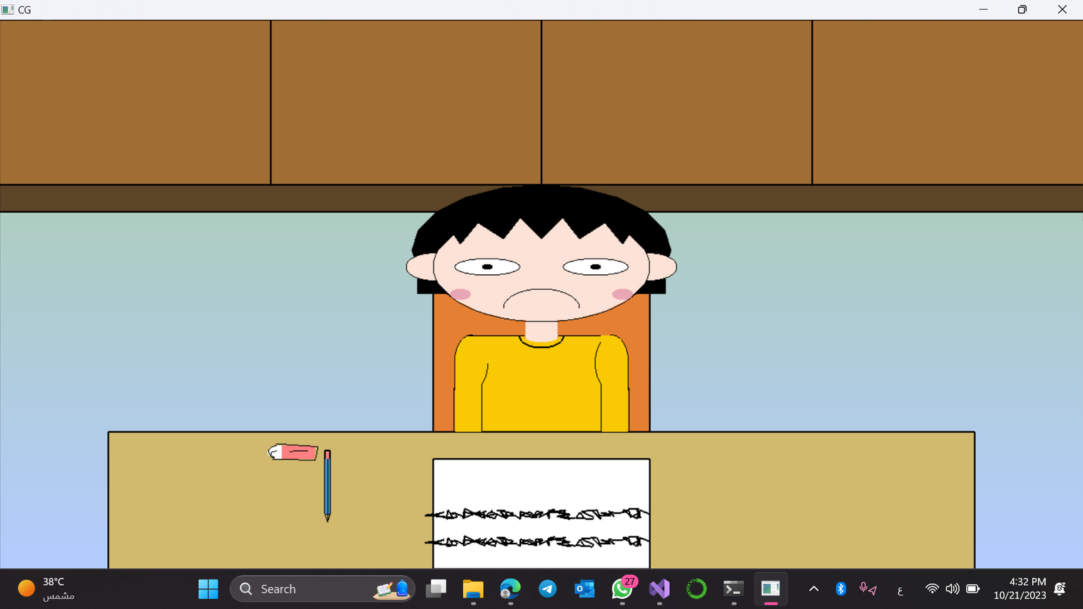
Guess how !

Slide 10
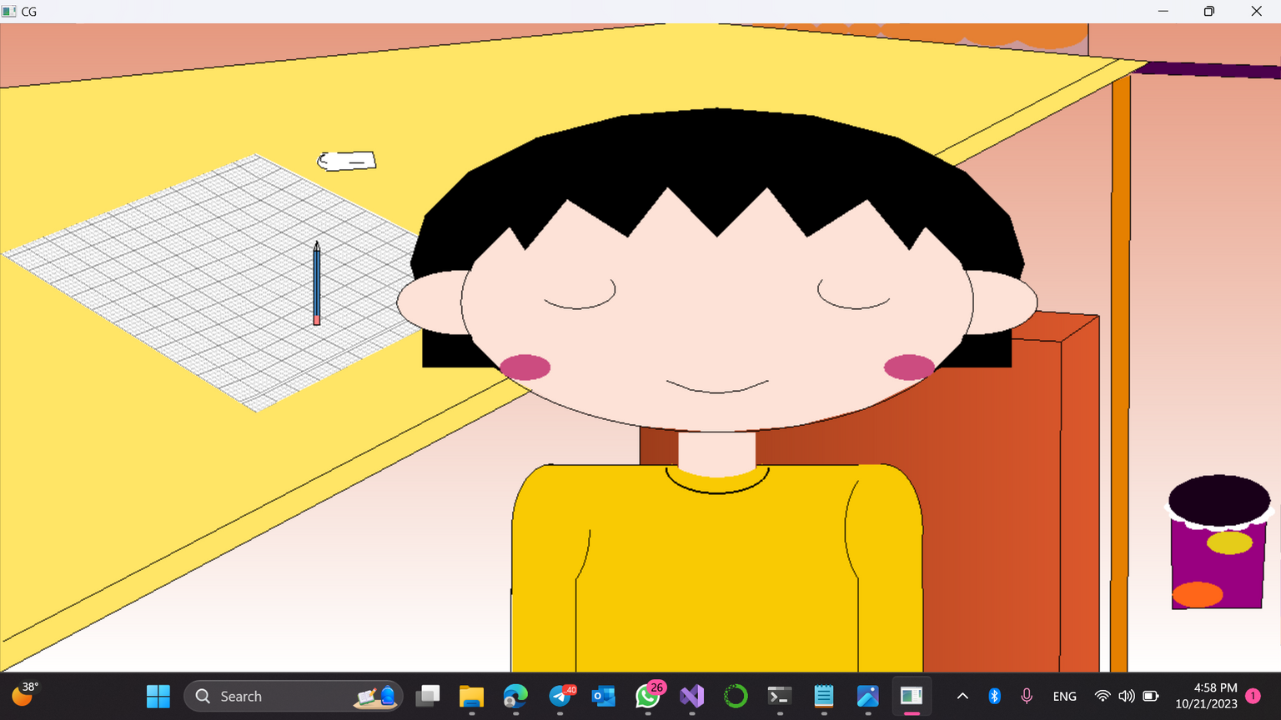
Guess how !

Slide 11
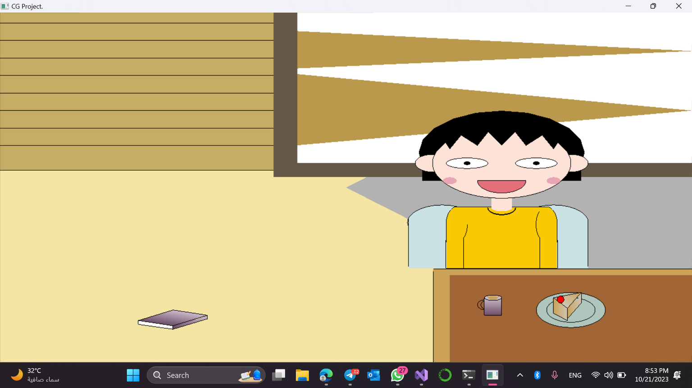
Guess how !

Slide 12

did you went through the same experience as Maroco?

Slide 13
Thank you for listening!

