Slide 1


Software Products / IT Industry
Consulting, Engineering & IT Services
Artificial Intelligence Applications
All marks or names of products mentioned in this document are the property of their resp

Slide 2
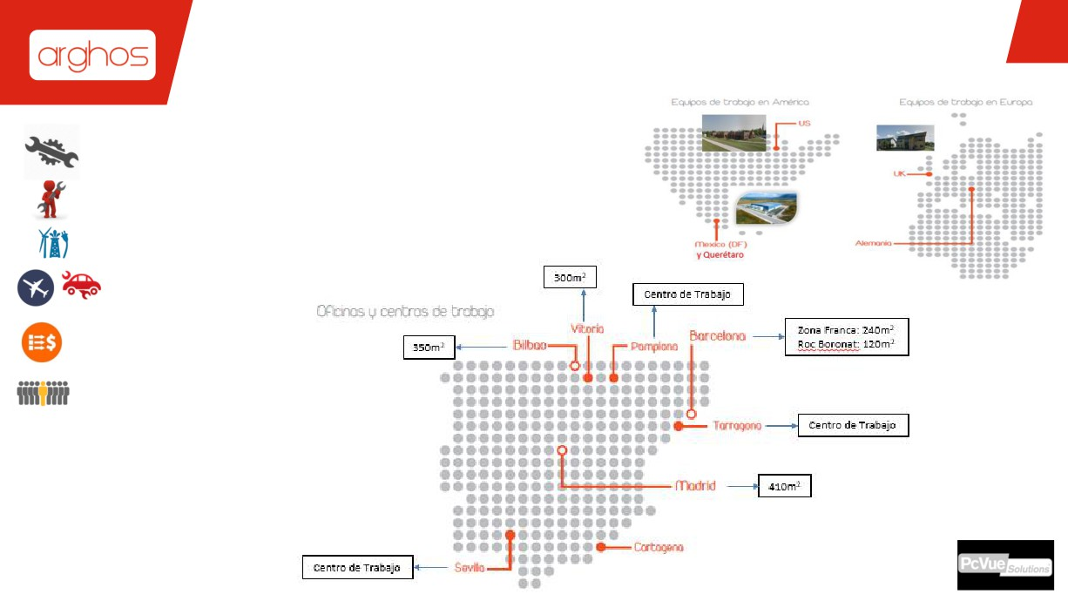
SUMARIO
REFERENCES INDEX
SOLUTION ENGINEERING ARTIFICIAL INTELLIGENCE
CONSULTING & SERVICES OTHER AREA REFERENCES
SOFTWARE PRODUCTS MANUFACTURING IT
+17m€ - 2017.
+ 300
their resp

Slide 3

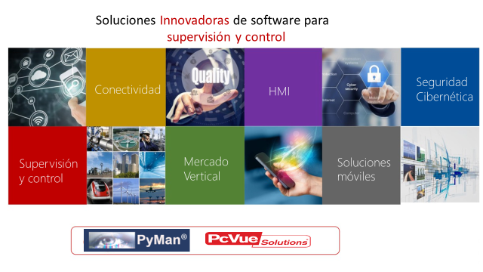
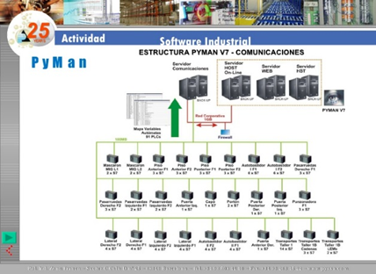
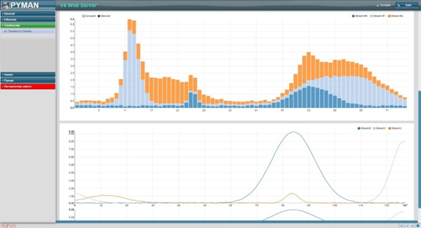
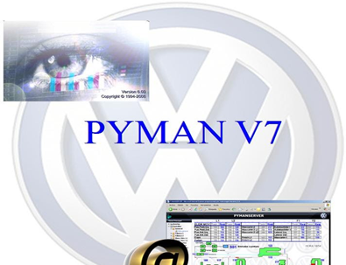
SOFTWARE PRODUCTS
Filial de un Grupo Industrial Aeronáutico de primer Nivel Servicios de Ingeniería & Consultoría
Sectores Industriales + Presencia Internacional
+17m€ - 2017.
+ 300
their resp

Slide 4
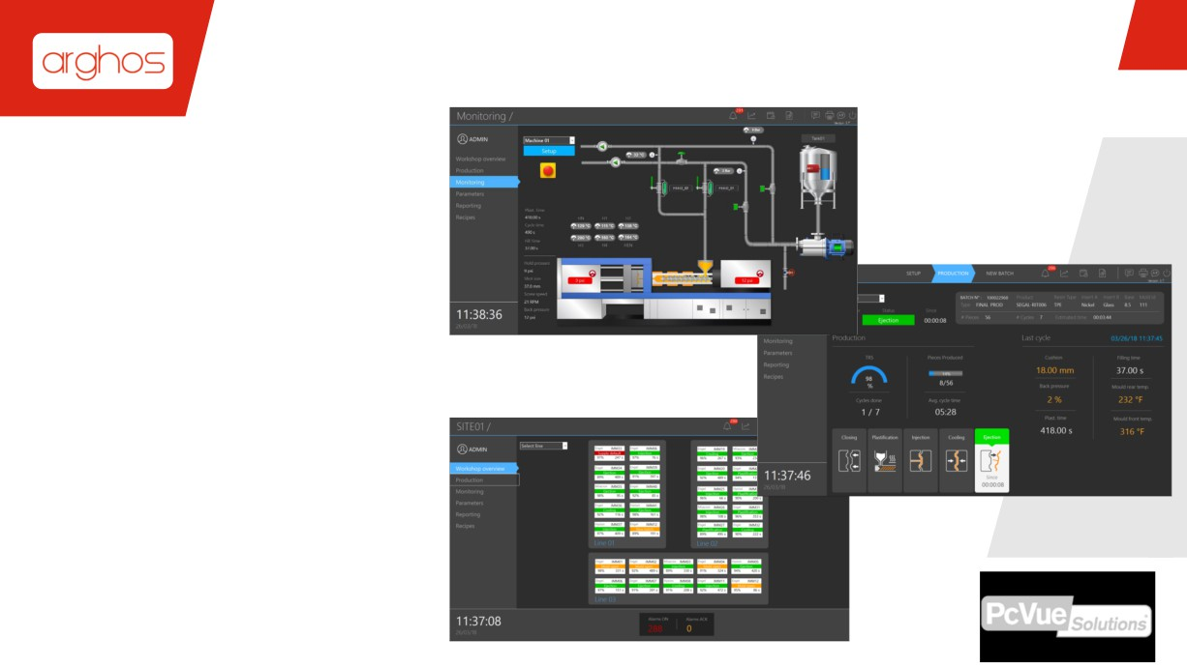
INDUSTRIAL APPLICATIONS
▪ Gestión de protocolos para las principales marcas de PLC (Schneider Electric, Siemens, Rockwell, Beckoff, Saia, Wago, etc.)
▪ Biblioteca gráfica 2D/3D y objetos ISO para entornos
industriales
▪ Gestión de lotes e interfaz de control fácil de usar
▪ Interfaz con gráficos SPC (Control estadístico de procesos)
▪ Informes
All marks or names of products mentioned in this document are the property of their respective owners.

Slide 5














SOLUTION ENGINEERING / TECHNOLOGIES
(NON-EXHAUSTIVE LIST)
DESIGN & ARCHITECTURE
TESTS & NORMATIVES
COMMUNICATION & DATABASES
SOFTWARE CODE PROGRAMMING
C/C++/C#, VISUAL C++ / LINUX
ASP.NET, VB.NET
JAVA, SERVLET, JSP, PHP
AJAX, WEB SERVICES
HTML, JAVASCRIPT
RATIONAL ROSE
ECLIPSE
DOORS
RHAPSODY
ATLASSIAN
TDD
AGILE
SCRUM
UML
GIT
J2EE, SPRING / ANGULAR
ADA 83/95, FORTRAN
VHDL/FPGA, XILINX / ALTERA
ENSAMBLADOR / MICRO
HOST LINK (OMRON)
INTERBUS (PHOENIX)
DF-1 (ALLEN BRADLEY)
TCP/IP, CANBUS
SQL, PL/SQL
ORACLE 8-11G
POSTGRESQL
MYSQL 5.X
DO-178B
MIL-STD
ECSS
SIL 0/2/4
IEC 60880
ADATEST
VISUALTEST
RATIONAL TEST
CANTATA
MERCURY
their resp

