Slide 1
聚类
vipjr

Slide 2
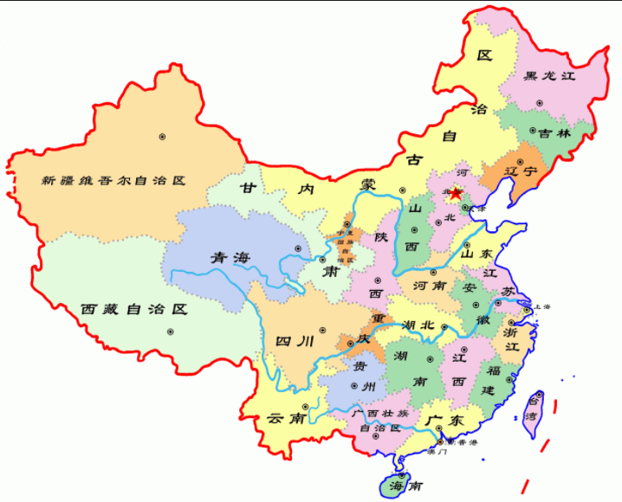
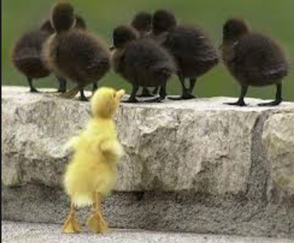
物以类聚人以群分

Slide 3
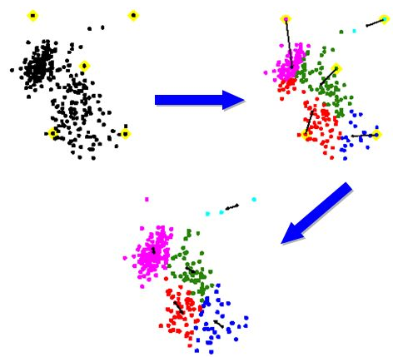
数据聚类

Slide 4
KNN与K-means聚类
KNN：k-nearest neighbors K-最紧邻。找到最近邻居，投票决定
K-means：K-均值算法。距离类别中心的距离作为判断依据。

Slide 5
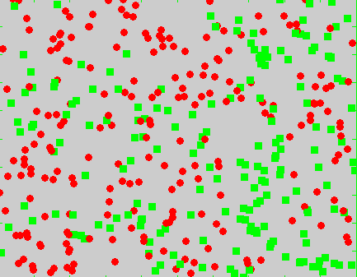
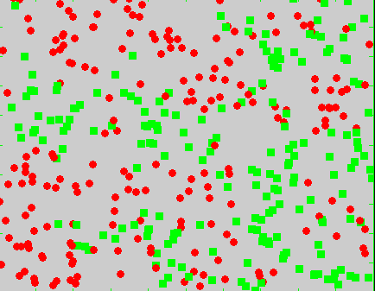
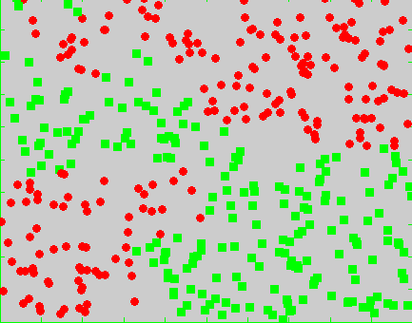
KNN算法举例

Slide 6
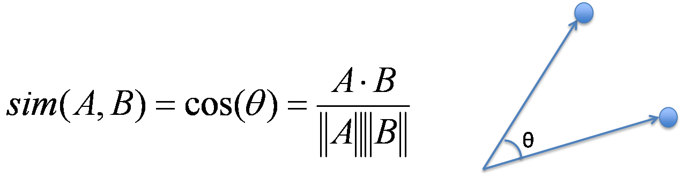
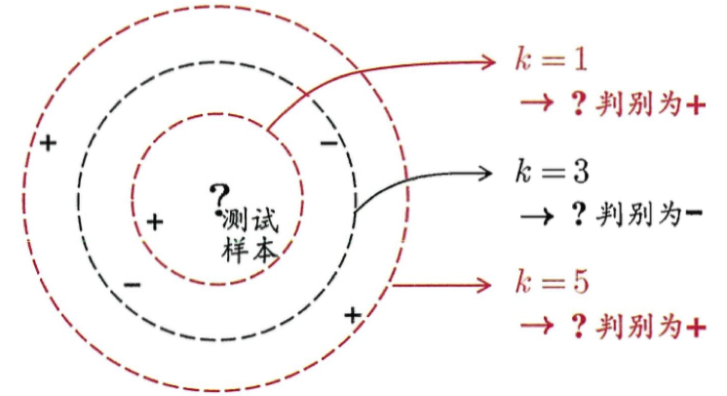
如何判断远近呢
（1）
（2） 投票

Slide 7
实例
import numpy as np
import matplotlib.pyplot as plt
from matplotlib.colors import ListedColormap
from sklearn import neighbors, datasets
n_neighbors = 15
# import some data to play with
iris = datasets.load_iris()
# we only take the first two features. We could avoid this ugly
# slicing by using a two-dim dataset
X = iris.data[:, :2]
y = iris.target
h = .02 # step size in the mesh
# Create color maps
cmap_light = ListedColormap(['#FFAAAA', '#AAFFAA', '#AAAAFF'])
cmap_bold = ListedColormap(['#FF0000', '#00FF00', '#0000FF'])

Slide 8
实例
for weights in ['uniform', 'distance']:
# we create an instance of Neighbours Classifier and fit the data.
clf = neighbors.KNeighborsClassifier(n_neighbors, weights=weights)
clf.fit(X, y)
# Plot the decision boundary. For that, we will assign a color to each
# point in the mesh [x_min, x_max]x[y_min, y_max].
x_min, x_max = X[:, 0].min() - 1, X[:, 0].max() + 1
y_min, y_max = X[:, 1].min() - 1, X[:, 1].max() + 1
xx, yy = np.meshgrid(np.arange(x_min, x_max, h),np.arange(y_min, y_max, h))
Z = clf.predict(np.c_[xx.ravel(), yy.ravel()])
# Put the result into a color plot
Z = Z.reshape(xx.shape)
plt.figure()
plt.pcolormesh(xx, yy, Z, cmap=cmap_light)
# Plot also the training points
plt.scatter(X[:, 0], X[:, 1], c=y, cmap=cmap_bold,edgecolor='k', s=20)
plt.xlim(xx.min(), xx.max())
plt.ylim(yy.min(), yy.max())
plt.title("3-Class classification (k = %i, weights = '%s')"% (n_neighbors, weights))
plt.show()

Slide 9
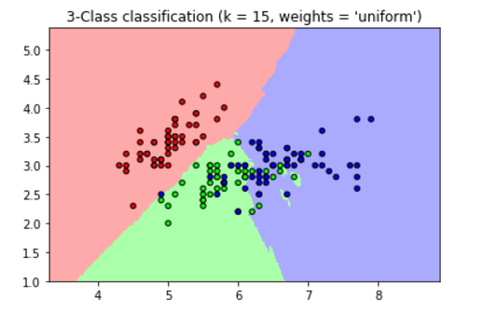
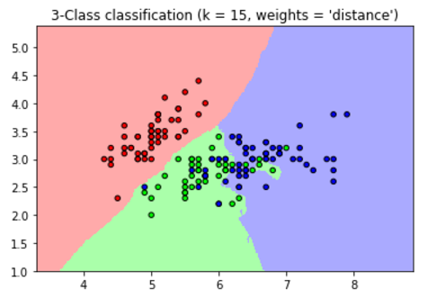

Slide 10
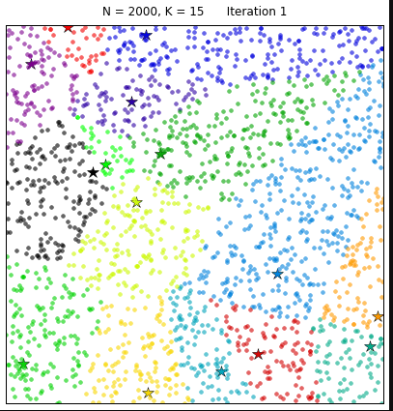
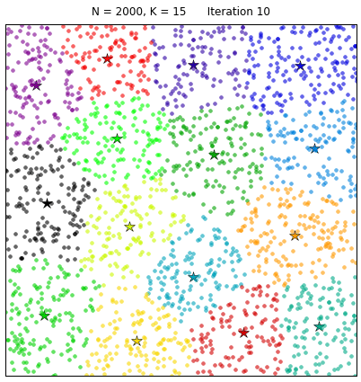
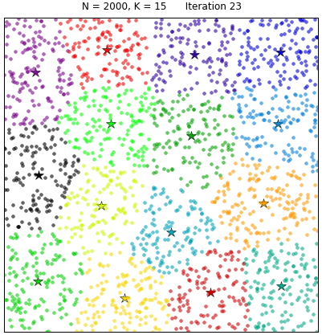
K-means算法

Slide 11
如何分类
（1）根据K，随机选择K个点作为中心
（2）计算新目标到中心的距离， 属于距离较近的类别
（3）每个样本分类后，重新计算中心
（4）不断重复（2）（3）

Slide 12
中心计算
5.1 | 3.5 | 1.4 | 0.2 | Iris-setosa
4.9 | 3 | 1.4 | 0.2 | Iris-setosa
4.7 | 3.2 | 1.3 | 0.2 | Iris-setosa
4.6 | 3.1 | 1.5 | 0.2 | Iris-setosa
A(5.1,3.5,1.4,0.2)
B(4.9,3.0,1.4,0.2)
C(4.7,3.2,1.3,0.2)
D(4.6,3.1,1.5,0.2)
（5.1+4.9+4.7+4.6)/4 = 4.825
（3.5+3+3.2+3.1）/4 = 3.2
（1.4+1.4+1.3+1.5）/4 = 1.4
（0.2+0.2+0.2+0.2）/4 = 0.2
中心计算：

Slide 13
K-means 算法实例
import matplotlib.pyplot as plt
from sklearn import datasets
from sklearn.cluster import KMeans
import sklearn.metrics as sm
import pandas as pd
import numpy as np
# Only needed if you want to display your plots inline if using Notebook
# change inline to auto if you have Spyder installed
%matplotlib inline
# import some data to play with
iris = datasets.load_iris()
print(iris.data)
print(iris.feature_names)
print(iris.target)
print(iris.target_names)

Slide 14
K-means 算法实例
# Store the inputs as a Pandas Dataframe and set the column names
x = pd.DataFrame(iris.data)
x.columns = ['Sepal_Length','Sepal_Width','Petal_Length','Petal_Width']
y = pd.DataFrame(iris.target)
y.columns = ['Targets']

Slide 15
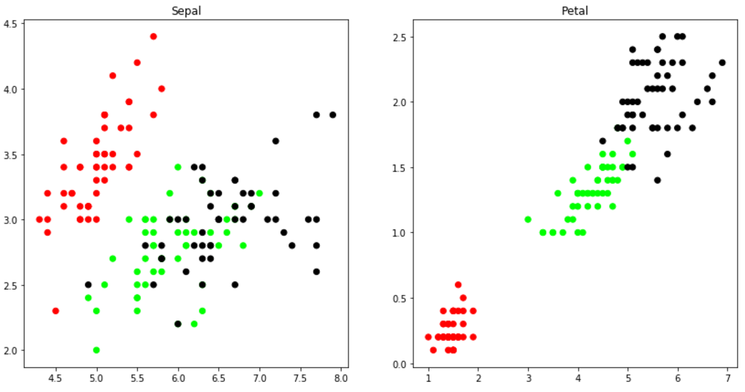
K-means 算法实例
# Set the size of the plot
plt.figure(figsize=(14,7))
# Create a colormap
colormap = np.array(['red', 'lime', 'black'])
# Plot Sepal
plt.subplot(1, 2, 1)
plt.scatter(x.Sepal_Length, x.Sepal_Width, c=colormap[y.Targets], s=40)
plt.title('Sepal')
plt.subplot(1, 2, 2)
plt.scatter(x.Petal_Length, x.Petal_Width, c=colormap[y.Targets], s=40)
plt.title('Petal')

Slide 16
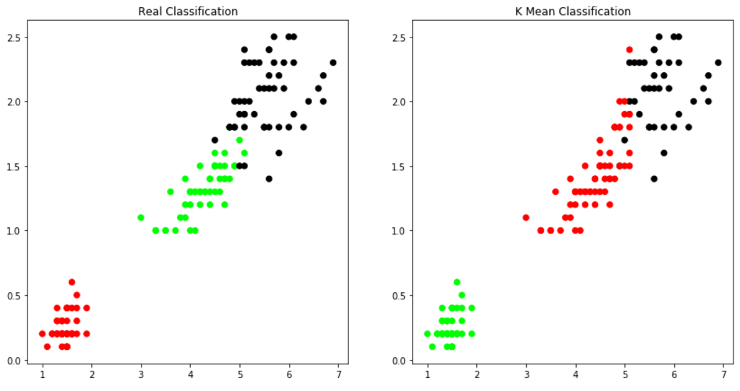
K-means 算法实例
# K Means Cluster
model = KMeans(n_clusters=3)
model.fit(x)
# K Means Cluster
model = KMeans(n_clusters=3)
model.fit(x)
# View the results
# Set the size of the plot
plt.figure(figsize=(14,7))
# Create a colormap
colormap = np.array(['red', 'lime', 'black'])
# Plot the Original Classifications
plt.subplot(1, 2, 1)
plt.scatter(x.Petal_Length, x.Petal_Width, c=colormap[y.Targets], s=40)
plt.title('Real Classification')
# Plot the Models Classifications
plt.subplot(1, 2, 2)
plt.scatter(x.Petal_Length, x.Petal_Width, c=colormap[model.labels_], s=40)
plt.title('K Mean Classification')

