Slide 1

IIT Bazaar
By:
Ernesto Garcia
Janusz Nosek
Swathi Shenoy

Slide 2
Table of Contents
About the app …………………………………………………………………………………………………………………………..3
Login …….…………………………………………………………………………………………………………………….4
Navigation bar ………………………………………………………………………………………………………………………….5
Bar code scanner ……………………………………………………………………………………………………………………….7
Refresh …………………………………………………………………………………………………………………………10
Notifications …………………………………………………………………………………………………………………………11
Watch list ……………………………………………………………………………………………………………………….13
Buy ………………………………………………………………………………………………………………………16
Sell ………………………………………………………………………………………………………………………21
Search ………………………………………………………………………………………………………………………27
Categories ………………………………………………………………………………………………………………………28

Slide 3
About the app
The app is used by students and faculty within IIT to buy and sell items on campus.
The sellers can click a picture of the item to be sold and it is visible to the potential buyers.
A buyer can also sell items by clicking a picture of the item.
A watch list is maintained which contains items the user wants to follow closely.
A QR code is associated with every item, which can be used to scan and retrieve the item.
PayPal API is used for the payment process.

Slide 4
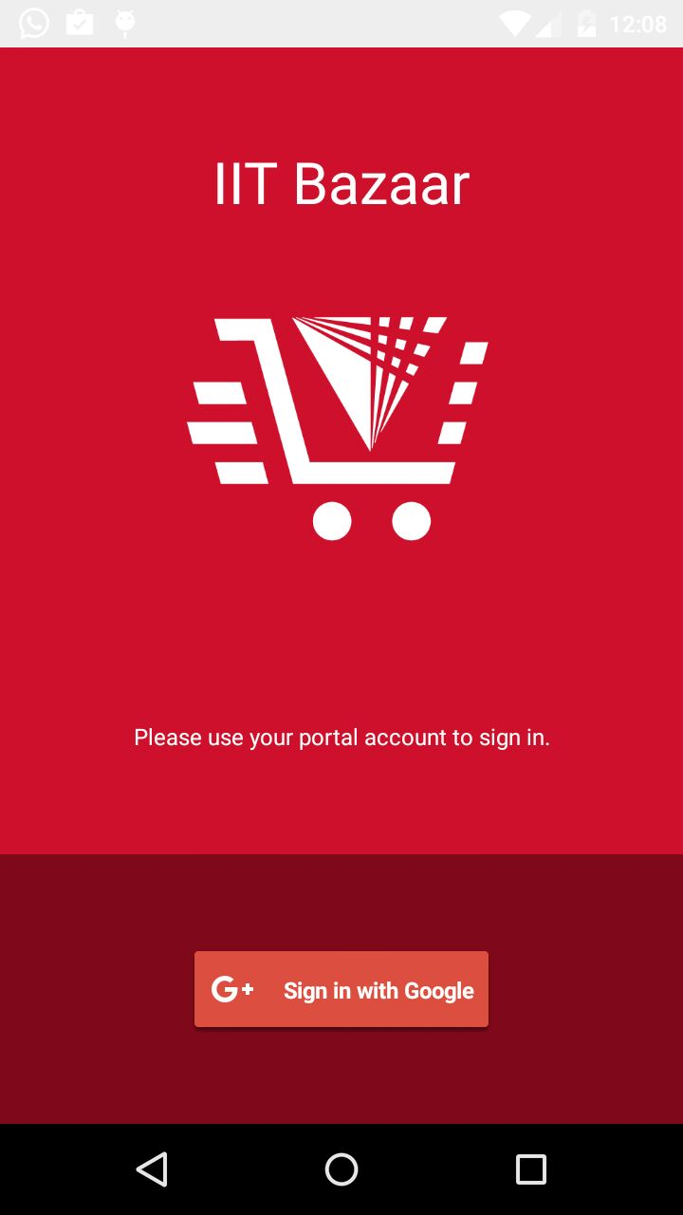
Login Screen
Click on Sign in with Google button.
Use hawk email id to login
Mandatory to have profile picture.

Slide 5
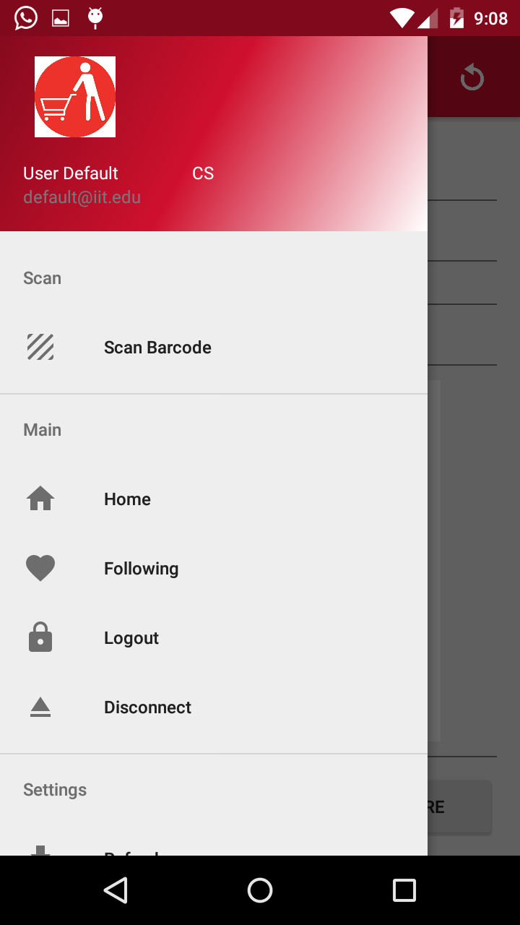
Navigation Pane

Slide 6
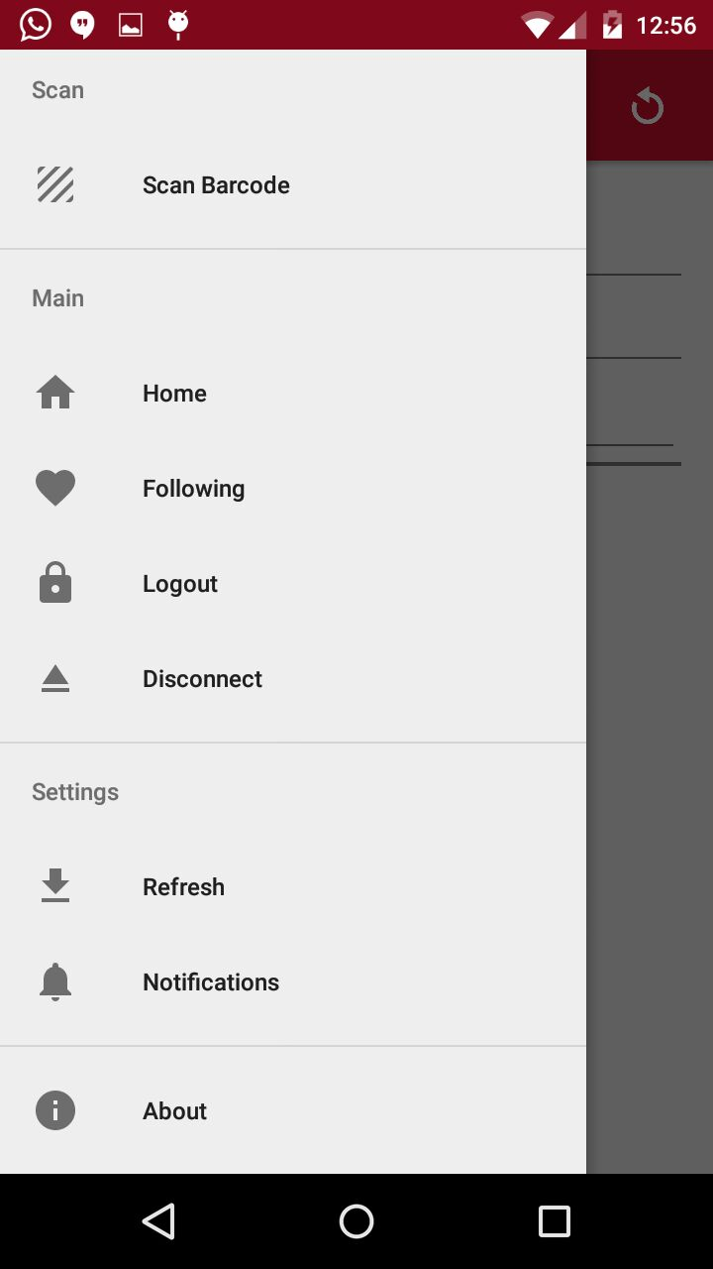
Navigation Pane

Slide 7
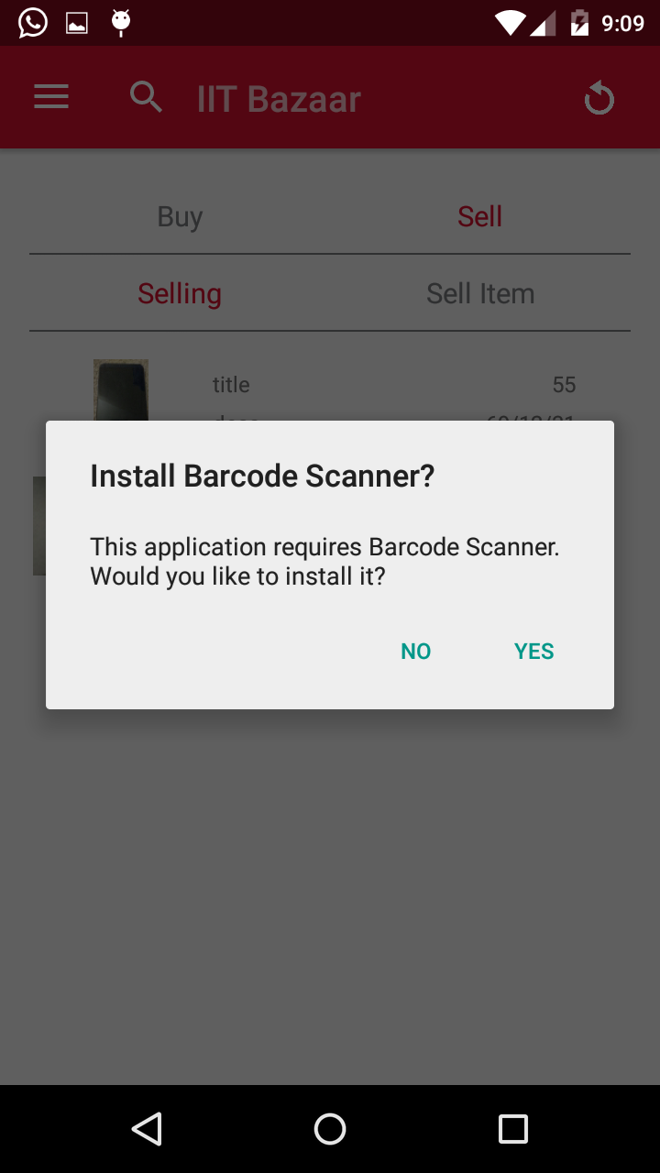
Bar code scanner
On being prompted with this message, click on Yes and install the app.

Slide 8
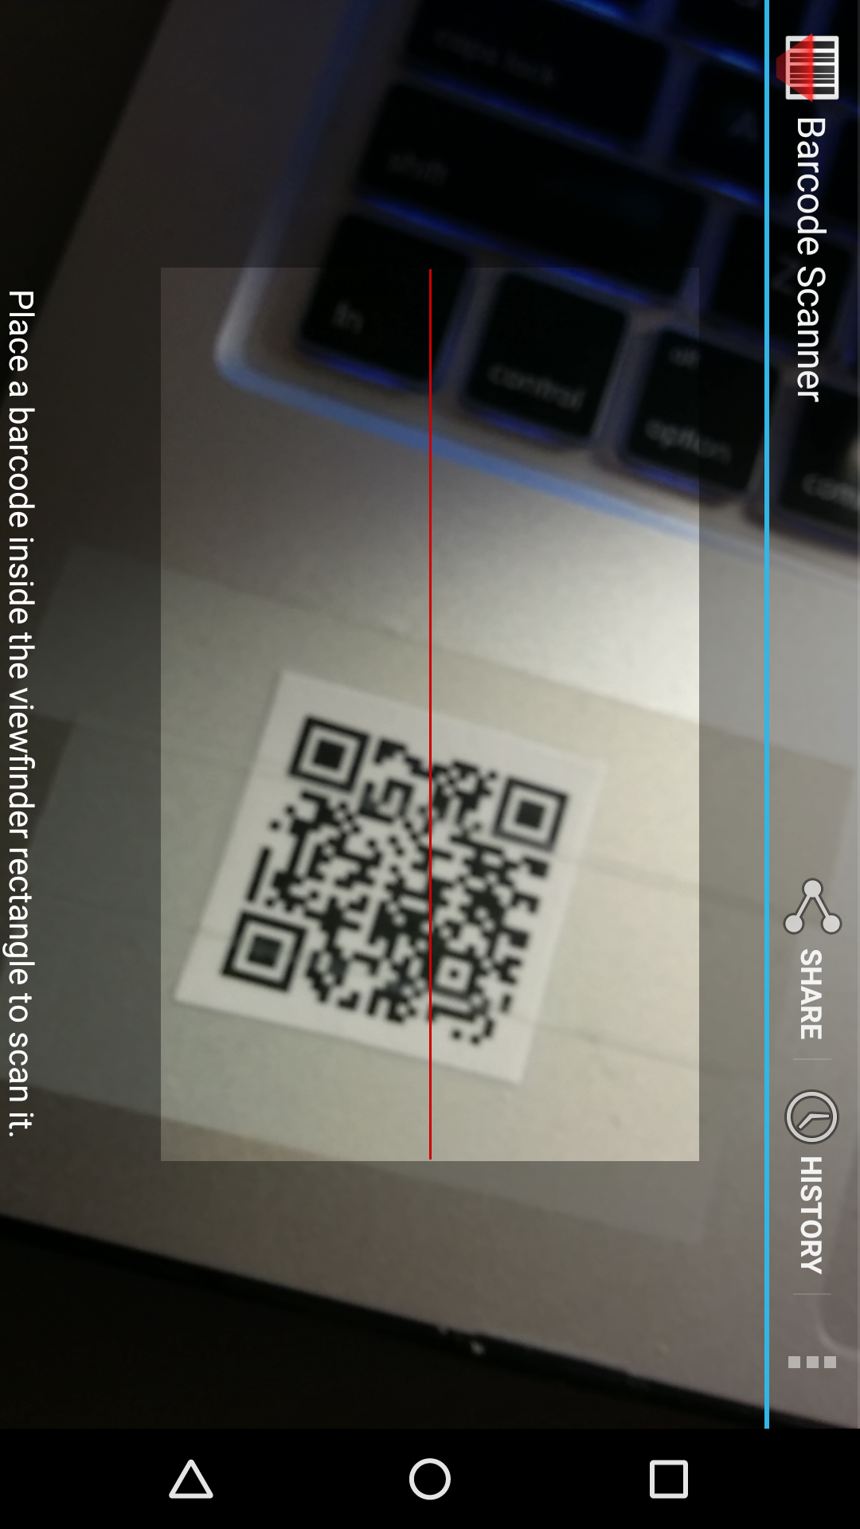
Bar code scanner
Once installed, a barcode can be scanned and an item retrieved.

Slide 9
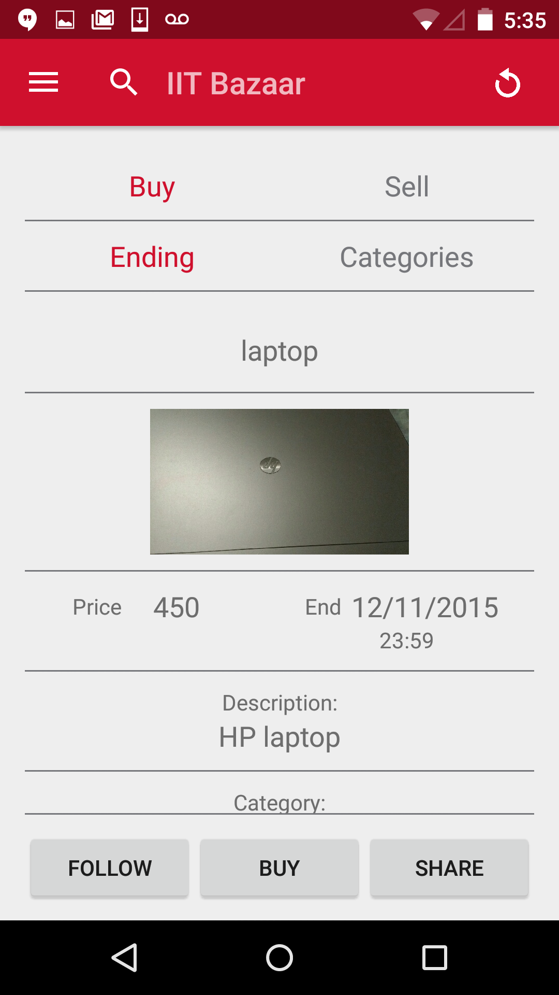
Bar code scanner
Once installed, a barcode can be scanned and an item retrieved.

Slide 10
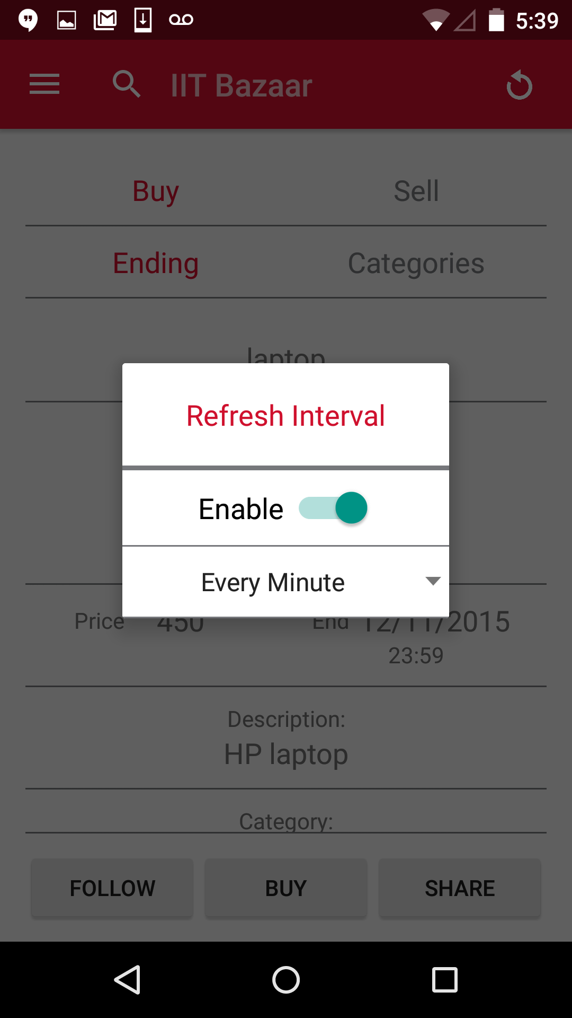
Refresh
The system can automatically sync itself if enabled.
The refresh interval can be adjusted to
Every minute
5 minutes
10 minutes
15 minutes
Every hour

Slide 11
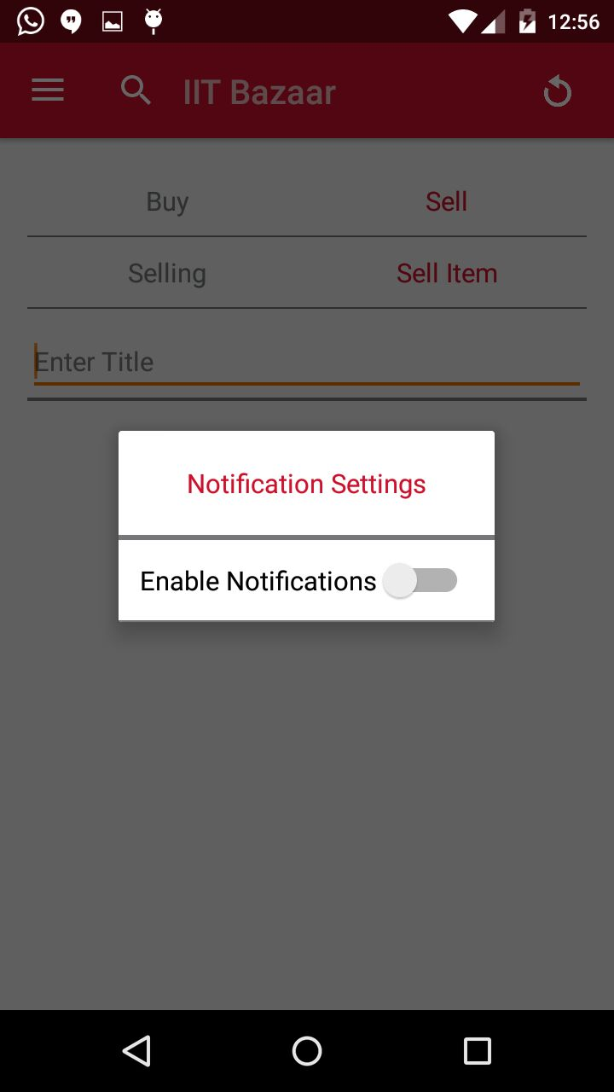
Notifications
Enable notifications here to be notified of any new items added to the buy list.

Slide 12
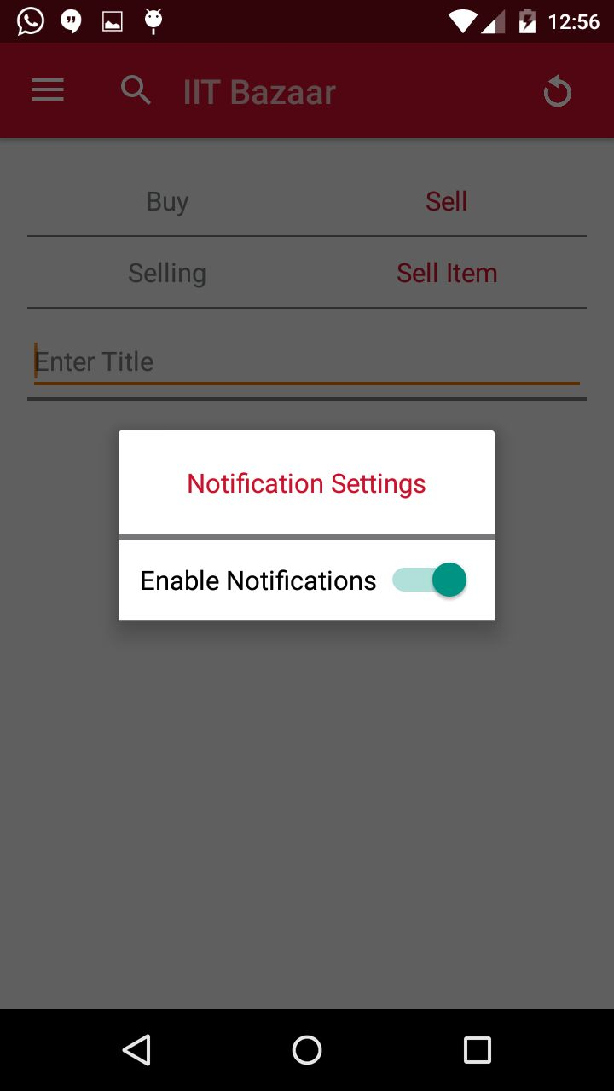
Notifications

Slide 13
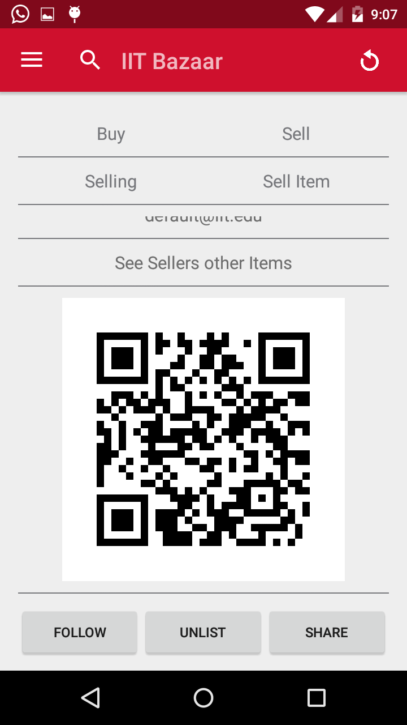
Watch List
Click on Follow button to add to watch list

Slide 14
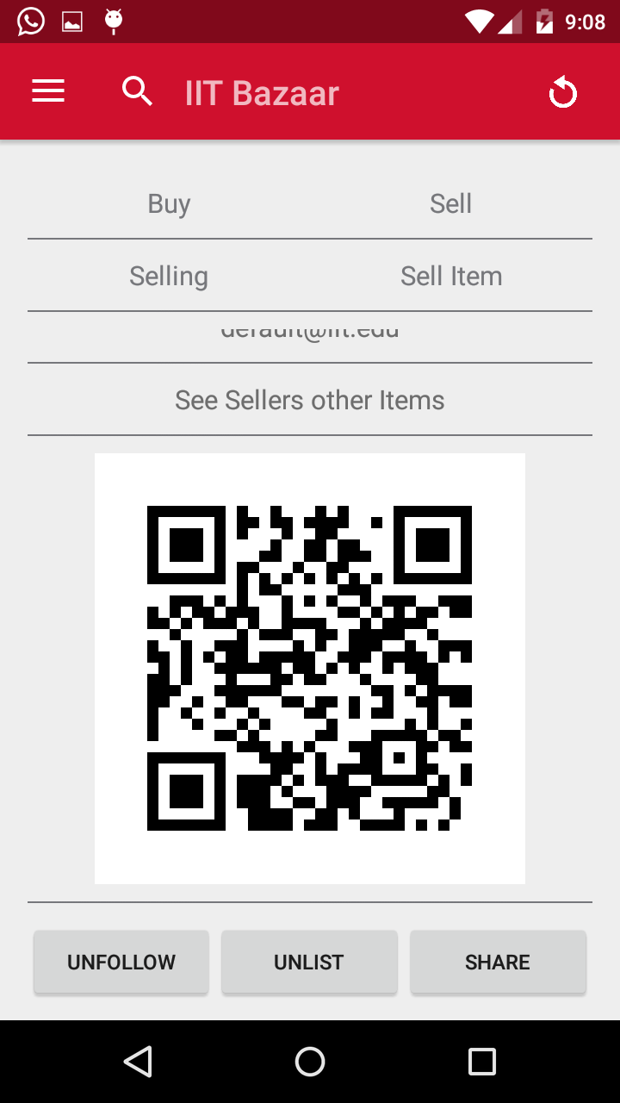
Watch List
Click on Unfollow to remove from watch list

Slide 15
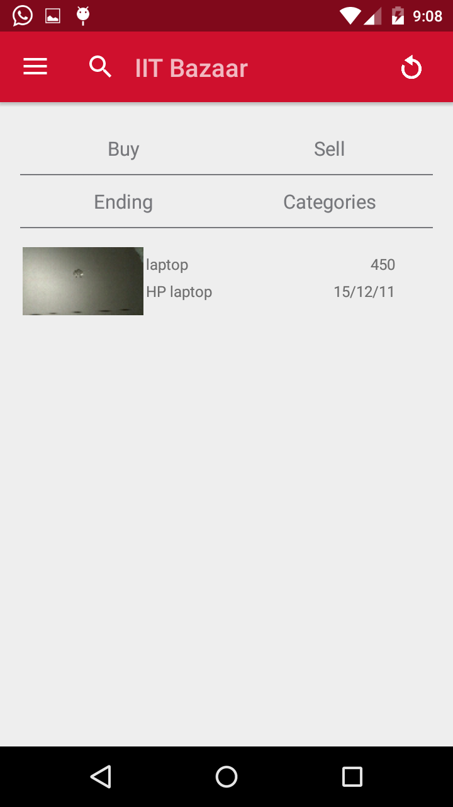
Watch List
List of items in the watch list.

Slide 16
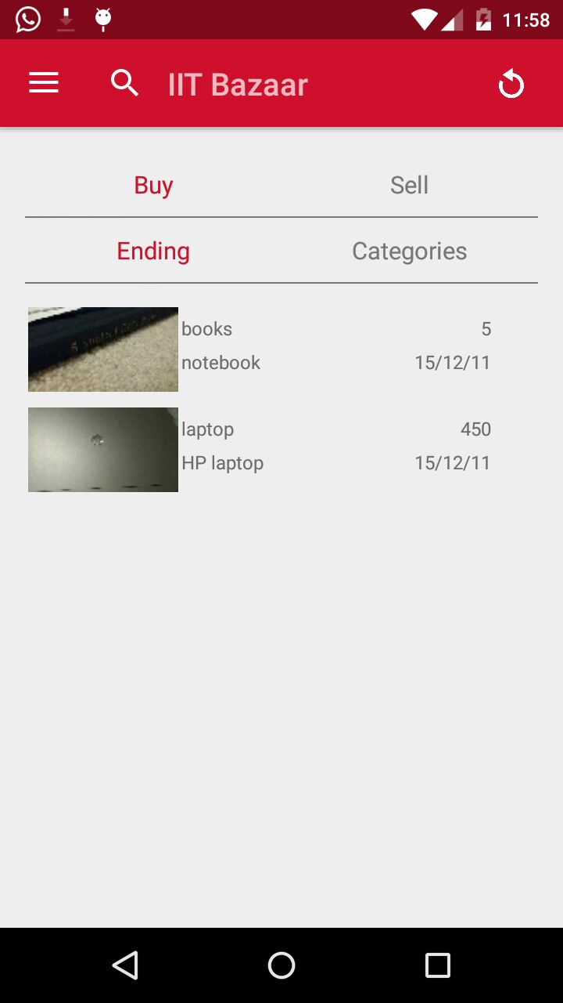
Buy
This is the home screen of the app.
It contains the list of items which are available for buying.
Click on any item and go through the description to know more about the app.

Slide 17
Buy
To buy the item, click on the buy button.
It prompts the options as shown in the figure.
The item can be purchased in two ways.
First, by emailing the seller about reserving the item for buying and paying personally.
Second is to use PayPal and do the payment online.

Slide 18
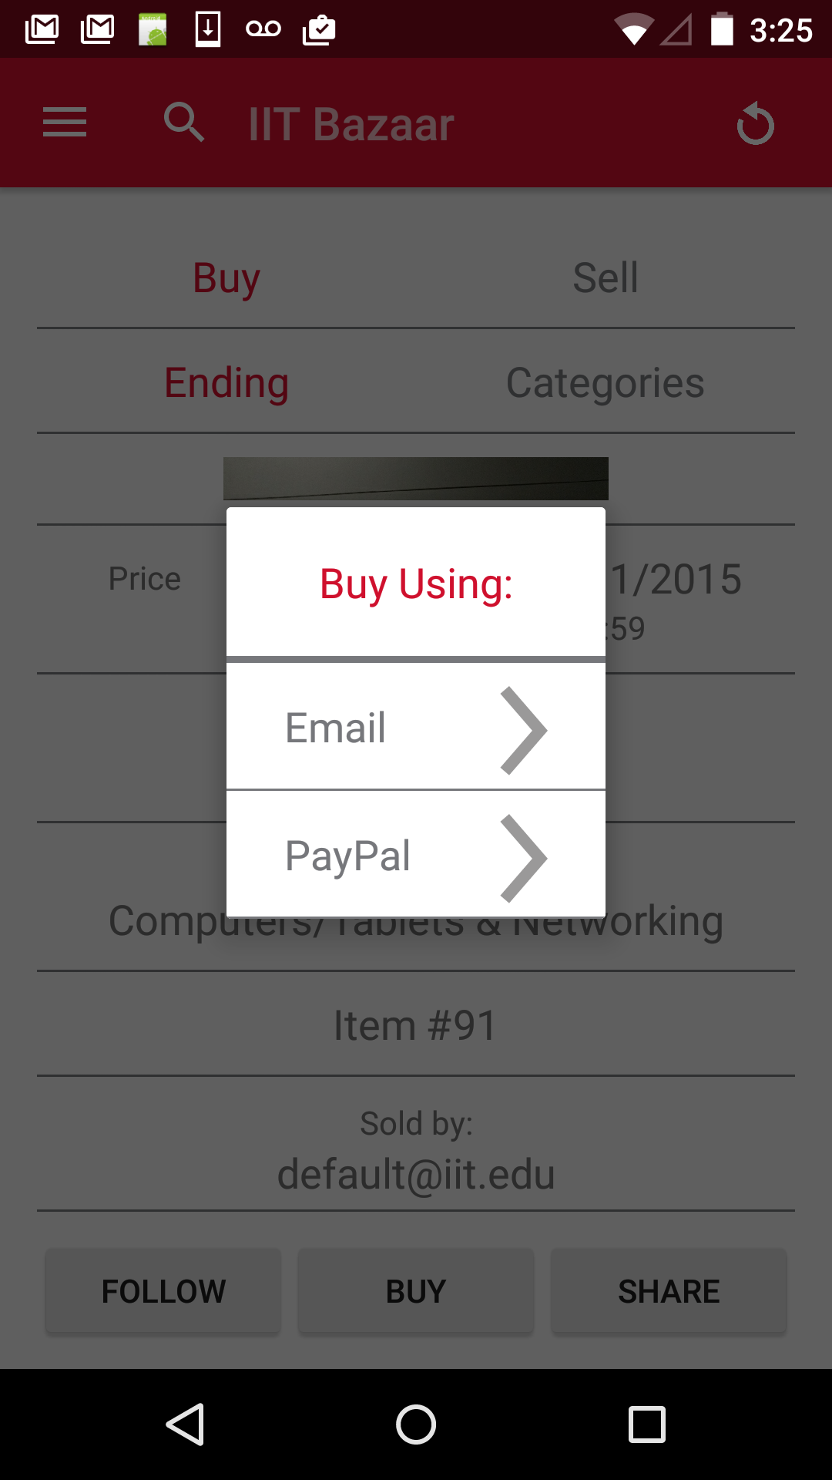
Buy
To buy the item, click on the buy button.
It prompts the options as shown in the figure.
The item can be purchased in two ways.
First, by emailing the seller about reserving the item for buying and paying personally.
Second is to use PayPal and do the payment online.

Slide 19
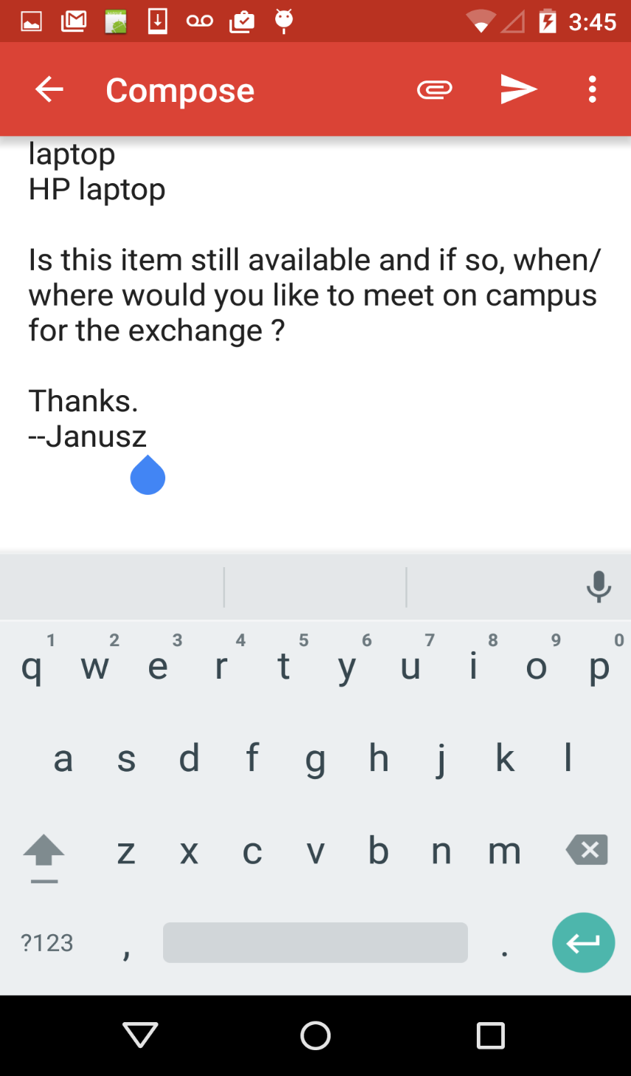
Buy
Payment via email
Email composed to reserve the item is as shown here.

Slide 20
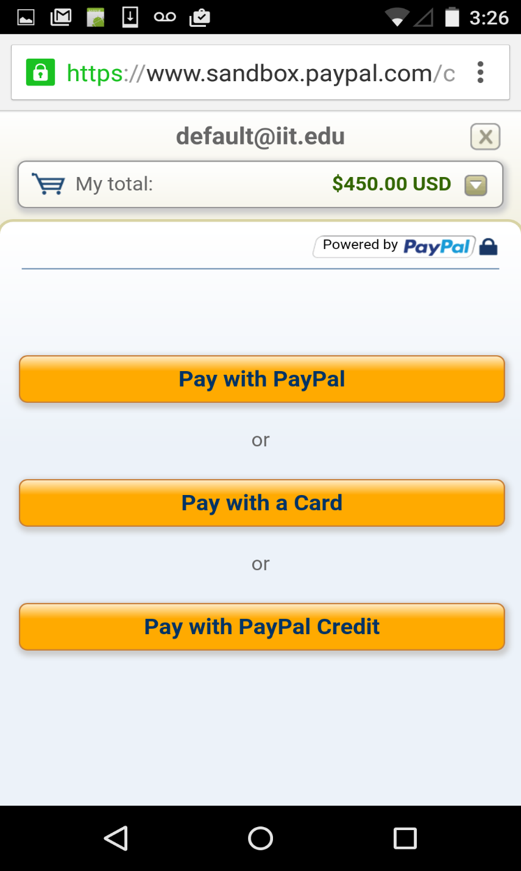
Buy
Payment using PayPal
The options to pay using PayPal are as shown here.
Click on any method that best suits you.

Slide 21
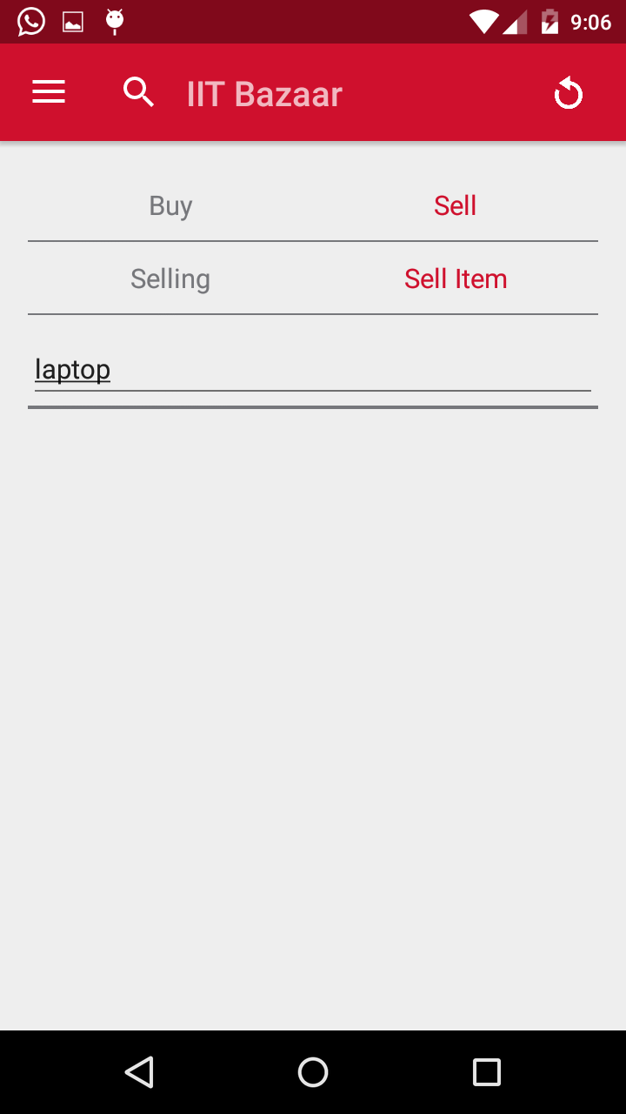
Sell
Click on the Sell button.
Then enter the title of the item being out up for sale and press enter key.
It redirects to the item description screen shown in next slide.

Slide 22
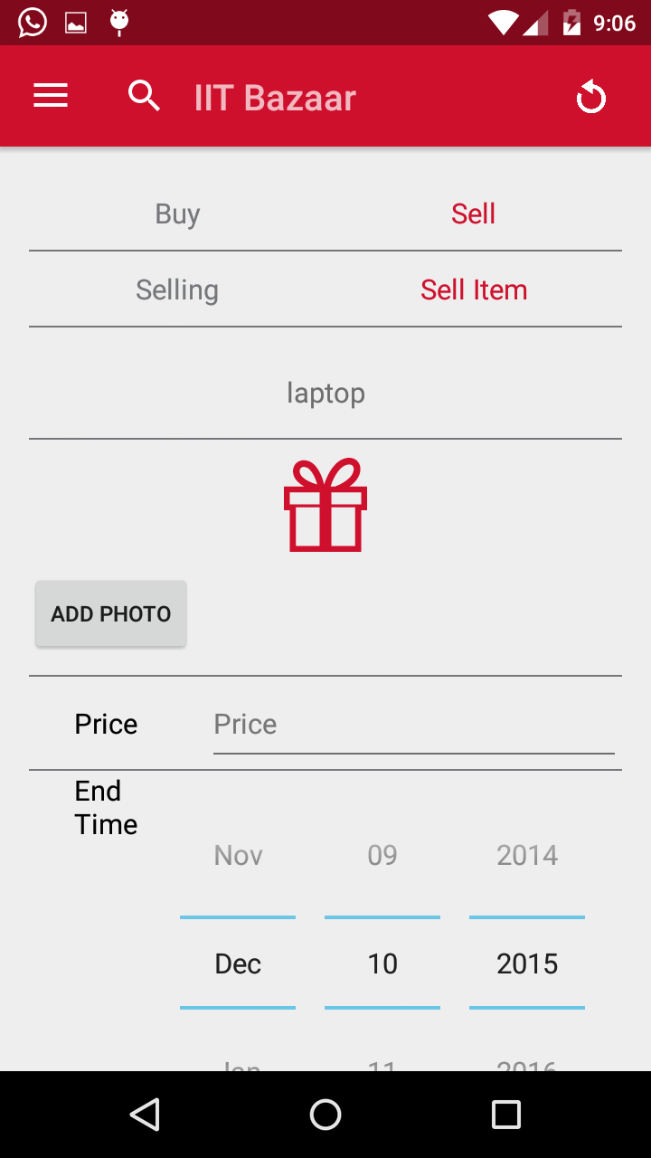
Sell
This screen allows the user to add the details of the items on sale like image, price, ending date, description etc.

Slide 23
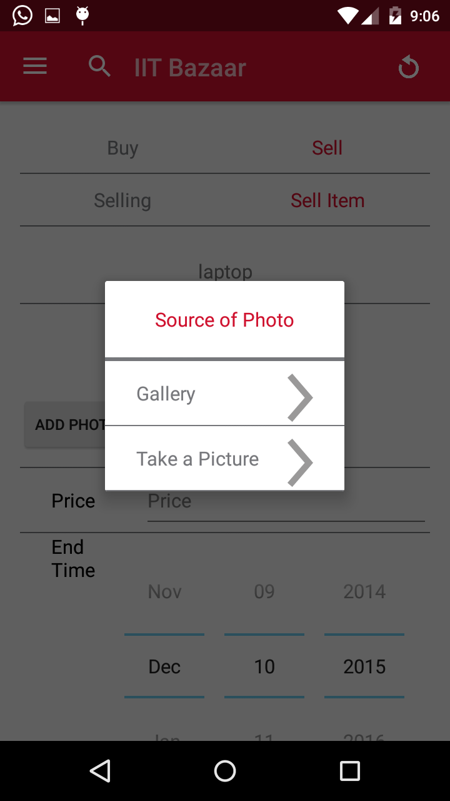
Sell
To add the image of the item being sold, two options are provided.
First option is to browse through an existing image from the gallery.
Second option is to take a picture using the camera.
Choose the appropriate option.

Slide 24
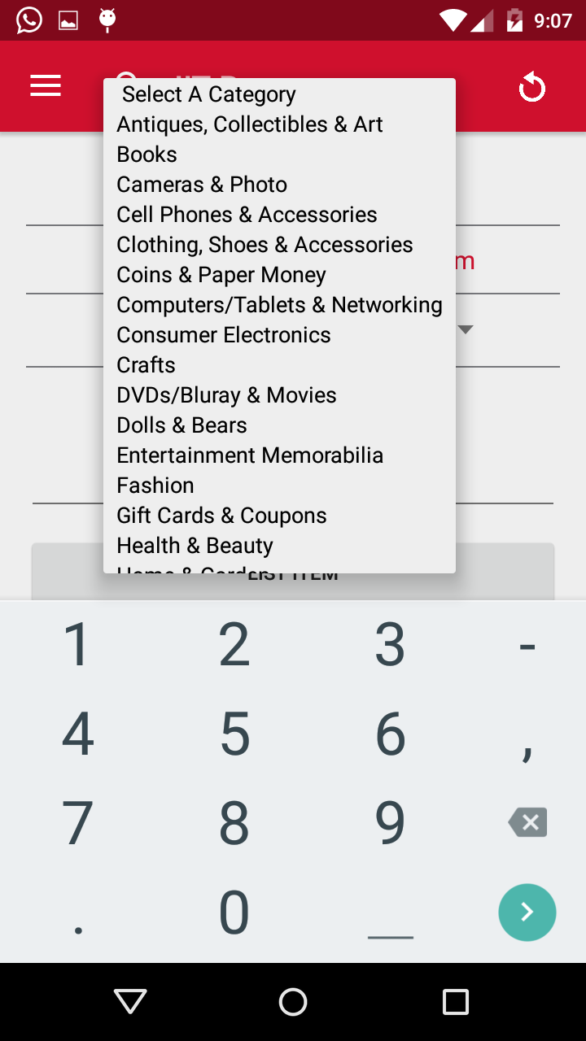
Sell
Enter the value of price and ending date for the item.
Then select the category from the list shown in the image.

Slide 25
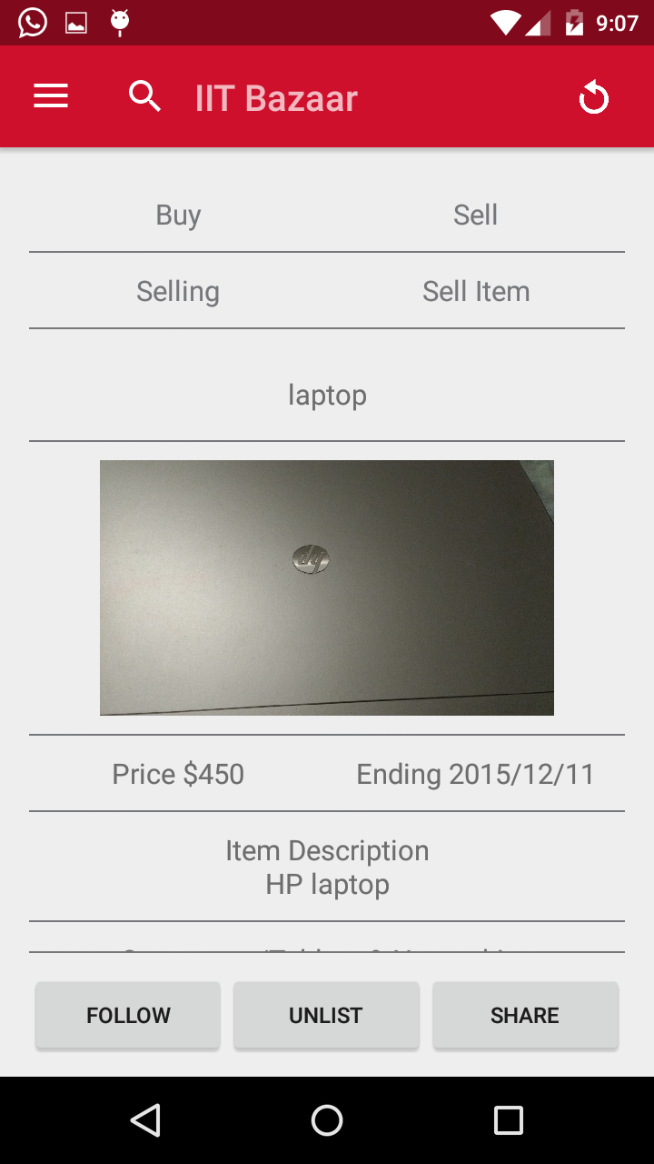
Item Description
After entering all the details of the item, click on LIST button.
It then shows the summary of the item being sold as shown in the image.
This can be followed, unlisted or shared.
Sharing an item will email the entire description with pictures attached including qr code.

Slide 26
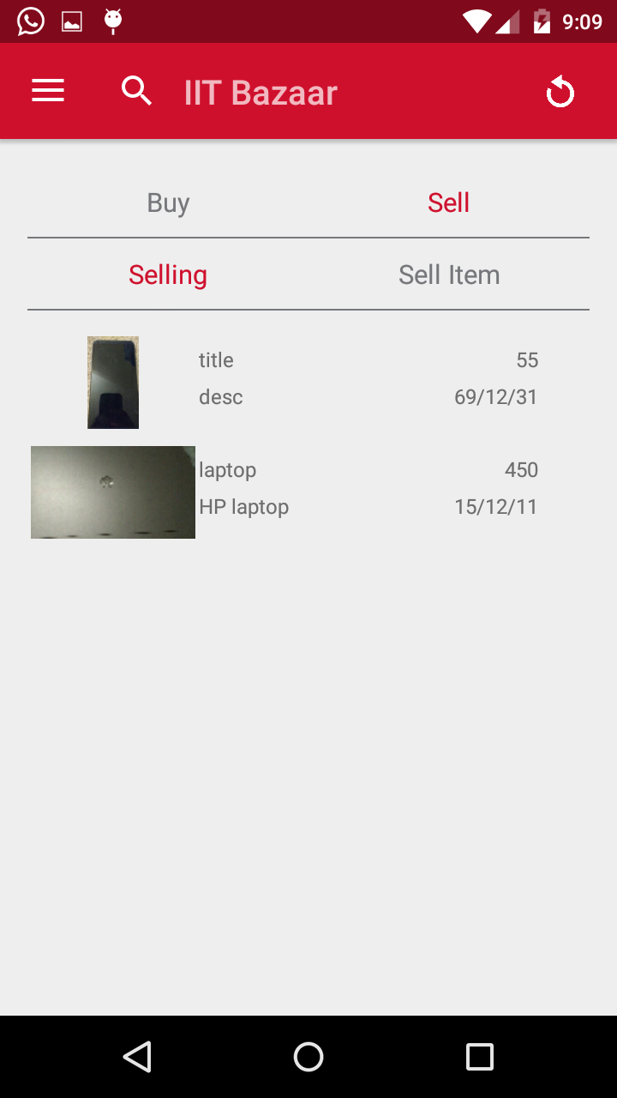
Sell Items List
Click on the Selling button.
This displays the list of items the user is selling.
On clicking the item, a detailed view with the details of the item is obtained.

Slide 27
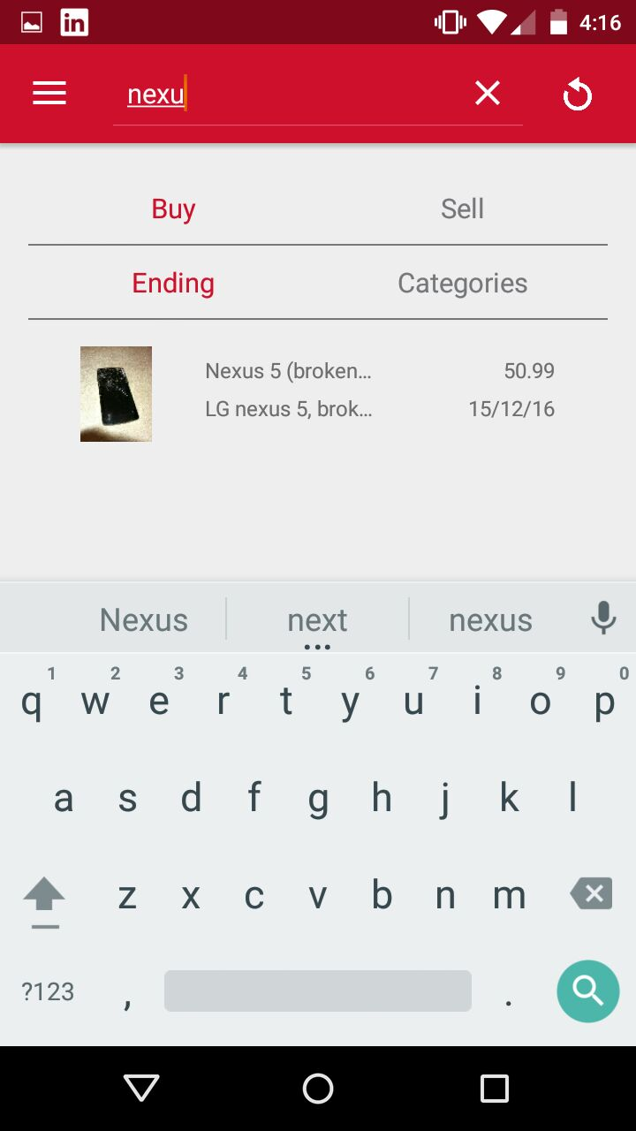
Search
Search is available on the buy list
Click on the search box or the search icon.
Enter the title or description of the item in the search box and it returns the matching item

Slide 28
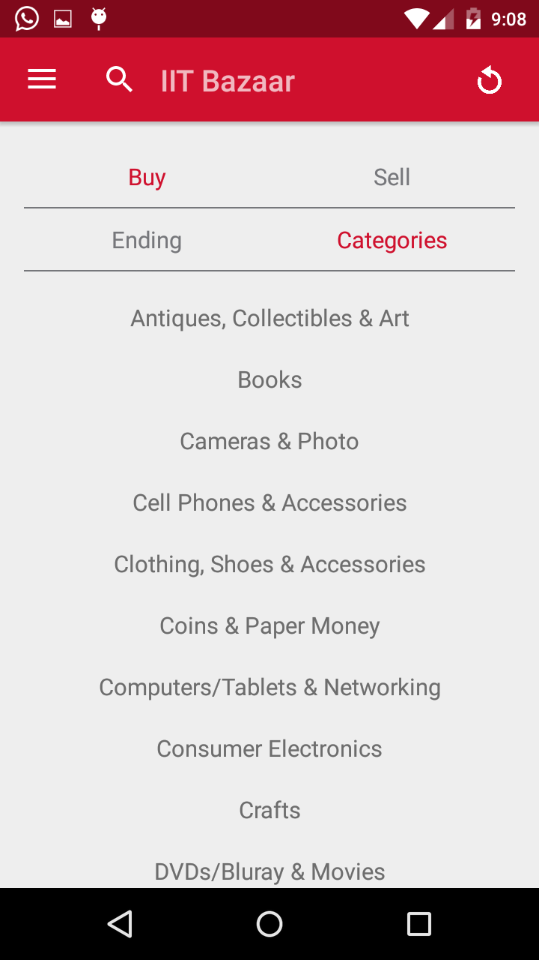
Categories
Click on the categories button.
It lists the categories of the various items on sale.
Click on any category and the list of items in that category will be obtained.

Slide 29
THANK YOU

