Slide 1
Analysís on Chinook Database
MySQL Project’s Report
Coordinator: Mr. Ho Nhut Minh
Reporter:
Nguyen Truong Vu – 1430727
Nguyen Quoc Bao – 1439125
So, let’s play role of Data analyst with us !

Slide 2
Table of contents
01
02
Overview the Data
Selecting albums to purchase
03
04
Sales by country
Employee sales performance
05
Album vs Individual track

Slide 3
01
Overview the data

Slide 4
02
Selecting album to purchase

Slide 5
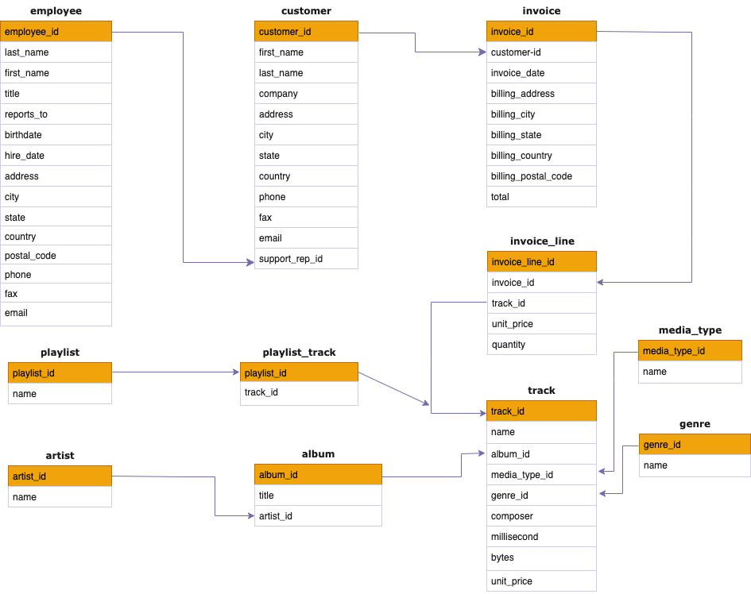
01. Overview

Slide 6
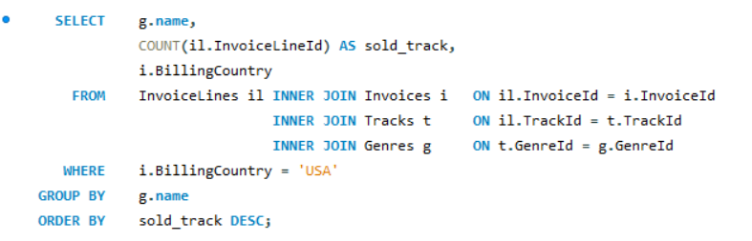
2.1. The most popular genre in the USA

Slide 7
02. Best Sell of Genres in the USA

Slide 8
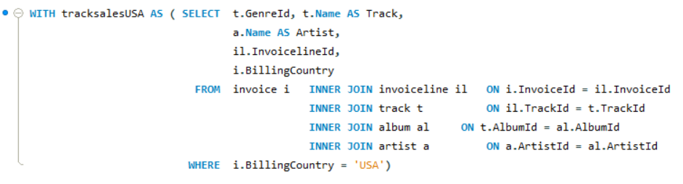
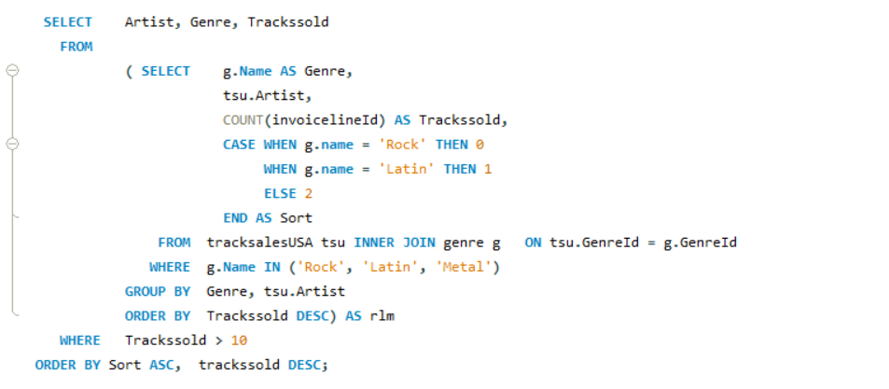
2.2. recommendation for three artists

Slide 9
02.01. Best Sell of Genres by Artist in the USA

Slide 10
03
Employee sales performance

Slide 11
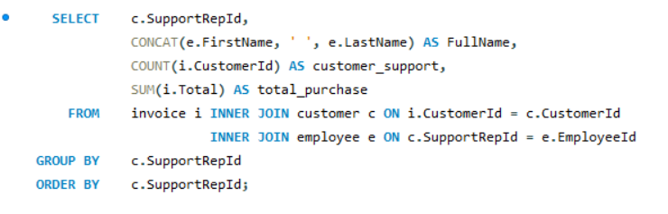
3. The Employee performance

Slide 12
The Employee Performance
03

Slide 13
04
Sales by country

Slide 14
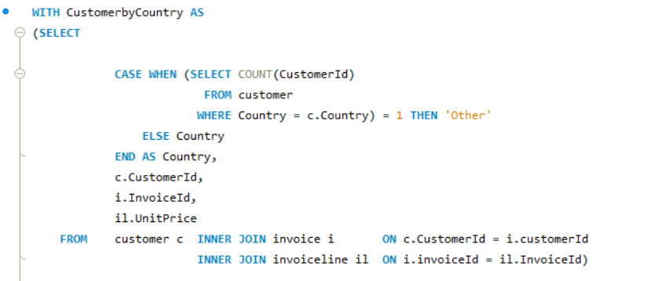
4. Sales by Country

Slide 15
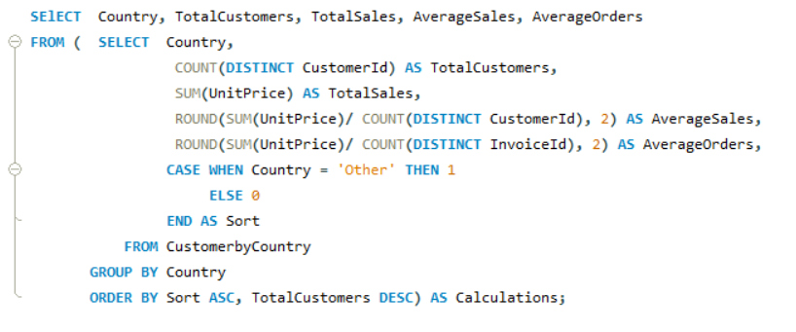
4. Sales by Country

Slide 16
Sales by country
04

Slide 17
05
Album or Individual

Slide 18
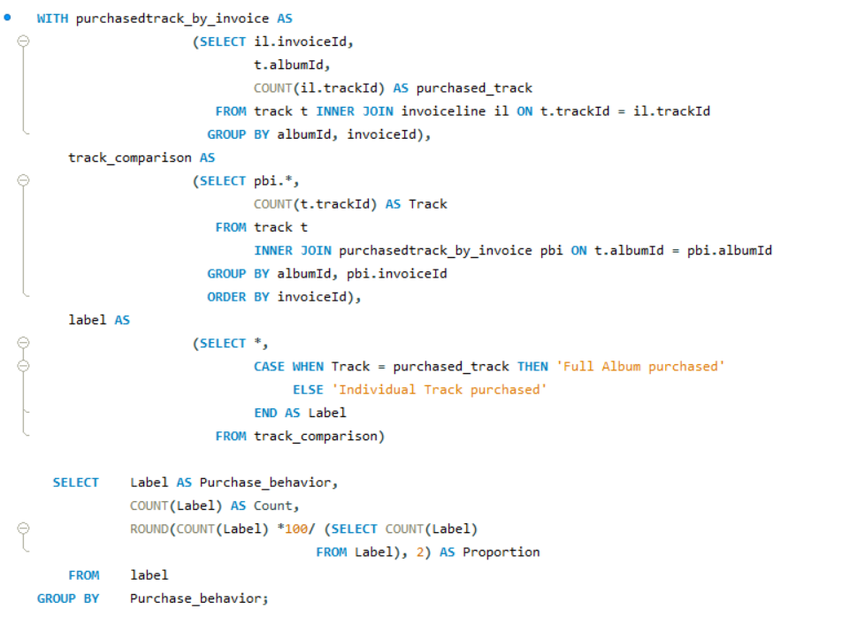

5. Album or Individual

Slide 19
5. Album or Individual

Slide 20
06
Factors affecting Sales

Slide 21
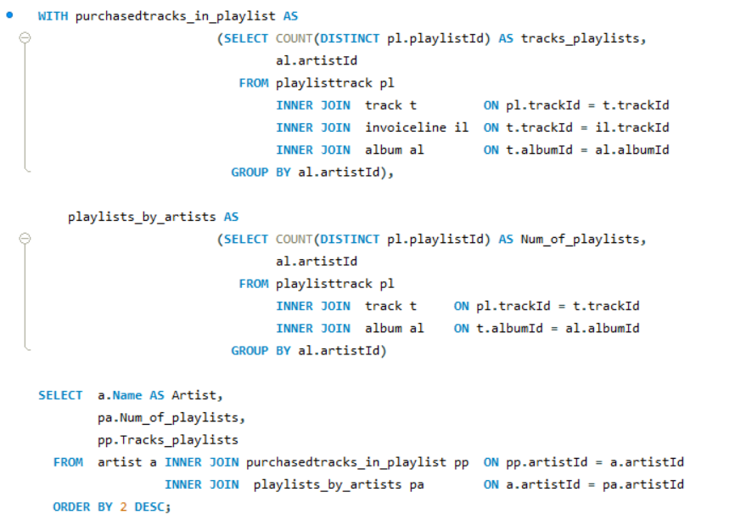
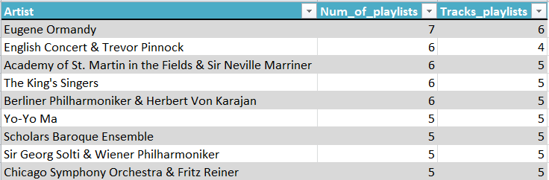
6.1 Which artist is used in the most playlists?

Slide 22
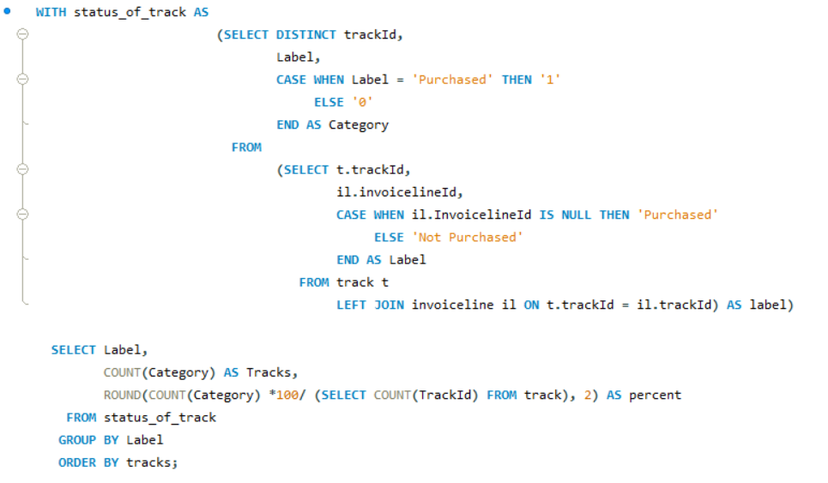

6.2 How many tracks have been purchased vs not purchased?

Slide 23
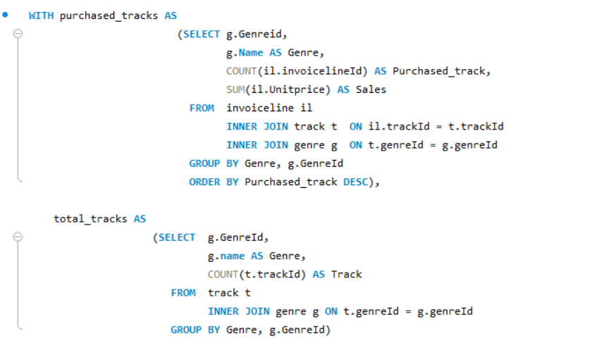
6.3. Is the range of tracks in the store reflective of their sales popularity?

Slide 24
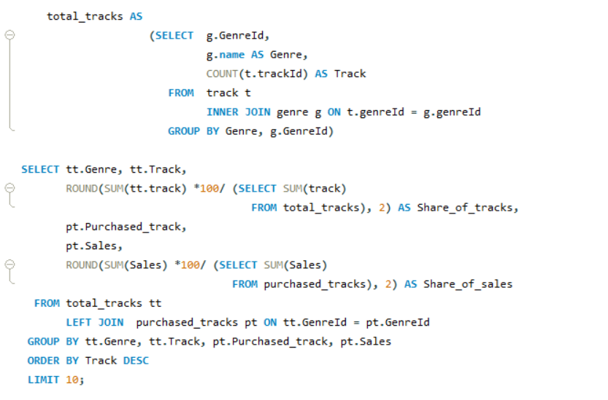
6.3. Is the range of tracks in the store reflective of their sales popularity?

Slide 25
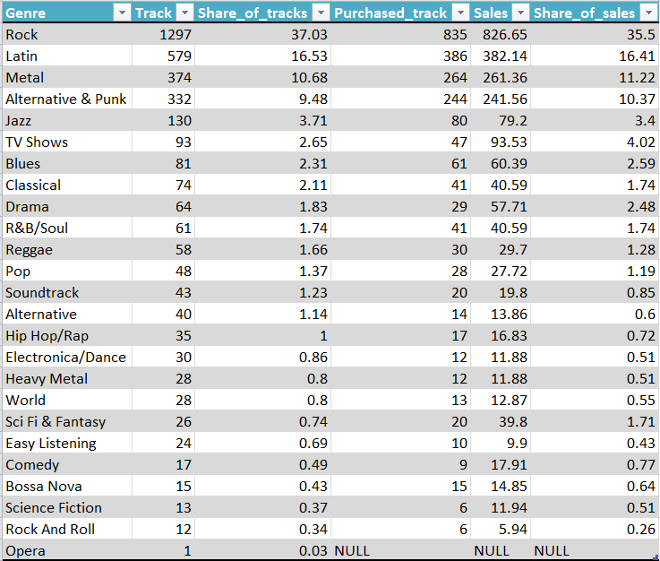
6.3. Is the range of tracks in the store reflective of their sales popularity?

Slide 26
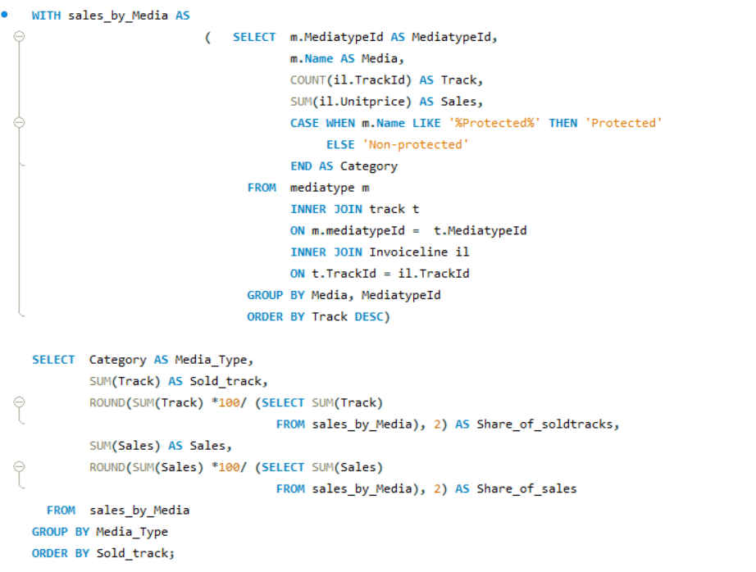

6.4. Do protected vs non-protected media types have an effect on popularity?

Slide 27
RECOMMENDATION
The USA has the highest sales
Focus on selling tracks of Rock, Latin, and Mental genre as those are the most popular genres.
there are some artists whose tracks are also preferred the most by the American. Thus, it is reasonable to store those tracks from those artists.
The store should obtain more data from employees and some context of sale in order to have deeper analysises of employee performance.

Slide 28
RECOMMENDATION
There are some reveal about the preference of customers for buying tracks
First, The store to stock individual tracks which have the highest sales, but not whole album.
Second, the store should cut down purchases for non-purchased tracks seems to be reasonable in order to make an optimal use of store’s expenditure.
Finally, almost customers prefer buying tracks of non-protected media rather than the protected one and it has potential impacts on the sales of the store.

