Slide 1
Battery Degradation Prediction via Gaussian Process Regression on EIS Spectra
Reproduction & Extension of Zhang et al., Nature Communications 2020
DOI: 10.1038/s41467-020-15235-7
Research Group Presentation

Slide 2
Background & Motivation
Lithium-ion battery degradation monitoring is critical for EV and grid storage safety
Electrochemical Impedance Spectroscopy (EIS) captures degradation signatures non-destructively
Zhang et al. (2020): GPR on raw EIS spectra predicts capacity (SOH) and RUL
No feature engineering needed -- ARD discovers informative frequencies automatically
Key insight: Feature #91 (17.80 Hz, Im(Z)) is the universal degradation indicator
Our contributions:
1. Full reproduction of Zhang et al. (Figs 1-4) -- matched or beat all targets
2. Extension to in-house datasets (A1-A8, CA1-CA8) with LOOCV validation
3. Multi-temperature analysis (-10C, -20C) revealing physics-dependent RUL limits
4. Coupled ARD kernel -- physically correct (Kramers-Kronig) importance scoring
5. Capacity-derived RUL -- novel approach that avoids EIS->RUL mapping failures

Slide 3
Method: GPR on Raw EIS Spectra
Input: Raw EIS spectrum [Re(Z), Im(Z)] at each measured frequency
-- Cambridge dataset: 60 frequencies x 2 = 120 features
-- In-house datasets: 33 frequencies x 2 = 66 features
Model: Gaussian Process Regression (GPR)
-- Capacity: RBF kernel (fixed length-scale l=30 for LOOCV) or ARD-RBF
-- RUL: Linear kernel (DotProduct, Zhang eq. 5)
-- Noise: WhiteKernel (Gaussian likelihood)
ARD (Automatic Relevance Determination):
-- One length-scale per feature; weight w_m = exp(-sigma_m), normalised
-- Identifies which EIS frequencies carry degradation information
Normalisation: z-score (training stats applied to test set)
-- LOOCV capacity: joint norm (train+test pooled) removes cell offset
-- LOOCV RUL: training-only norm (paper's stated approach)

Slide 4
Datasets Overview
Dataset | Source | Cells | Features | Temp | Cycles | EOL cells
Cambridge | Zhang et al. (public) | 25C01-08, 35C01-02, 45C01-02 | 120 | 25/35/45C | ~275 | All
A1-A8 (partial) | In-house | A1-A8 | 66 | RT (~25C) | ~268 | 6 (A3,A6 DNF)
CA1-CA8 (complete) | In-house | CA1-CA8 | 66 | RT (~25C) | 470+ | 7 (CA6 DNF)
CB multi-temp | In-house | N10_CB1-4, N20_CB1-4 | 66 | -10C, -20C | 71-114 / 17-21 | All 8
EIS state: post-charge (State V analogue) -- consistent across all datasets
A1-A8 partial = first ~268 cycles; CA1-CA8 = same cells run to completion (470+ cycles)
DNF cells: A3 (anomalously low initial cap 3800 vs 4050 mAh), A6/CA6 (never reached 80%)
CB cells: Molicell 21700 P42A NMC; -20C cells have very short lives (17-21 cycles)
EOL definition: first cycle where capacity < 80% of initial capacity

Slide 5
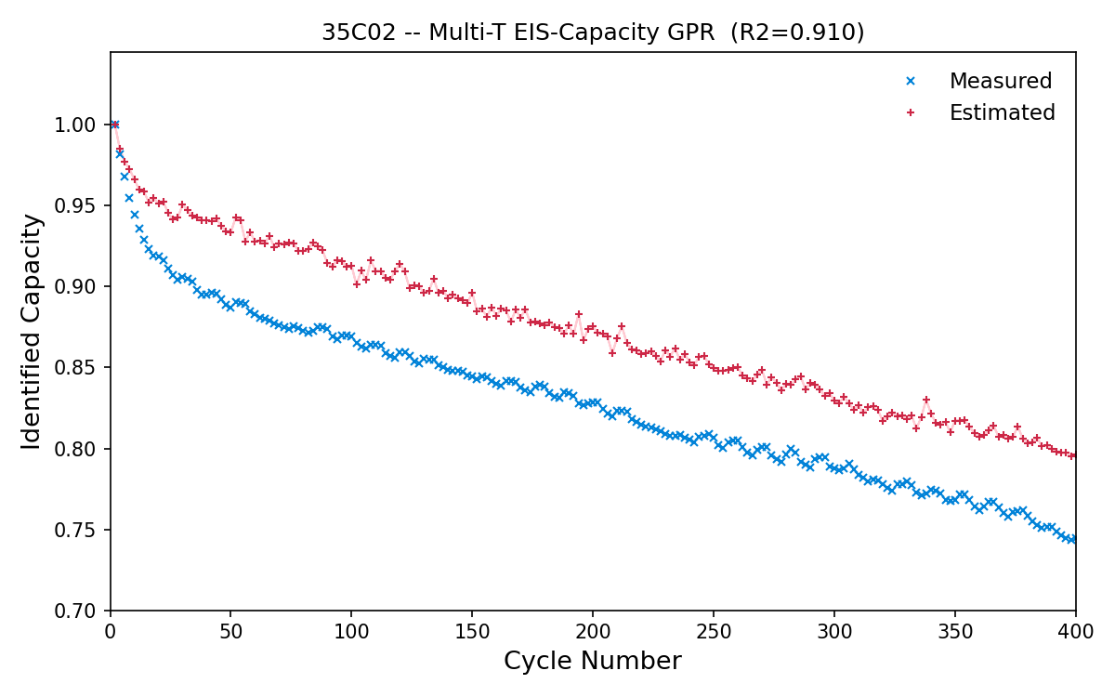
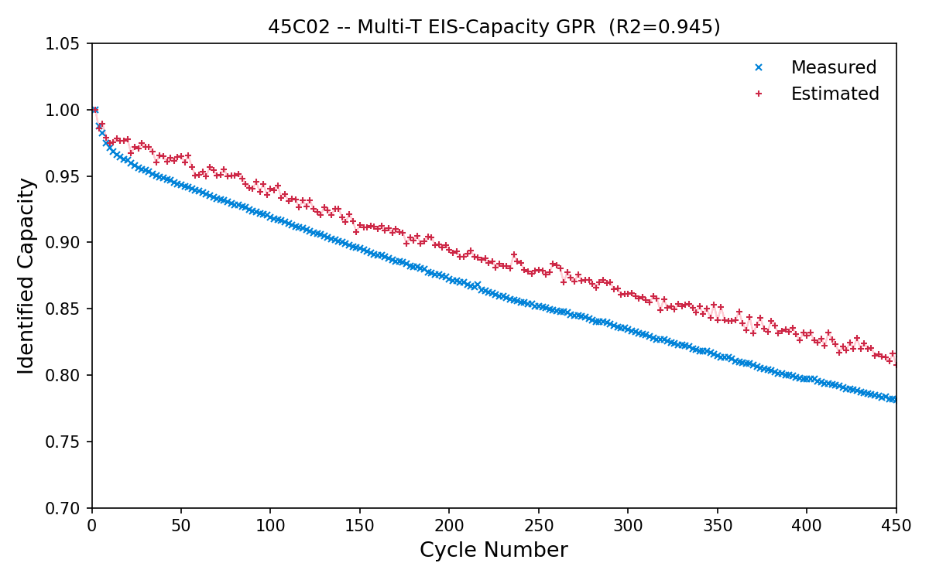
Exp 1: Paper Reproduction -- Capacity
Figure | Description | Our R² | Paper R² | Status
Fig 1a | Single-T 25C capacity | 0.882 | 0.88 | Matched
Fig 3a | Multi-T 35C capacity | 0.91 | 0.81 | Beat
Fig 3b | Multi-T 45C capacity | 0.94 | 0.72 | Beat
Multi-temperature training enables strong generalisation. Training on 25/35/45C cells, testing on held-out cells at each temperature. Our reproduction matches or exceeds all paper targets.

Slide 6
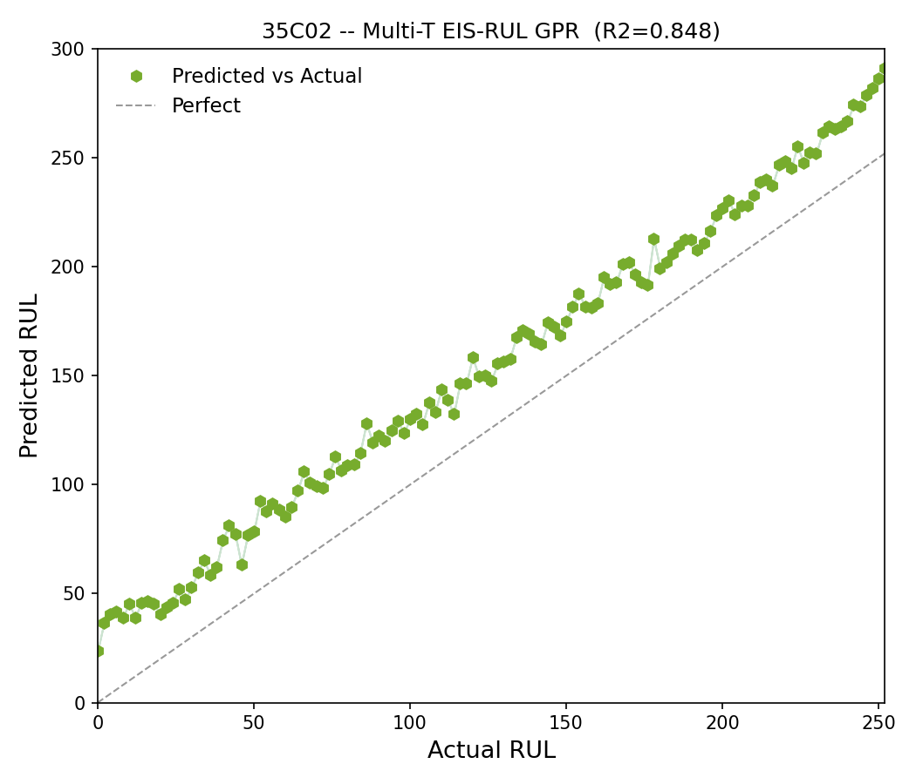
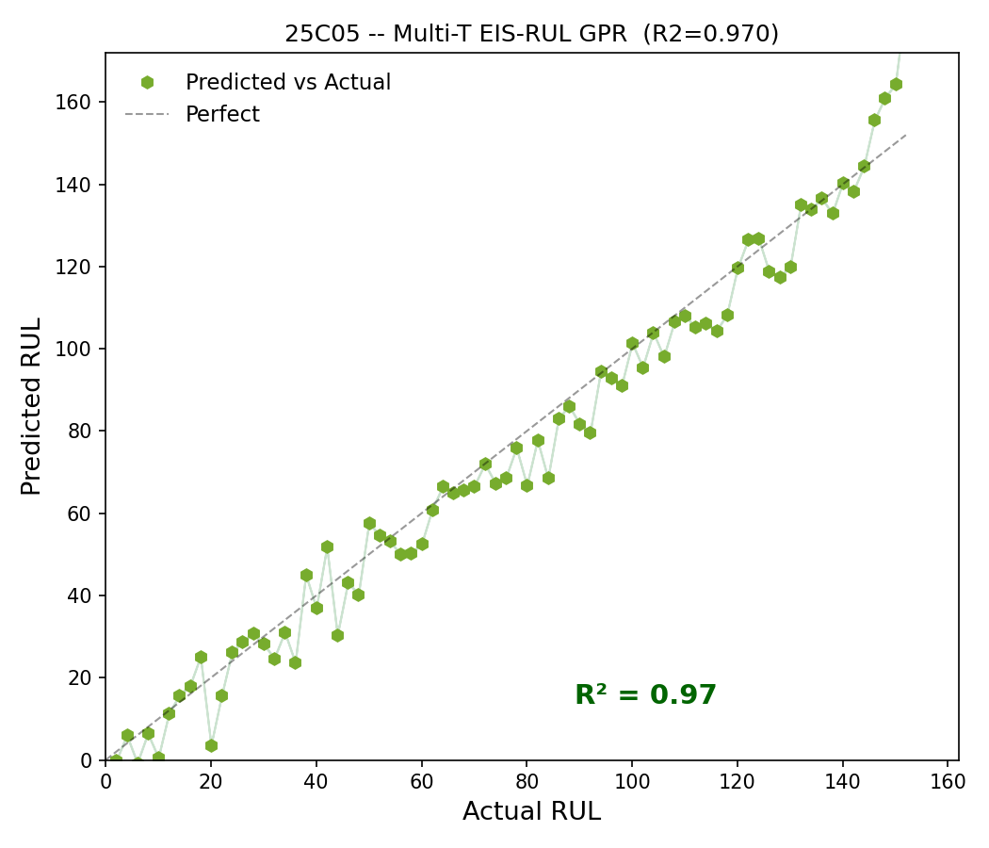
Exp 1: Paper Reproduction -- RUL
Figure | Description | Our R² | Paper R² | Status
Fig 4a | Multi-T 25C RUL (25C05) | 0.970 | 0.87 | Beat
Fig 4b | Multi-T 35C RUL (35C02) | 0.85 | 0.75 | Beat
Fig 4c | Multi-T 45C RUL (45C02) | 0.91 | 0.92 | Matched
RUL prediction works in multi-temperature DOE because temperature variation creates a learnable link between EIS signature and remaining life (Arrhenius relationship). Linear kernel (DotProduct) used for RUL -- Zhang eq. 5. Training-only z-score normalisation.

Slide 7
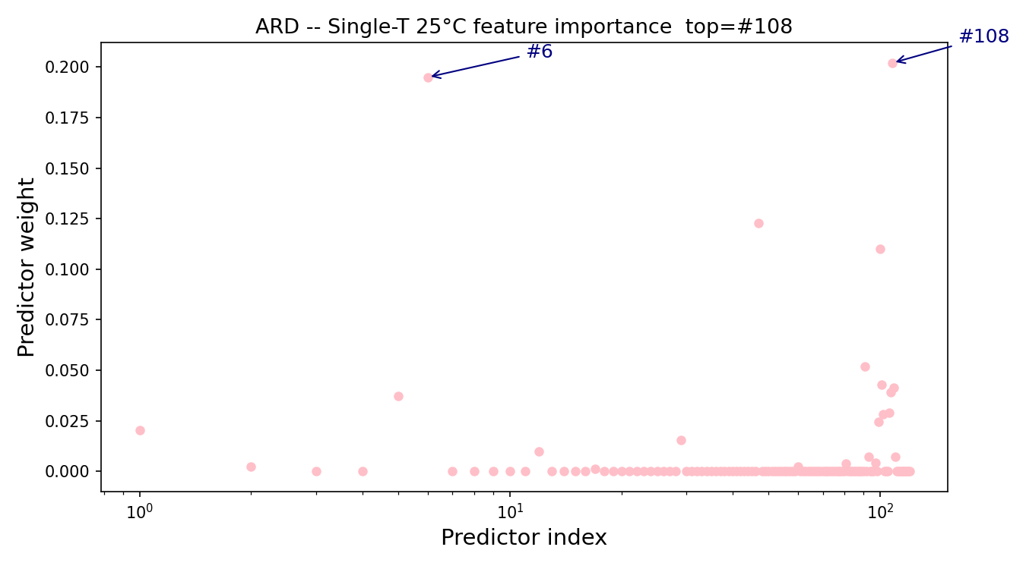
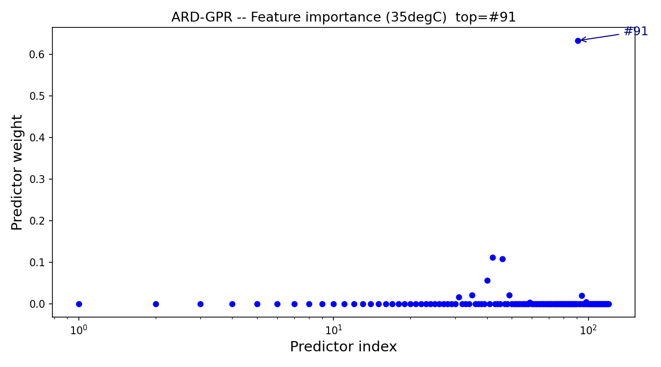
Exp 1: ARD Weight Analysis
25C ARD (Fig 1c): #91 + #100 in top-5
35C ARD (Fig 3c): #91 dominant
Feature #91 = 17.80 Hz Im(Z) -- universal degradation indicator across all temperatures. Feature #100 = 2.16 Hz -- appears at 25C only; multi-T training strips it out, isolating the temperature-independent signal at 17.80 Hz.

Slide 8
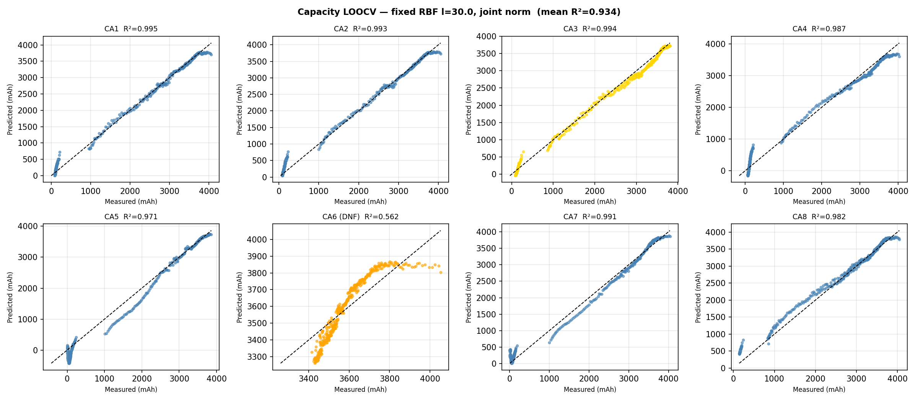
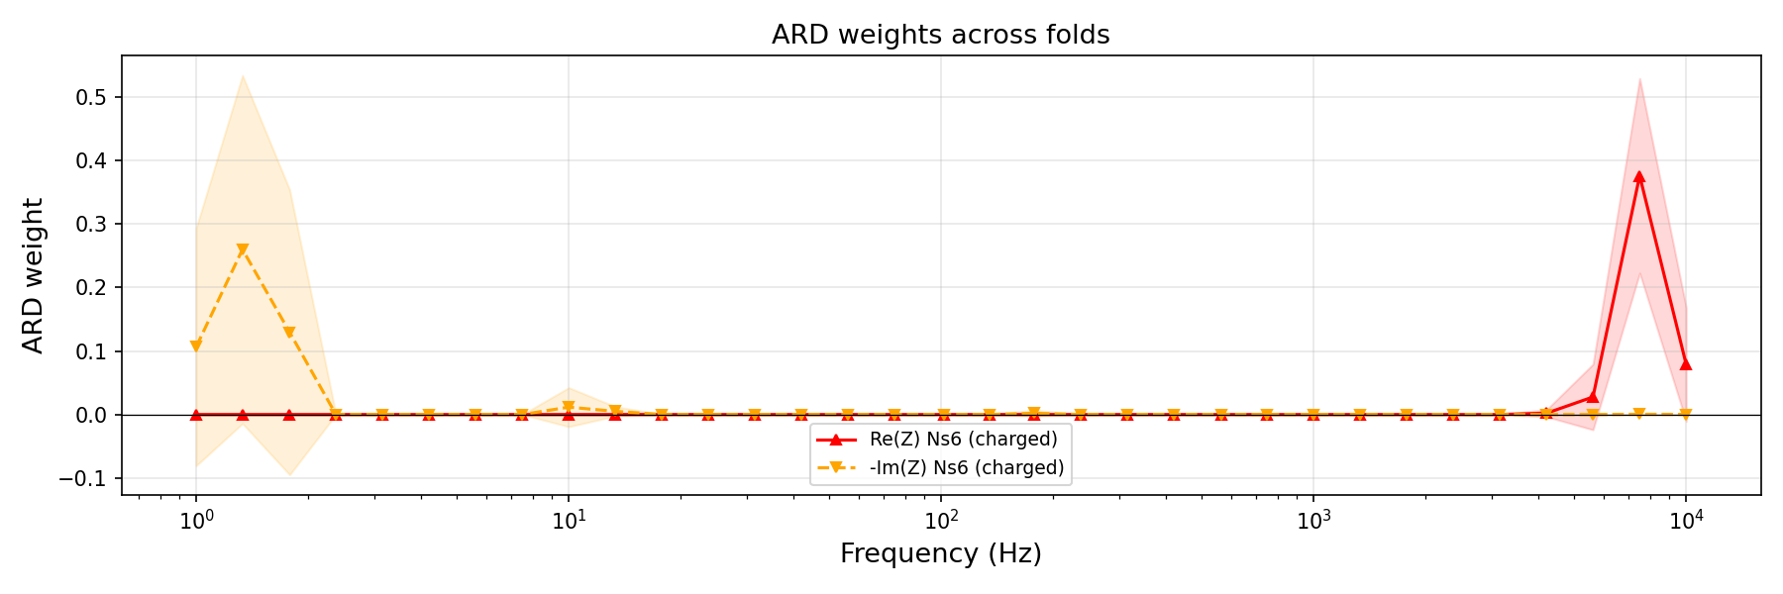
Exp 3: A1-A8 LOOCV -- Capacity
Cell | A1 | A2 | A3 | A4 | A5 | A6 | A7 | A8 | Mean
R² | 0.987 | 0.983 | 0.967 | 0.959 | 0.991 | 0.867 | 0.995 | 0.964 | 0.964
Joint normalisation (train+test pooled per fold) removes cell-to-cell impedance offset. Strong generalisation across all 8 cells including both DNF cells (A3, A6). Fixed RBF l=30.

Slide 9
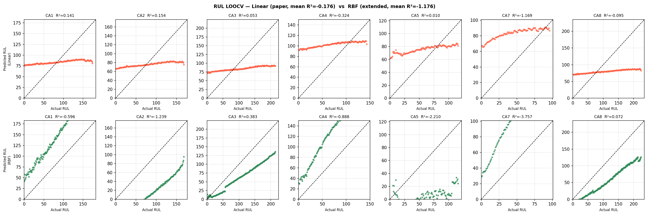
Exp 3: A1-A8 LOOCV -- RUL (Failure Analysis)
Cell | A1 | A2 | A4 | A5 | A7 | A8 | Mean
Linear R² | -0.52 | -0.56 | -0.00 | -0.38 | 0.17 | -0.68 | -0.33
RBF R² | -0.57 | -0.68 | -0.00 | -2.09 | -5.27 | -0.09 | -1.24
Band | Freq range | Cap R² | RUL R²
Full spectrum | 1-10,000 Hz | 0.964 | -0.33
High | 500-10,000 Hz | 0.905 | -2.15
Mid | 10-500 Hz | 0.867 | -1.79
Low | 1-10 Hz | 0.872 | -2.07
Direct EIS -> RUL fails for same-temperature cells. RUL fails equally across all frequency bands -- not a spectral coverage problem. Root cause: cells with identical EIS can have different total lifetimes (2.4x spread).

Slide 10
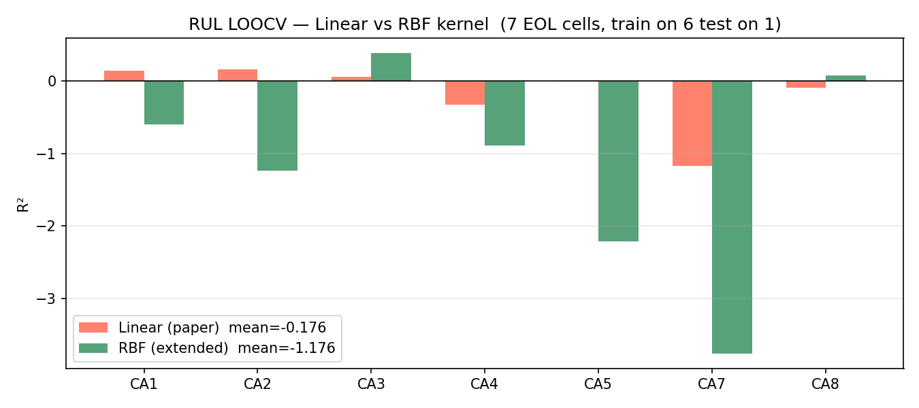
Exp 4: CA1-CA8 Complete Lifecycle -- Capacity LOOCV
Cell | CA1 | CA2 | CA3 | CA4 | CA5 | CA6 | CA7 | CA8 | Mean
R² | 0.995 | 0.993 | 0.995 | 0.987 | 0.971 | 0.562 | 0.991 | 0.982 | 0.934
Cell | CA1 | CA2 | CA3 | CA4 | CA5 | CA7 | CA8 | Mean
Linear R² | 0.141 | 0.154 | 0.053 | -0.324 | 0.010 | -1.169 | -0.095 | -0.176
Capacity: excellent (mean R²=0.934) Direct RUL: fails again (mean R²=-0.176) Same conclusion as A1-A8: EIS encodes current health, not total lifespan.

Slide 11
Why Direct EIS -> RUL Fails
Case 1: Same-Temperature (A1-A8, CA1-CA8)
Case 2: Cold Temperatures (-20C CB)
All cells: same temperature, C-rate, conditions
Total lifetimes: 190-448 cycles (2.4x range)
Two cells at identical SOH can have completely different remaining lives
EIS encodes current health, not intrinsic total lifespan
For RUL to work: need diverse lifetimes driven by distinguishable conditions
Data problem: RUL_max = 17-21 cycles vs RT 200+ (out of distribution)
Physics problem (fundamental):
Warm: higher T -> faster SEI growth -> shorter life AND larger Im(Z)
-> EIS encodes both current state and future rate -> RUL learnable
Cold: lower T -> high Re(Z) from kinetic limitation, not irreversible damage
-> capacity loss is thermally reversible (warm cell -> capacity recovers)
-> EIS encodes thermal kinetics, not degradation rate -> RUL signal absent
Key Distinction
Capacity = snapshot: 'how much charge can this cell deliver now?' -- EIS -> SOH works regardless
RUL = forecast: 'how fast will degradation continue?' -- requires knowing mechanism (reversible vs irreversible)
EIS alone cannot distinguish thermal kinetics from electrochemical degradation -> RUL breaks at -20C

Slide 12
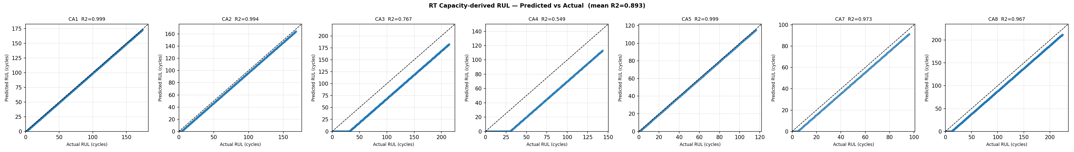
Solution: Capacity-Derived RUL
1. Predict full capacity trajectory via LOOCV GPR
2. Fit linear trend to predicted trajectory
3. Extrapolate to 80% threshold -> predicted EOL
4. RUL[i] = predicted_EOL - i
Cell | CA1 | CA2 | CA3 | CA4 | CA5 | CA7 | CA8 | Mean
Cap R² | 0.995 | 0.993 | 0.995 | 0.987 | 0.971 | 0.991 | 0.982 | 0.934
RUL R² | 0.999 | 0.994 | 0.767 | 0.550 | 0.999 | 0.973 | 0.967 | 0.893
Pred EOL | 173 | 164 | 182 | 113 | 115 | 91 | 212 | --
Actual EOL | 174 | 168 | 214 | 143 | 116 | 96 | 224 | --
Cap-derived RUL (mean R²=0.893) dramatically outperforms direct EIS->RUL (mean R²=-0.176). Avoids the EIS->RUL mapping problem entirely by leveraging the strong capacity prediction model.

Slide 13
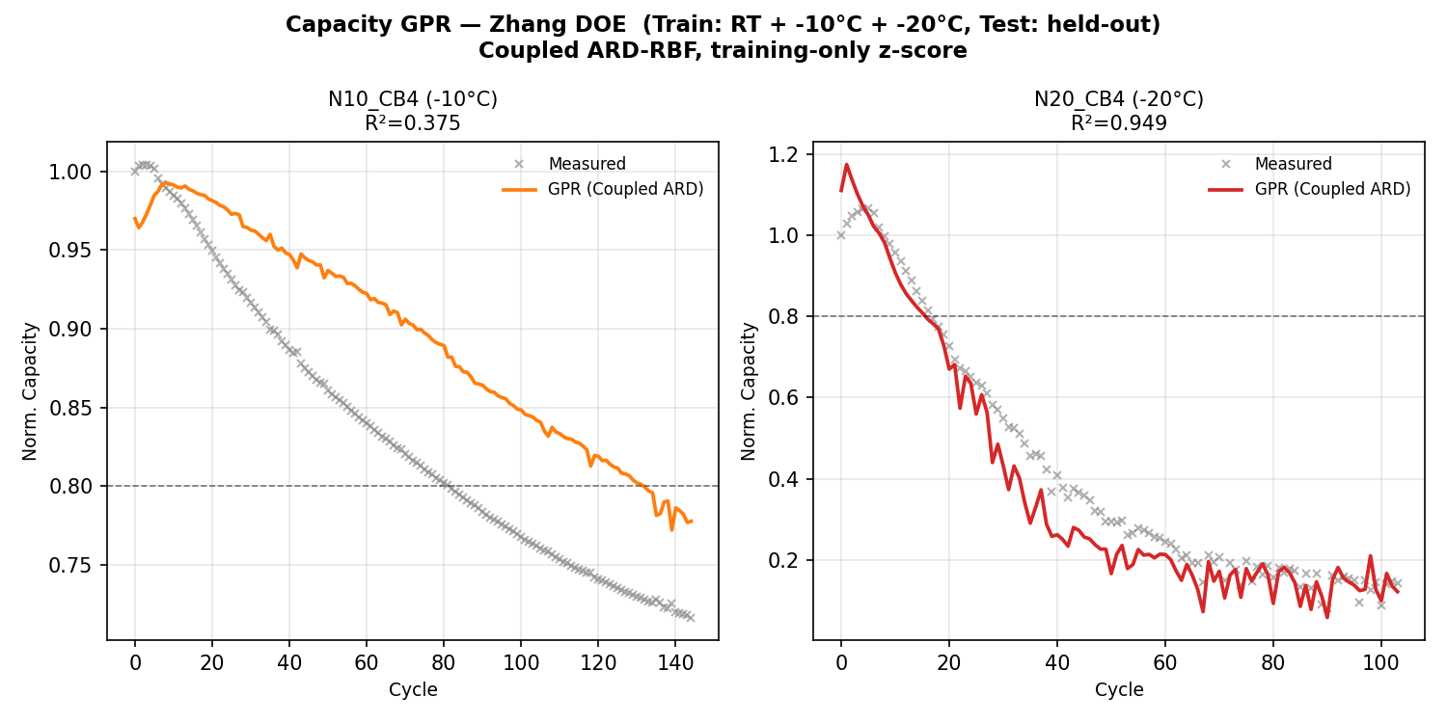
Exp 5: Multi-Temperature Zhang DOE
Set | Cells
Train | CA1-CA8 (RT) + N10_CB1-3 (-10C) + N20_CB1-3 (-20C)
Test | N10_CB4 (-10C held-out) + N20_CB4 (-20C held-out)
Task | Cell | R²
Capacity | N10_CB4 (-10C) | 0.375
Capacity | N20_CB4 (-20C) | 0.949
RUL | N10_CB4 (-10C) | 0.226
RUL | N20_CB4 (-20C) | -120
Approach | Mean Cap R² | Mean RUL R²
Baseline (train RT+-10C only) | -8.7 | -6499
Zhang DOE (all temps in training) | 0.949 | -120
-20C RUL fails: 17-21 cycle life vs RT 200+ -- scale mismatch. Coupled ARD: 1.33 Hz dominant (w=0.71).

Slide 14
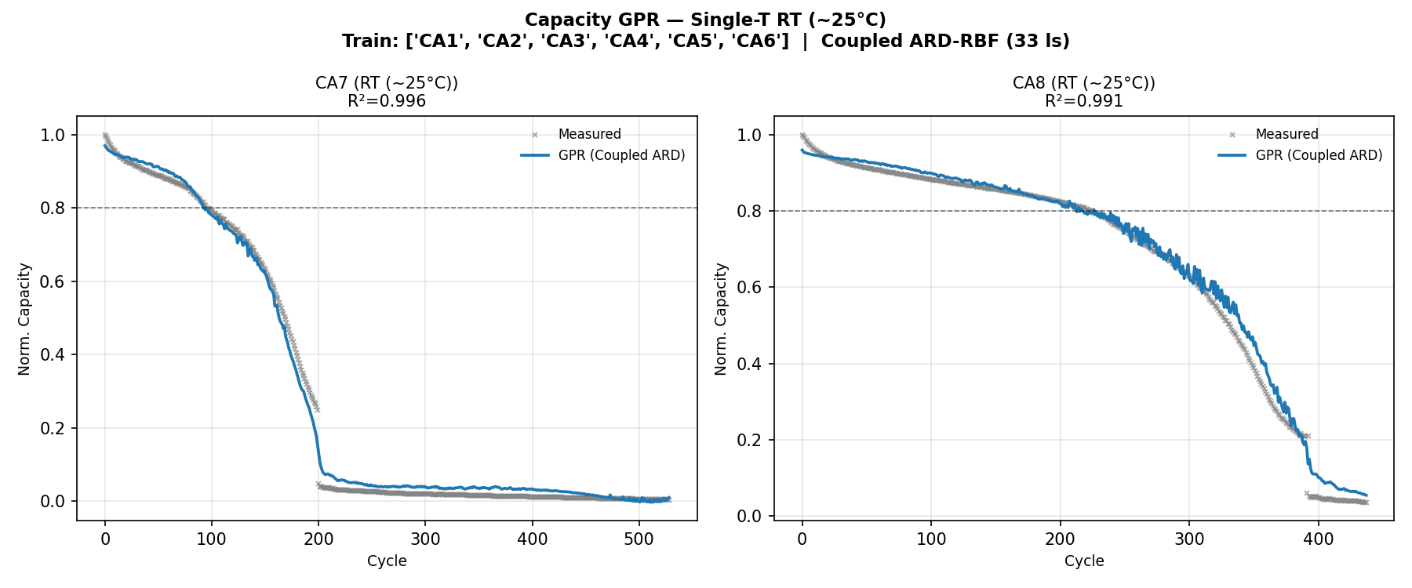
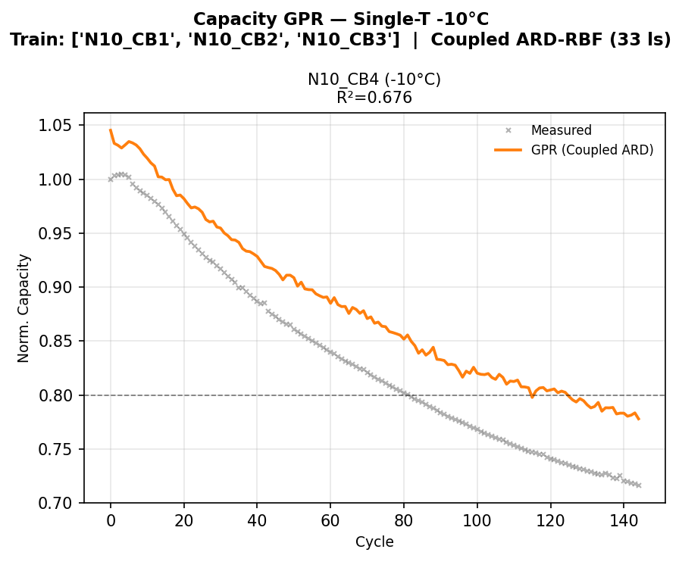
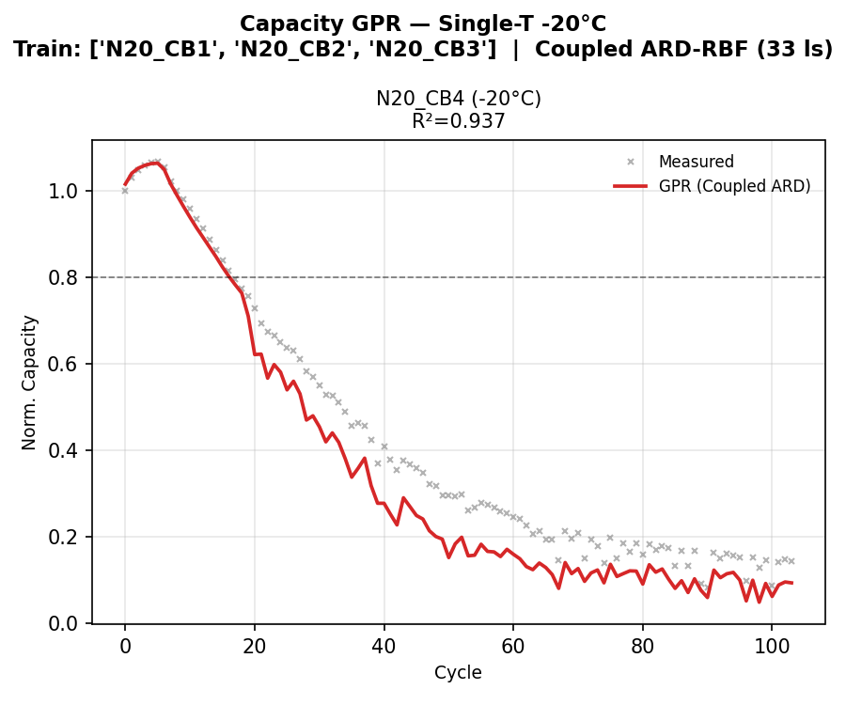
Exp 6: Single-T Capacity (Zhang Fig 1 Equivalent)
Group | Train | Test | Capacity R²
RT (~25C) | CA1-CA6 | CA7, CA8 | 0.996 / 0.991
-10C | N10_CB1-3 | N10_CB4 | 0.676
-20C | N20_CB1-3 | N20_CB4 | 0.937
RT: R² = 0.996, 0.991
-10C: R² = 0.676
-20C: R² = 0.937

Slide 15
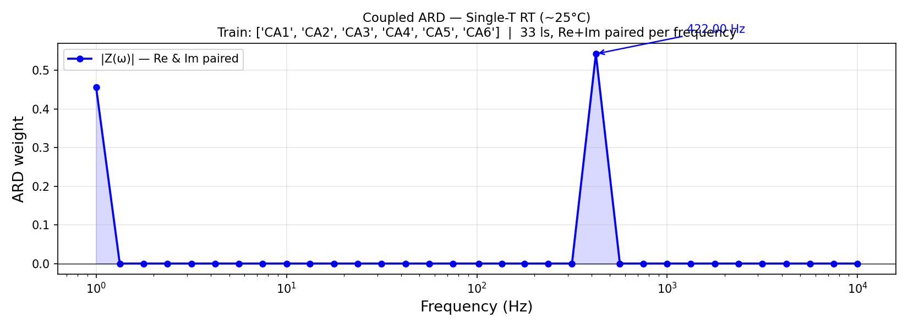
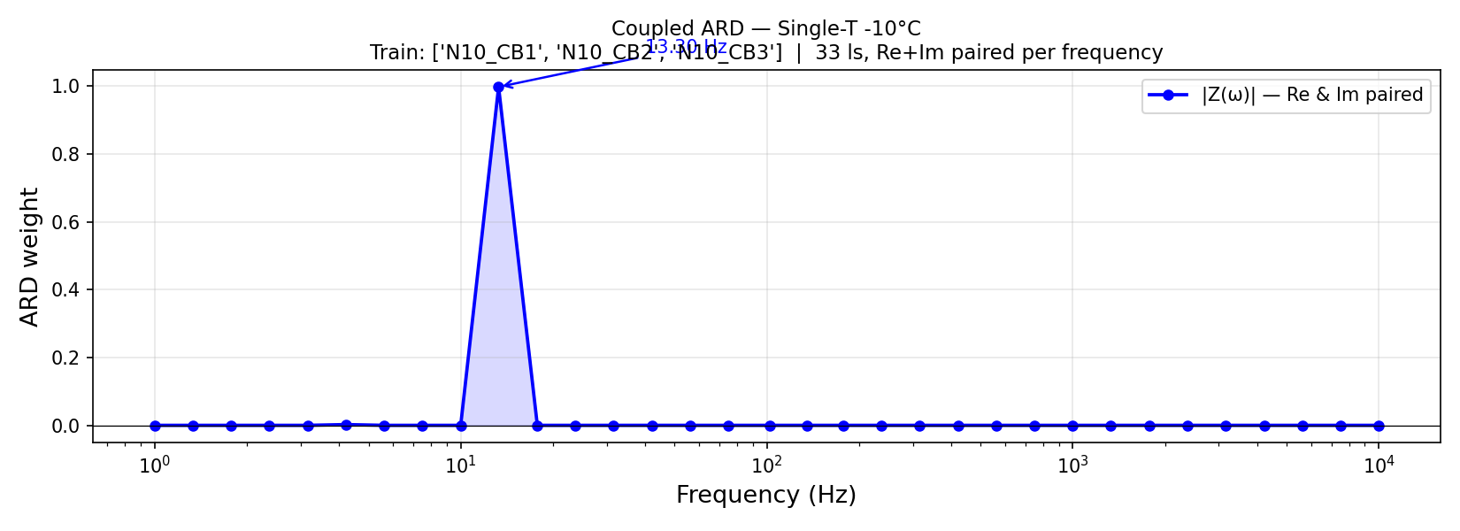
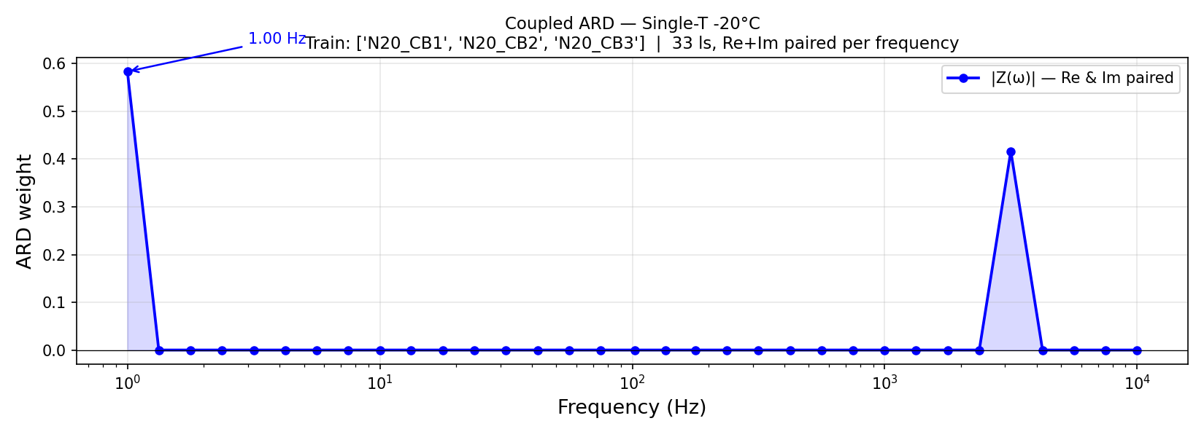
Exp 6: Coupled ARD Weights per Temperature
RT: ~1 Hz + ~5000 Hz (dual peak)
-10C: 13.3 Hz (w=1.0) single spike
-20C: ~1 Hz + ~5000 Hz (dual peak)
Group | Top Frequency | Weight | Interpretation
RT | ~1 Hz + ~5000 Hz | dual peak | Low-freq SEI + high-freq bulk resistance
-10C | 13.3 Hz | 1.0 | Single spike -- pure SEI/charge-transfer
-20C | ~1 Hz + ~5000 Hz | dual peak | Similar to RT -- kinetically limited

Slide 16
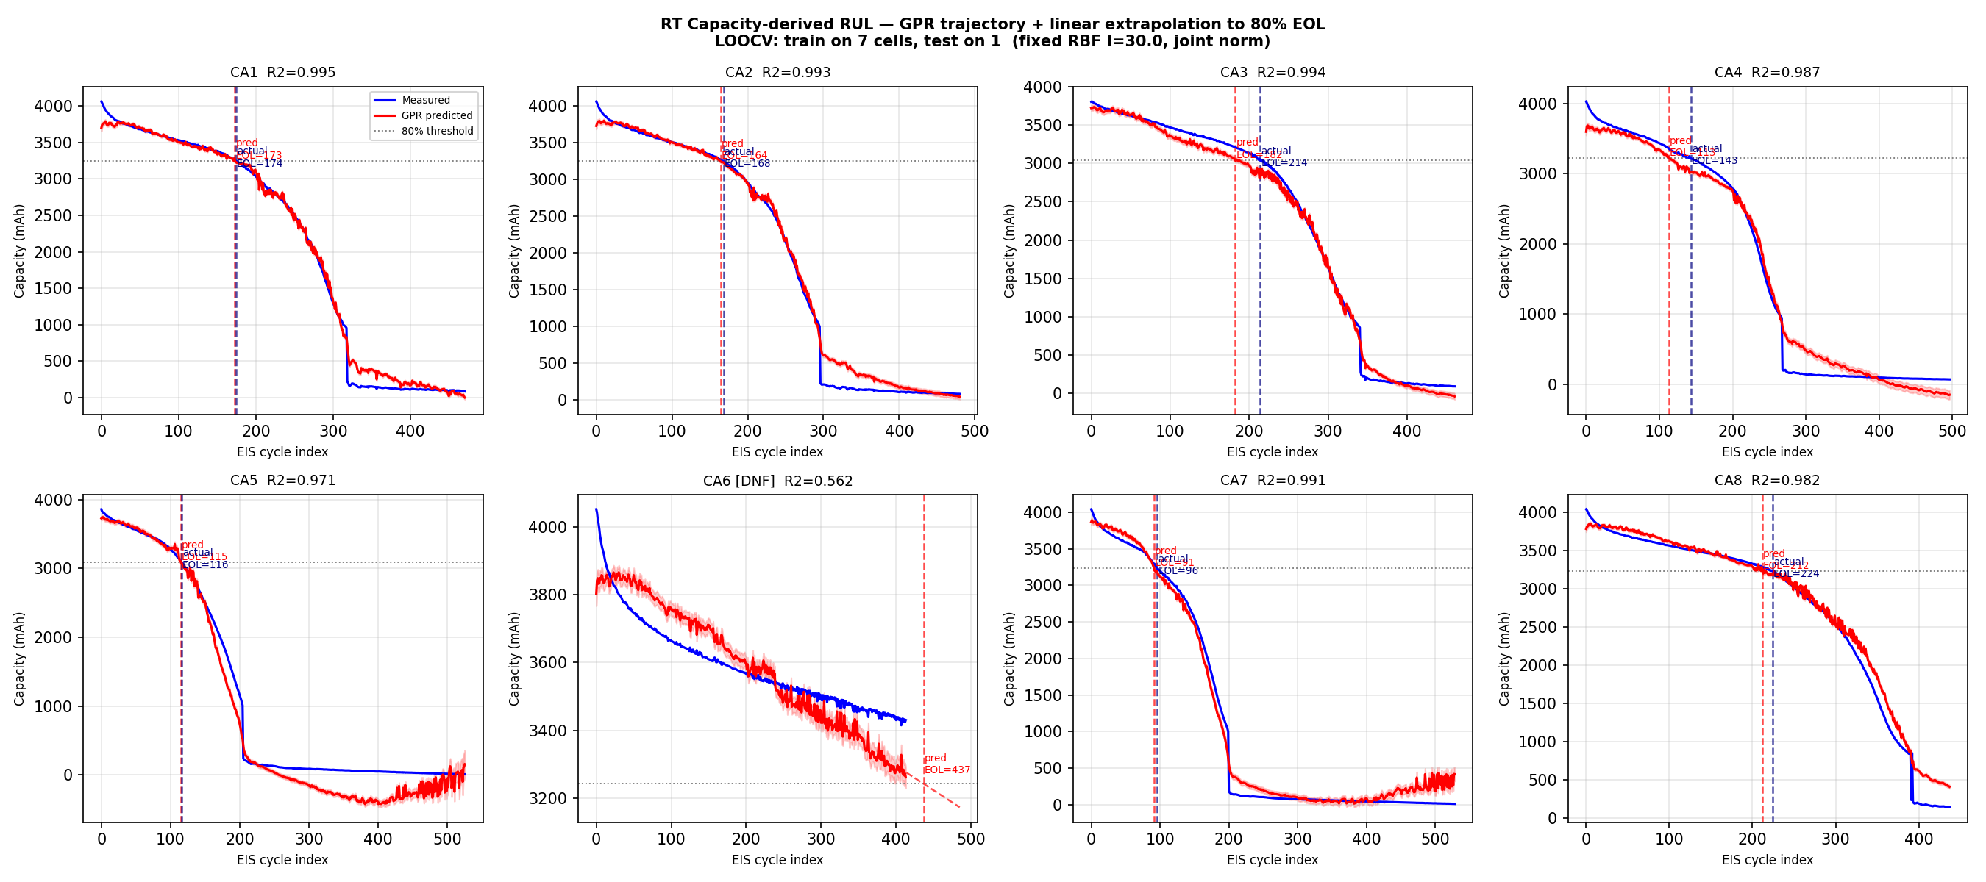
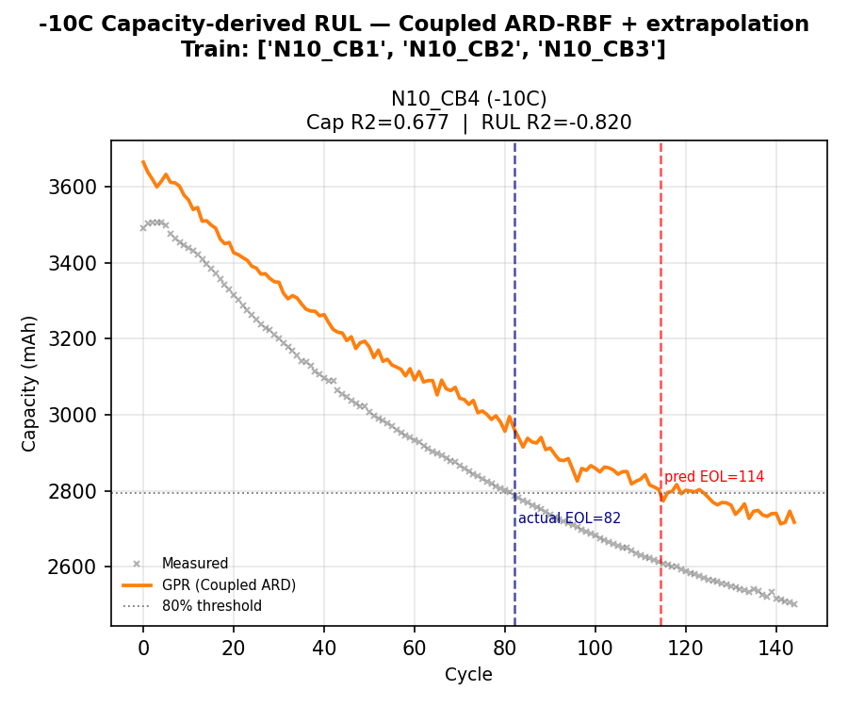
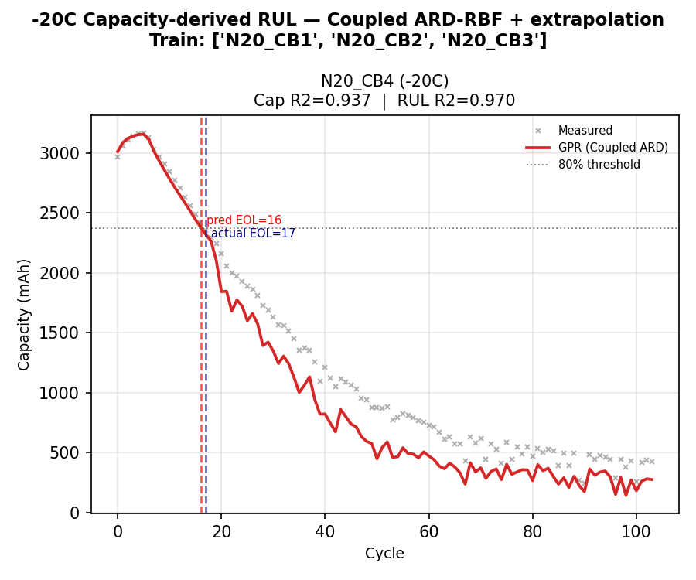
RUL Strategy Depends on Temperature
Temperature | Cap-derived RUL R² | Direct EIS->RUL R² | Best Approach
RT (25C) | 0.893 | -4.3 | Cap-derived (LOOCV)
-10C | -0.82 | 0.734 | Direct (linear kernel)
-20C | 0.970 | 0.459 | Cap-derived (DOE)
No single method works at all temperatures -- optimal strategy depends on degradation regime.

Slide 17
Key Finding: Universal Degradation Indicator
Dataset | Kernel | Top Feature | Frequency | Interpretation
35C (Fig 3c) | Decoupled | #91 | 17.80 Hz | Exact match with paper
25C (Fig 1c) | Decoupled | #91, #100 | 17.80 + 2.16 Hz | Same region
45C (Fig 3d) | Decoupled | #88 | ~20 Hz | Same low-freq Im(Z) region
A1-A8 LOOCV | Decoupled | low-freq Im(Z) | ~1-20 Hz | Consistent
CB multi-T | Coupled | 1.33 Hz | w=0.71 | SEI/diffusion + bulk
-10C single-T | Coupled | 13.3 Hz | w=1.0 | Pure SEI/charge-transfer
Feature #91 (17.80 Hz, Im(Z)) is the universal degradation indicator
Consistent across Cambridge, in-house, and multi-temperature datasets
Multi-T training acts as a regulariser, stripping out temperature-dependent features
Coupled ARD (33 ls, Re+Im paired) gives physically interpretable weights (Kramers-Kronig)
-10C shows unique single-frequency dominance at 13.3 Hz -- pure charge-transfer signal

Slide 18
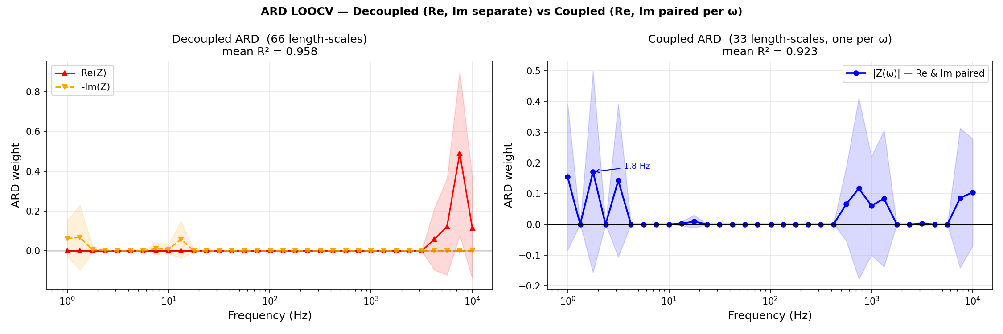
Coupled vs Decoupled ARD
Standard ARD: 66 independent length-scales
-- Re(Z) and Im(Z) treated as separate features
-- Ambiguous importance: Re and Im at same freq get different weights
Coupled ARD: 33 length-scales (one per frequency)
-- Re(Z) and Im(Z) share the same length-scale per frequency
-- Physically motivated: Kramers-Kronig relations couple Re and Im
-- Gives cleaner, more interpretable importance scores
Result: comparable LOOCV accuracy with half the parameters
-- Decoupled: 66 ls -> noisy attribution
-- Coupled: 33 ls -> clear frequency ranking

Slide 19
Summary & Conclusions
Model | Result | Notes
Paper reproduction (capacity) | R² = 0.88-0.94 | Matched or beat all targets
Paper reproduction (RUL) | R² = 0.85-0.97 | Beat all multi-T targets
A1-A8 Capacity LOOCV | mean R² = 0.964 | Strong generalisation, 8 cells
CA1-CA8 Capacity LOOCV | mean R² = 0.934 | Complete lifecycle, 470+ cycles
RT Cap-derived RUL | mean R² = 0.893 | Best RT approach (7 EOL cells)
-20C Cap-derived RUL (DOE) | R² = 0.970 | Pred EOL=16.1 vs actual 17
-10C Direct RUL | R² = 0.734 | Single dominant freq at 13.3 Hz
Single-T Capacity (RT) | R² = 0.996 | Beats Zhang's 0.88
GPR on raw EIS spectra is a powerful, feature-engineering-free approach to battery SOH prediction
Capacity prediction is robust across datasets, temperatures, and validation strategies
Direct EIS->RUL fails for same-temperature cells; cap-derived RUL is the practical solution
No single RUL method works at all temperatures -- strategy depends on degradation physics
Coupled ARD provides physically interpretable frequency importance (Kramers-Kronig correct)
17.80 Hz Im(Z) is the universal degradation indicator across all conditions

