Slide 1
Chapter 1. Basic Structure of Computers

Slide 2
The different types of computers
The basic structure of a computer and its
operation
Machine instructions and their execution
Number and character representations
Addition and subtraction of binary numbers
Basic performance issues in computer
systems

Slide 3
Since their introduction in the 1940s, digital computers -- types that vary widely in size, cost, computational power, and intended use.
Modern computers can be divided roughly into four general categories:

Slide 4
Embedded computers
Personal computers
Servers and Enterprise systems
Supercomputers and Grid computers

Slide 5
Embedded computers
These are integrated into a larger device or system in order to automatically monitor and control a physical process or environment.
They are used for a specific purpose rather than for general processing tasks.
Typical applications include industrial and home automation, appliances, telecommunication products, and vehicles.
Users may not even be aware of the role that computers play in such systems.

Slide 6
Personal computers
have achieved widespread use in homes, educational institutions, and business and engineering office settings, primarily for dedicated individual use.
They support a variety of applications such as general computation, document preparation, computer-aided design, audiovisual entertainment, interpersonal communication, and Internet browsing.

Slide 7
A number of classifications are used for personal computers
Desktop Computers
Workstation Computers
Portable and Notebook computers

Slide 8
Desktop computers serve general needs and fit within a typical personal workspace.
Workstation computers offer higher computational capacity and more powerful graphical display capabilities for engineering and scientific work.
Portable and Notebook computers provide the basic features of a personal computer in a smaller lightweight package.
They can operate on batteries to provide mobility.

Slide 9
Servers and Enterprise systems
Large computers that are meant to be shared by a potentially large number of users who access them from some form of personal computer over a public or private network.
Such computers may host large databases and provide information processing for a government agency or a commercial organization.

Slide 10
Supercomputers and Grid computers
Normally offer the highest performance.
They are the most expensive and physically the largest category of computers.
Supercomputers are used for the highly demanding computations needed in weather forecasting, engineering design and simulation, and scientific work.
They have a high cost.

Slide 11
Grid computers provide a more cost-effective alternative.
They combine a large number of personal computers and disk storage units in a physically distributed high-speed network, called a grid, which is managed as a coordinated computing resource.
By evenly distributing the computational workload across the grid, it is possible to achieve high performance on large applications ranging from numerical computation to information searching.

Slide 12
Functional Units

Slide 13
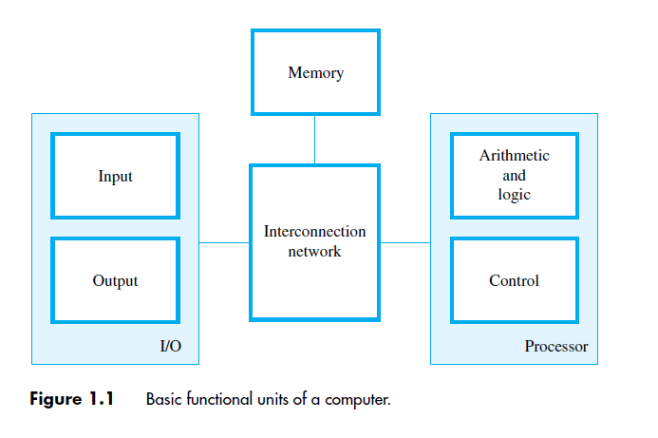
Functional Units

Slide 14
A computer consists of five functionally independent main parts:
Input, memory, arithmetic and logic, output, and control units,

Slide 15
Input Unit
Computers accept coded information through input units ---the keyboard.
Whenever a key is pressed, the corresponding letter or digit is automatically translated into its corresponding binary code and transmitted to the processor.
touchpad, mouse, joystick, and trackball, microphones, camera, Internet.

Slide 16
Information Handled by a Computer
Instructions/machine instructions
Govern the transfer of information within a computer as well as between the computer and its I/O devices
Specify the arithmetic and logic operations to be performed
Program
Data
Used as operands by the instructions
Source program
Encoded in binary code – 0 and 1

Slide 17
Memory Unit
Function is to store programs and data
Two classes of storage
Primary storage
It is called main memory.—Fast – works with electronic speeds.
Programs must be stored in memory while they are being executed
Consists of large number of semiconductor storage cells – capable to store one bit of information.
They are handled in groups of fixed size called words.
The memory is organized so that one word can be stored or retrieved in one basic operation.
Word Length – 16 or 32 bits.

Slide 18
To provide easy access to any word in the memory, a distinct address is associated with each word location.
A particular word is accessed by specifying its address and issuing a control command to the memory that starts the storage or retrieval process.
A memory in which any location can be accessed in a short and fixed amount of time after specifying its address is called a random-access memory (RAM).
The time required to access memory is memory access time.
Memory hierarchy – cache, main memory

Slide 19
Cache Memory
Secondary storage – larger and cheaper

Slide 20
Arithmetic and Logic Unit (ALU)
Most computer operations are executed in ALU of the processor.
Load the operands into memory – bring them to the processor – perform operation in ALU – store the result back to memory or retain in the processor.
Registers
Fast control of ALU

Slide 21
Control Unit
All computer operations are controlled by the control unit.
The timing signals that govern the I/O transfers are also generated by the control unit.
Control unit is usually distributed throughout the machine instead of standing alone.
Operations of a computer:
Accept information in the form of programs and data through an input unit and store it in the memory
Fetch the information stored in the memory, under program control, into an ALU, where the information is processed
Output the processed information through an output unit
Control all activities inside the machine through a control unit

Slide 22
Basic Operational Concepts

Slide 23
Review
Activity in a computer is governed by instructions.
To perform a task, an appropriate program consisting of a list of instructions is stored in the memory.
Individual instructions are brought from the memory into the processor, which executes the specified operations.
Data to be used as operands are also stored in the memory.

Slide 24
A Typical Instruction
Add R0,LOCA
Add the operand at memory location LOCA to the operand in a register R0 in the processor.
Place the sum into register R0.
The original contents of LOCA are preserved.
The original contents of R0 is overwritten.
Instruction is fetched from the memory into the processor – the operand at LOCA is fetched and added to the contents of R0 – the resulting sum is stored in register R0.

Slide 25
Add R4, R2, R3
Adds the contents of registers R2 and R3, then places their sum into register R4
After completing the desired operations, the results are in processor registers. They
can be transferred to the memory using instructions such as
Store R4, LOC

Slide 26
For Load and Store instructions, transfers between the memory and the processor.
These are initiated by sending the address of the desired memory location to the memory unit and asserting the appropriate control signals.
The data are then transferred to or from the
memory.

Slide 27
Separate Memory Access and ALU Operation
Load LOCA, R1
Add R1, R0
Whose contents will be overwritten?

Slide 28
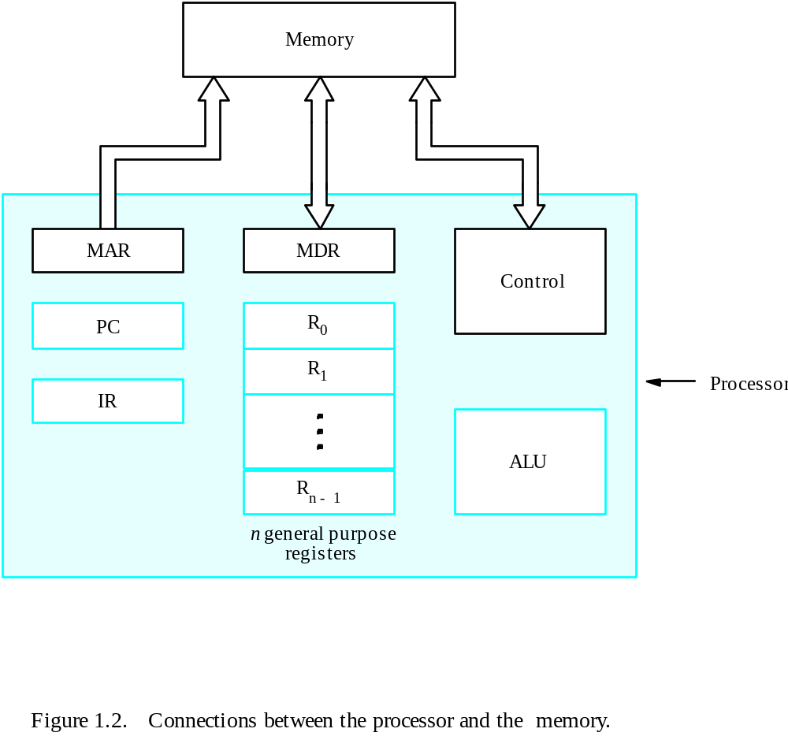
Connection Between the Processor and the Memory

Slide 29
Registers
Instruction register (IR)
Program counter (PC)
Memory address register (MAR)
Memory data register (MDR)
General-purpose register (R₀ – R_{n-1})

Slide 30
Typical Operating Steps
Programs reside in the memory through input devices
PC is set to point to the first instruction
The contents of PC are transferred to MAR
A Read signal is sent to the memory
The first instruction is read out and loaded into MDR
The contents of MDR are transferred to IR
Decode and execute the instruction

Slide 31
Typical Operating Steps (Cont’)
Get operands for ALU
  General-purpose register
  Memory (address to MAR – Read – MDR to ALU)
Perform operation in ALU
Store the result back
  To general-purpose register
  To memory (address to MAR, result to MDR – Write)
During the execution, PC is incremented to the next instruction

Slide 32
Number Representation and Arithmetic Operations

Slide 33
Signed Integer
3 major representations:
Sign and magnitude
One’s complement
Two’s complement
In all three systems MSB position 0 for positive and 1 for Negative.
Positive values have identical representations in all systems, but negative values have different representations.
Assumptions:
4-bit machine word
16 different values can be represented
Roughly half are positive, half are negative

Slide 34
Binary, Signed-Integer Representations
Page 28
B
V
alues represented
Sign and
b
3
b
2
b
1
b
0
magnitude
1'
s complement
2'
s complement
0
1
1
1
+
7
+
7
+
7
0
1
1
0
+
6
+
6
+
6
0
1
0
1
+
5
+
5
+
5
0
1
0
0
+
4
+
4
+
4
0
0
1
1
+
3
+
3
+
3
0
0
1
0
+
2
+
2
+
2
0
0
0
1
+
1
+
1
+
1
0
0
0
0
+
0
+
0
+
0
1
0
0
0
-
0
-
7
-
8
1
0
0
1
-
1
-
6
-
7
1
0
1
0
-
2
-
5
-
6
1
0
1
1
-
3
-
4
-
5
1
1
0
0
-
4
-
3
-
4
1
1
0
1
-
5
-
2
-
3
1
1
1
0
-
6
-
1
-
2
1
1
1
1
-
7
-
0
-
1
Figure 2.1. Binary, signed-integer representations.

Slide 35
In the sign-and-magnitude system, negative values are represented by changing the most significant bit
For example, +5 is represented by 0101, and −5 is represented by 1101.
In 1’s-complement representation, negative values are obtained by complementing each bit of the corresponding positive number.
Thus, the representation for −3 is obtained
by complementing each bit in the vector 0011 to yield 1100.
the 2’s-complement of a number is obtained by adding 1 to the 1’s-complement of that number.

Slide 36
Distinct representations are there for +0 and -0 in first two representations, But one representation in 2’s complement form.
The sign-and-magnitude system is the simplest representation, but it is also the most awkward for addition and subtraction operations.
The 1’s-complement method is somewhat better.
The 2’s-complement system is the most efficient method for performing addition and subtraction operations.

Slide 37
To understand 2’s-complement arithmetic, consider addition modulo N.
A helpful graphical device for the description of addition of unsigned integers mod N is a circle with the values 0 through N − 1 marked along its perimeter.
The decimal values 0 through 15 are represented by their 4-bit binary values 0000 through 1111 around the outside of the circle.
to perform addition, locate a and move b units in the clockwise direction to arrive at (a + b) mod 16.

Slide 38
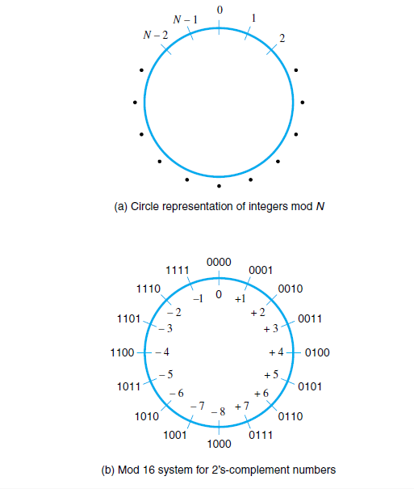

Slide 39
Now consider a different interpretation of the mod 16 circle.
We will reinterpret the binary vectors outside the circle to represent the signed integers from −8 through +7 in the
2’s-complement representation as shown inside the circle.
example of adding +7 to −3.
0111 and 1101, respectively.
To add these numbers, locate 0111 on the circle. Then move 1101 (13) steps in the clockwise direction to arrive at 0100, which yields the correct answer of +4.

Slide 40
Addition and Subtraction – 2’s Complement
4
+ 3
7
0100
0011
0111
-4
+ (-3)
-7
1100
1101
11001
If carry-in to the high
order bit =
carry-out then ignore
carry
if carry-in differs from
carry-out then overflow
4
- 3
1
0100
1101
10001
-4
+ 3
-1
1100
0011
1111
Simpler addition scheme makes twos complement the most common
choice for integer number systems within digital systems

Slide 41
2’s-Complement Add and Subtract Operations
(a)
0 0 1 0
(
+
2
)
(b)
0 1 0 0
(
+
4
)
+
0 0 1 1
(
+
3
)
+
1 0 1 0
(
-
6
)
0 1 0 1
(
+
5
)
1 1 1 0
(
-
2
)
(c)
1 0 1 1
(
-
5
)
(d)
0 1 1 1
(
+
7
)
+
1 1 1 0
(
-
2
)
+
1 1 0 1
(
-
3
)
1 0 0 1
(
-
7
)
0 1 0 0
(
+
4
)
(e)
1 1 0 1
(
-
3
)
1 1 0 1
-
1 0 0 1
(
-
7
)
+
0 1 1 1
0 1 0 0
(
+
4
)
(f)
0 0 1 0
(
+
2
)
0 0 1 0
-
0 1 0 0
(
+
4
)
+
1 1 0 0
1 1 1 0
(
-
2
)
(g)
0 1 1 0
(
+
6
)
0 1 1 0
-
0 0 1 1
(
+
3
)
+
1 1 0 1
0 0 1 1
(
+
3
)
(h)
1 0 0 1
(
-
7
)
1 0 0 1
-
1 0 1 1
(
-
5
)
+
0 1 0 1
1 1 1 0
(
-
2
)
(i)
1 0 0 1
(
-
7
)
1 0 0 1
-
0 0 0 1
(
+
1
)
+
1 1 1 1
1 0 0 0
(
-
8
)
(j)
0 0 1 0
(
+
2
)
0 0 1 0
-
1 1 0 1
(
-
3
)
+
0 0 1 1
0 1 0 1
(
+
5
)
Figure 2.4. 2's-complement Add and Subtract operations.

Slide 42
Overflow - Add two positive numbers to get a negative number or two negative numbers to get a positive number
-1
+0
-1
+0
-2
1111
0000
+1
-2
1111
0000
+1
-3
1110
0001
-3
1110
0001
1101
+2
1101
+2
-4
0010
-4
0010
1100
0011
+3
1100
0011
+3
-5
1011
-5
0100
+4
1011
0100
+4
-6
1010
-6
1010
0101
+5
0101
+5
1001
0110
1001
0110
-7
1000
+6
-7
+6
0111
1000
0111
-8
+7
-8
+7
5 + 3 = -8
-7 - 2 = +7

Slide 43
Overflow Conditions
0 1 1 1
0 1 0 1
0 0 1 1
1 0 0 0
1 0 0 0
1 0 0 1
1 1 0 0
1 0 1 1 1
5
3
-8
-7
-2
7
Overflow
Overflow
0 0 0 0
0 1 0 1
0 0 1 0
0 1 1 1
1 1 1 1
1 1 0 1
1 0 1 1
1 1 0 0 0
5
2
7
-3
-5
-8
No overflow
No overflow
Overflow when carry-in to the high-order bit does not equal carry out

Slide 44
Sign Extension
Task:
  Given w-bit signed integer x
  Convert it to w+k-bit integer with same value
Rule:
  Make k copies of sign bit:
  X ′ = x_{w–1} ,…, x_{w–1} , x_{w–1} , x_{w–2} ,…, x₀
w
X
• • •
k copies of MSB
• • •
X ′
• • •
• • •
k
w

Slide 45
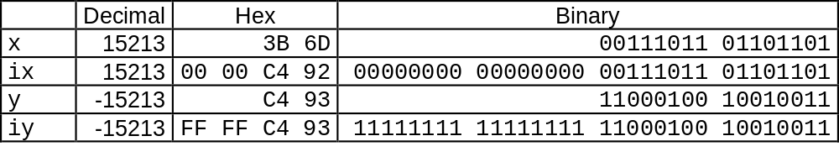
Sign Extension Example
short int x = 15213;
int ix = (int) x;
short int y = -15213;
int iy = (int) y;

Slide 46
Interrupt
Normal execution of programs may be preempted if some device requires urgent servicing.
The normal execution of the current program must be interrupted – the device raises an interrupt signal.
Interrupt-service routine
Current system information backup and restore (PC, general-purpose registers, control information, specific information)

Slide 47
Bus Structures
There are many ways to connect different parts inside a computer together.
A group of lines that serves as a connecting path for several devices is called a bus.
Address/data/control

Slide 48
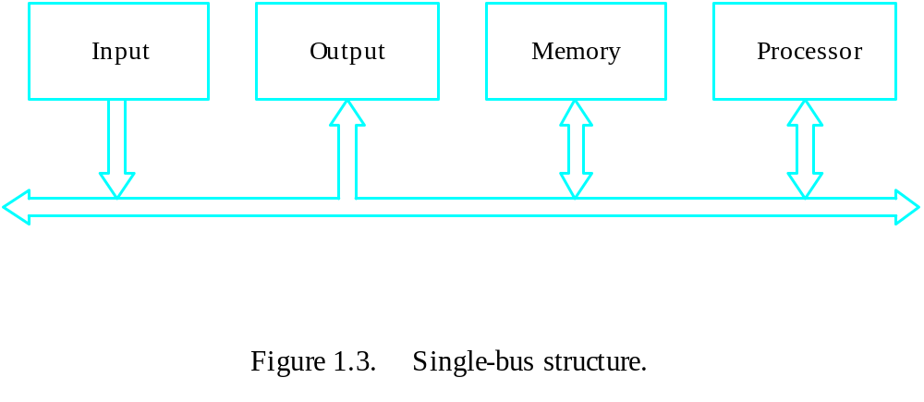
Bus Structure
Single-bus

Slide 49
Speed Issue
Different devices have different transfer/operate speed.
If the speed of bus is bounded by the slowest device connected to it, the efficiency will be very low.
How to solve this?
A common approach – use buffers.

Slide 50
Performance

Slide 51
Performance
The most important measure of a computer is how quickly it can execute programs.
Three factors affect performance:
Hardware design
Instruction set
Compiler

Slide 52
Performance
Processor time to execute a program depends on the hardware involved in the execution of individual machine instructions.
Main
Cache
memory
memory
Processor
Bus
Figure 1.5.
The processor cache.

Slide 53
Performance
The processor and a relatively small cache memory can be fabricated on a single integrated circuit chip.
Speed
Cost
Memory management

Slide 54
Processor Clock
Clock, clock cycle, and clock rate
The execution of each instruction is divided into several steps, each of which completes in one clock cycle.
Hertz – cycles per second

Slide 55
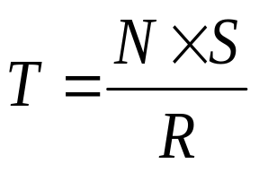
Basic Performance Equation
T – processor time required to execute a program that has been prepared in high-level language
N – number of actual machine language instructions needed to complete the execution (note: loop)
S – average number of basic steps needed to execute one machine instruction. Each step completes in one clock cycle
R – clock rate
Note: these are not independent to each other
How to improve T?

Slide 56
Pipeline and Superscalar Operation
Instructions are not necessarily executed one after another.
The value of S doesn’t have to be the number of clock cycles to execute one instruction.
Pipelining – overlapping the execution of successive instructions.
Add R1, R2, R3
Superscalar operation – multiple instruction pipelines are implemented in the processor.
Goal – reduce S (could become <1!)

Slide 57
Clock Rate
Increase clock rate
Improve the integrated-circuit (IC) technology to make the circuits faster
Reduce the amount of processing done in one basic step (however, this may increase the number of basic steps needed)
Increases in R that are entirely caused by improvements in IC technology affect all aspects of the processor’s operation equally except the time to access the main memory.

Slide 58
CISC and RISC
Tradeoff between N and S
A key consideration is the use of pipelining
S is close to 1 even though the number of basic steps per instruction may be considerably larger
It is much easier to implement efficient pipelining in processor with simple instruction sets
Reduced Instruction Set Computers (RISC)
Complex Instruction Set Computers (CISC)

Slide 59
Compiler
A compiler translates a high-level language program into a sequence of machine instructions.
To reduce N, we need a suitable machine instruction set and a compiler that makes good use of it.
Goal – reduce N×S
A compiler may not be designed for a specific processor; however, a high-quality compiler is usually designed for, and with, a specific processor.

Slide 60
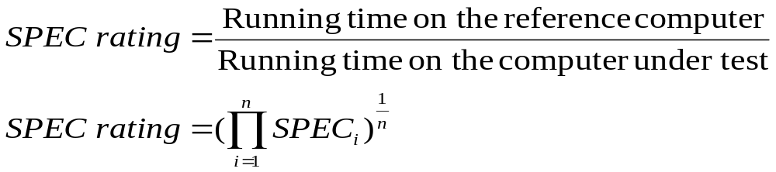
Performance Measurement
T is difficult to compute.
Measure computer performance using benchmark programs.
System Performance Evaluation Corporation (SPEC) selects and publishes representative application programs for different application domains, together with test results for many commercially available computers.
Compile and run (no simulation)
Reference computer

Slide 61
Multiprocessors and Multicomputers
Multiprocessor computer
Execute a number of different application tasks in parallel
Execute subtasks of a single large task in parallel
All processors have access to all of the memory – shared-memory multiprocessor
Cost – processors, memory units, complex interconnection networks
Multicomputers
Each computer only have access to its own memory
Exchange message via a communication network – message-passing multicomputers

