Slide 1
Chapter 2. Machine Instructions and Programs

Slide 2
Objectives
Machine instructions and program execution, including branching and subroutine call and return operations.
Number representation and addition/subtraction in the 2’s-complement system.
Addressing methods for accessing register and memory operands.
Assembly language for representing machine instructions, data, and programs.
Program-controlled Input/Output operations.

Slide 3
Memory Locations, Addresses, and Operations

Slide 4
Memory is organized as a large array of bytes or words
Word is a group of n-bits, ‘n’ is called word length.
Memory is represented as a collection of words.
The word length range from 16 to 64 bits.
Accessing the memory requires address for each location.
So, use numbers from 0 to 2^{K} -1 to address the successive memory locations. (K address bits)i.e memory can have up to . 2^{K} memory locations.

Slide 5
Memory Location, Addresses
n
bits
Memory consists of many millions of storage cells, each of which can store 1 bit.
Data is usually accessed in n-bit groups. n is called word length.
first word
second word
•
•
•
i
th word
•
•
•
last word
Figure 2.5. Memory words.

Slide 6
Memory Location, Addresses, and Operation
32-bit word length example
32 bits
•
•
•
b
31
b
30
b
1
b
0
Sign bit:
b
31
=
0
for positive numbers
b
31
=
1
for negative numbers
(a) A signed integer
8 bits
8 bits
8 bits
8 bits
ASCII
ASCII
ASCII
ASCII
character
character
character
character
(b) Four characters

Slide 7
Memory Location, Addresses, and Operation
To retrieve information from memory, either for one word or one byte (8-bit), addresses for each location are needed.
A k-bit address memory has 2^{k} memory locations, namely 0 – 2^{k}-1, called memory space.
24-bit memory: 2²⁴ = 16,777,216 = 16M (1M=2²⁰)
32-bit memory: 2³² = 4G (1G=2³⁰)
1K(kilo)=2¹⁰
1T(tera)=2⁴⁰

Slide 8
Byte Addressability
It is impractical to assign distinct addresses to individual bit locations in the memory.
The most practical assignment is to have successive addresses refer to successive byte locations in the memory – byte-addressable memory.
Byte locations have addresses 0, 1, 2, … If word length is 32 bits, they successive words are located at addresses 0, 4, 8,…

Slide 9
Big-Endian and Little-Endian Assignments
Big-Endian: lower byte addresses are used for the most significant bytes of the word
Little-Endian: opposite ordering. lower byte addresses are used for the less significant bytes of the word
W
ord
address
Byte address
Byte address
0
0
1
2
3
0
3
2
1
0
4
4
5
6
7
4
7
6
5
4
•
•
•
•
•
•
2
k
-
4
2
k
-
4
2
k
-
3
2
k
-
2
2
k
-
1
2
k
-
4
2
k
-
1
2
k
-
2
2
k
-
3
2
k
-
4
(a) Big-endian assignment
(b) Little-endian assignment
Figure 2.7. Byte and word addressing.

Slide 10
Address ordering of bytes
Word alignment
  Words are said to be aligned in memory if they begin at a byte addr. that is a multiple of the num of bytes in a word.
    16-bit word: word addresses: 0, 2, 4,….
    32-bit word: word addresses: 0, 4, 8,….
    64-bit word: word addresses: 0, 8,16,….
Access numbers, characters, and character strings

Slide 11
Memory Operation
Both program instructions and data are stored in memory.
To execution an instruction the processor first take the instruction from memory.
The operands and results are also moved between memory and processor.
Two basic operations are involved in memory.

Slide 12
Memory Operation
Read operation
To start the read operation the processor send the address of the memory and a request that it’s contents to be read.
Copy the content. The memory content doesn’t change.
Load (or Read or Fetch)

Slide 13
Instruction and Instruction Sequencing
Register Transfer Notation
Assembly-Language Notation
RISC and CISC Instruction Sets
Introduction to RISC Instruction Sets
Instruction Execution and Straight-Line Sequencing
Branching

Slide 14
Must-Perform Operations
A computer have instructions capableof performing 4 types of must operations.
Data transfers between the memory and the processor registers
Arithmetic and logic operations on data
Program sequencing and control
I/O transfers

Slide 15
Basic Notations:
Register Transfer Notation
We will see the transformation from one location in a computer to the other. Possible locations are memory locations, processor registers, registers in the I/O sub system.
Such locations are assigned with convenient names.
Eg: memory locations Loc, PLACE, A, var1

Slide 16
Predefined names for processor registers may be R0, R1, R2 etc..
Contents of any location are represented with square brackets.
Identify a location by a symbolic name standing for its hardware binary address (LOC, R0,…)
Contents of a location are denoted by placing square brackets around the name of the location (R1←[LOC], R3 ←[R1]+[R2]).
Register Transfer Notation (RTN)

Slide 17
Assembly Language Notation
Represent machine instructions and programs.
Move LOC, R1
R1 = R1←[LOC]
Add R1, R2, R3
R3= R3 ←[R1]+[R2]

Slide 18
Instruction specifies an operation to be performed and the operands involved.
In assembly language ADD, Move, load etc are called mnemonics.
Mnemonics are the words that describe the operations.

Slide 19
This operation transfer an item of information from the processor to a specific memory location.
To initiate write:
The processor sends the address of desired location to the memory along with the data to be written into the location.
Memory uses the address and data perform a write
Store (or Write)
Overwrite the content in memory

Slide 20
RISC and CISC Instruction Sets
One of the most important characteristics that distinguish different computers is the nature of their instructions.
There are two fundamentally different approaches in the design of instruction sets for modern computers.

Slide 21
RISC and CISC Instruction Sets
RISC: Reduced Instruction set Computer
CISC: Complex Instruction set Computer
RISC Characteristics:
Relatively few instructions
Relatively few addressing modes.
More accesses are limited to load and store instructions.
All operations are done with the registers of the CPU.
It is designed to reduce the execution time by simplifying the instruction set computer.
Each instruction requires only one clock cycle.

Slide 22
Two key characteristics of RISC instruction sets are:
• Each instruction fits in a single word.
• A load/store architecture is used, in which
– Memory operands are accessed only using Load and Store instructions.
– All operands involved in an arithmetic or logic operation must either be in processor registers, or one of the operands may be given explicitly within the instruction
word.

Slide 23
Introduction to RISC Instruction SETs
C=A+B:
Load R2,A
Load R3,B
Add R4,R2,R3
Store R4,C

Slide 24
Load destination, source
Load processor_register, memory_location
Add is a three-operand, or a three-address, instruction of the form Add destination, source1, source2

Slide 25
Instruction Execution and Straight-Line Sequencing

Slide 26
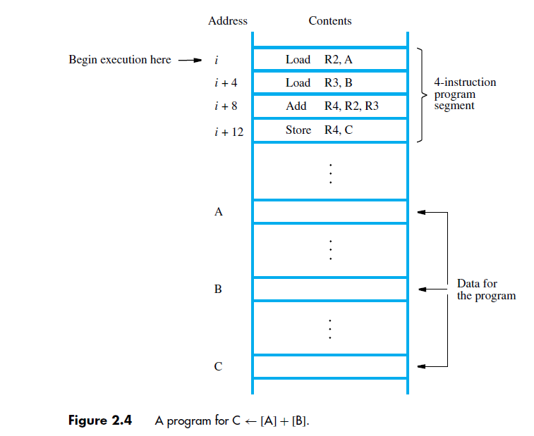

Slide 27
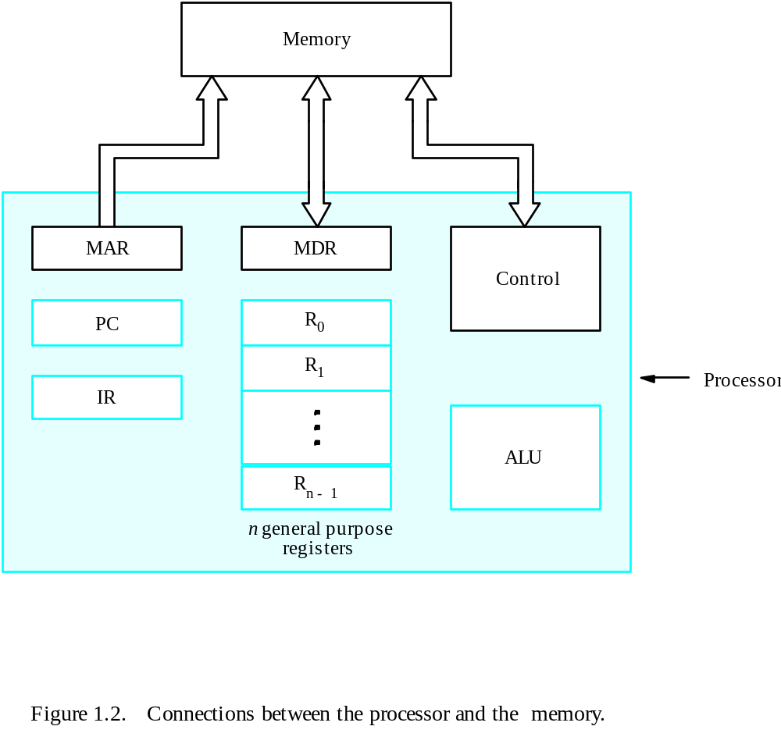
Connection Between the Processor and the Memory

Slide 28
Let us consider how this program is executed.
The processor contains a register called the program counter (PC), which holds the address of the next instruction to be executed.
To begin executing a program, the address of its first instruction (i in our example) must be placed into the PC.
the processor control circuits use the information in the PC to fetch
and execute instructions, one at a time, in the order of increasing addresses.
This is called straight-line sequencing. During the execution of each instruction, the PC is incremented by 4 to point to the next instruction.

Slide 29
Executing a given instruction is a two-phase procedure.
In the first phase, called instruction fetch, the instruction is fetched from the memory location whose address is in
the PC.
This instruction is placed in the instruction register (IR) in the processor.
At the start of the second phase, called instruction execute, the instruction in IR is examined to determine which operation is to be performed.
The specified operation is then performed by the processor.
This involves a small number of steps such as fetching operands from the memory or from processor registers, performing an arithmetic or logic operation, and
storing the result in the destination location.

Slide 30
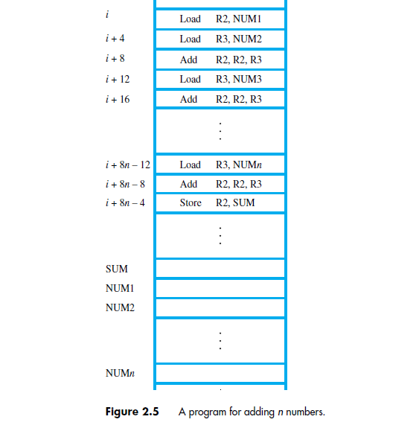
A program adding n numbers without Branching

Slide 31
We now introduce branch instructions. This type of instruction loads a new address into the program counter.
As a result, the processor fetches and executes the instruction at this new address, called the branch target instead of the one in sequence.
A conditional branch instruction causes a branch only if a specified condition is satisfied.
If the condition is not satisfied, the PC is incremented in the normal way, and the next instruction in sequential address order is fetched and executed.
Branch_if_[R2]>0 LOOP

Slide 32
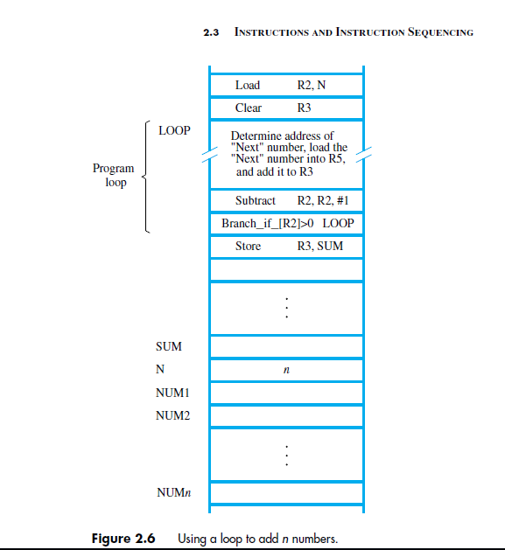
Branching

Slide 33
One way of implementing conditional branch instructions is to compare the contents of two registers and then branch to the target instruction if the comparison meets the specified.
For example, the instruction that implements the action
Branch_if_[R4]>[R5] LOOP
may be written in generic assembly language as
Branch_greater_than R4, R5, LOOP
or using an actual mnemonic as
BGT R4, R5, LOOP

Slide 34
Addressing Modes
The way in which memory operand is addressed is called Addressing modes.
Def: The term addressing modes refers to the way in which the operand of an instruction is specified.

Slide 35
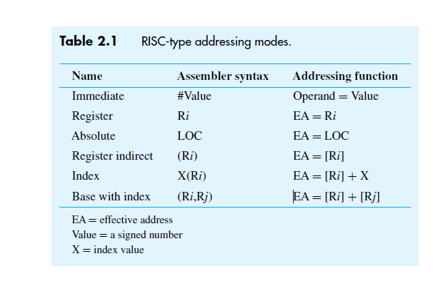
Basic Addressing Modes

Slide 36
Immediate Mode: Actual data is specified as part of the instruction. i.e. instruction as an operand field rather than as address field. The operand field contains the actual operand.
ADD R4, R6,#200
Register Mode:
Register name is specified as part of the instruction, i.e. register contains actual data i.e operands i.e operands are in registers.
ADD R4,R2,R3

Slide 37
Absolute mode (or) Direct Addressing mode:
Memory address is specified as a part of the instruction, this memory location contains the actual value.
i.e. The operand resides in the memory and its address is specified in the address field of the instruction.
Load R2, Num1

Slide 38
Indirect Addressing
The address field of the instruction specifies the address of the memory location.
That contains the effective address of the operand. Two references to memory are required to fetch the operand.
ADD R1, (A)

Slide 39
Register Indirect Addressing Mode
Register name is specified as part of the instruction. That register contains the address of the operand in the memory.
i.e The register contains the address of the operand rather than the operand.
Load R2, (R3)

Slide 40
Few addressing modes requires that the address field of the instruction to be added to the content of a specific registers in the CPU.
Effective Address = Address part of the instruction + Content of CPU register.
The CPU registers may be PC, index registers or base registers.
Relative Addressing Mode:
In this effective address of the operand is obtained by adding the content of PC with address part of the instruction.
EA = X + (PC)

Slide 41
Indexed Addressing Mode:
In this addressing mode the content of an index register is added to the address part of the instruction to obtain the effective address.
Index register is a CPU register that contains an index value. Here X denotes the constant value contained in the instruction and Ri is the name of the register involved.
The effective operand is given by E.A= X+[Ri]
Here X may be given either as an explicit number (or) a symbolic name representing numeric value.

Slide 42
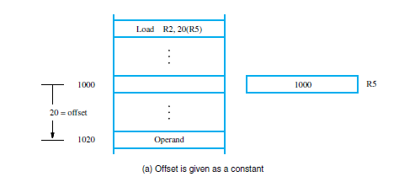

Slide 43
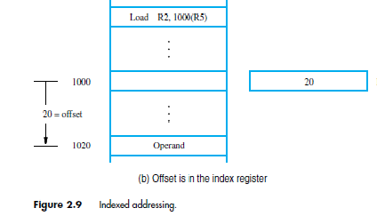

Slide 44
Base with Index
Effective Address is the sum of the contents of the register Ri and Rj.
The second register is called base register.
ADD R2, [Ri+Rj]
Auto Increment and Auto Decrement mode:
The E.A of an operand is the contents of a register specified in the instruction.
After accessing the operand, contents of this register is automatically incremented by 1.
ADD R1, (R2) +

Slide 45
Stacks
A stack is a list of data elements or words.
LIFO
Push, Pop, Top
It is a storage structure that stores information in the format of LIFO.
It is a group of memory locations with the register that holds the address of the top of the element.
The register that holds the address of the address of the top element of the stack is called Stack pointer (SP)

Slide 46
Stack can be implemented in two ways.
Register Stack
Memory Stack
Memory Stack: Code segment, Data Segment, Stack
Push: SP <- SP-1
M[SP] <- DR
Substract SP, SP, #1
Store Rj, (SP)
New item to be pushed on the stack is in processor register Rj

Slide 47
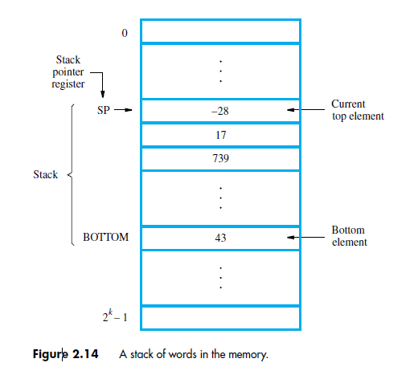

Slide 48
POP:
DR <- M[SP}
SP <- SP+1
Load Rj, (SP)
ADD SP,SP, #4
Load the top value from the stack into register Rj and increment the SP by 4.

Slide 49
Most of the computers do not provide hardware to check stack full (or) empty.
The stack limits can be checked by using two processor registers. One to hold the upper limit and other to hold lower limit.
Before push,SP is compared with upper limit.
After PoP, SP is compared with lower limit.

Slide 50
Subroutines
It is a set of instructions which are used repeatedly in a program is called subroutine.
(OR)
The block of instructions which carries out a specific and well defined task is called subroutine.
Need of subroutines.
Some space is allocated for subroutines
When a subroutine is called, PC is jumped to the starting address of the subroutine.
Before it jumps the present PC value is stored in a link register.
After execution of subroutine, when a return statement appers the link register’s value is placed in PC.

Slide 51
Subroutine Call and Return
The way in which a computer makes it possible to call and return from subroutines is referred to as its subroutine linkage method.
The simplest subroutine linkage method is to save the return address in a specific location, which may be a register dedicated to this function.
Such a register is called the link register.
When the subroutine completes its task, the Return instruction returns to the calling program by branching indirectly through the
link register.

Slide 52
The Call instruction is just a special branch instruction that performs the following operations:
• Store the contents of the PC in the link register
• Branch to the target address specified by the Call instruction
The Return instruction is a special branch instruction that performs the operation
• Branch to the address contained in the link register

Slide 53
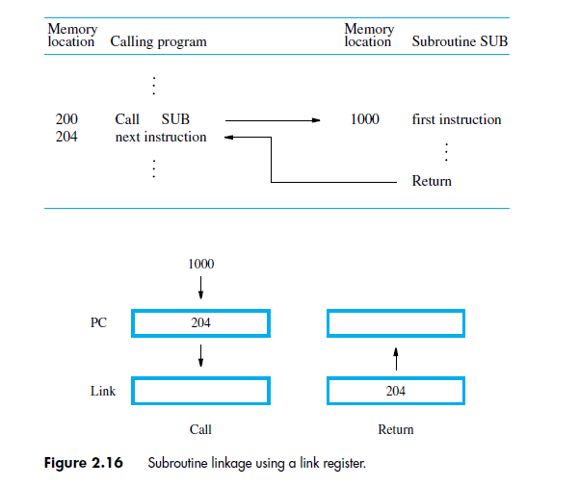

Slide 54
Subroutine Nesting
The one subroutine calls another.
In nested calls the link register will be overwritten, so stack is used for this purpose.

Slide 55
Parameter Passing
When calling a subroutine, the program must provide parameters to the subroutine to be used in the computation.
Later, the subroutine returns other parameters, which are the results of the computation.
This exchange of information between a calling program and a subroutine is referred to as parameter passing.
Parameter passing may be accomplished in several ways.
The parameters may be placed in registers or in memory locations, where they can be accessed by the subroutine.
Alternatively, the parameters may be placed on the processor stack.

Slide 56
Passing parameters through processor registers is straightforward and efficient.
program for adding a list of numbers can be implemented as a subroutine, LISTADD, with the parameters passed through registers.
The size of the list, n, contained in memory location N, and the address, NUM1, of the first number, are passed through registers R2 and R4.
The sum computed by the subroutine is passed back to the calling program through register R3.

Slide 57
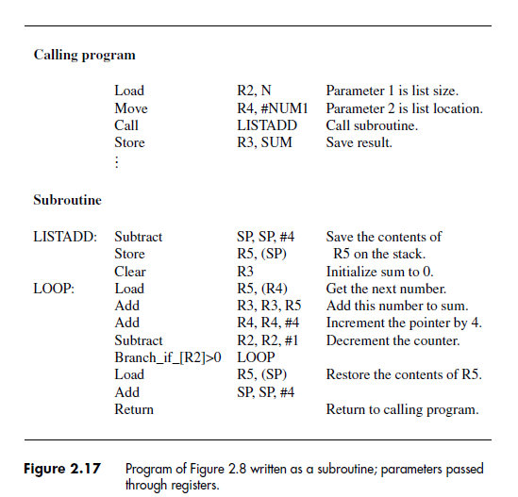
Parameters Passes through Registers

Slide 58
If many parameters are involved, there may not be enough general-purpose registers available for passing them to the subroutine.
The processor stack provides a convenient and flexible mechanism for passing an arbitrary number of parameters.
Assume that before the subroutine is called, the top of the stack is at level 1.
The calling program pushes the address NUM1 and the value n onto the stack and calls subroutine LISTADD.
The top of the stack is now at level 2.

Slide 59
The subroutine uses four registers while it is being executed.
Since these registers may contain valid data that belong to the calling program, their contents should be saved at the beginning of the subroutine by pushing them onto the stack.
The top of the stack is now at level 3.

Slide 60
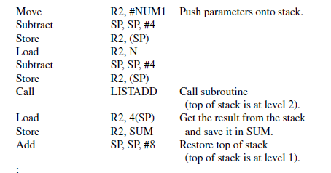
Parameters passed on the Stack

Slide 61
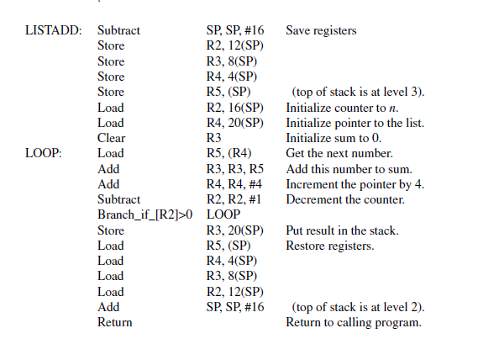

Slide 62
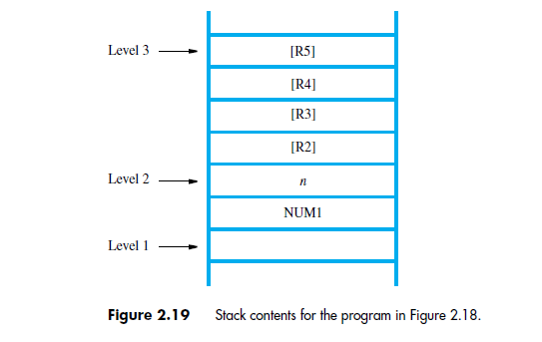

Slide 63
The Stack Frame
During execution of the subroutine, six locations at the top of the stack contain entries that are needed by the subroutine.
These locations constitute a private work space for the subroutine, allocated at the time the subroutine is entered and deallocated when the subroutine returns control to the calling program.
Such space is called a stack frame.
If the subroutine requires more space for local memory variables, the space for these variables can also be allocated on the stack.

Slide 64
Shows an example of a commonly used layout for information in a stack frame.
In addition to the stack pointer SP, it is useful to have another pointer register, called the frame pointer (FP), for convenient access to the parameters passed to the subroutine and to the local memory variables used by the subroutine.

Slide 65
