Slide 1

Chapter 3

Slide 2


Slide 3
The components of a computer system communicate with each other through an interconnection network.
The interconnection network consists of circuits
needed to transfer information between the processor, the memory unit, and a number of I/O devices.
Each I/O device is not taken as a separate device, rather an I/O devices are as an addressable locations to the processor.
Each I/O device is mapped with one memory address.

Slide 4
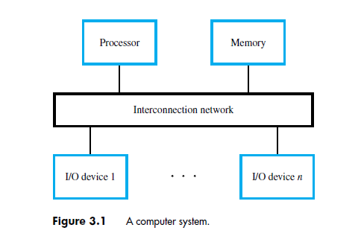

Slide 5

Processor
Memory
Bus
I/O de
vice 1
I/O de
vice
n
Multiple I/O devices may be connected to the processor and the memory via a bus.
Bus consists of three sets of lines to carry address, data and control signals.
Each I/O device is assigned an unique address.
To access an I/O device, the processor places the address on the address lines.
The device recognizes the address, and responds to the control signals.

Slide 6

It is a way to exchange data and instructions between CPU and I/O devices attached to it.
It is the one where processor and the I/O devices share the same address space.
Any instruction that can access memory can be used to transfer data to and from an I/O device.
Load R2, DATAIN
DATAIN is the address of a register in an input device.
Store R2, DATAOUT
DATAOUT, which is a register in an output device.

Slide 7

I/O devices are connected to an interconnection network, by using the circuit called the device interface.
It provides the means of data transfer between CPU and I/O devices.
The computer system includes a special hardware between the CPU and I/O to supervise and synchronize all I/O transfer. These components called interface.

Slide 8
From the processor perspective, an I/O device appears as a set of special purpose registers of 3 types.
Status Register: May hold information about the current status of the device.
Control Registers: These are used to control and configure the device.
Data Registers: Used to read the data from or send data to I/O device.
Each of the I/O registers has an address, so that CPU can read/write the data into specific registers.
These registers are accessed by program instructions.

Slide 9
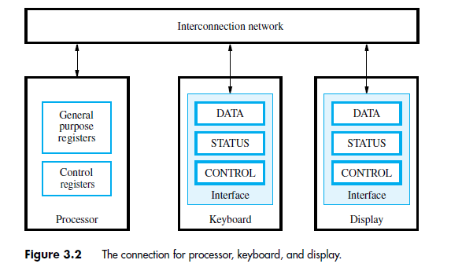

Slide 10
Program-Controlled I/O Example
Read in character input from a keyboard and produce character output on a display screen.
Rate of data transfer (keyboard, display, processor)
Difference in speed between processor and I/O device creates the need for mechanisms to synchronize the transfer of data.
A solution: on output, the processor sends the first character and then waits for a signal from the display that the character has been received. It then sends the second character. Input is sent from the keyboard in a similar way.

Slide 11
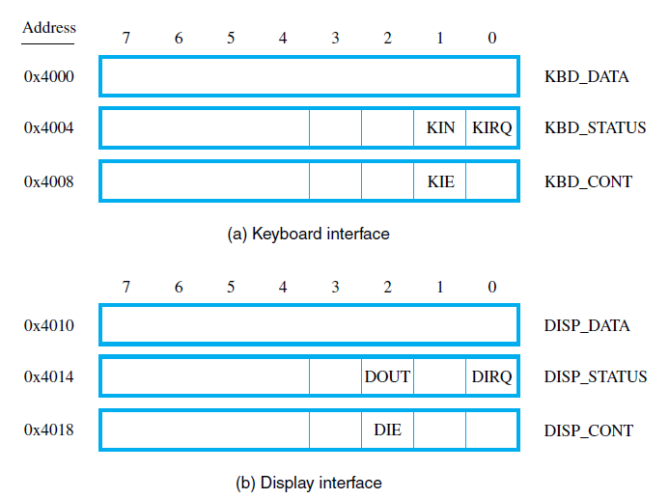

Slide 12
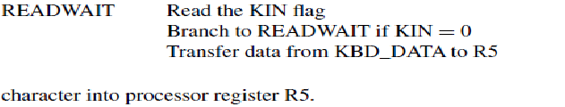

Slide 13


Slide 14
Accessing I/O devices (contd..)
Recall that the rate of transfer to and from I/O devices is slower than the speed of the processor. This creates the need for mechanisms to synchronize data transfers between them.
Program-controlled I/O:
  Processor repeatedly monitors a status flag to achieve the necessary synchronization.
  Processor polls the I/O device.
Two other mechanisms used for synchronizing data transfers between the processor and memory:
  Interrupts.
  Direct Memory Access.

Slide 15


Slide 16
Interrupts
In program-controlled I/O, when the processor continuously monitors the status of the device, it does not perform any useful tasks.
An alternate approach would be for the I/O device to alert the processor when it becomes ready.
  Do so by sending a hardware signal called an interrupt to the processor.
  At least one of the bus control lines, called an interrupt-request line is dedicated for this purpose.
Processor can perform other useful tasks while it is waiting for the device to be ready.

Slide 17
3 types of interrupts
External Interrupts: Generated by external devices like I/O devices requesting the transfer of data.
Internal: Called traps. Raised from illegal use of an instruction /data. These are caused by program.
Eg: Divide by zero, Register overflow, invalid opcode, stack overflow.
Software Interrupts: These are used by the programmers for various operations.

Slide 18

Program 1
Interrupt Service routine
1
2
Interrupt
occurs
i
here
i
+
1
M

Slide 19
Interrupts (contd..)
Treatment of an interrupt-service routine is very similar to that of a subroutine.
However there are significant differences:
  A subroutine performs a task that is required by the calling program.
  Interrupt-service routine may not have anything in common with the program it interrupts.
  Interrupt-service routine and the program that it interrupts may belong to different users.
  .

Slide 20
What happens when an interrupt occurs?
Processor is executing the instruction located at address i when an interrupt occurs.
Routine executed in response to an interrupt request is called the interrupt-service routine.
When an interrupt occurs, control must be transferred to the interrupt service routine.
But before transferring control, the current contents of the PC (i+1), must be saved in a known location.
This will enable the return-from-interrupt instruction to resume execution at i+1.
Return address, or the contents of the PC are usually stored on the processor stack.

Slide 21
ISR tells the processor, what to do when an interrupt occurs.
For every interrupt, there must be an ISR available in main memory.
All ISR starting addresses are available in IVT.
i) Execute the current instruction, and saves the PC on the stack.
ii) It saves the current status of the PC register.
iii) It jumps to the memory loc. of the IVT.
iv) the processor gets the address of ISR from IVT and jumps to it. And starts the execution of ISR.

Slide 22
  As a result, before branching to the interrupt-service routine, not only the PC, but other information such as condition code flags, and processor registers used by both the interrupted program and the interrupt service routine must be stored.
  This will enable the interrupted program to resume execution upon return from interrupt service routine

Slide 23
Interrupts (contd..)
Saving and restoring information can be done automatically by the processor or explicitly by program instructions.
Saving and restoring registers involves memory transfers:
    Drawbacks:
  Increases the total execution time.
  Increases the delay between the time an interrupt request is received, and the start of execution of the interrupt-service routine.
  This delay is called interrupt latency.

Slide 24
In order to reduce the interrupt latency, most processors save only the minimal amount of information:
  This minimal amount of information includes Program Counter and processor status registers.
Any additional information that must be saved, must be saved explicitly by the program instructions at the beginning of the interrupt service routine.

Slide 25
Interrupts (contd..)
When a processor receives an interrupt-request, it must branch to the interrupt service routine.
It must also inform the device that it has recognized the interrupt request.
This can be accomplished in two ways:
  Some processors have an explicit interrupt-acknowledge control signal for this purpose.
  In other cases, the data transfer that takes place between the device and the processor can be used to inform the device.

Slide 26
Enabling Interrupts (contd..)
Processors generally provide the ability to enable and disable such interruptions as desired.
One simple way is to provide machine instructions such as Interrupt-enable and Interrupt-disable in PS register.
To avoid interruption by the same device during the execution of an interrupt service routine:
  First instruction of an interrupt service routine can be Interrupt-disable.
  Last instruction of an interrupt service routine can be Interrupt-enable.
Processor has special line called Edge triggered line.

Slide 27
Multiple devices (contd..)
Multiple I/O devices may be connected to the processor and the memory via a bus. Some or all of these devices may be capable of generating interrupt requests.
  Each device operates independently, and hence no definite order can be imposed on how the devices generate interrupt requests

Slide 28
How does the processor know which device has generated an interrupt?
How does the processor know which interrupt service routine needs to be executed?
When the processor is executing an interrupt service routine for one device, can other device interrupt the processor?
If two interrupt-requests are received simultaneously, then how to break the tie?

Slide 29
The means by which these issues are handled vary from one computer to another.
When an interrupt request is received it is necessary to identify the particular device that raised the request.
if two devices raise interrupt requests at the same time, it must be possible to break the tie and select one of the two requests for service.

Slide 30
When the processor receives an interrupt request over this control line, how does it know which device is requesting an interrupt?
This information is available in the status register of the device requesting an interrupt:
  The status register of each device has an IRQ bit which it sets to 1 when it requests an interrupt.
Interrupt service routine can poll the I/O devices connected to the bus. The first device with IRQ equal to 1 is the one that is serviced.
Polling mechanism is easy, but time consuming to query the status bits of all the I/O devices connected to the bus.
An alternate is vectored Interrupts.

Slide 31
Vectored Interrupts
The device requesting an interrupt may identify itself directly to the processor.
  Device can do so by sending a special code (4 to 8 bits) the processor over the bus. If processor busy wait until INTA signal.
  Code supplied by the device may represent a part of the starting address of the interrupt-service routine.
  The remainder of the starting address is obtained by the processor based on other information such as the range of memory addresses where interrupt service routines are located.
Usually the location pointed to by the interrupting device is used to store the starting address of the interrupt-service routine.

Slide 32
Interrupt Nesting
During the execution of one ISR, if it allows another Interrupt then that is known as Interrupt nesting.
This is like our nested subroutine calls.

Slide 33
priority of Devices
I/O devices are organized in a priority structure:
A priority level is assigned to a processor that can be changed under program control.
  Priority level of a processor is the priority of the program that is currently being executed.
  When the processor starts executing the interrupt service routine of a device, its priority is raised to that of the device.
  If the device sending an interrupt request has a higher priority than the processor, the processor accepts the interrupt request.
Notes:
Repeat that multiple I/O devices may be connected to the processor. These multiple I/O devices may be organized according a certain priority. When the processor is servicing an interrupt from a device, only devices which have higher priority can interrupt the processor. That is, only devices which have higher priority can interrupt the processing of the ISR of the device of lower priority.
In order to implement this scheme, a priority level is assigned to a processor. This priority level can be changed under program control or it depends on which program is currently being executed by the processor. That is, the priority of the processor is the priority of the program that the processor is currently executing. When the processor receives an interrupt request from a device, and starts executing the ISR of that device, its priority is raised to that of the device. Now, if another device wants to interrupt the processor, then it is allowed to do so, only if its priority is higher than the priority of the processor which is set to the priority of the ISR of the device.

Slide 34
Handling Simultaneous Requests
We also need to consider the problem of simultaneous arrivals of interrupt requests from
two or more devices. The processor must have some means of deciding which request to
service first. Polling the status registers of the I/O devices is the simplest such mechanism.
In this case, priority is determined by the order in which the devices are polled.

Slide 35

I
N
T
R
1
I
N
T
R
p
Processor
Device 1
Device 2
Device
p
INTA1
INTA
p
Priority arbitration
Each device has a separate interrupt-request and interrupt-acknowledge line.
Each interrupt-request line is assigned a different priority level.
Interrupt requests received over these lines are sent to a priority arbitration circuit
in the processor.
If the interrupt request has a higher priority level than the priority of the processor,
then the request is accepted.

Slide 36
I/O devices vary in complexity from simple to quite complex.
A commonly used approach is to provide a control register in the device interface, which holds the information needed to control the behaviour of the device.
One bit in the register serves as the interrupt-enable bit, IE. When it is set to 1, the device is placed into a mode in which it is allowed to interrupt the processor whenever it is ready for an I/O transfer.
Eg: Key board, Display

Slide 37
Controlling I/O Device
Behavior

Slide 38
Controlling I/O Device Behaviour
It is important to ensure that interrupt requests are generated only by those I/O devices that the processor is currently willing to recognize.
Hence, we need a mechanism in the interface circuits of individual devices to control whether a device is allowed to interrupt the processor.
The control needed is usually provided in the form of an interrupt-enable bit in the device’s interface circuit.

Slide 39
Processor Control
Registers

Slide 40
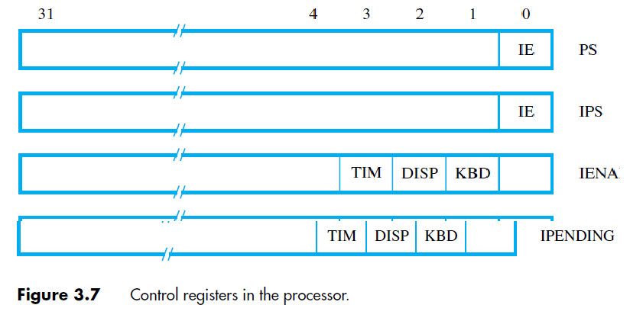
To deal with interrupts it is useful to have some other control registers.

Slide 41
The status register, PS, includes the interrupt-enable bit, IE, in addition to other status information.
The processor will accept interrupts only when this bit is set to 1.
The IPS register is used to automatically save the contents of PS when an interrupt request is received and accepted.
the interrupt-service routine, the previous state of the processor is automatically restored by transferring the contents of IPS into PS.

Slide 42
It becomes necessary to save the contents of IPS on the stack if nested interrupts are allowed.
The IENABLE register allows the processor to selectively respond to individual I/O devices.
A bit may be assigned for each device, as shown in the figure for the keyboard, display, and a timer circuit When a bit is set to 1, the processor will accept interrupt requests from the corresponding device.

Slide 43
The IPENDING register indicates the active interrupt requests.
This is convenient when multiple devices may raise requests at the same time.
Then, a program can decide which interrupt should be serviced first.
In RISC style computers : MoveControl R2, PS
MoveControl IENABLE, R3

