Slide 1

Chapter 7

Slide 2
We have seen the programmers view of I/O dada transfers.
We will discuss the details of the hardware needed to make such transfers possible.

Slide 3


Slide 4
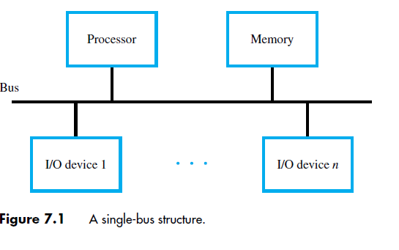
Bus Structure
The interconnection network is used to transfer the data among the processor, memory, and I/O devices.
The commonly used interconnection network is called bus.

Slide 5
Only one source/destination pair of units can use this bus to transfer data at any one time.
Bus consists of three sets of lines used to carry address, data, and control signals.
  Data, Address , Control
  I/O devices interfaces are connected to these lines, as shown.

Slide 6
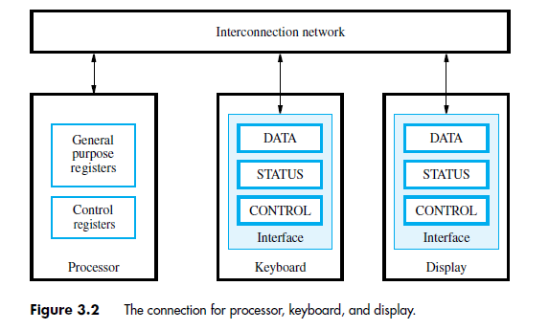

Slide 7
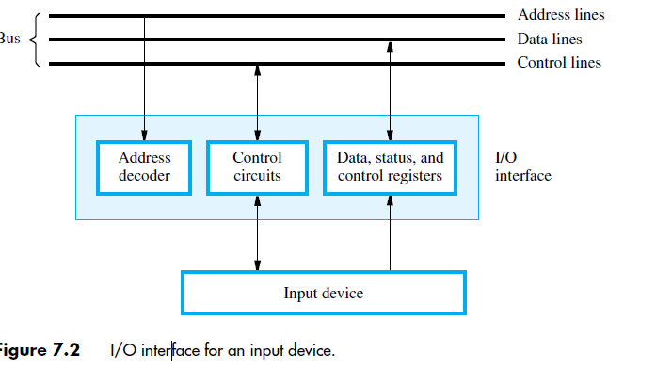

Slide 8
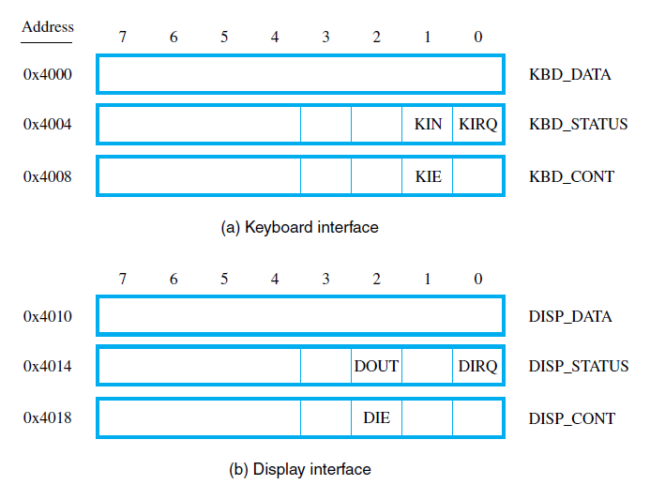

Slide 9
Processor, main memory, and I/O devices are interconnected by means of a bus.
Each I/O device is assigned a unique set of addresses for the registers in its interface
When a the processor places a particular address on the address lines, it is examined by the address Decoders of all devices on the bus.
Address is observed by all devices decoders
The device recognizes this address responds to the commands issued on the control lines.

Slide 10
The processor uses the control lines to request either
a Read or aWrite operation, and the requested data are transferred over the data lines.

Slide 11
It is a way to exchange data and instructions between CPU and I/O devices attached to it.
It is the one where processor and the I/O devices share the same address space.
Any instruction that can access memory can be used to transfer data to and from an I/O device.
Load R2, DATAIN
DATAIN is the address of a register in an input device.
Store R2, DATAOUT
DATAOUT, which is a register in an output device.

Slide 12
Bus Operation

Slide 13
Bus Operation
Bus Protocol
Synchronous Bus
Asynchronous Bus

Slide 14
Bus protocol
The set of rules that govern the behavior of various devices connected to the bus, as to when to place information on the bus, when to assert control signals, etc.
These rules are implemented by control signals that indicate what and when actions are to be taken.
One control line, usually labelled R/W, specifies whether a Read or a Write operation is to be performed. Read-1, Write – 0

Slide 15
Bus protocol (contd..)
Control signals specify:
  Whether it is a read or a write operation.
  When several operand sizes (byte, word, long word) the require. Size is indicated by other control lines
  Timing information to indicate when the processor and I/O devices may place data or receive data from the bus.
Notes:
Recall that one device plays the role of a master. The device that initiates the data transfer on the bus by issuing read or write control signals is called as a master. The device that is being addressed by the master is called a slave or a target.

Slide 16
Two types of data transfer depending on the mechanism of timing the data.
  Synchronous,
  Asynchronous.
  In any data transfer one device plays the role of a master.
  This is a device that initiates data transfer by issuing read/write command on the bus.
  Normally CPU behaves like a master.

Slide 17
Synchronous bus
All devices derive timing information from a common clock line – Bus clock
The signal on this line has two phases
A high level followed by low level
The clock line has equally spaced pulses which define equal time intervals.
  In a simple synchronous bus, each of these pulses constitutes a bus cycle.
One data transfer can take place during one bus cycle.

Slide 18

T
ime
Bus clock
Address and
command
Data
t
0
t
1
t
2
Master places the
device address and
command on the bus,
and indicates that
it is a Read operation.
Bus cycle
Addressed slave places
data on the data lines
Master “strobes” the data
on the data lines into its
input buffer, for a Read
operation.
In case of a Write operation, the master places the data on the bus along with the
address and commands at time t₀.
The slave strobes the data into its input buffer at time t₂.

Slide 20
In case of a Write operation, the master places the data on the bus along with the address and commands at time t₀.
The slave strobes the data into its input buffer at time t₂.

Slide 21
Synchronous bus (contd..)
Once the master places the device address and command on the bus, it takes time for this information to propagate to the devices:
  This time depends on the physical and electrical characteristics of the bus.
Also, all the devices have to be given enough time to decode the address and control signals, so that the addressed slave can place data on the bus.

Slide 22
Synchronous bus (contd..)
Width of the pulse t₁ - t₀ depends on:
  Maximum propagation delay between two devices connected to the bus.
  Time taken by all the devices to decode the address and control signals, so that the addressed slave can respond at time t₁.

Slide 23
At the end of the clock cycle, at time t₂, the master strobes the data on the data lines into its input buffer if it’s a Read operation.
  “Strobe” means to capture the values of the data and store them into a buffer.
When data are to be loaded into a storage buffer register, the data should be available for a period longer than the setup time of the device.
Width of the pulse t₂ - t₁ should be longer than:
  Maximum propagation time of the bus plus
  Set up time of the input buffer register of the master.

Slide 24

T
ime
Address &
command
appear on the
bus.
Bus clock
Data reaches
the master.
Seen by
master
t
AM
Address and
command
Address &
command reach
the slave.
Data
t
DM
Seen by slave
t
AS
Data appears
on the bus.
Address and
command
Data
t
DS
t
t
1
t
0
Signals do not appear on the bus as soon as they are placed on the bus, due to the
propagation delay in the interface circuits.
Signals reach the devices after a propagation delay which depends on the
characteristics of the bus.
Data must remain on the bus for some time after t₂ equal to the hold time of the buffer.
2

Slide 26
Synchronous bus -- Limitations
Data transfer has to be completed within one clock cycle.
  Clock period t2 - t0 must be such that the longest propagation delay on the bus and the slowest device interface must be accommodated.
  Forces all the devices to operate at the speed of the slowest device.
Processor just assumes that the data are available at t2 in case of a Read operation, or are read by the device in case of a Write operation.
  What if the device is actually failed, and never really responded?

Slide 27
Synchronous bus (contd..)
To overcome these, most busses incorporate control signals that represent a response from the device.
These signals inform
  Inform the master that the slave has recognized the address, and is ready to participate in a data transfer operation.
  Enable to adjust the duration of the data transfer operation based on the speed of the participating slaves.
High-frequency bus clock is used:
  Data transfer spans several clock cycles instead of just one clock cycle as in the earlier case.

Slide 28


Slide 29

Address & command
requesting a Read
operation appear on
the bus.
T
ime
1
2
3
4
Clock
Address
Command
Master strobes data
into the input buffer.
Data
Sla
v
e-ready
Slave places the data on the bus,
and asserts Slave-ready signal.
Clock changes are seen by all the devices
at the same time.
Notes:
Slave-ready signal is an acknowledgement from the slave to the master to confirm that the valid data has been sent. Depending on when the slave-ready signal is asserted, the duration of the data transfer can change.

Slide 30
Here the slave responds in cycle3.
A different device may responds earlier(or) later cycle.
If the addressed device doesn’t respond at all the master waits for some predefined no of clock cycles, then aborts the operation.

Slide 31
Asynchronous bus
Data transfers on the bus is controlled by a handshake between the master and the slave.
Common clock in the synchronous bus case is replaced by two timing control lines:
  Master-ready,
  Slave-ready.
Master-ready signal is asserted by the master to indicate to the slave that it is ready to participate in a data transfer.
Slave-ready signal is asserted by the slave in response to the master-ready from the master, and it indicates to the master that the slave is ready to participate in a data transfer.

Slide 32
Asynchronous bus (contd..)
Data transfer using the handshake protocol:
  Master places the address and command information on the bus.
  Asserts the Master-ready signal to indicate to the slaves that the address and command information has been placed on the bus.
  All devices on the bus decode the address.
  Addressed slave performs the required operation, and informs the processor it has done so by asserting the Slave-ready signal.
  Master removes all the signals from the bus, once Slave-ready is asserted.
  If the operation is a Read operation, Master also strobes the data into its input buffer.

Slide 33

T
ime
Address
and command
Master-ready
Slave-ready
Data
t
0
t
1
t
2
t
3
t
4
t
5
Bus cycle

Slide 35
t0- Master places the address and command information on the bus.
t₁ - Master asserts the Master-ready signal. Master-ready signal is asserted at t₁ instead of t₀
t₂ - Addressed slave places the data on the bus and asserts the Slave-ready signal.
t₃ - Slave-ready signal arrives at the master.
t₄ - Master removes the address and command information.
t₅ - Slave receives the transition of the Master-ready signal from 1 to 0. It removes the data and the Slave-ready signal from the bus.

Slide 36
Asynchronous vs. Synchronous bus
Advantages of asynchronous bus:
  Eliminates the need for synchronization between the sender and the receiver.
  Can accommodate varying delays automatically, using the Slave-ready signal.
Disadvantages of asynchronous bus:
  Data transfer rate with full handshake is limited by two-round trip delays.
  Data transfers using a synchronous bus involves only one round trip delay, and hence a synchronous bus can achieve faster rates.

Slide 37
ARBITRATION
There are occasions when two or more entities contend for the use of a single resource in a computer system.
This decision is usually made in an arbitration process performed by an arbitration circuit.
The arbitration process starts when each device sending a request to use the shared resource.
Consider a shared bus

Slide 38
A device that wishes to use the bus sends a request to the arbiter.
When multiple requests arrive at the same time, the arbiter selects one request and grants the bus to the corresponding device.

Slide 39
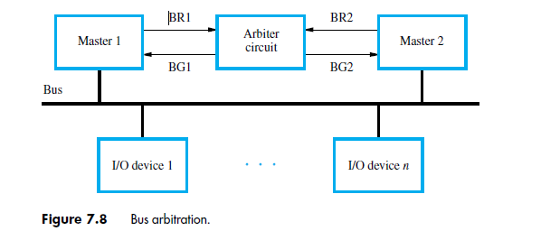

Slide 41
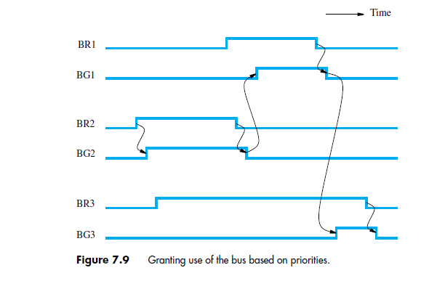

Slide 42


Slide 43
Interface circuits
I/O interface consists of the circuitry required to connect an I/O device to a computer bus.
Side of the interface which connects to the computer has bus signals for:
  Address,
  Data
  Control
Side of the interface which connects to the I/O device has:
  Datapath and associated controls to transfer data between the interface and the I/O device.
  This side is called as a “port”.
Ports can be classified into two:
  Parallel port,
  Serial port.

Slide 44
Interface circuits (contd..)
Parallel port transfers data in the form of a number of bits, normally 8 or 16 to or from the device.
Serial port transfers and receives data one bit at a time.
Processor communicates with the bus in the same way, whether it is a parallel port or a serial port.
  Conversion from the parallel to serial and vice versa takes place inside the interface circuit.

Slide 45
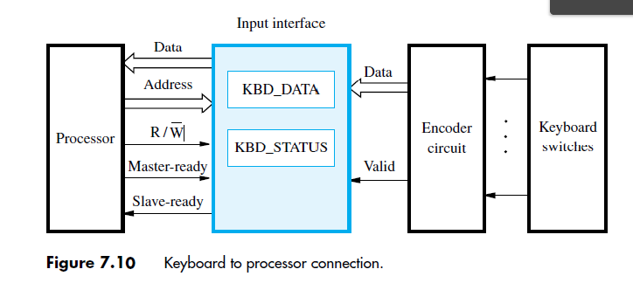
Input Interface – Key Board

Slide 46
Functions of the I/O Interface
1. Provides a register for temporary storage of data
2. Includes a status register containing status information that can be accessed by the processor
3. Includes a control register that holds the information governing the behaviour of the interface
4. Contains address-decoding circuitry to determine when it is being addressed by the processor
5. Generates the required timing signals
6. Performs any format conversion that may be necessary to transfer data between the processor and the I/O device, such as parallel-to-serial conversion in the case of a serial port

Slide 47
Keyboard is connected to a processor using a parallel port.
Processor is 32-bits and uses memory-mapped I/O and the asynchronous bus protocol.
On the processor side of the interface we have:
- Data lines.
- Address lines
- Control or R/W line.
- Master-ready signal and
- Slave-ready signal.

Slide 48
On the keyboard side of the interface:
-Encoder circuit which generates a code for the key pressed.
- Data lines contain the code for the key.
- Valid line changes from 0 to 1 when the key is pressed.
- This causes the code to be loaded into DATAIN and SIN to be set to 1.

Slide 49
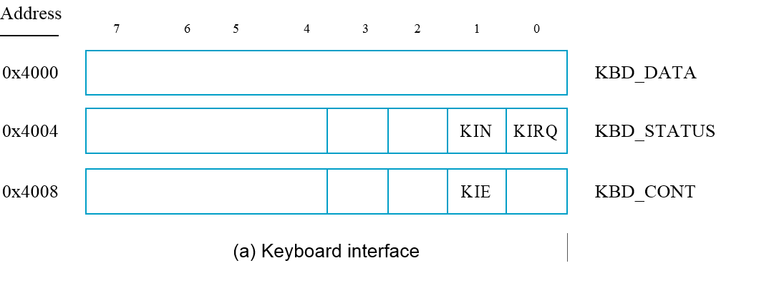

Slide 50
circuit that can be used to connect a keyboard to a processor.
There are only two registers:
A data register - KBD_DATA
Status register - KBD_STATUS
The latter contains the keyboard status flag, KIN.
Key pressed – ASCII
KIN– 1, KBD- DATA – Data
O/P of Encoder -- One byte of data representing encoded character and one valid bit.

Slide 51
The interface circuit is shown connected to an asynchronous bus on which transfers are controlled by the handshake signals Master-ready and Slave-ready.

Slide 52
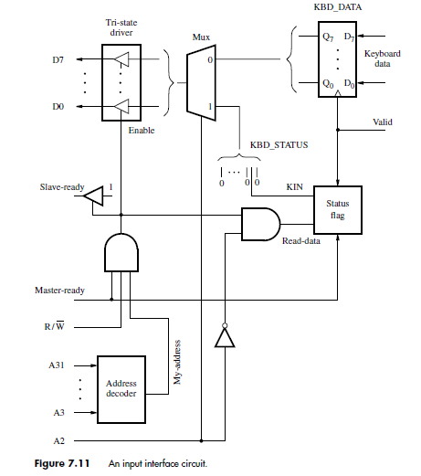
An Input interface circuit

Slide 53
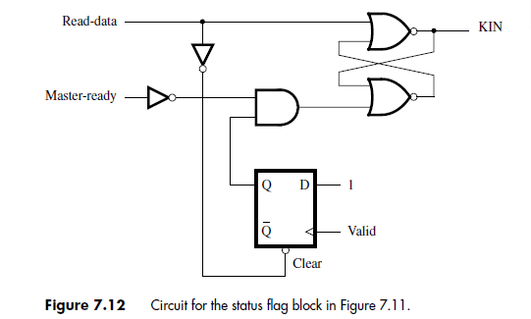

Slide 54

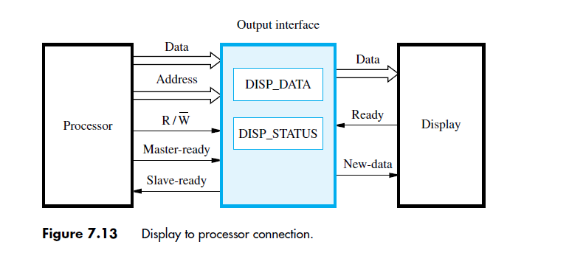

Slide 55
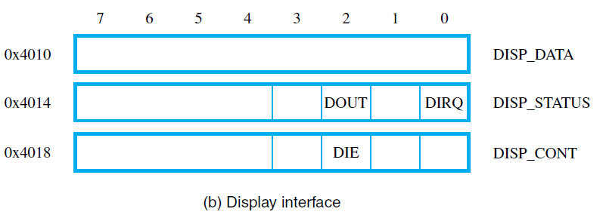

Slide 56
Printer is connected to a processor using a parallel port.
Processor is 32 bits, uses memory-mapped I/O and asynchronous bus protocol.
On the processor side:
- Data lines.
- Address lines
- Control or R/W line.
- Master-ready signal and
- Slave-ready signal.

Slide 57

On the printer side:
We have assumed that the display uses two handshake signals, New-data and Ready.
When the display is ready to accept a character, it asserts its Ready signal, which causes the DOUT flag in the DISP_STATUS register to be set to 1.

Slide 58
When the I/O routine checks DOUT and finds it equal to 1, it sends a character to DISP_DATA.
This clears the DOUT flag to 0 and sets the New-data signal to 1.
In response, the display returns Ready to 0 and accepts and displays the character in DISP_DATA.
When it is ready to receive another character, it asserts Ready again, and the cycle repeats.

Slide 60
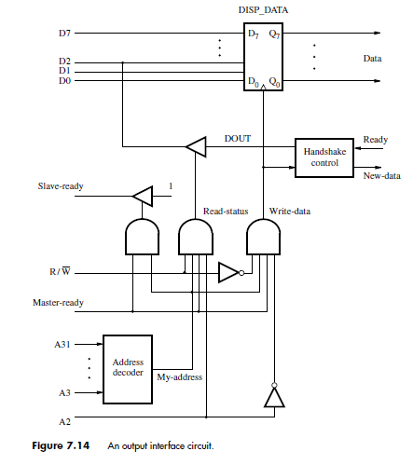
Output Interface

Slide 62
Serial Interface

Slide 63
Serial port
Serial port is used to connect the processor to I/O devices that require transmission of data one bit at a time.
Serial port communicates in a bit-serial fashion on the device side and bit parallel fashion on the bus side.
  Transformation between the parallel and serial formats is achieved with shift registers that have parallel access capability.

Slide 64
Input shift re
gister
Serial
input
Input shift register accepts input one bit
at a time from the I/O device.
Once all the 8 bits are received, the
contents of the input shift register are
loaded in parallel into DATAIN register.
Output data in the DATAOUT register
are loaded into the output shift register.
Bits are shifted out of the output shift
register and sent out to the I/O device one
bit at a time.
As soon as data from the input shift reg.
are loaded into DATAIN, it can start
accepting another 8 bits of data.
Input shift register and DATAIN registers
are both used at input so that the input
shift register can start receiving another
set of 8 bits from the input device after
loading the contents to DATAIN, before
the processor reads the contents of
DATAIN. This is called as double-
buffering.
D
A
T
AIN
D7
D0
My-address
D
A
T
A
OUT
RS1
RS0
Chip and
R
/
W
re
gister
Output shift re
gister
Serial
Ready
select
Accept
Recei
ving clock
I
N
T
R
Status
and
ransmission clock
control
T

Slide 65
Input shift register accepts input one bit at a time from the I/O device.
Once all the 8 bits are received, the contents of the input shift register are loaded in parallel into DATAIN register.
Output data in the DATAOUT register are loaded into the output shift register.
Bits are shifted out of the output shift register and sent out to the I/O device one bit at a time.
As soon as data from the input shift reg. are loaded into DATAIN, it can start accepting another 8 bits of data.

Slide 66
Input shift register and DATAIN registers are both used at input so that the input shift register can start receiving another
set of 8 bits from the input device after loading the contents to DATAIN, before the processor reads the contents of
DATAIN. This is called as double- buffering.

Slide 67
Serial port (contd..)
Serial interfaces require fewer wires, and hence serial transmission is convenient for connecting devices that are physically distant from the computer.
Speed of transmission of the data over a serial interface is known as the “bit rate”.
  Bit rate depends on the nature of the devices connected.
In order to accommodate devices with a range of speeds, a serial interface must be able to use a range of clock speeds.
Several standard serial interfaces have been developed:
  Universal Asynchronous Receiver Transmitter (UART) for low-speed serial devices.
  RS-232-C for connection to communication links.

Slide 68
PCI Bus

Slide 69
Standard I/O interfaces
A number of standards have been developed for the expansion bus.
  Some have evolved by default.
  For example, IBM’s Industry Standard Architecture.
Three widely used bus standards:
  PCI (Peripheral Component Interconnect)
  SCSI (Small Computer System Interface)
  USB (Universal Serial Bus)

Slide 70
PCI Bus
Peripheral Component Interconnect
Introduced in 1992
Low-cost and Processor independent bus
It is housed on the motherboard of a computer and used to connect I/O interfaces for a wide variety of devices.
Plug-and-play capability

Slide 71
Processor
Main
memory
Bridge circuit translates
signals and protocols from
processor bus to PCI bus.
Processor bus
Bridge
PCI bus
Expansion bus on
the motherboard
Additional
SCSI
Ethernet
USB
ISA
memory
controller
Interface
controller
Interface
SCSI b
us
IDE
V
ideo
disk
Disk
CD-R
OM
controller
controller
Disk 1
Disk 2
CD-
K
e
yboard
Game
R
OM

Slide 72
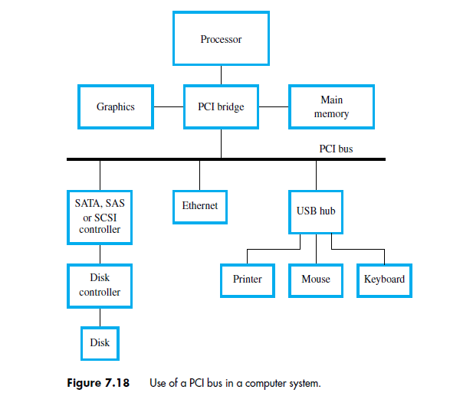

Slide 73
Bus Structures
The PCI bus is connected to the processor bus via a controller called a bridge.
The bridge has a serial port for connecting the computer’s memory.
Another special high speed port for connecting graphics devices
The bridge translates and commands and responses from one bus to the other and transfers data between them

Slide 74
The processor sends a read request to an I/O device, the bridge forwards the commands and address lines on the bus.
I/O devices are connected to the PCI bus through port that use standards such as Ethernet, USB,SATA, SCSI.
PCI bus supports 3 interfaces
R/W operation that involves a single word is treated as a burst of length one.
PCI uses same bus to transfer both address and data

Slide 75
We assumed that the master maintains the address information on the bus until data transfer is completed. But, the address is needed only long enough for the slave to be selected.
Thus, the address is needed on the bus for one clock cycle only, freeing the address lines to be used for sending data in subsequent clock cycles.
The result is a significant cost reduction

Slide 76
Data transfer
we will examine a typical bus transaction.
Bus master, which is the device that initiates data transfers by issuing Read and Write commands, is called the initiator in PCI terminology.
The addressed device that responds to these commands is called a target.
The target-ready, TRDY# = Slave-ready
initiator-ready signal, IRDY#, to support burst transfers.

Slide 77
Data transfer signals on the PCI bus.
Name
F
unction
CLK
A
33-MHz
or
66-MHz
clock.
FRAME#
Sent
b
y
the
initiator
to
indicate
the
duration
of
a
transaction.
AD
32
address/data
lines,
which
may
b
e
optionally
increased
to
64.
C/BE#
4
command/byte-enable
lines
(8
for
a
64-bit
bus).
IRD
Y#,
TRD
Y#
Initiator-ready
and
Target-ready
signals.
DEVSEL#
A
response
from
the
device
indicating
that
it
has
recognized
its
address
and
is
ready
for
a
data
transfer
transaction.
IDSEL#
Initialization
Device
Select.

Slide 78
A complete transfer operation on the PCI bus, involving an address and a burst of data, is called a transaction

Slide 79
1
2
3
4
5
6
7
CLK
Frame#
AD
Adress
#1
#2
#3
#4
C/BE#
Cmnd
Byte enable
IRD
Y#
TRD
Y#
DEVSEL#
A read operation on the PCI bus

Slide 80
Clock Cycle #1: Bus master asserts frame# to indicate the beginning of a transaction.
It sends address on address lines and read command on C/BE# lines
Clock Cycle #2: The initiator removes the address and disconnects its drivers from AD lines and asserts IRDY#
IRDY# - It is ready to receive the data
Target asserts DEVSEL# signal

Slide 81
Clock Cycle #3:
Target asserts TRDY# and begins to send the data.
It maintains DEVSEL# in asserted state until the end of the transaction
Initiator uses frame# to indicate duration of the burst
This deactivates at cycle #5, during this the initiator receives 3rd word.
In response to that it receives next word and stops
After sending 4th word deactivates TRDY# and DEVSEL# and disconnects its drivers on the AD lines.

Slide 82
SCSI Bus

Slide 83
SCSI Bus
The acronym SCSI stands for Small Computer System Interface.
It refers to a standard bus defined by the American National Standards Institute (ANSI) under the designation X3.131 .
In the original specifications of the standard, devices such as disks are connected to a computer via a 50-wire cable, which can be up to 25 meters in length and can transfer data at rates up to 5 megabytes/s.
The SCSI bus standard has undergone many revisions, and its data transfer capability has increased very rapidly, almost doubling every two years.
SCSI-2 and SCSI-3 have been defined, and each has several options.
Because of various options SCSI connector may have 50, 68 or 80 pins.

Slide 84
SCSI Bus (Contd.,)
Devices connected to the SCSI bus are not part of the address space of the processor
The SCSI bus is connected to the processor bus through a SCSI controller.
A packet may contain a block of data, commands from the processor to the device, or status information about the device.
A controller connected to a SCSI bus is one of two types – an initiator or a target.
An initiator has the ability to select a particular target and to send commands specifying the operations to be performed. The disk controller operates as a target. It carries out the commands it receives from the initiator.
The initiator establishes a logical connection with the intended target.
Once this connection has been established, it can be suspended and restored as needed to transfer commands and bursts of data.
While a particular connection is suspended, other device can use the bus to transfer information.
This ability to overlap data transfer requests is one of the key features of the SCSI bus that leads to its high performance.

Slide 85
SCSI Bus (Contd.,)
Data transfers on the SCSI bus are always controlled by the target controller.
To send a command to a target, an initiator requests control of the bus and, after winning arbitration, selects the controller it wants to communicate with and hands control of the bus over to it.
Then the controller starts a data transfer operation to receive a command from the initiator.

Slide 86
SCSI Bus (Contd.,)
Assume that processor needs to read block of data from a disk drive and that data are stored in disk sectors that are not contiguous.
The processor sends a command to the SCSI controller, which causes the following sequence of events to take place:
  The SCSI controller, acting as an initiator, contends for control of the bus.
  When the initiator wins the arbitration process, it selects the target controller and hands over control of the bus to it.
  The target starts an output operation (from initiator to target); in response to this, the initiator sends a command specifying the required read operation.
  The target, realizing that it first needs to perform a disk seek operation, sends a message to the initiator indicating that it will temporarily suspend the connection between them. Then it releases the bus.
  The target controller sends a command to the disk drive to move the read head to the first sector involved in the requested read operation. Then, it reads the data stored in that sector and stores them in a data buffer. When it is ready to begin transferring data to the initiator, the target requests control of the bus. After it wins arbitration, it reselects the initiator controller, thus restoring the suspended connection.

Slide 87
SCSI Bus (Contd.,)
  The target transfers the contents of the data buffer to the initiator and then suspends the connection again
  The target controller sends a command to the disk drive to perform another seek operation. Then, it transfers the contents of the second disk sector to the initiator as before. At the end of this transfers, the logical connection between the two controllers is terminated.
  As the initiator controller receives the data, it stores them into the main memory using the DMA approach.
  The SCSI controller sends as interrupt to the processor to inform it that the requested operation has been completed

Slide 88
Operation of SCSI bus from H/W point of view
Category
Name
F
unction
Data
–
DB(0)
to
Data
lines:
Carry
one
b
yte
of
information
–
DB(7)
during
the
information
transfer
phase
and
iden
tify
device
during
arbitration,
selection
and
reselection
phases
–
DB(P)
P
arit
y
bit
for
the
data
bus
Phase
–
BSY
Busy:
Asserted
when
the
bus
is
not
free
–
SEL
Selection:
Asserted
during
selection
and
reselection
Information
–
C/D
Con
trol/Data:
Asserted
during
transfer
of
type
con
trol
information
(command,
status
or
message)
–
MSG
Message:
indicates
that
the
information being
transferred
is
a
message
Table 4. The SCSI bus signals.

Slide 89
Table 4. The SCSI bus signals.(cont.)
Category
Name
F
unction
Handshake
–
REQ
Request:
Asserted
b
y
a
target
to
request
a
data
transfer
cycle
–
A
CK
Ac
kno
wledge:
Asserted
b
y
the
initiator
when
it
has
completed
a
data
transfer
op
eration
Direction of
–
I/O
Input/Output:
Asserted
to
indicate
an
input
transfer
op
eration
e
(relativ
to
the
initiator)
–
Other
A
TN
A
tten
tion:
Asserted
b
y
an
initiator
when
it
wishes
to
send
a
message
to
a
target
–
RST
Reset:
Causes
all
device
con
trols
to
disconnect
from
the
bus
and
assume
their
start-up
state

Slide 90
Main Phases involved
Arbitration
  A controller requests the bus by asserting BSY and by asserting it’s associated data line
  When BSY becomes active, all controllers that are requesting bus examine data lines
Selection
  Controller that won arbitration selects target by asserting SEL and data line of target. After that initiator releases BSY line.
  Target responds by asserting BSY line
  Target controller will have control on the bus from then
Information Transfer
  Handshaking signals are used between initiator and target
  At the end target releases BSY line
Reselection

