Slide 1
Chapter . Pipelining

Slide 2
Overview
Pipelining is widely used in modern processors.
Pipelining improves system performance in terms of throughput.
Pipelined organization requires sophisticated compilation techniques.

Slide 3
Basic Concepts

Slide 4
Making the Execution of Programs Faster
Use faster circuit technology to build the processor and the main memory.
Arrange the hardware so that more than one operation can be performed at the same time.
In the latter way, the number of operations performed per second is increased even though the elapsed time needed to perform any one operation is not changed.

Slide 5
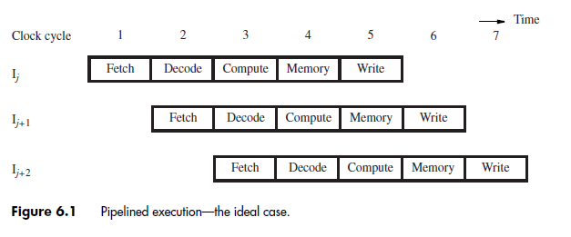

Slide 6
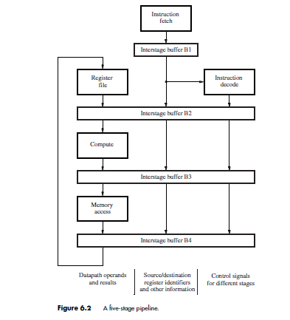

Slide 7
Pipelining Issues

Slide 8
There are times when it is not possible to have a new instruction enter the pipeline in every cycle.
Consider the case of two instructions, Ij and I j+1, where the destination register for instruction Ij is a source register for instruction Ij+1.
The result of instruction Ij is not written into the register file until cycle 5, but it is needed earlier in cycle 3 when the source operand is read for instruction Ij+1.

Slide 9
To obtain the correct result, it is necessary to wait until
the new value is written into the register by instruction Ij.
Hence, instruction Ij+1 cannot read its operand until cycle 6, which means it must be stalled in the Decode stage for three cycles.
While instruction Ij+1 is stalled, instruction Ij+2 and all subsequent instructions are similarly delayed.
New instructions cannot enter the pipeline, and the total execution time is increased.

Slide 10
Any condition that causes the pipeline to stall is called a hazard .
Data Hazard
Other hazards from memory delay, branch instructions, and resource limitations.

Slide 11
Data Dependencies
Add R2, R3, #100
Subtract R9, R2, #30
data dependency between these two instructions, because register R2 carries data from the first instruction to the second.

Slide 12
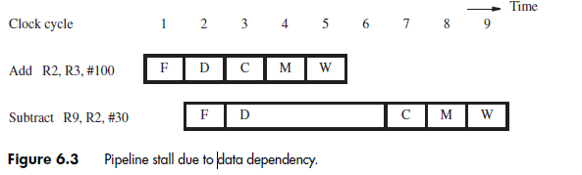

Slide 13
Operand Forwarding
Pipeline stalls due to data dependencies can be alleviated through the use of operand forwarding.
The desired value is actually available at the end of cycle 3, when the ALU completes the operation for the Add instruction.
This value is loaded into register RZ, which is a part of inter stage buffer B3.
Rather than stall the Subtract instruction, the hardware can forward the value from register RZ to where it is needed in cycle 4, which is the ALU input.

Slide 14
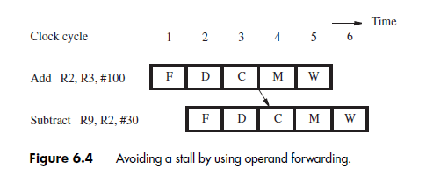
Pipelined Execution when forward is used

Slide 15
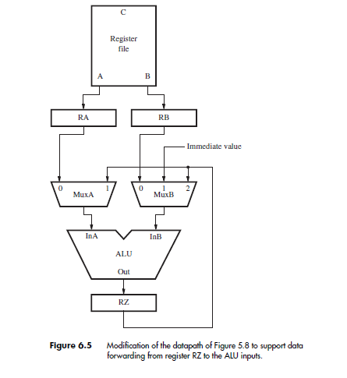

Slide 16
Handling Data Dependencies in Software
The figures 6.3 and 6.4 shows how data dependencies handled by the processor hardware.
An alternative approach is to leave the task of detecting data dependencies and dealing with them to the compiler.
When the compiler identifies a data dependency between two successive instructions Ij and Ij+1, it can insert three explicit NOP (No-operation) instructions between them.
The NOPs introduce the necessary delay to enable instruction Ij+1 to read the new value from the register file after it is written.

Slide 17
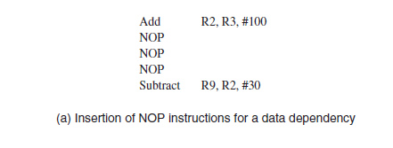

Slide 18
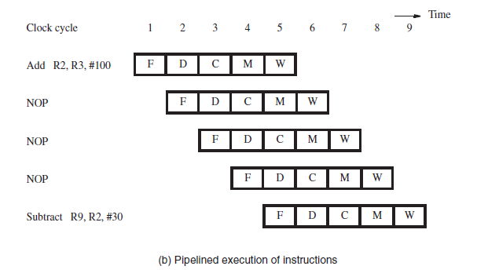
The three NOP instructions have the same effect on execution time as the stall in Figure 6.3.

Slide 19
Requiring the compiler to identify dependencies and insert NOP instructions simplifies the hardware implementation of the pipeline.
However, the code size increases, and the execution time is not reduced as it would be with operand forwarding.
The compiler can attempt to optimize the code to improve performance and reduce the code size by reordering instructions to move useful instructions into the NOP slots.
The compiler must consider data dependencies between instructions, which constrain the extent to which the NOP slots can be usefully filled.

Slide 20
Memory Delays
Delays arising from memory accesses are another cause of pipeline stalls
Load instruction may require more than one clock cycle to obtain its operand from memory.
This may occur because the requested instruction or data are not found in the cache, resulting in a cache miss.
A cache miss causes all subsequent instructions to be
delayed.
A similar delay can be caused by a cache miss when fetching an instruction.

Slide 21
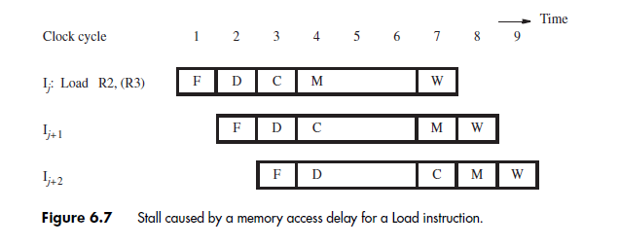

Slide 22
There is an additional type of memory-related stall that occurs when there is a data dependency involving a Load instruction. Consider the instructions:
Load R2, (R3)
Subtract R9, R2, #30
Assume that the data for the Load instruction is found in the cache, requiring only one cycle to access the operand

Slide 23
Operand forwarding cannot be done in the same manner as Figure 6.4, because the data read from the cache are not available until they are loaded into register RY at the beginning of cycle 5.
Therefore, the Subtract instruction must be stalled for one cycle.

Slide 24
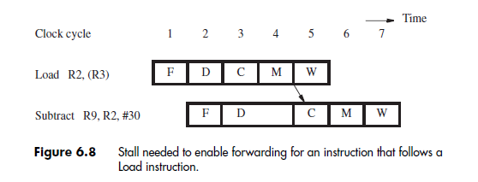

Slide 25
The compiler can eliminate the one-cycle stall for this type of data dependency by reordering instructions.
to insert a useful instruction between the Load instruction and the instruction that depends on the data read from the memory.
Or NOP

Slide 26
Branch Delays

Slide 27
Branch instructions can alter the sequence of execution, but they must first be executed to determine whether and where to branch.

Slide 28
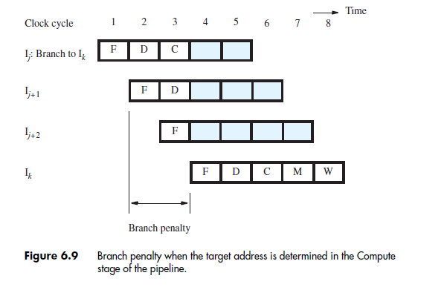
Branch Delays
Unconditional Branches

Slide 29
Branch instructions occur frequently With a two-cycle branch penalty, the relatively high frequency of branch instructions could increase the execution time for a program by as much as 40 percent.
Therefore, it is important to find ways to mitigate this impact on performance.
Reducing the branch penalty requires the branch target address to be computed earlier in the pipeline.

Slide 30
Rather than wait until the Compute stage, it is possible to determine the target address and update the program counter in the Decode stage.
Thus, instruction Ik can be fetched one clock cycle earlier, reducing the branch penalty to one cycle.

Slide 31
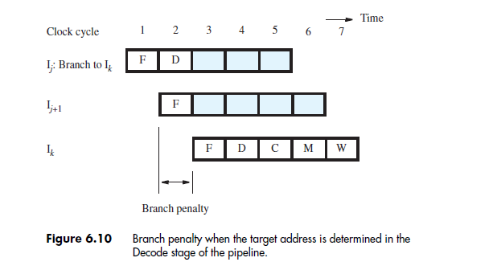

Slide 32
The adder in the figure5.10 is needed to increment the PC in every cycle.
A second adder is needed in the Decode stage to compute a branch target address for every instruction.
When the instruction decoder determines that the instruction is indeed a branch instruction, the computed target address will be available before the end of the cycle.
It can then be used to fetch the target instruction in the next cycle.

Slide 33
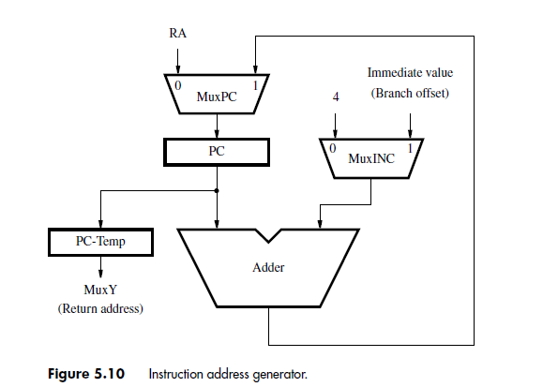

Slide 34
Conditional Branches

Slide 35
conditional branch instruction such as
Branch_if_[R5]=[R6] LOOP

Slide 36
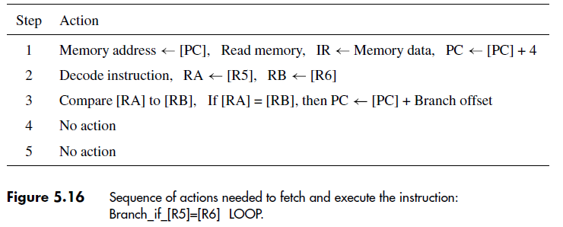

Slide 37
For pipelining, the branch condition must be tested as early as possible to limit the branch penalty.
Similar to the unconditional branch the comparator that tests the branch condition can also be moved to the Decode stage, enabling the conditional branch
decision to be made at the same time that the target address is determined.

Slide 38
The Branch Delay Slot
The location that follows a branch instruction is called the branch delay slot.
Rather than conditionally discard the instruction in the delay slot, we can arrange to have the pipeline always execute this instruction, whether or not the branch is taken.

Slide 39
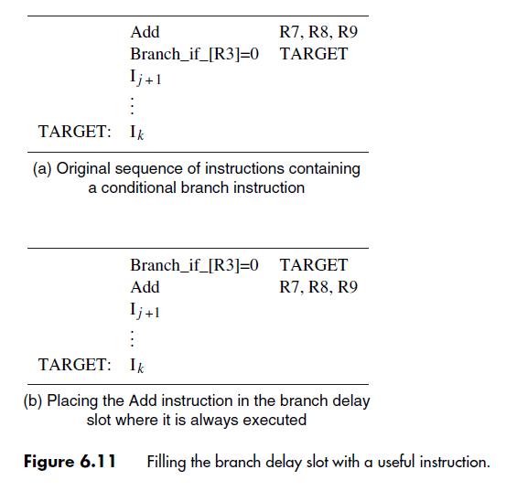
The Branch Delay Slot

Slide 40
Branch Prediction

Slide 41
Branch Prediction
Static Branch Prediction
Dynamic Branch Prediction.
Static Branch Prediction:
Branch taken – backward
Branch not taken – forward
based on sign of offset

Slide 42
Static Branch Prediction
We discuss how the prediction is made in cycle 1 while a branch instruction is being fetched.
If the prediction is correct, the fetched instruction is allowed to complete and there is no penalty.
However, if it is determined that the branch is to be taken, the instruction that has been fetched is discarded
and the correct branch target instruction is fetched.
Misprediction incurs the full branch penalty.
Similarly not taken.

Slide 43
A backward branch at the end of a loop is taken most of the time.
For such a branch, better accuracy can be achieved by predicting that the branch is likely to be taken.
Similarly, for a forward branch at the beginning of a loop, the not-taken prediction leads to good prediction accuracy.
The processor can determine the static prediction of taken or not-taken by checking the sign of the branch offset.

Slide 44
Dynamic Branch Prediction
To improve prediction accuracy further, we can use actual branch behavior to influence the prediction, resulting in dynamic branch prediction
keeping track of branch decisions everytime that a branch instruction is executed.
A dynamic prediction algorithm can use the result of the most recent execution of a branch instruction
The processor assumes that the next time the instruction is executed, the branch decision is likely to be the same as the last time

Slide 45
Hence, the algorithm may be described by the two-state machine. The two states are:
LT - Branch is likely to be taken
LNT - Branch is likely not to be taken
Eg: Loop

Slide 46
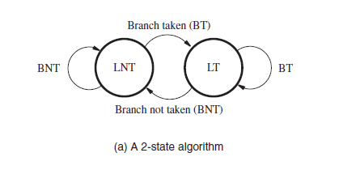

Slide 47
Better prediction accuracy can be achieved by keeping more information about execution history.
An algorithm that uses four states.
ST - Strongly likely to be taken
LT - Likely to be taken
LNT - Likely not to be taken
SNT - Strongly likely not to be taken

Slide 48
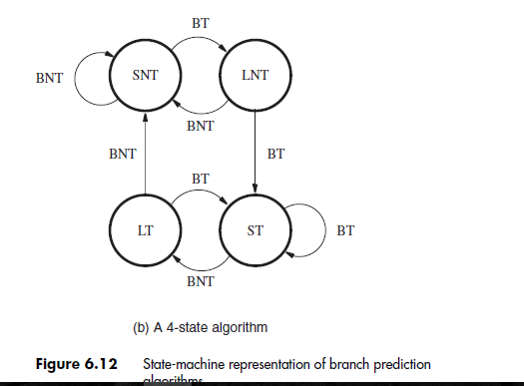

Slide 49
Branch Target Buffer for Dynamic Prediction
The required information is usually stored in a small, fast memory called the branch target buffer.
The branch target buffer identifies branch instructions by their addresses.
As each branch instruction is executed, the processor records the address of the instruction and the outcome of the branch decision in the buffer.

Slide 50
The information is organized in the form of
a lookup table, in which each entry includes:
the address of the branch instruction
one or two state bits for the branch prediction algorithm
the branch target address
So many branches- more size- more recent ones

Slide 51
6.7 Resource Limitations
The pipeline stalls when there are insufficient hardware resources to permit all actions to proceed concurrently.
If two instructions need to access the same resource in the same clock cycle, one instruction must be stalled to allow the other instruction to use the resource.
This can be prevented by providing additional hardware.

Slide 52
Single cache – Fetch and memory access
If both the Fetch and Memory stages of the pipeline are connected to the cache, then it is not possible for activity in both stages to proceed simultaneously.
One access at a time/cycle, not simultaneously
25% are Load and Store instructions.
These stalls increase the execution time by 25 percent.
Use separate caches for data and instructions

Slide 53
Performance
Evaluation

Slide 54
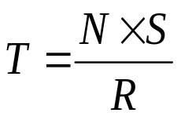
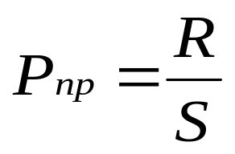
Non- Pipelined System
Non pipelined system the execution time T of a program with N instructions is given by:
Basic performance equation:
- S is the average number of clock cycles it takes to fetch and execute one instruction (5)
- R is the clock rate in cycles per second.
Instruction throughput: is defined as the number of instructions executed per second.

Slide 55
Pipelined System
If there are no cache misses, S is equal to 5.
Pipelining improves performance by overlapping the execution of successive instructions
Introduces one new instruction per cycle
Thus, in the absence of stalls, S is equal to 1, and the ideal throughput with pipelining is Pp = R

Slide 56
Pipelined System Contd..
An n-stage pipeline has the potential to increase the throughput by n times.
However, the only real measure of performance is the total execution time of a program.
Higher instruction throughput will not necessarily lead to higher performance.
Two questions regarding pipelining
How much of this potential increase in instruction throughput can be realized in practice?
What is good value of n?

Slide 57
Any time a pipeline is stalled or instructions are discarded, the instruction throughput is reduced below its ideal value.
The performance of a pipeline is highly influenced by factors such as stalls due to data dependencies between instructions and penalties due to branches.
Cache misses increase the execution time even further.

Slide 58
Effects of Stalls and Penalties

Slide 59
Effects of Stalls
While ideal pipelined execution has S = 1, stalls due to such Load instructions have the effect of increasing S by an amount δstall.
Load instructions constitute 25 percent of the dynamic instruction count, and assume that 40 percent of these Load instructions are followed by a dependent instruction.
stall is needed in such cases. Hence, the increase over the ideal case of S = 1 is

Slide 60
δstall = 0.25 × 0.40 × 1 = 0.10
the execution time T is increased by 10 percent, and throughput is reduced to
Pp = R/(1 + δstall) = R/1.1= 0.91R

Slide 61
Penalties due to misprediction of branches:
When both the branch decision and the branch target address are determined in the Decode stage of the pipeline, the branch penalty is one cycle.
20% of the instruction count of a program, and that the average prediction accuracy for branch instructions is 90%.
10% of all branch instructions that are executed incur a one-cycle penalty due to mis prediction.
The increase in the average number of cycles per instruction due to branch penalties is
δbranch_penalty = 0.20 × 0.10 × 1 = 0.02

Slide 62
5 percent of all fetched instructions incur a cache miss
30 percent of all instructions executed are Load or Store instructions, and 10 percent of their data-operand accesses incur a cache miss.
The penalty to access the main memory for a cache miss is 10 cycles.
δmiss = (0.05 + 0.30 × 0.10) × 10 = 0.8
When all factors are combined, S is increased from the ideal value of 1 to
1 + δstall + δbranch_penalty + δmiss.

Slide 63
Number of Pipeline Stages
Since an n-stage pipeline has the potential to increase the throughput by n times, how about we use a 10,000-stage pipeline?
As the number of stages increase, the probability of the pipeline being stalled increases.
The inherent delay in the basic operations increases.
Hardware considerations (area, power, complexity,…)

Slide 64
Pipeline Performance
Again, pipelining does not result in individual instructions being executed faster; rather, it is the throughput that increases.
Throughput is measured by the rate at which instruction execution is completed.
Pipeline stall causes degradation in pipeline performance.
We need to identify all hazards that may cause the pipeline to stall and to find ways to minimize their impact.

