Slide 1
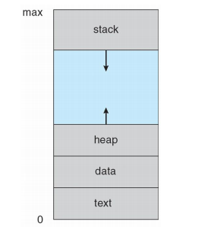
Chapter 3
Process:
a program in execution
Process includes
Program Counter
Stack
Data Section

Slide 2
stack, which contains temporary data (such as function parameters, return addresses, and local variables).
data section, which contains global variables.
heap, which is memory that is dynamically allocated during process run time.
program counter specifying the next instruction to execute

Slide 3
Process State:
As a process executes, it changes state. The state of a process is defined in part by the current activity of that process.
Each process may be in one of the following states:
New. The process is being created.
• Running. Instructions are being executed.
• Waiting. The process is waiting for some event to occur (such as an I/O
completion or reception of a signal).
• Ready. The process is waiting to be assigned to a processor.
• Terminated. The process has finished execution.

Slide 4
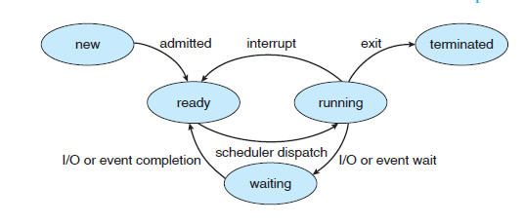
Diagram of Process States

Slide 5
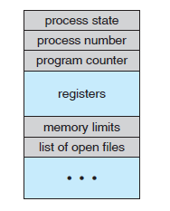
Process Control Block:
Each process is represented in the operating system by a process control block (PCB)—also called a task control block.
It is also called as task control block.
It is shown in following fig.

Slide 6
Process state: The state may be new, ready, running, waiting, halted, and so on.
Program counter: The counter indicates the address of the next instruction to be executed for this process.
CPU registers:The registers vary in number and type, depending on the computer architecture. They include accumulators, index registers, stack pointers, and general-purpose registers, plus any condition-code information. Along with the program counter, this state information must be saved when an interrupt occurs.

Slide 7
CPU-scheduling information. This information includes a process priority, pointers to scheduling queues, and any other scheduling parameters.
Memory-management information. This information may include such information as the value of the base and limit registers, the page tables, or the segment tables, depending on the memory system used by the operating system.
Accounting information. This information includes the amount of CPU and real time used, time limits, account numbers, job or process numbers, and so on.
I/O status information. This information includes the list of I/O devices allocated to the process, a list of open files, and so on.

Slide 8
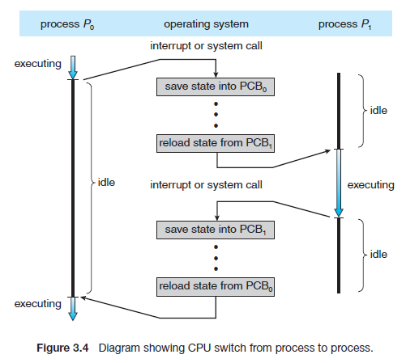

Slide 9
Process Scheduling
In multiprocessor environment more than is executed, so every time CPU switches from one process to other process.
Scheduling Queues:
Job queue – set of all processes in the system
Ready queue – set of all processes residing in main memory, ready and waiting to execute
Device queues – set of processes waiting for an I/O device
Processes migrate among the various queues

Slide 10
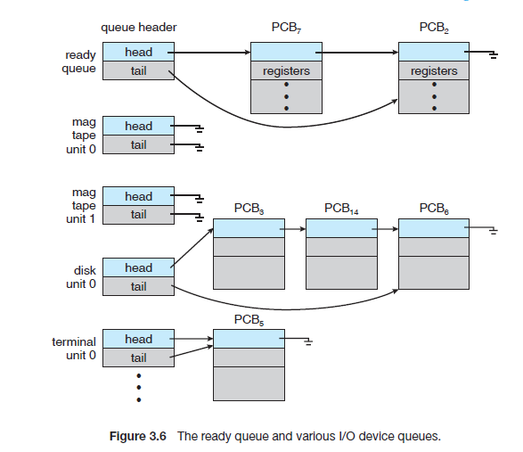

Slide 11
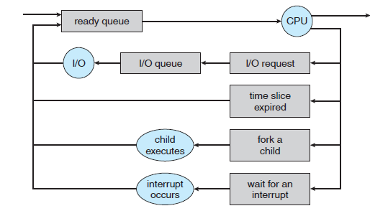
Queueing Diagram: A common representation of process scheduling is a queueing diagram.It is shown in following fig.

Slide 12
Each rectangular box represents a queue.
Two types of queues are present: the ready queue and a set of device queues.
The circles represent the resources
The arrows indicate the flow of processes in the system.
A new process is initially put in the ready queue. It waits there until it is selected for execution, or is dispatched. Once the process is allocated the CPU and is executing, one of several events could occur:

Slide 13
The process could issue an I/O request and then be placed in an I/O queue.
• The process could create a new subprocess and wait for the subprocess’s termination.
• The process could be removed forcibly from the CPU as a result of an
interrupt, and be put back in the ready queue.
In the first two cases, the process eventually switches from the waiting state to the ready state and is then put back in the ready queue

Slide 14
Schedulers
A process migrates among the various scheduling queues throughout its lifetime. The operating system must select, for scheduling purposes, processes from these queues in some fashion. The selection process is carried out by the appropriate scheduler.
Long-term scheduler (or job scheduler) – selects which processes should be brought into the ready queue
Short-term scheduler (or CPU scheduler) – selects which process should be executed next and allocates CPU

Slide 15
The distinction between these two schedulers lies in frequency of execution
The long-term scheduler controls the degree of multiprogramming.
An I/O-bound process is one that spends more of its time doing I/O than it spendsdoing computations.
A CPU-bound process, is one that spends more of its time doing computations.
It is important that the long-term scheduler select a good process mix of I/O-bound and CPU-bound processes. If all processes are I/O bound, the ready queue will almost always
be empty, and the short-term scheduler will have little to do. If all processes are CPU bound, the I/O waiting queue will almost always be empty, devices will go unused, and again the system will be unbalanced. The system with the best performance will thus have a combination of CPU-bound and I/O-bound processes.

Slide 16
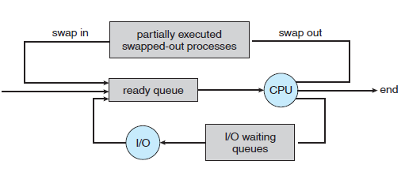
time-sharing systems introduce an additional, intermediate level of scheduling i.e medium-term scheduler. It is shown in fig.
Reduce the degree of multiprogramming

Slide 17
Context switch: Switching the CPU to another process requires performing a state save of the current process and a state restore of a different process. This task is known as a context switch.
Operations on Process:
Process creation:
Parent process create children processes, which, in turn create other processes, forming a tree of processes.
operating systems identify processes according to a unique process identifier (or pid), which is typically an integer number

Slide 18
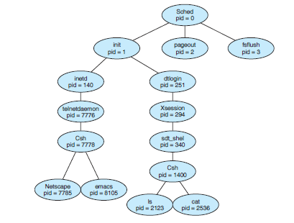
The following fig. illustrates a typical process tree for the Solaris operating system, showing the name of each process and its pid.

Slide 19
In Solaris, the process at the top of the tree is the sched process, with pid of 0. The sched process creates several children processes—including pageout and fsflush. These processes are responsible for managing memory and file systems.
The sched process also creates the init process,which serves as the root parent process for all user processes.
In this figure we see two children of init—inetd and dtlogin.
inetd is responsible for networking services such as telnet and ftp;
dtlogin is the process representing a user login screen. When a user logs in, dtlogin creates an X-windows session (Xsession), which in turns creates the sdt shel process. Below sdt shel, a user’s command-line shell—the C-shell or csh—is created. In this commandline interface, the user can then invoke various child processes, such as the ls and cat commands. We also see a csh process with pid of 7778 representing a user who has logged onto the system using telnet.

Slide 20
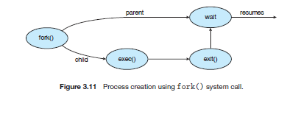
When a process creates a new process, two possibilities exist for execution:
1. The parent continues to execute concurrently with its children.
2. The parent waits until some or all of its children have terminated.
There are also two possibilities for the address space of the new process:
1. The child process is a duplicate of the parent process (it has the same
program and data as the parent).
2. The child process has a new program loaded into it.

Slide 21
Process Termination:
A process terminates when it finishes executing its final statement and asks the operating system to delete it by using the exit() system call.
All the resources of the process—including physical and virtual memory, open files, and I/O buffers—are deallocated by the Operating system.
A parent may terminate the execution of one of its children for a variety of reasons, such as these
The child has exceeded its usage of some of the resources that it has been
allocated.
The task assigned to the child is no longer required.
The parent is exiting, and the operating system does not allow a child to continue if its parent terminates.

Slide 22
Interprocess Communication:
Processes executing concurrently in the operating system may be either independent processes or cooperating processes.
A process is independent if it cannot affect or be affected by the other processes executing in the system.
A process is cooperating if it can affect or be affected by the other processes executing in the system.

Slide 23
Reasons for providing an environment that allows process cooperation
Information sharing. Since several users may be interested in the same piece of information (for instance, a shared file), we must provide an environment to allow concurrent access to such information.
Computation speedup. If we want a particular task to run faster, we must break it into subtasks, each of which will be executing in parallel with the others. Notice that such a speedup can be achieved only if the computer has multiple processing elements (such as CPUs or I/O channels).
Modularity. We may want to construct the system in a modular fashion,
dividing the system functions into separate processes or threads
• Convenience. Even an individual user may work on many tasks at the same time. For instance, a user may be editing, printing, and compiling in parallel.

Slide 24
Cooperating processes require an interprocess communication (IPC) mechanism that will allow them to exchange data and information. There are two fundamental models of interprocess communication:
(1) shared memory
(2) message passing.
In the shared-memory model, a region of memory that is shared by cooperating processes is established. Processes can then exchange information by reading and writing data to the shared region.
In the messagepassing model, communication takes place by means of messages exchanged between the cooperating processes.

Slide 25
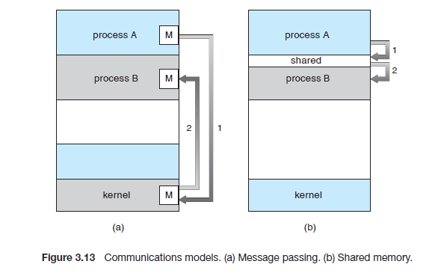

Slide 26
Message passing is also easier to implement than shared memory for intercomputer communication.
Shared memory allows maximum speed and convenience of communication. Shared memory is faster than message passing.
Shared-Memory Systems:
Interprocess communication using shared memory requires communicating processes to establish a region of shared memory.
They can then exchange information by reading and writing data in the shared areas

Slide 27
Example: producer consumer problem
A producer process produces information that is consumed by a consumer process. client–server paradigm is a producer consumer problem.
Here server as a producer and client as a consumer. For example, a Web server produces (that is, provides) HTML files and images, which are consumed (that is, read) by the client Web browser requesting the resource.

Slide 28
One solution to the producer–consumer problem uses shared memory. To allow producer and consumer processes to run concurrently, we must have available a buffer of items that can be filled by the producer and emptied by the consumer. This buffer will reside in a region of memory that is shared by the producer and consumer processes. A producer can produce one item while the consumer is consuming another item.

Slide 29
Two types of buffers can be used.
The unbounded buffer places no practical limit on the size of the buffer. The consumer may have to wait for new items, but the producer can always produce newitems.
The bounded buffer assumes a fixed buffer size. In this case, the consumer must wait if the buffer is empty, and the producer must wait if the buffer is full.

Slide 30
The following variables reside in a region of memory shared by the producer and consumer processes:
#define BUFFER SIZE 10
typedef struct {
. . .
}item;
item buffer[BUFFER SIZE];
int in = 0;
int out = 0;

Slide 31
The shared buffer is implemented as a circular array with two logical
pointers: in and out. The variable in points to the next free position in the buffer; out points to the first full position in the buffer. The buffer is empty when in == out; the buffer is full when ((in + 1) % BUFFER SIZE) == out.

Slide 32
Producer code
while (true) {
/* produce an item in nextProduced */
while (((in + 1) % BUFFER SIZE) == out)
; /* do nothing */
buffer[in] = nextProduced;
in = (in + 1) % BUFFER SIZE;
}

Slide 33
Consumer code
item nextConsumed;
while (true) {
while (in == out)
; // do nothing
nextConsumed = buffer[out];
out = (out + 1) % BUFFER SIZE;
/* consume the item in nextConsumed */
}

Slide 34
Message Passing:
It is particularly useful in a distributed environment, where the communicating processes may reside on different computers connected by a network.
For example, a chat program used on the World Wide Web could be designed so that chat participants communicate with one another by exchanging messages
A message-passing facility provides at least two operations: send(message)
and receive(message). Messages sent by a process can be of either fixed or variable size.

Slide 35
variable-sized messages require a more complex system-level implementation, but the programming task becomes simpler.
fixed-sized messages require a simple system-level implementation, but the programming task becomes difficult.
If processes P and Q want to communicate, they must send messages to and receive messages from each other.
send()/receive() operations

Slide 36
Naming:
direct communication:
each process that wants to communicate must explicitly name the recipient or sender of the communication. In this scheme, the send() and receive() primitives are defined as:
send(P, message)—Send a message to process P.
receive(Q, message)—Receive a message from process Q.

Slide 37
A communication link in this scheme has the following properties:
A link is established automatically between every pair of processes that want to communicate. The processes need to know only each other’s identity to communicate.
A link is associated with exactly two processes.
Between each pair of processes, there exists exactly one link.

Slide 38
This scheme exhibits symmetry in addressing; that is, both the sender
process and the receiver process must name the other to communicate.
In asymmetry addressing only the sender names the recipient; the recipient is not required to name the sender
In this scheme, the send() and receive() primitives are defined as follows:
send(P, message)—Send a message to process P.
receive(id, message)—Receive a message from any process; the variable
id is set to the name of the process with which communication has taken place.

Slide 39
Indirect Communication : The messages are sent to and received from
mailboxes, or ports. The send() and receive() primitives are defined as follows:
send(A, message)—Send a message to mailbox A.
receive(A, message)—Receive a message from mailbox A.

Slide 40
In this scheme, a communication link has the following properties:
A link is established between a pair of processes only if both members of the pair have a shared mailbox.
A link may be associated with more than two processes.
Between each pair of communicating processes, there may be a number of different links, with each link corresponding to one mailbox.

Slide 41
Synchronization:
Communication between processes takes place through calls to send() and receive() primitives. Message passing may be either blocking or nonblocking— also known as synchronous and asynchronous
Blocking send: The sending process is blocked until the message is received by the receiving process or by the mailbox.
Nonblocking send:The sending process sends the message and resumes
operation.
Blocking receive: The receiver blocks until a message is available.
Nonblocking receive:The receiver retrieves either a valid message or a null.

Slide 42
Buffering
Whether communication is direct or indirect,messages exchanged by communicating processes reside in a temporary queue.
Zero capacity. The queue has a maximum length of zero.
Bounded capacity. The queue has finite length n.
Unbounded capacity. The queue’s length is potentially infinite.

