Slide 1
Chapter 4

Slide 2
Thread: It is a basic unit of CPU utilization.
It has thread ID, a program counter, a register set, and a stack. It shares with other threads belonging to the same process its code section, data section, and other operating-system resources, such as open files and signals.
The process is single threaded and multi threaded.
Traditional or Heavyweight process has a single thread of control
Multithreaded process has multiple threads of control
The difference between single-threaded process and multithreaded process is shown in fig

Slide 3
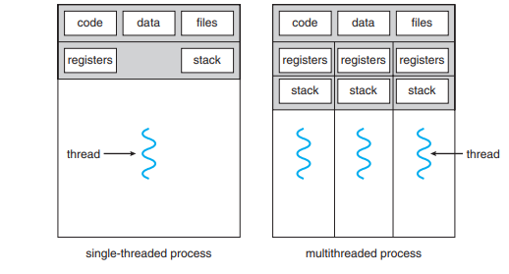

Slide 4
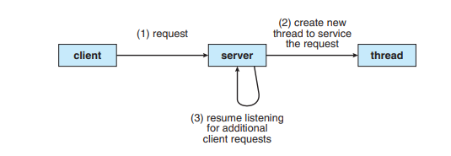
Example:
If the web-server process is multithreaded, the server will create a separate thread that listens for client requests. When a request is made, rather than creating another process, the server creates a new thread to service the request and resume listening for additional requests. This is illustrated in Figure.

Slide 5
The benefits of multithreaded programming:
Responsiveness: Multithreading an interactive application may allow a program to continue running even if part of it is blocked or is performing a lengthy operation, thereby increasing responsiveness to the user. A single-threaded application would be unresponsive to the user until the operation had completed.
Resource sharing: Threads share the memory and the resources of the process to which they belong by default. It causes several different threads can access the same address space.
Economy: Threads share the resources of the process to which they belong, it is more economical to create and context-switch threads.
Scalability: The benefits of multithreading can be even greater in a multiprocessor architecture, where threads may be running in parallel on different processing cores. A single-threaded process can run on only one processor, regardless how many are available.

Slide 6

Multicore Programming:
Each core appears as a separate processor to the operating system. The cores appear across CPU chips or within CPU chips, we call these systems multicore or multiprocessor systems.
Multithreaded programming provides a mechanism for more efficient use of these multiple computing cores and improved concurrency.
Consider an application with four threads. If system has a single computing core, the threads are executed concurrently. It is shown in following figure

Slide 7
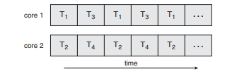
If system with multiple cores, then these threads are executed parallelly. It is shown in figure.

Slide 8
Difference between parallelism and concurrency:
A system is parallel if it can perform more than one task simultaneously. It needs multiple processors.
a concurrent system supports more than one task by allowing all the tasks to make progress. It achieved through interleaving operation of threads on single processor

Slide 9
Programming Challenges in Multicore Programming:
Identifying tasks: This involves examining applications to find areas that can be divided into separate, concurrent tasks. Ideally, tasks are independent of one another and thus can run in parallel on individual cores.
Balance: While identifying tasks that can run in parallel, programmers must also ensure that the tasks perform equal work of equal value. Balance the work on all processors.
Data splitting: Separate data properly to run with the tasks
Data dependency: The data accessed by the tasks must be examined for dependencies between two or more tasks.
Testing and debugging: When a program is running in parallel on multiple cores, many different execution paths are possible. Testing and debugging such concurrent programs is inherently more difficult than testing and debugging single-threaded applications.

Slide 10
Types of parallelism
Data parallelism: It focuses on distributing subsets of the same data across multiple computing cores and performing the same operation on each core.
Task parallelism: It involves distributing not data but tasks (threads) across multiple computing cores. Each thread is performing a unique operation. Different threads may be operating on the same data, or they may be operating on different data.
Ex: On a dual-core system, however, thread A, running on core 0, could sum the elements [0] . . . [N/2 − 1] while thread B, running on core 1, could sum the elements [N/2] . . . [N − 1]. The two threads would be running in parallel on separate computing cores.
In this example
Data parallelism involves the distribution of elements of A across multiple cores.
Task parallelism involves the distribution of tasks across multiple cores

Slide 11
Multithreading Models:
User threads: These are supported above the kernel and are managed without kernel support.
Kernel threads: These are supported and managed directly by the operating system.
A relationship must exist between user threads and kernel threads.
They are
many-to-one model
one-to-one model
many-to many model

Slide 12
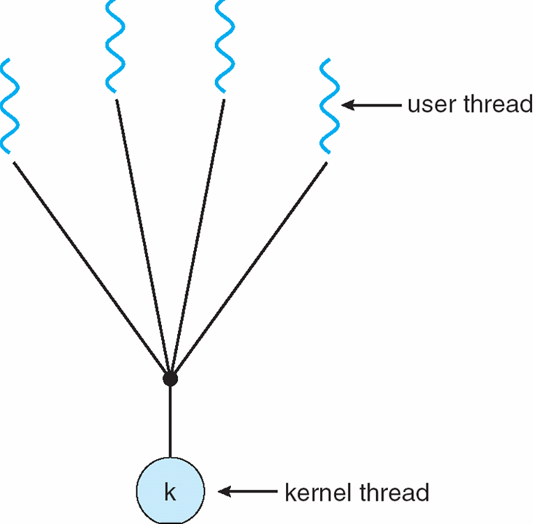
Many to one: Many user-level threads mapped to single kernel thread. It is shown in figure. Thread management is done by the thread library in user space, so it is efficient. However, the entire process will block if a thread makes a blocking system call. Also, because only one thread can access the kernel at a time, multiple threads are unable to run in parallel on multicore systems.

Slide 13
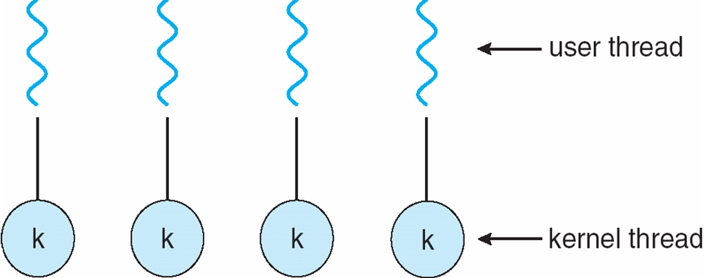
One-to-One :
It maps each user thread to a kernel thread. It is shown in following figure.

Slide 14
It provides more concurrency than the many-to-one model by allowing another thread to run when a thread makes a blocking system call. It also allows multiple threads to run in parallel on multiprocessors. The only drawback to this model is that creating a user thread requires creating the corresponding kernel thread. Because the overhead of creating kernel threads can burden the performance of an application.

Slide 15
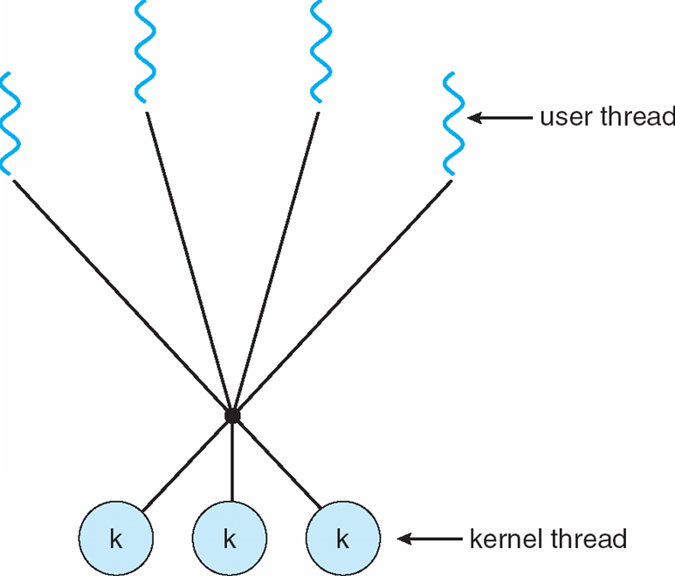
Many to Many:
Allows many user level threads to be mapped to many kernel threads. It supports the parallel execution in multicore processors. Allows the operating system to create a sufficient number of kernel threads. It is shown in figure.

Slide 16
Thread Libraries
It provides API to the programmer for creating and managing threads.
Two ways for implementing a thread library.
One approach is to provide the library at user space with no kernel support. All code and data structures for the library exist at user space. This means that invoking a function in the library results in a local function call in user space and not a system call.
Other approach is to provide a kernel level library supported directly by the operating system. All code and data structures for the library exist at kernel space. This means that invoking a function in the API for the library results in a system call to the kernel.

Slide 17
Three thread libraries use in today.
POSIX Pthreads may be provided either as user-level or kernel-level. A POSIX standard (IEEE 1003.1c) API for thread creation and synchronization. API specifies behavior of the thread library, implementation.
Win32 is a kernel level library on windows system
Java threads are managed by JVM. It is implemented using the thread model provided by OS.

Slide 18
Posix: thread creation
#include<pthread.h>
pthread_create(thread, attr, start_routine, arg)
returns : 0 on success, some error code on failure

Slide 19
pthread_create (pthread_t *thread, pthread_attr_t *attr, void *(*start_routine)(void *), void *arg)
thread: An identifier for the new thread returned by the subroutine. This is a pointer to pthread_t structure. When a thread is created, an identifier is written to the memory location to which this variable points. This identifier enables us to refer to the thread.
attr: An attribute object that may be used to set thread attributes. We can specify a thread attributes object, or NULL for the default values.
start_routine: The routine that the thread will execute once it is created. We should pass the address of a function taking a pointer to void as a parameter and the function will return a pointer to void. So, we can pass any type of single argument and return a pointer to any type.

Slide 20
arg:
A single argument that may be passed to start_routine. It must be passed as a void pointer. NULL may be used if no argument is to be passed.
pthread_attr_init(pthread_attr_t *attr);
initialises a thread attributes object attr with the default value for all of the individual attributes used by a given implementation

Slide 21
pthread_join(pthread_t thread, void **retval)
The pthread_join() function waits for the thread specified by thread to terminate.
If that thread has already terminated, then pthread_join() returns immediately. The thread specified by thread must be joinable. If retval is not NULL, then pthread_join() copies the exit status of the target thread into the location pointed to by retval. If the target thread was canceled, then PTHREAD_CANCELED is placed in the location pointed to by retval.

Slide 22
#include <stdio.h>
#include<pthread.h>
int sum;
void *runner(void* param);
int main( int argc, char *argv[])
{
pthread_t tid; //thread identifier
pthread_attr_t attr; //set of thread attributes
pthread_attr_init(&attr);
pthread_create(&tid, &attr, runner, argv[1]);
pthread_join(tid,NULL);
printf("sum=%d",sum);
return 0;
}
void *runner(void *param)
{
int i,upper=atoi(param);
sum=0;
for(i=1;i<=upper;i++)
sum=sum+i;
pthread_exit(0);
}

Slide 23
Attribute | Default Value | Description
detachstate | PTHREAD_CREATE_JOINABLE | Thread may be joined by other threads.
inheritsched | PTHREAD_INHERIT_SCHED | Scheduling parameters, policy, and scope are inherited from creating thread.
schedparam | — | Priority set to default for scheduling policy.
schedpolicy | SCHED_OTHER | Scheduling policy is determined by the system.
scope | PTHREAD_SCOPE_SYSTEM | Threads are scheduled system-wide.
stackaddr | N/A | Attribute not supported; address selected by OS.
stacksize | 0 | Stack size inherited from process stack size attribute.

Slide 24
POSIX compilation on Linux
On Linux, programs that use the Pthreads API must be compiled with –pthread or –lpthread
cc thread.c -o thread -lpthread
cc is the compiler command.
thread.c is the name of c program source file.
-o is option to make object file.
thread is the name of object file.
-lpthread is option to execute pthread.h library file

Slide 25
Win32:
The technique for creating threads using the Win32 thread library is similar to the Pthreads technique. Threads are created in the Win32 API using the CreateThread() function, and—just as in Pthreads—a set of attributes for the thread is passed to this function. These attributes include security information, the size of the stack, and a flag that can be set to indicate if the thread is to start in a suspended state

Slide 26
Java Threads
Java language and its API provide a rich set of features for the creation and management of threads.
There are two techniques for creating threads in a Java program.
One approach is to create a new class that is derived from the Thread class and to override its run() method.
Other approach is to define a class that implements the Runnable interface.

Slide 27
The Runnable interface is defined as follows:
public interface Runnable
{
public abstract void run();
}

Slide 28
Implicit threading: to transfer the creation and management of threading from application developers to compilers and run-time libraries.
Three methods explored
Thread Pools
OpenMP
Grand Central Dispatch

Slide 29
OpenMP
The most common implicit threading library is OpenMP. OpenMP uses the #pragma compiler directive to detect and insert additional library code at compile time.
the #pragma line indicates that OpenMP (omp) should parallelize a statement (parallel for) with some constraints on the variables.

Slide 30
Thread Pool
Create a number of threads at process startup in a pool where they await work.
Advantages:
Usually slightly faster to service a request with an existing thread than create a new thread. A threas returns to pool once it completes servicing a request.
Allows the number of threads in the application(s) to be bound to the size of the pool. Limits the number of threads that exist at any one point.

Slide 31
#include < stdio.h >
#include <omp.h>
int main(void)
{
#pragma omp parallel
{
printf("Hello, world.\n");
}
return 0;
}

Slide 32
$ cc -o omp_helloc -fopenmp omp_hello.c #include <omp.h> export OMP_NUM_THREADS=2 $ ./omp_helloc Hello World from thread = 0 Hello World from thread = 1

Slide 33
Grand Central Dispatch
Blocks placed in a dispatch queue
Block = self-contained unit of work identified by the programmer
GCD schedules by placing them blocks on dispatch queue
Two types of queues:
serial – blocks removed in FIFO order, queue is per process, called main queue
Programmers can create additional serial queues within program
concurrent – removed in FIFO order but several may be removed at a time.

Slide 34
Threading Issues
fork() and exec() system call:
The fork() system call is used to create a separate, duplicate process.
If one thread in a program calls fork(), does the new process duplicate all threads, or is the new process single-threaded? Some UNIX systems have chosen to have two versions of fork(), one that duplicates all threads and another that duplicates only the thread that invoked the fork() system call.
if a thread invokes the exec() system call, the program specified in the parameter to exec() will replace the entire process—including all threads.
Two versions of fork() to use depends on the application.

Slide 35
If exec() is called immediately after forking, then duplicating all threads is unnecessary, as the program specified in the parameters to exec() will replace the process. In this instance, duplicating only the calling thread is appropriate.
Cancellation:
Thread cancellation is the task of terminating a thread before it has completed
A thread that is to be canceled is often referred to as the target thread.

Slide 36
Cancellation of a target thread may occur in two different scenarios:
Asynchronous cancellation. One thread immediately terminates the target thread.
Deferred cancellation. The target thread periodically checks whether it should terminate, allowing it an opportunity to terminate itself in an orderly fashion.
The difficulty with cancellation occurs in situations where resources have been allocated to a canceled thread or where a thread is canceled while in the midst of updating data it is sharing with other threads. This becomes especially troublesome with asynchronous cancellation.
With deferred cancellation the thread is cancelled safely

Slide 37
Signal Handling
A signal is used in UNIX systems to notify a process that a particular event has occurred. A signal may be received either synchronously or asynchronously. synchronous or asynchronous, follow the same pattern
1. A signal is generated by the occurrence of a particular event.
2. A generated signal is delivered to a process.
3. Once delivered, the signal must be handled.
Example of synchronous signals: illegal memory
Example of asynchronous signals: timer expire

Slide 38
A signal may be handled by one of two possible handlers:
1 A default signal handler
2. A user-defined signal handler
Every signal has a default signal handler that is run by the kernel when handling that signal.
user-defined signal handler: Here default action can be overridden by user defined action.
Signals are handled in different ways.
Some signals are simply ignored
Others are handled by terminating the program.
Handling signals in single-threaded programs is simple

Slide 39
The following options exist for handling signals
1. Deliver the signal to the thread to which the signal applies.
2. Deliver the signal to every thread in the process.
3. Deliver the signal to certain threads in the process.
4. Assign a specific thread to receive all signals for the process.
The method for delivering a signal depends on the type of signal generated.
synchronous signals need to be delivered to the thread causing the signal and not to other threads in the process.

Slide 40
asynchronous signals is not as clear. Some asynchronous signals—such as a signal that terminates a process—should be sent to all threads.
asynchronous signals causes a problem in multi-threading. So in Posix threads provides pthread kill(pthread t tid, int signal) function, which allows a signal to be delivered to a specified thread (tid).

Slide 41
Thread Pools
The first issue concerns the amount of time required to create the thread prior to servicing the request, together with the fact that this thread will be discarded once it has completed its work. The second issue is more troublesome: if we allow all concurrent requests to be serviced in a new thread, we have not placed a bound on the number of threads concurrently active in the system. Unlimited threads could exhaust system resources, such as CPU time or memory. One solution to this problem is to use a thread pool.

Slide 42
The general idea behind a thread pool is to create a number of threads at process startup and place them into a pool, where they sit and wait for work. When a server receives a request, it awakens a thread from this pool—if one is available—and passes it the request for service. Once the thread completes its service, it returns to the pool and awaits more work. If the pool contains no available thread, the server waits until one becomes free.

Slide 43
Thread pools offer these benefits:
Servicing a request with an existing thread is usually faster than waiting to create a thread.
A thread pool limits the number of threads that exist at any one point. This is particularly important on systems that cannot support a large number of concurrent threads.

Slide 44
Thread-Specific Data:
Threads belonging to a process share the data of the process. Indeed, this sharing of data provides one of the benefits of multithreaded programming. However, in some circumstances, each thread might need its own copy of certain data. We will call such data thread-specific data.

Slide 45
Scheduler Activations
A final issue to be considered with multithreaded programs concerns communication between the kernel and the thread library, which may be required by the many-to-many and two-level models.
An intermediate data structure between the user and kernel threads. This data structure— typically known as a lightweight process or LWP. It is shown in following figure.

Slide 46
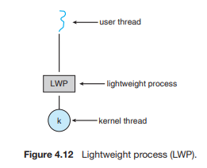

Slide 47
To the user-thread library, the LWP appears to be a virtual processor on which the application can schedule a user thread to run. Each LWP is attached to a kernel thread, and it is kernel threads that the operating system schedules to run on physical processors.
If a kernel thread blocks (such as while waiting for an I/O operation to complete), the LWP blocks as well. Up the chain, the user-level thread attached to the LWP also blocks

Slide 48
One scheme for communication between the user-thread library and the kernel is known as scheduler activation. It works as follows: The kernel provides an application with a set of virtual processors (LWPs), and the application can schedule user threads onto an available virtual processor. Furthermore, the kernel must inform an application about certain events. This procedure is known as an upcall. Upcalls are handled by the thread library with an upcall handler, and upcall handlers must run on a virtual processor

