Slide 1
Chapter 5

Slide 2
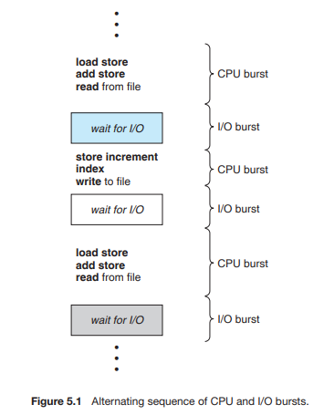
CPU –I/O Burst Cycle:

Slide 3
The success of CPU scheduling depends on an observed property of processes:
process execution consists of a cycle of CPU execution and I/O wait. Processes alternate between these two states. Process execution begins with a CPU burst. That is followed by an I/O burst, which is followed by another CPU burst, then another I/O burst, and so on. Eventually, the final CPU burst ends with a system request to terminate execution (Figure 5.1)
The durations of CPU bursts have been measured extensively. Although they vary greatly from process to process and from computer to computer

Slide 4
CPU Scheduler
Whenever the CPU becomes idle, the operating system must select one of the processes in the ready queue to be executed. The selection process is carried out by the short-term scheduler (or CPU scheduler).
A ready queue can be implemented as a FIFO queue, a priority queue, a tree, or simply an unordered linked list.
Two types
Preemptive Scheduling
Non preemptive Scheduling

Slide 5
Preemptive Scheduling: Preemptive scheduling is used when a process switches from running state to ready state or from waiting state to ready state.
Non preemptive Scheduling: The process holds the CPU till it gets terminated or it reaches a waiting state. In case of non-preemptive scheduling does not interrupt a process running CPU in middle of the execution. Instead, it waits till the process complete its CPU burst time and then it can allocate the CPU to another process

Slide 6
CPU-scheduling decisions may take place under the following four circumstances:
1. When a process switches from the running state to the waiting state (for example, as the result of an I/O request or an invocation of wait for the termination of one of the child processes)
2.When a process switches from the running state to the ready state (for example, when an interrupt occurs)
3. When a process switches from the waiting state to the ready state (for
example, at completion of I/O)
4. When a process terminates

Slide 7
Dispatcher:
The dispatcher is the module that gives control of the CPU to the process selected by the short-term scheduler. This function involves the following
Switching context
Switching to user mode
Jumping to the proper location in the user program to restart the program
dispatch latency: The time it takes for the dispatcher to stop one process and start another running

Slide 8
Scheduling Criteria: It includes the following:
CPU utilization – keep the CPU as busy as possible
Throughput – # of processes that complete their execution per time unit
Turnaround time – amount of time to execute a particular process
Waiting time – amount of time a process has been waiting in the ready queue
Response time – amount of time it takes from when a request was submitted until the first response is produced, not output (for time-sharing environment)

Slide 9
Difference between preemptive and non preemptive scheduling algorithms
Preemptive | Non preemptive
1. Preemptive scheduling is used when a process switches from running state to ready state or from waiting state to ready state. The resources (mainly CPU cycles) are allocated to the process for the limited amount of time and then is taken away, and the process is again placed back in the ready queue if that process still has CPU burst time remaining. That process stays in ready queue till it gets next chance to execute. | 1. Non-preemptive Scheduling is used when a process terminates, or a process switches from running to waiting state. In this scheduling, once the resources (CPU cycles) is allocated to a process, the process holds the CPU till it gets terminated or it reaches a waiting state. In case of non-preemptive scheduling does not interrupt a process running CPU in middle of the execution. Instead, it waits till the process complete its CPU burst time and then it can allocate the CPU to another process.
2. SRTF, preemptive priority, RR scheduling are preemptive | 2. FCFS and non preemptive SJF are non preemptive scheduling algorithms

Slide 10
Scheduling Algorithms:
First-Come, First-Served Scheduling:
In this algorithm the process that requests the CPU first is allocated the CPU first.
Advantages: Implementation is easy.
Disadvantage:
Convoy effect: All the other processes wait for the one big process to get off the CPU.
Note: FCFS scheduling algorithm is non preemptive. Once the CPU has been allocated to a process, that process keeps the CPU until it releases the CPU, either by terminating or by requesting I/O.
Note: Write the example from your Note book

Slide 11
Shortest-Job-First Scheduling
Non preemptive
Preemptive
SJF (non preemptive):
In SJF the process are scheduled based on burst time. The process which has smallest burst time that process is scheduled for execution from ready queue process. This process is not pre-empted until its completion. If both process have same burst time then based on FCFS is scheduled.
Advantages: It has less average waiting time when compared to FCFS
Disadvantage: The difficulty with SJF is knowing the length of next CPU request.
Write example from your Note book.

Slide 12
Shortest Remaining Time First (SRTF) Scheduling Algorithm Premptive SJF scheduling is called shortest-remaining-time-first scheduling
It is the preemptive mode of Shortest Job First (SJF) scheduling. In this algorithm, the process which has the short burst time is executed by the CPU. There is no need to have the same arrival time for all the processes. If another process was having the shortest burst time then the current process which is executing get stopped in between the execution, and the new arrival process will be executed first.
Ex:

Slide 13

Process ID | Arrival Time | Burst Time | Completion Time | Turn Around Time | Waiting Time | Response Time
1 | 0 | 8 | 20 | 20 | 12 | 0
2 | 1 | 4 | 10 | 9 | 5 | 1
3 | 2 | 2 | 4 | 2 | 0 | 2
4 | 3 | 1 | 5 | 2 | 1 | 4
5 | 4 | 3 | 13 | 9 | 6 | 10
6 | 5 | 2 | 7 | 2 | 0 | 5

Slide 14
Priority Scheduling Algorithm: In this algorithm based on priority process is scheduled.
Types of Priority Scheduling Algorithm:
Preemptive Priority Scheduling: If the new process arrived at the ready queue has a higher priority than the currently running process, the CPU is preempted, which means the processing of the current process is stoped and the incoming new process with higher priority gets the CPU for its execution.
Non-Preemptive Priority Scheduling: In case of non-preemptive priority scheduling algorithm if a new process arrives with a higher priority than the current running process, the incoming process is put at the head of the ready queue, which means after the execution of the current process it will be processed.

Slide 15
Non preemptive priority scheduling algorithm
In this algorithm the process is seheduled on CPU based on priority. If both process have same priority then based on FCFS is scheduled.

Slide 16
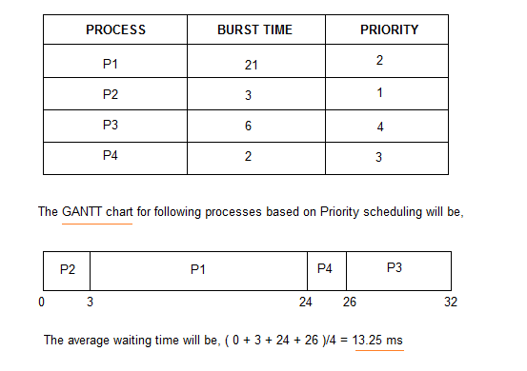
CT WT TAT
P1= 24 3 24
P2=3 0 3
P3=32 26 32
P4=26 24 26

Slide 17
Process | AT | BT | Priority
P1 | 0 | 5 | 1
P2 | 1 | 3 | 2
P3 | 2 | 8 | 1
P4 | 3 | 6 | 3
Gantt Chart
CT WT TAT
5 0 5
16 12 15
13 3 11
22 13 19
P1 | P3 | P2 | P4

Slide 18
Preemptive Priority Scheduling Algorithm : In this algorithm process are scheduled based on priority but current process stops its execution if higher priority process arrival in ready queue. Write the example from note book
Procss | Arrival Time | Burst Time | Priority | CT | WT
P1 | 0 | 5 | 2
P2 | 4 | 8 | 1
P3 | 6 | 2 | 4
P4 | 8 | 6 | 3

Slide 19
Disadvantages:
Starvation or indefinite blocking: a process ready to run for CPU can wait indefinitely because of low priority
Solution to starvation:
Aging: It is a technique of gradually increasing the priority of processes that wait in the system for a long time.

Slide 20
Round Robin Scheduling:
Round Robin is a CPU scheduling algorithm where each process is assigned a fixed time in a cyclic way.
Write the example from your Note book

Slide 21
Time quantum 1
Process | Arrival Time | Burst Time
P1 | 0 | 3
P2 | 0 | 4
P3 | 0 | 3

Slide 22
Time Quantum 2
Process | Arrival Time | Burst Time
P1 | 0 | 5
P2 | 1 | 4
P3 | 2 | 2
3 | 3 | 1

Slide 23
Advantages:
Simple
Starvation free as all processes get fair share of CPU.
Disadvantages
There is Larger waiting time and Response time
There is Low throughput.
There is Context Switches.

Slide 24
Multilevel Queue Scheduling:
processes are easily classified into different groups. For example, a common distribution is made between foreground (interactive) processes and background (batch) processes. These two types of processes have different response-time requirements and so may have different scheduling needs. In addition, foreground processes may have priority (externally defined) over background processes.
A multilevel queue scheduling algorithm partitions the ready queue into several separate queues. It is shown in following figure. The processes are permanently assigned to one queue, generally based on some property of the process, such as memory size, process priority, or process type. Each queue has its own scheduling algorithm. For example, separate queues might be used for foreground and background processes. The foreground queue might be scheduled by an RR algorithm, while the background queue is scheduled by an FCFS algorithm.

Slide 25
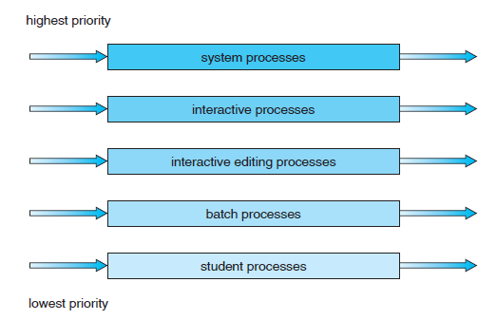
Fig: multilevel queue scheduling

Slide 26
A multilevel queue scheduling algorithm with five queues, listed below in order of priority:
1. System processes
2. Interactive processes
3. Interactive editing processes
4. Batch processes
5. Student processes
Each queue has absolute priority over lower-priority queues. If an interactive editing process entered the ready queue while a batch process was running, the batch process would be preempted.

Slide 27
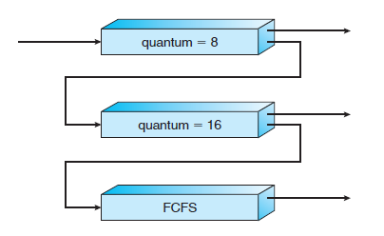
Multilevel Feedback Queue Scheduling
In multilevel queue scheduling algorithm processes do not move from one queue to the other. It is inflexible.
In multilevel feedback queue scheduling algorithm, a process to move between queues. It is shown in following figure with three queues.

Slide 28
A process entering the ready queue is put in queue 0. A process in queue 0 is given a time quantum of 8 milliseconds. If it does not finish within this time, it is moved to the tail of queue 1. If queue 0 is empty, the process at the head of queue 1 is given a quantum of 16 milliseconds. If it does not complete, it is preempted and is put into queue 2. Processes in queue 2 are run on an FCFS basis but are run only when queues 0 and 1 are empty.

Slide 29
A multilevel feedback queue scheduler is defined by the following parameters:
• The number of queues.
• The scheduling algorithm for each queue.
• The method used to determine when to upgrade a process to a higher priority
queue.
• The method used to determine when to demote a process to a lower priority
queue.
• The method used to determine which queue a process will enter when that
process needs service.

Slide 30
Multiple-Processor Scheduling:
use any available processor to run any process in the queue.
Approaches to Multiple-Processor Scheduling
Asymmetric multiprocessing – only one processor accesses the system data structures, alleviating the need for data sharing
Symmetric multiprocessing (SMP) – each processor is self-scheduling, all processes in common ready queue, or each has its own private queue of ready processes

Slide 31
Issues concerning SMP systems
If the process migrates from one processor to another processor, then the contents of cache memory must be invalidated for the first processor, and the cache for the second processor must be repopulated. Because of high cost of invalidating and repopulating cache, SMP system try to avoid the migration of process from one processor to other processor. This is known as processor affinity.
Two types
Soft affinity: Operating system will attempt to keep a processor on a single processor, but not guarantee that.
Hard affinity: Operating system will attempt to keep a processor on a single processor.

Slide 32
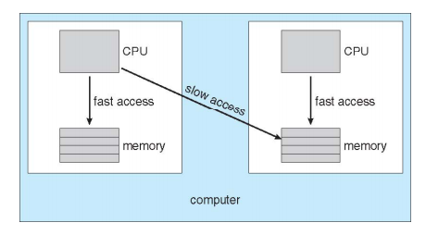
The main memory architecture of a system can affect processor affinity issue. In following figure, an architecture has a non-uniform memory access (NUMA) featuring, in which CPUs on board can access the memory on that board faster than they can access memory on other boards.

Slide 33
On SMP systems, it is important to keep the workload balanced among all processors to fully utilize the benefits of having more than one processor.
Load Balancing attempts to keep the workload evenly distributed across all processors in an SMP system.
They are two general approaches to load balancing
Push migration
Pull migration
Push migration is where the operating system checks the load (number of processes in the run queue) on each processor periodically. If there’s an imbalance, some processes will be moved from one processor onto another.
Pull migration occurs when an idle processor pulls a waiting task from busy processor.

Slide 34
Multi-core Processor:
to place multiple processor cores on same physical chip
Each core maintains its architectural state
Multicore processors are faster and consume less power than systems in which each processor has its own physical chip.
Scheduling issues in multi-core processors:
memory stall : When a processor accesses memory, it spends a significant amount of time waiting for data to become available. This situation known as memory stall.

Slide 35
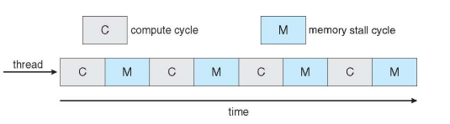
The reasons for memory stall
Catch miss
It is shown in following figure

Slide 36
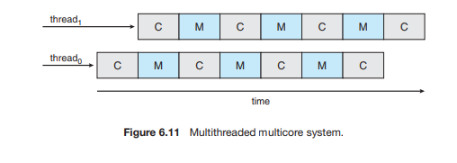
Recent hardware designers have implemented multithreaded processor cores in which two or more hardware threads are assigned to each core for avoiding memory stall. Here if one thread stalls while waiting for memory the core can switch to another thread. It is shown in following figure.

Slide 37
Two ways for multithread a processing core
Coarse-grained
Fine-grained
Coarse-grained: In this multithreading, a thread executes on a processor until a long-latency event such as memory stall occurs. Because of the delay caused by the long-latency event, the processor must switch to another thread to begin execution.
The cost of switching between threads is high.
Fine-grained: In this multithreading, the processor switches between threads in a round robin fashion.
The cost of switching is small.

Slide 38
Real Time Operating System:
Two types
Soft real-time systems
Hard real-time systems
Soft real-time systems provide no guarantee as to when a critical real-time process will be scheduled. They guarantee only that the process will be given preference over noncritical processes.
Hard real-time systems have stricter requirements. A task must be serviced by its deadline.

