Slide 2
Chapter 10
FILES

Slide 3
File: A file is a named collection of related information that is recorded on secondary storage.
File Attributes:
• Identifier: This unique tag, usually a number, identifies the file within the file system; it is the non-human-readable name for the file.
• Type: This information is needed for systems that support different types of files.
• Location: This information is a pointer to a device and to the location of the file on that device.
• Size: The current size of the file (in bytes, words, or blocks) and possibly the maximum allowed size are included in this attribute.
• Protection: Access-control information determines who can do reading, writing, executing, and so on.
• Time, date, and user identification: This information may be kept for creation, last modification, and last use. These data can be useful for protection, security, and usage monitoring.

Slide 4
File Operations:
Creating a file
Writing a file
Reading a file
Repositioning within a file
Deleting a file
Truncating a file

Slide 5
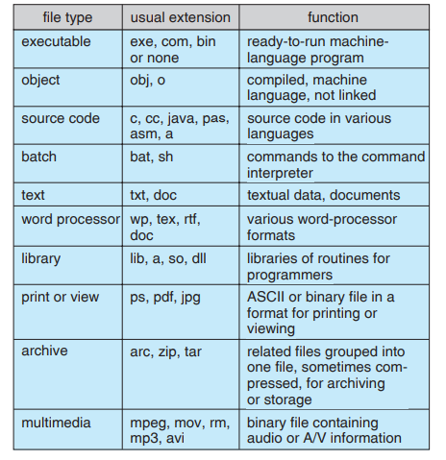
File Types:

Slide 6
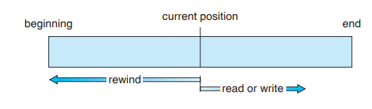
Access Methods: Information in the file must be accessed and read into computer memory. The information in the file can be accessed in several ways.
Sequential Access:
The simplest access method is sequential access. Information in the file is processed in order, one record after the other. This mode of access is by far the most common; for example, editors and compilers usually access files in this fashion Sequential access, which is depicted in above Figure, is based on a tape model of a file.

Slide 7
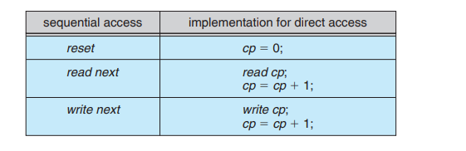
Direct Access:
The direct-access method is based on a disk model of a file, since disks allow random access to any file block. For direct access, the file is viewed as a numbered sequence of blocks or records. Thus, we may read block 14, then read block 53, and then write block 7. There are no restrictions on the order of reading or writing for a direct-access file.
For the direct-access method, the file operations must be modified to include the block number as a parameter. Thus, we have read n, where n is the block number, rather than read next, and write n rather than write next. An alternative approach is to retain read next and write next, as with sequential access, and to add an operation position file to n, where n is the block number. Then, to effect a read n, we would position to n and then read next. We can easily simulate sequential access on a direct-access file by simply keeping a variable cp that defines our current position, as shown in following figure.

Slide 8
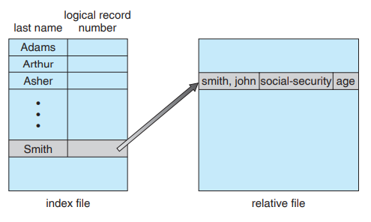
Indexed sequential-access method (ISAM): uses a small master index that points to disk blocks of a secondary index. The secondary index blocks point to the actual file blocks. The file is kept sorted on a defined key.

Slide 9
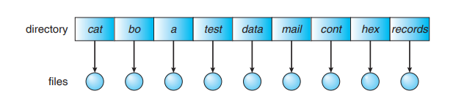
Directory Structure:
Single-Level Directory: It is shown in the following figure. All files are contained in the same directory.
Advantages: It is easy to support and understand.
Disadvantages:
1. Naming Problem: A single-level directory has significant limitations, however, when the number of files increases or when the system has more than one user. Since all files are in the same directory, they must have unique names. If two users call their data file test, then the unique-name rule is violated.
2. Grouping problem: Even a single user on a single-level directory may find it difficult to remember the names of all the files as the number of files increases. Grouping is not possible to store similar files in one directory.

Slide 10
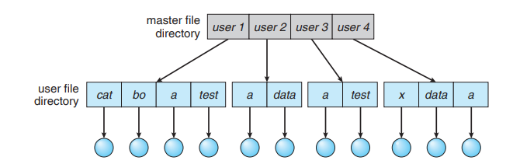
Two-Level Directory: In the two-level directory structure, each user has his own user file directory (UFD). The UFDs have similar structures, but each lists only the files of a single user. When a user job starts or a user logs in, the system’s master file directory (MFD) is searched. The MFD is indexed by user name or account number, and each entry points to the UFD for that user It is shown in following figure.

Slide 11
Advantages:
1. In this directory structure easy to access file.
2. Naming problem is solved
Disadvantages:
1. It suffered from Grouping problem.

Slide 12
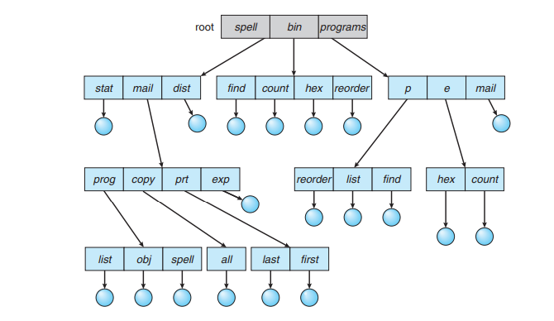
Tree-Structured Directories:
This generalization allows users to create their own subdirectories and to organize their files accordingly. A tree is the most common directory structure. The tree has a root directory, and every file in the system has a unique path name. It is shown in the following figure.

Slide 13
Advantages:
1. Easy to access the files.
2. Naming problem reduced.
3. Grouping problem reduced
Disadvantages:
Files are not shared between users.

Slide 14
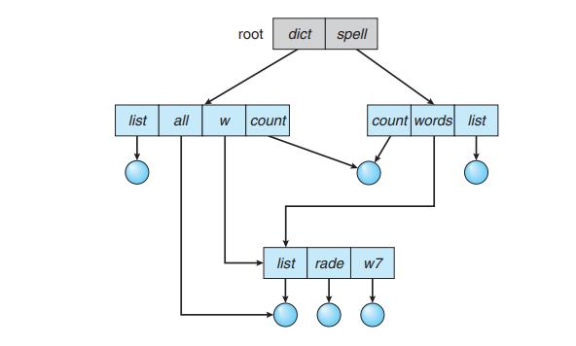
Acyclic-Graph Directories: It is shown in fig.
Advantages:
It is flexible compared to Tree-Structured Directories.
Disadvantages:
Several problems may occurs at the traverse and deleting the file contents.

Slide 15
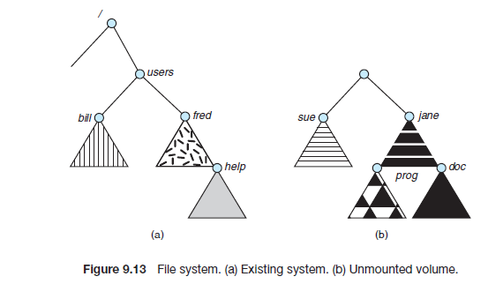
File Mouting: is the location within the file structure where the file system is to be attached. To illustrate file mounting, consider the file system depicted in Figure 9.13, where the triangles represent subtrees of directories. Figure 9.13(a) shows an existing file system, while Figure 9.13(b) shows an unmounted volume residing on /device/dsk

Slide 16
File unmounting is detaching the file from the location point.
File Sharing:
File Sharing is sharing of files on multiple user systems. Sharing may be done through a protection scheme on distributed systems, files may be shared across a Network File System (NFS).
Through user IDs file sharing is done between multiple users by creating group IDs.
Through Remote file system file sharing is done.
They are three methods for file sharing through remote file system.

Slide 17
The first implemented method involves manually transferring files between machines via programs like ftp.
The second major method uses a distributed file system (DFS) in which remote directories are visible from a local machine.
In some ways, the third method, the World Wide Web, which uses the url of file for sharing.
Client-server model allows clients to mount remote file systems from servers. In LINUX NFS (network file system) protocol is used to implement client-server model. In windows DFS protocol is used to implement client server model.

Slide 18
Protection: It can be provided in many ways.
For a small single-user Laptop systems, we might provide protection by physically removing the floppy disks and locking them in a desk drawer or file cabinet.
In a multiuser system, the following mechanisms are needed.
Protection mechanisms provide controlled access by limiting the types of file access that can be made. Access is permitted or denied depending on several factors, one of which is the type of access requested. Several different types of operations may be controlled:
• Read: Read from the file.
• Write: Write or rewrite the file.
• Execute: Load the file into memory and execute it.
• Append: Write new information at the end of the file.
• Delete: Delete the file and free its space for possible reuse.
• List: List the name and attributes of the file.

Slide 19
Access Control:
An access-control list (ACL) specifying user names and the types of access allowed for each user. When a user requests access to a particular file, the operating system checks the access list associated with that file. If that user is listed for the requested access, the access is allowed. Otherwise, a protection violation occurs, and the user job is denied access to the file.
• Owner. The user who created the file is the owner.
• Group. A set of users who are sharing the file and need similar access is a group, or work group.
• Universe. All other users in the system constitute the universe.

