Slide 2
Chapter 11
Implementing File-Systems

Slide 3
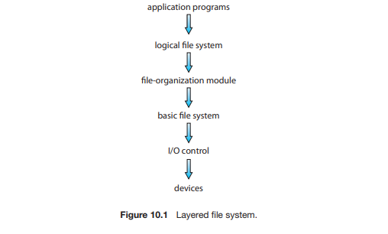
File systems provide efficient and convenient access to the disk by allowing data to be stored, located, and retrieved easily. The structure shown in Figure.

Slide 4
I/O control: consists of device drivers and interrupts handlers to transfer information between the main memory and the disk system.
The basic file system: needs only to issue generic commands to the appropriate device driver to read and write physical blocks on the disk. This layer also manages the memory buffers and caches that hold various file-system, directory, and data blocks.
file-organization module: can translate logical block addresses to physical block addresses

Slide 5
The logical file system manages metadata information. Metadata includes all the file-system structure except the actual data (or contents of the files). The logical file system manages the directory structure to provide the file organization module with the information the latter needs, given a symbolic file name. It maintains file structure via file-control blocks.
The logical file system is also responsible for protection and security.
A file-control block (FCB) contains information about the file, including ownership, permissions, and location of the file contents.

Slide 6
File-System Implementation:
on-disk and in-memory structures are used to implement a file system. These structures vary depending on the operating system and the file system, but some general principles apply.
On disk, the file system may contain information about how to boot an operating system stored there, the total number of blocks, the number and location of free blocks, the directory structure, and individual files. We describe them briefly

Slide 7
A boot-control block (per volume) can contain information needed by the system to boot an operating system from that volume.
A volume-control block (per volume) contains volume (or partition) details, such as the number of blocks in the partition, the size of the blocks, a free-block count and free-block pointers, and a free-FCB count and FCB pointers
A directory structure (per file system) is used to organize the files
A per-file FCB contains many details about the file. It has a unique identifier number to allow association with a directory entry

Slide 8
The in-memory information is used for both file-system management and performance improvement via caching. The data are loaded at mount time, updated during file-system operations, and discarded at dismount.
An in-memory mount table contains information about each mounted volume
An in-memory directory-structure cache holds the directory information of recently accessed directories
The system-wide open-file table contains a copy of the FCB of each open file, as well as other information
The per-process open-file table contains a pointer to the appropriate entry in the system-wide open-file table, as well as other information.
Buffers hold file-system blocks when they are being read from disk or written to disk

Slide 9
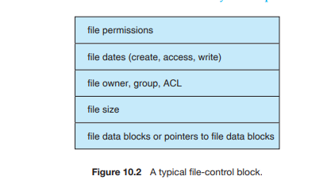
To create a new file, it allocates a new FCB. The system then reads the appropriate directory into memory, updates it with the new file name and FCB, and writes it back to the disk. A typical FCB is shown in Figure.

Slide 10
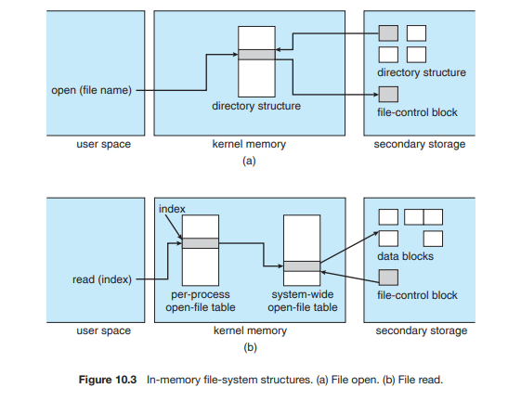

Slide 11
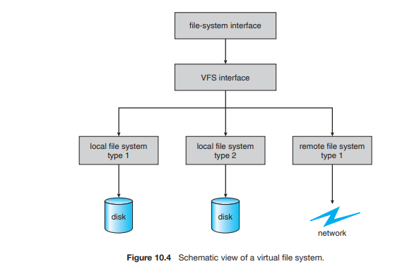
Virtual File Systems

Slide 12
Directory Implementation:
Linear List: The simplest method of implementing a directory is to use a linear list of file names with pointers to the data blocks.
This method is simple to program but time-consuming to execute.
The real disadvantage of a linear list of directory entries is that finding a file requires a linear search.
A sorted list allows a binary search and decreases the average search time.
So a more sophisticated tree data structure, such as a B-tree, might help here.

Slide 13
Hash Table: Another data structure used for a file directory is a hash table. The hash table takes a value computed from the file name and returns a pointer to the file name in the linear list. Therefore, it can greatly decrease the directory search time.
Insertion and deletion are also fairly straightforward, although some provision must be made for collisions—situations in which two file names hash to the same location.
The major difficulties with a hash table are its generally fixed size and the dependence of the hash function on that size.

Slide 14
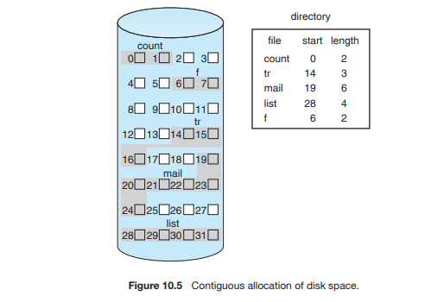
File Allocation Methods:
There are 3 major methods of allocating disk space
Contiguous allocation:-

Slide 15
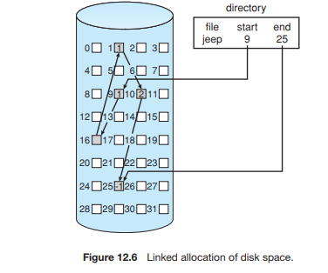
Linked allocation

Slide 16
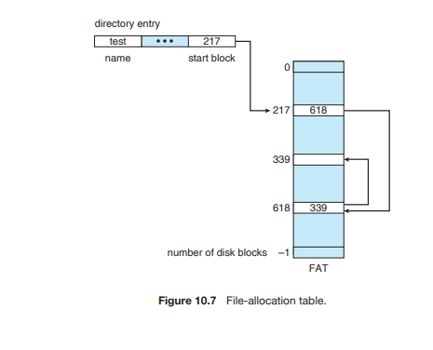
Linked Allocation:

Slide 17
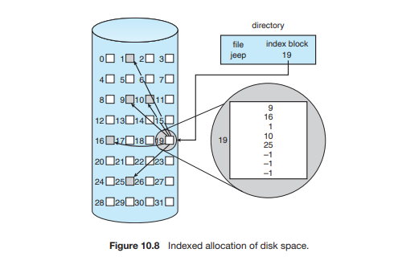
Indexed Allocation:
Linked scheme
Multilevel index
Combined scheme

Slide 18
Free space management:
To keep track of free disk space, the system maintains a free space list. The free space list records all free disk blocks — those not allocated to some file or directory. There are many methods to find the free space.
Bit vector:- The free space list is implemented as a bit map or bit vector. Each block is represented by 1 bit. If the block is free the bit is 1 if the block is allocated the bit is 0.
Ex:- consider a disk where blocks 2,3,4,5,8,9,10,11,12,13,17,18,25, 26 and 27 are free and rest of blocks are allocated. The free space bit map would be 001111001111110001100000011100000
The main advantage of this approach is that it is relatively simple and efficient to find the first free block or ‘n’ consecutive free blocks on the disk.

Slide 19
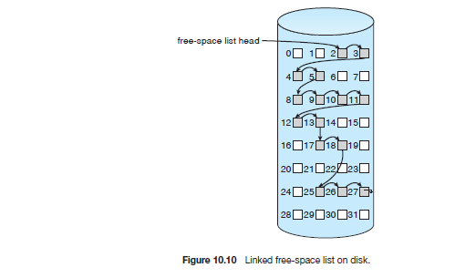
Linked list:- Another approach is to link together all the free disk blocks, keeping a pointer to the first free block in a special location on the disk and caching it in memory. This first block contain a pointer to the next free disk block, and so on. In this approach, we would keep a pointer to block 2 as the first free block. Block 2 would contain a pointer to block 3, which would point to block 4, which would point to block 5, which would point to block 8, and so on. It is shown in figure.

Slide 20
This scheme is not efficient to traverse the list, we must read each block, which requires I/O time. Disk space is also wasted to maintain the pointer to next free space.
Grouping:- Another method is store the addresses of ‘n’ free blocks in the first free block. The first (n-1) of these blocks are actually free. The last block contains the addresses of another ‘n’ free blocks and so on. The main advantage of this approach is that the addresses of a large no.of blocks can be found quickly.

Slide 21
Counting:- Another approach is counting. Generally several contiguous blocks may be allocated or freed simultaneously. Particularly when space is allocated with the contiguous allocation algorithm or through clustering. Thus, rather than keeping a list of ‘n’ free disk address, we can keep the address of first free block and the number ‘n’ of free contiguous blocks that follow the first block. Each entry in the free space list then consists of a disk address and a count.

