Slide 2
Main Memory
Basic Hardware: We must protect the process from one process to other. So we can provide this protection by using two registers, usually a base and a limit, as illustrated in Figure 8.1. The base register holds the smallest legal physical memory address; the limit register specifies the size of the range. For example, if the base register holds 300040 and the limit register is 120900, then the program can legally access all addresses from 300040 through 420939 (inclusive).

Slide 3
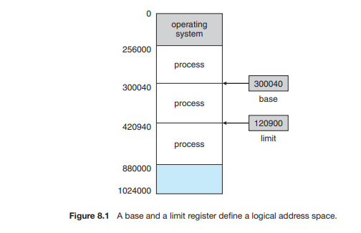

Slide 4
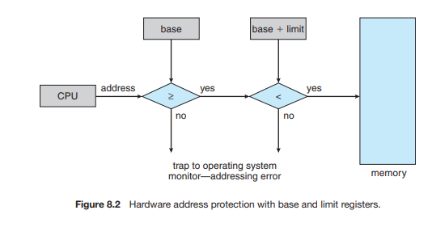

Slide 5
The binding of instructions and data to memory addresses can be done at any step along the way:
Compile time:If you know at compile time where the process will reside in memory, then absolute code can be generated.
Load time: If it is not known at compile time where the process will reside in memory, then the compiler must generate relocatable code.
Execution time: If the process can be moved during its execution from one memory segment to another, then binding must be delayed until run time.

Slide 6
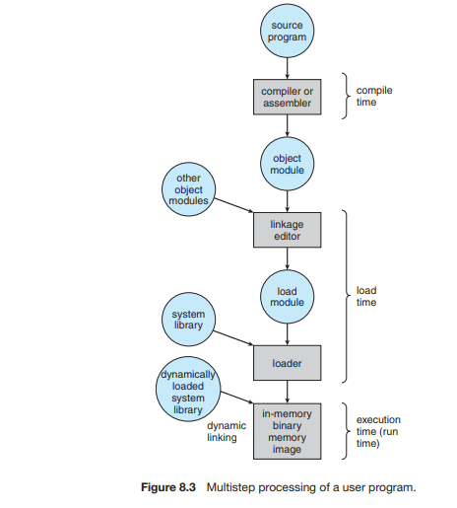
Multistep processing of a user program

Slide 7
Logical Versus Physical Address Space:
An address generated by the CPU is commonly referred to as a logical address.
address seen by the memory unit—that is, the one loaded into the memory-address register of the memory i.e physical address.
The compile-time and load-time address-binding methods generate identical logical and physical addresses. However, the execution-time address-binding scheme results in differing logical and physical addresses. The set of all logical addresses generated by a program is a logical address space. The set of all physical addresses corresponding to these logical addresses is a physical address space.

Slide 8
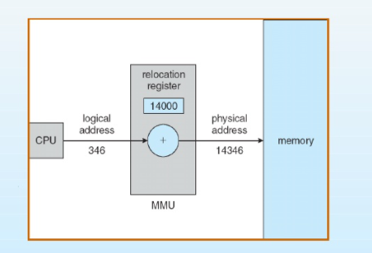
The run-time mapping from virtual to physical addresses is done by a hardware device called the memory-management unit (MMU). This mapping is shown in figure.

Slide 9
Dynamic Loading
With dynamic loading, a routine is not loaded until it is called. All routines are kept on disk in a relocatable load format. The main program is loaded into memory and is executed. When a routine needs to call another routine, the calling routine first checks to see whether the other routine has been loaded. If it has not, the relocatable linking loader is called to load the desired routine into memory and to update the program’s address tables to reflect this change. Then control is passed to the newly loaded routine.
Advantages:
It is useful when large amounts of code are needed to handle infrequently occurring cases.
No special support from the operating system is required.

Slide 10
Dynamic Linking and Shared Libraries
Dynamically linked libraries are system libraries that are linked to user programs when the programs are run.
Some operating systems support only static linking, in which system libraries are treated like any other object module and are combined by the loader into the binary program image.
Dynamic linking: linking, postponed until execution time. This feature is usually used with system libraries, such as language subroutine libraries.
With dynamic linking, a stub is included in the image for each library routine reference. The stub is a small piece of code that indicates how to locate the appropriate memory-resident library routine or how to load the library if the routine is not already present. When the stub is executed, it checks to see whether the needed routine is already in memory. If it is not, the program loads the routine into memory.
Other programs linked before the new library was installed will continue using the older library. This system is also known as shared libraries.

Slide 11
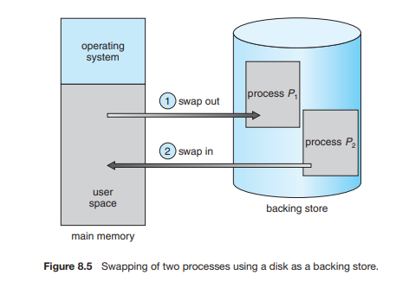
Swapping:
swapping involves moving processes between main memory and a backing store.
The backing store is commonly a fast disk. Swapping is done based on priority-based scheduling algorithms.
Major part of swap time is transfer time. Total transfer time is directly proportional to the amount of memory swapped.
System maintains a ready queue of ready-to-run processes which have images on disk.

Slide 12
Contiguous Memory Allocation
Main memory usually into two partitions
Operating system held in low memory. User process held in high memory. In contiguous memory allocation, each process is contained in a single section of memory that is contiguous to the section containing the next process.
Memory Protection: Relocation register scheme used to protect user processes from each other and from changing operating system code and data.
Base register contains value of smallest physical address
Limit register contains range of logical addresses. Each logical address must be less than the limit register
MMU maps logical address dynamically.

Slide 13
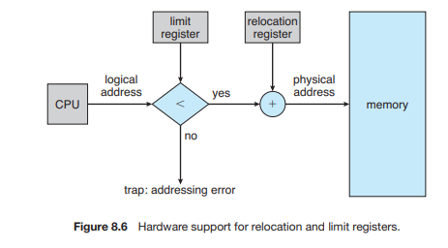

Slide 14
Memory allocation:
Allocating memory is to divide memory into several fixed-sized partitions. Each partition may contain exactly one process. Thus, the degree of multiprogramming is bound by the number of partitions. In this multiple partition method, when a partition is free, a process is selected from the input queue and is loaded into the free partition. When the process terminates, the partition becomes available for another process.

Slide 15
In the variable-partition scheme, the operating system keeps a table indicating which parts of memory are available and which are occupied. Initially, all memory is available for user processes and is considered one large block of available memory i.e a hole. memory contains a set of holes of various sizes.
As processes enter the system, they are put into an input queue. The operating system takes into account the memory requirements of each process and the amount of available memory space in determining which processes are allocated memory. When a process is allocated space, it is loaded into memory. When a process terminates, it releases its memory, which the operating system may then fill with another process from the input queue.

Slide 16
When a process arrives and needs memory, the system searches the set for a hole that is large enough for this process. If the hole is too large, it is split into two parts. One part is allocated to the arriving process; the other is returned to the set of holes. When a process terminates, it releases its block of memory, which is then placed back in the set of holes. If the new hole is adjacent to other holes, these adjacent holes are merged to form one larger hole.
Dynamic storage allocation: Three strategies are used for allocation of list of free holes
First-fit: Allocate the first hole that is big enough.
Best-fit: Allocate the smallest hole that is big enough; must search entire list, unless ordered by size Produces the smallest leftover hole.
Worst-fit: Allocate the largest hole; must also search entire list.
both first fit and best fit are better than worst fit in terms of decreasing time and storage utilization.
first-fit and best-fit strategies for memory allocation suffer from external fragmentation

Slide 17
Fragmentation: two types
External Fragmentation: Total memory space exists to satisfy a request, but it is not contiguous.
Internal Fragmentation: allocated memory may be slightly larger than requested memory; this size difference is memory internal to a partition, but not being used.
solution to the problem of external fragmentation is compaction. The goal is to shuffle the memory contents so as to place all free memory together in one large block.

Slide 18
Compaction is not always possible, however. If relocation is static and is done at assembly or load time, compaction cannot be done. It is possible only if relocation is dynamic and is done at execution time. If addresses are relocated dynamically, relocation requires only moving the program and data and then changing the base register to reflect the new base address. This scheme can be expensive.
Another possible solution to the external-fragmentation problem is to permit the logical address space of the processes to be noncontiguous, thus allowing a process to be allocated physical memory wherever such memory is available. Two complementary techniques achieve this solution: segmentation and paging.

Slide 19
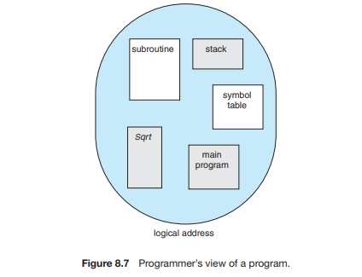
Segmentation: Segmentation is a memory-management scheme that supports this programmer view of memory. A logical address space is a collection of segments. It is shown in following figure.
The addresses specify both the segment name and the offset within the segment. The programmer therefore specifies each address by two quantities: a segment name and an offset.

Slide 20
For simplicity of implementation, segments are numbered and are referred to by a segment number, rather than by a segment name. Thus, a logical address consists of a two tuple:
<segment-number, offset>
when a program is compiled, the compiler automatically constructs segments reflecting the input program. A C compiler might create separate segments for the following:
1. The code 2. Global variables 3. The heap, from which memory is allocated 4. The stacks used by each thread 5. The standard C library Libraries
that are linked in during compile time might be assigned separate segments. The loader would take all these segments and assign them segment numbers.

Slide 21
Segmentation Hardware:
Logical address consists of a two tuple: <segment number,offset>
Segment table – maps two-dimensional physical addresses; each table entry has:
base – contains the starting physical address where the segments reside in memory
limit – specifies the length of the segment
Segment-table base register (STBR) points to the segment table’s location in memory
Segment-table length register (STLR) indicates number of segments used by a program; segment number s is legal if s < STLR.

Slide 22
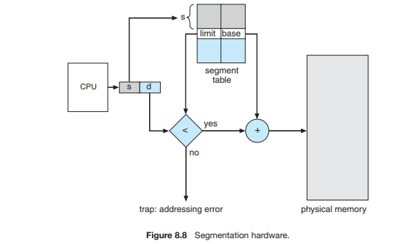

Slide 23
The use of a segment table is illustrated in Figure 8.8. A logical address consists of two parts: a segment number, s, and an offset into that segment, d. The segment number is used as an index to the segment table. The offset d of the logical address must be between 0 and the segment limit. If it is not, we trap to the operating system (logical addressing attempt beyond end of segment). When an offset is legal, it is added to the segment base to produce the address in physical memory of the desired byte.

Slide 24
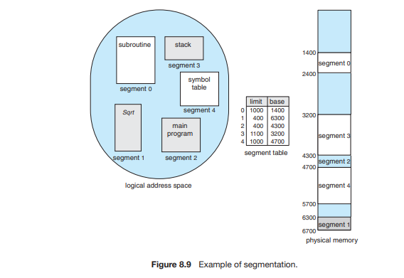
Example of Segmentation

Slide 25
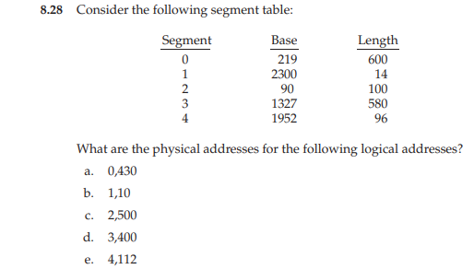

Slide 26
Paging: It is also another non contiguous memory management scheme. It avoids the external fragmentation and the need for compaction. Paging is implemented through cooperation between the operating system and the computer hardware.
Basic Method:
The basic method for implementing paging involves breaking physical memory into fixed-sized blocks called frames and breaking logical memory into blocks of the same size called pages. When a process is to be executed, its pages are loaded into any available memory frames from their source (a file system or the backing store). The backing store is divided into fixed-sized blocks that are the same size as the memory frames or clusters of multiple frames

Slide 27
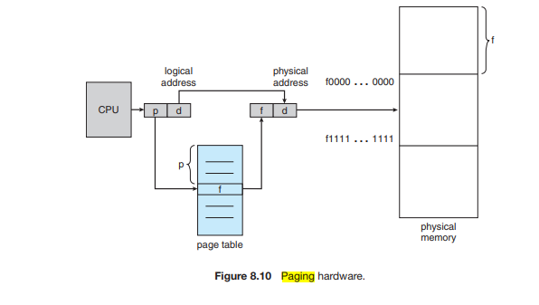
The hardware support for paging is illustrated in Figure 8.10

Slide 28
Address generated by CPU is divided into:
Page number (p) – used as an index into a page table which contains base address of each page in physical memory
Page offset (d) – combined with base address to define the physical memory address that is sent to the memory unit
. If the size of the logical address space is 2^{m}, and a page size is 2^{n} bytes, then the high-order m − n bits of a logical address designate the page number, and the n low-order bits designate the page offset.

Slide 29
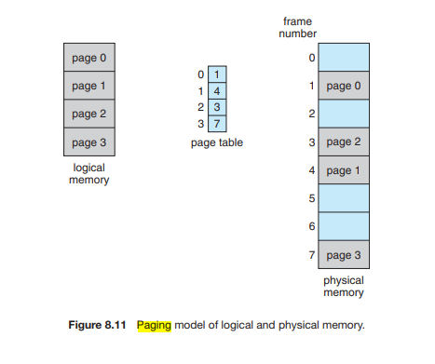
The paging model of memory is shown in Figure 8.11.

Slide 30
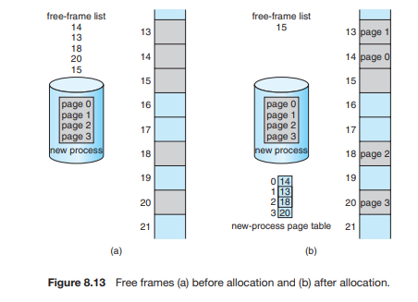
When we use a paging scheme, we have no external fragmentation: any free frame can be allocated to a process that needs it. However, we may have some internal fragmentation.

Slide 31
When a process arrives in the system to be executed, its size, expressed in pages, is examined. Each page of the process needs one frame. Thus, if the process requires n pages, at least n frames must be available in memory. If n frames are available, they are allocated to this arriving process. The first page of the process is loaded into one of the allocated frames, and the frame number is put in the page table for this process. The next page is loaded into another frame, its frame number is put into the page table, and so on. It is shown in above figure.

Slide 32
Hardware:
Page table is kept in main memory
Page-table base register (PTBR) points to the page table
Page-table length register (PTLR) indicates size of the page table
In this scheme every data/instruction access requires two memory accesses
One for the page table and one for the data / instruction
The two memory access problem can be solved by the use of a special fast-lookup hardware cache called associative memory or translation look-aside buffers (TLBs)

Slide 33
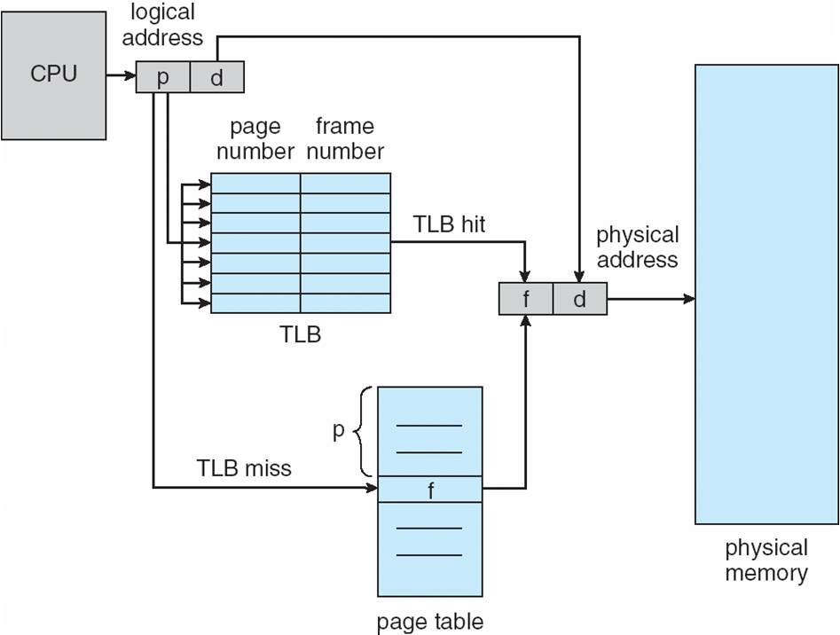
Paging Hardware with TLB

Slide 34
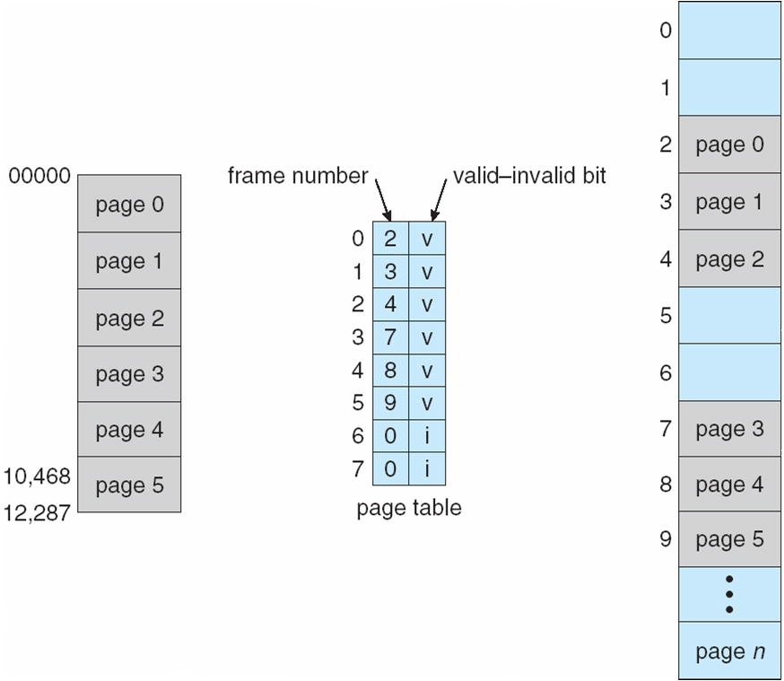
Protection:
Valid-invalid bit attached to each entry in the page table:
“valid” indicates that the associated page is in the process’ logical address space, and is thus a legal page
“invalid” indicates that the page is not in the process’ logical address space

Slide 35
Shared pages: These are provide the shared code.
Shared code
One copy of read-only (reentrant) code shared among processes (i.e., text editors, compilers, window systems)
Similar to multiple threads sharing the same process space
Also useful for interprocess communication if sharing of read-write pages is allowed
Private code and data
Each process keeps a separate copy of the code and data
The pages for the private code and data can appear anywhere in the logical address space

Slide 36
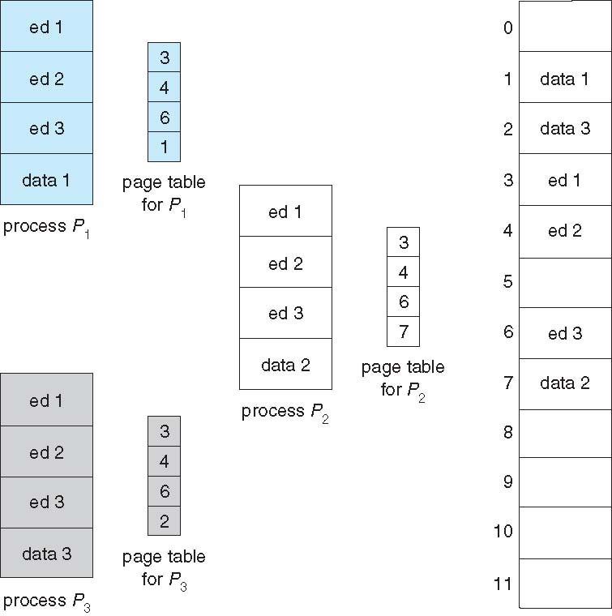
Shared page example:

Slide 37
Structure of the page table:
The techniques for structuring the page table are:
Hierarchical paging
Hashed Page table
Inverted Page table

Slide 38
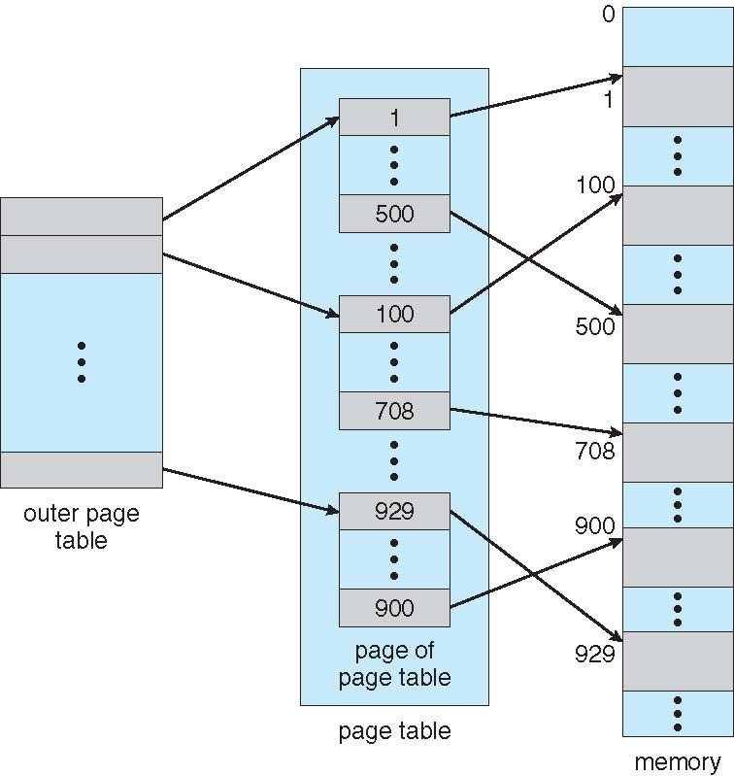
Hierarchical paging :
In this technique the logical address space divided into multiple page tables. A simple technique is a two-level page table.It is shown in figure.

Slide 39
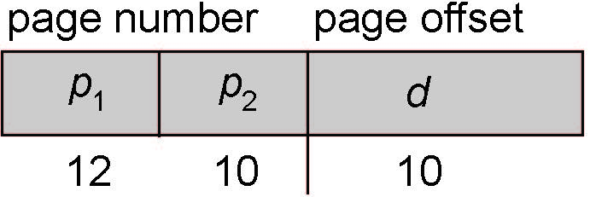
Two-level paging example:
A logical address (on 32-bit machine with 1K page size) is divided into:
a page number consisting of 22 bits
a page offset consisting of 10 bits
Since the page table is paged, the page number is further divided into:
a 12-bit page number
a 10-bit page offset
Thus, a logical address is as follows:
where p₁ is an index into the outer page table, and p₂ is the displacement within the page of the inner page table
Known as forward-mapped page table

Slide 40
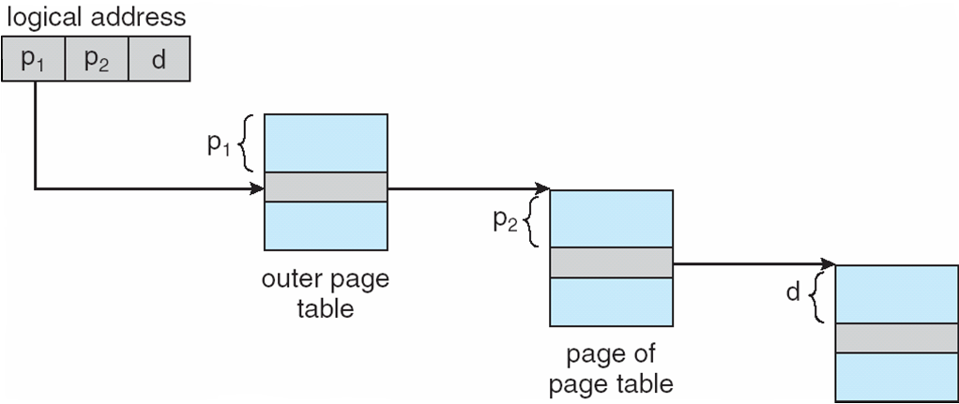
Address translation is shown in following figure

Slide 41
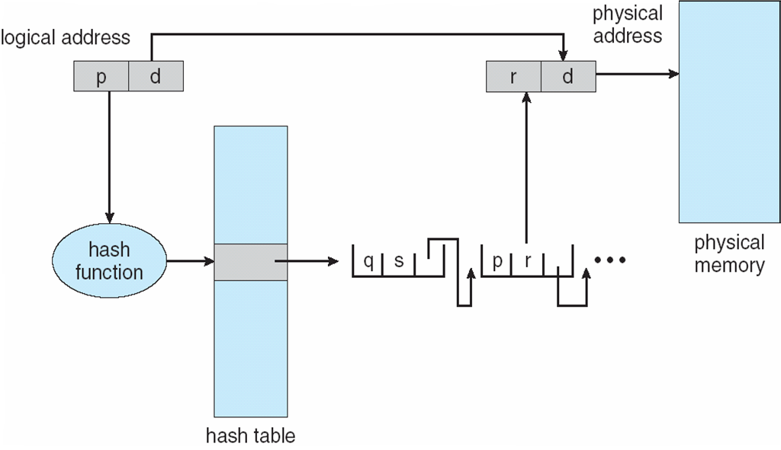
Hash page table

Slide 42
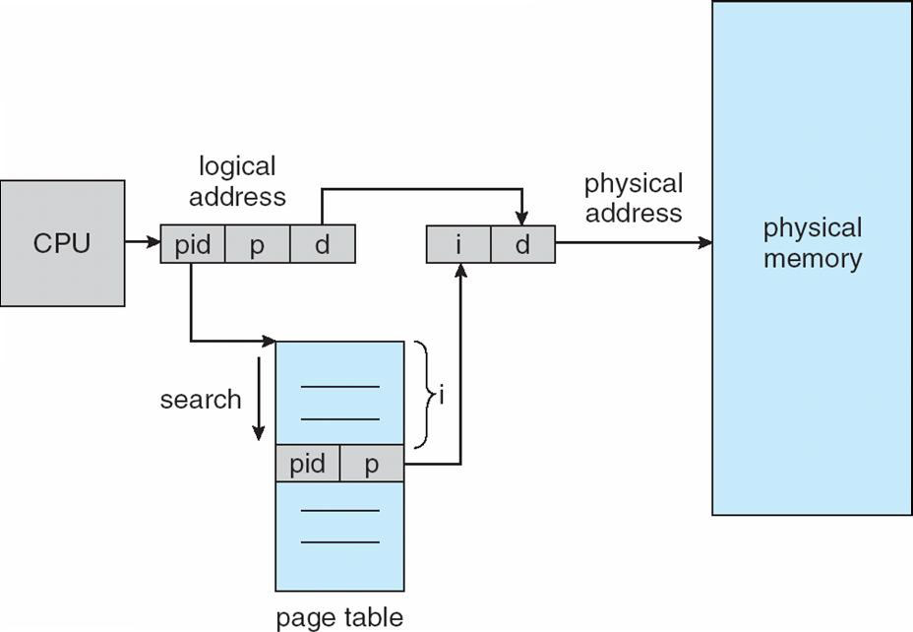
Invert Page table

