Slide 2
Virtual Memory
Benefits when ever program partially loaded in memory during execution
more programs could be run at the same time, with a corresponding increase in CPU utilization and throughput but with no increase in response time or turnaround time.
Less I/O would be needed to load or swap user programs into memory, so each user program would run faster.

Slide 3
Virtual memory is implemented through demand paging.
Demand Paging: to load pages only as they are needed. It is called demand paging. It is used in virtual memory systems.
With demand-paged virtual memory, pages are loaded only when they are demanded during program execution.

Slide 4
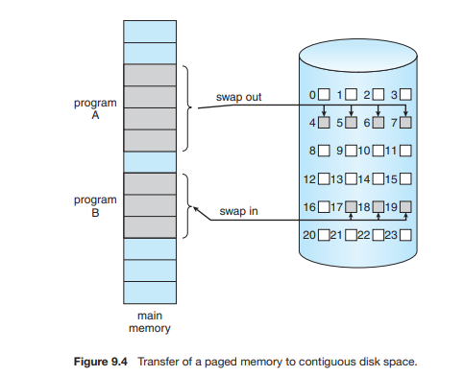
A demand-paging system is similar to a paging system with swapping (Figure 9.4) where processes reside in secondary memory (usually a disk). It is shown in figure

Slide 5
When we want to execute a process, we swap it into memory by swapper. Rather than swapping the entire process into memory, Lagy swapper swaps a page into memory whenever that page will be needed. Pager brings only those pages which are required during execution of process.

Slide 6
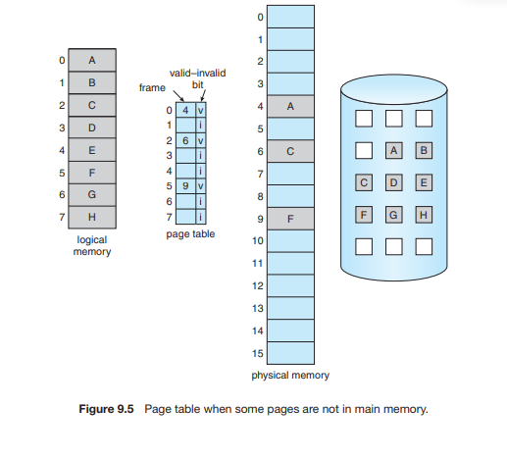

Slide 7
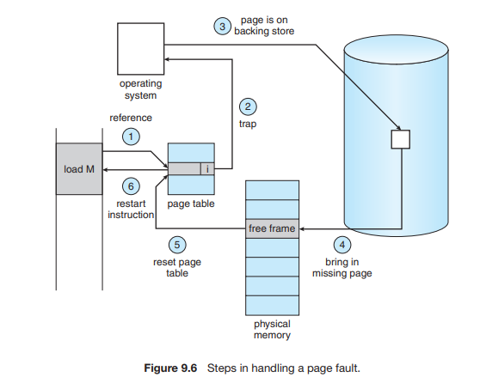
Steps in handling a page fault

Slide 8
The hardware to support demand paging is the same as the hardware for paging and swapping:
Page table. This table has the ability to mark an entry invalid through a valid–invalid bit or a special value of protection bits.
Secondary memory. This memory holds those pages that are not present in main memory. The secondary memory is usually a high-speed disk. It is known as the swap device, and the section of disk used for this purpose is known as swap space.

Slide 9
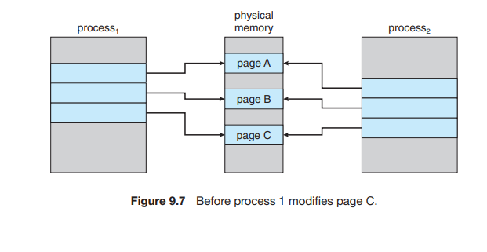
Copy-on-Write: In this technique, the child and parent processes initially share the same pages.
These shared pages are marked as copy-on-write pages, meaning that if either process writes to a shared page, a copy of the shared page is created.

Slide 10
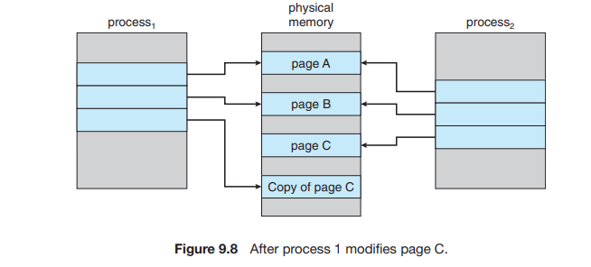

Slide 11
Page Replacement
Advantages of Demand Paging:
Large virtual memory.
More efficient use of memory.
Unconstrained multiprogramming. There is no limit on degree of multiprogramming.
Disadvantages of Demand Paging:
4. Number of tables and amount of processor over head for handling page interrupts are greater than in the case of the simple paged management techniques.
5. due to the lack of an explicit constraints on a jobs address space size.

Slide 12
The operating system determines where the desired page is residing on the disk but then finds that there are no free frames on the free-frame list

Slide 13
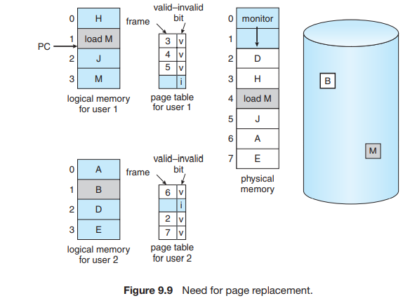
The operating system determines where the desired page is residing on the disk but then finds that there are no free frames on the free-frame list.

Slide 14
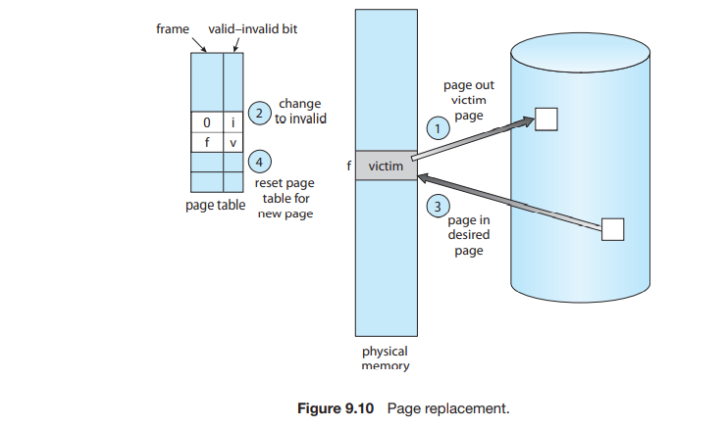
Page replacement: It is shown in figure.

Slide 15
1.Find the location of the desired page on the disk.
2. Find a free frame:
If there is a free frame, use it.
If there is no free frame, use a page-replacement algorithm to select a victim frame.
Write the victim frame to the disk; change the page and frame tables accordingly.
3. Read the desired page into the newly freed frame; change the page and frame tables.
4. Continue the user process from where the page fault occurred.
modify bit (or dirty bit): When this scheme is used, each page or frame has a modify bit associated with it in the hardware. The modify bit for a page is set by the hardware whenever any byte in the page is written into, indicating that the page has been modified.

Slide 16
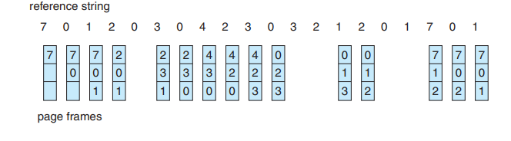
Page replacement algorithms
FIFO

Slide 17
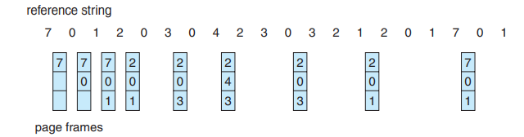
Belady’s anomaly:the page-fault rate may increase as the number of allocated frames increases.
Optimal: Replace the page that will not be used for the longest period of time.
The optimal page-replacement algorithm is difficult to implement, because it requires future knowledge of the reference string.

Slide 18
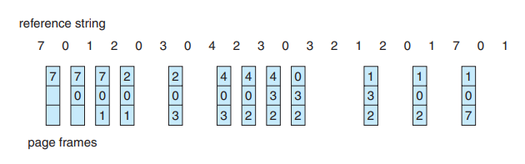
LRU: LRU chooses that page that has not been used for the longest period of time

Slide 19
The LRU policy is often used as a page-replacement algorithm and is considered to be good. The major problem is how to implement LRU replacement. The problem is to determine an order for the frames defined by the time of last use. Two implementations are feasible:
Counters: In the simplest case, we associate with each page-table entry a time-of-use field and add to the CPU a logical clock or counter. The clock is incremented for every memory reference. Whenever a reference to a page is made, the contents of the clock register are copied to the time-of-use field in the page-table entry for that page

Slide 20
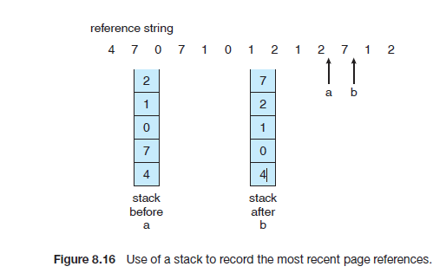
Stack: Another approach to implementing LRU replacement is to keep a stack of page numbers. Whenever a page is referenced, it is removed from the stack and put on the top. In this way, the most recently used page is always at the top of the stack and the least recently used page is always at the bottom. It is shown in following figure.

Slide 21
LRU-Approximation Page Replacement:
LRU needs special hardware.
With each page associate a bit, initially = 0
When page is referenced bit set to 1
We do not know the order
Additional – Reference – Bits Algorithm:
We can keep an 8-bit byte for each page in a table in memory. At regular intervals, a timer interrupt transfers control to the operating system. The operating system shifts the reference bit for each page into the high-order bit of its 8-bit byte, shifting the other bits right by 1 bit and discarding the low-order bit. These 8-bit shift registers contain the history of page use for the last eight time periods. If the shift register contains 00000000, then the page has not been used for eight time periods; a page that is used at least once each period would have a shift register value of 11111111. A page with a history register value of 11000100 has been used more recently than one with a value of 01110111.

Slide 22
Second-Chance Algorithm
The basic algorithm of second-chance replacement is a FIFO replacement algorithm. When a page has been selected, however, we inspect its reference bit. If the value is 0, we proceed to replace this page; but if the reference bit is set to 1, we give the page a second chance and move on to select the next FIFO page. When a page gets a second chance, its reference bit is cleared, and its arrival time is reset to the current time. Thus, a page that is given a second chance will not be replaced until all other pages have been replaced. One way to implement the second-chance algorithm (sometimes referred to as the clock algorithm) is as a circular queue.

Slide 23
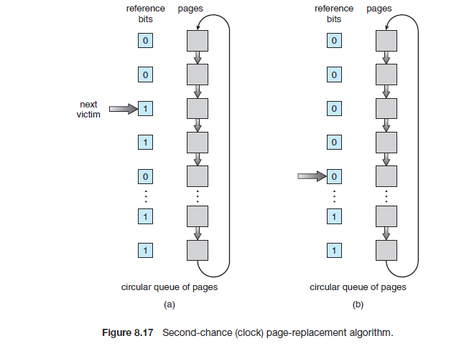

Slide 24
Enhanced Second – Chance Algorithm:
We can enhance the second-chance algorithm by considering the reference bit and the modify bit as an ordered pair. With these two bits, we have the following four possible classes:
1. (0, 0) neither recently used nor modified—best page to replace
2. (0, 1) not recently used but modified—not quite as good, because the
page will need to be written out before replacement
3. (1, 0) recently used but clean—probably will be used again soon
4. (1, 1) recently used and modified—probably will be used again soon, and
the page will be need to be written out to disk before it can be replaced

Slide 25
Counting-Based Page Replacement:
We can keep a counter of the number of references that have been made to each page and develop the following two schemes.
The least-frequently-used (LFU) page-replacement algorithm requires that the page with the smallest count be replaced. This algorithm suffers from the situation in which a page is used heavily during the initial phase of a process, but then is never used again.
The most-frequently-used (MFU) page-replacement algorithm is based on the argument that the page with the smallest count was probably just brought in and has yet to be used.
The implementation of these algorithms is expensive.

Slide 26
Allocation of Frames
Minimum Number of Frames:
Each process needs be allocated a minimum number of frames. As the number of frames allocated to each process decreases, the page-fault rate increases, slowing process execution. In addition, remember that, when a page fault occurs before an executing instruction is complete, the instruction must be restarted. Consequently, we must have enough frames to hold all the different pages that any single instruction can reference. Whereas the minimum number of frames per process is defined by the architecture, the maximum number is defined by the amount of available physical memory.

Slide 27
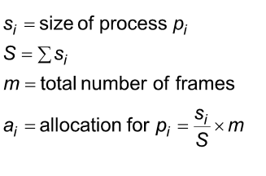
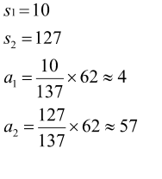
Allocation Algorithms:
Equal allocation: The easiest way to split m frames among n processes is to give everyone an equal share, m/n frames. For instance, if there are 93 frames and five processes, each process will get 18 frames. The three leftover frames can be used as a free-frame buffer pool.
Proportional allocation– Allocate free frames according to the size of process. m=62

Slide 28
Global Versus Local Allocation:
Another important factor in the way frames are allocated to the various processes is page replacement with multiple processes competing for frames, we can classify page-replacement algorithms into two broad categories: global replacement and local replacement.
Global replacement allows a process to select a replacement frame from the set of all frames, even if that frame is currently allocated to some other process; that is, one process can take a frame from another.
Local replacement requires that each process select from only its own set of allocated frames.

Slide 29
With a local replacement strategy, the number of frames allocated to a process does not change. With global replacement, a process may happen to select only frames allocated to other processes, thus increasing the number of frames allocated to it (assuming that other processes do not choose its frames for replacement).
One problem with a global replacement algorithm is that a process cannot control its own page-fault rate. The set of pages in memory for a process depends not only on the paging behavior of that process but also on the paging behavior of other processes. Therefore, the same process may perform quite differently (for example, taking 0.5 seconds for one execution and 10.3 seconds for the next execution) because of totally external circumstances. Such is not the case with a local replacement algorithm.

Slide 30
Under local replacement, the set of pages in memory for a process is affected by the paging behavior of only that process. Local replacement might hinder a process, however, by not making available to it other, less used pages of memory. Thus, global replacement generally results in greater system throughput and is therefore the more common method.

Slide 31
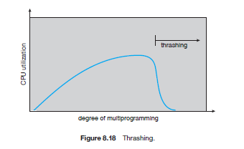
Thrashing: a process is busy swapping pages in and out.
Cause of Thrashing: As the degree of multiprogramming increases, CPU utilization also increases, although more slowly, until a maximum is reached. If the degree of multiprogramming is increased even further, thrashing sets in, and CPU utilization drops sharply. At this point, to increase CPU utilization and stop thrashing, we must decrease the degree of multiprogramming.

Slide 32
Solution for Thrashing:
We can limit the effects of thrashing by using a local replacement algorithm With local replacement, if one process starts thrashing, it cannot steal frames from another process and cause the latter to thrash as well. However, the problem is not entirely solved. If processes are thrashing, they will be in the queue for the paging device most of the time. The average service time for a page fault will increase because of the longer average queue for the paging device. Thus, the effective access time will increase even for a process that is not thrashing.

Slide 33
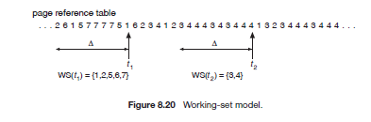
To prevent thrashing, we must provide a process with as many frames as it needs. But how do we know how many frames it “needs”? There are several techniques. The working-set strategy starts by looking at how many frames a process is actually using. This approach defines the locality model of process execution (working set model).
Working set model: This model uses a parameter, ∆, to define the working-set window. The idea is to examine the most recent ∆ page references. The set of pages in the most recent ∆ page references is the working set.

