Slide 1
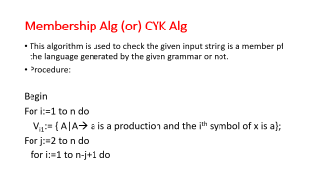
Membership Algorithm (CYK Alg)

Slide 2
Membership Alg (or) CYK Alg
This algorithm is used to check the given input string is a member pf the language generated by the given grammar or not.
Procedure:
Begin
For i:=1 to n do
V_{i1}:= { A|A→ a is a production and the i^{th} symbol of x is a};
For j:=2 to n do
for i:=1 to n-j+1 do

Slide 3
begin
V_{ij}:= φ;
for k:=1 to j-1 do
V_{ij} := V_{ij} U { A|A→ BC is a production, B is in
V_{ik} and C is in V_{i+k,j-k}}
end
end

Slide 4
1. Consider the following grammar S→AB|BC A→BA|a B→CC|b C→AB|a check whether the following string “baaba” is a member of L(G) or not
Solution:
Membership algorithm or CYK algorithm is used to check the given string is in language or not.
To apply CYK, we need to check whether the given language grammar is in CNF or not.
Here , the given grammar is in CNF so apply CYK algorithm
Length of the given string is 5 so, we need to construct 5x5 table for V_{i,j} as shown below

Slide 5
First row(V_{i,1} ) is filled by observing the given grammar rules
B→b, A→a and C→a are implying b and a so we place B, A&C in corresponding Cells

Slide 6
V_{1,2}= {B.(A,C)} = {BA,BC} = A,S [Since A→BA and S→BC]
V_{2,2}= {(A,C).(A,C)} = {AA,AC,CA,CC} =B [Since B→CC]
V_{3,2}= {(A,C).B} = {AB,CB} = S,C [Since S→AB and C→AB]
V_{4,2}= {B.(A,C)} = {BA,BC} = A,S [Since A→BA and S→BC]

Slide 7
V_{1,3}= { (A,S).(A,C) U B.B}
= {AA,AC,SA,SC,BB}
= φ [Since, no rules implying these]
V_{2,3}= {B.B U (A,C).(S,C)}
= { BB,AS,AC,CS,CC}
= B [Since B→CC]
V_{3,3}= { (S,C).(A,C) U (A,C).(A,S)}
= {SA,SC,CA,CC,AA,AS,CA,CS}
= B [Since B→CC]

Slide 8
V_{1,4}= {φ.B U (A,S).(S,C) U B.B
= { AS,AC,SS,SC,BB}
= φ [Since, no rules implying
these]
V_{2,4}={B.(A,C) U B.(A,S) U (A,C).B}
= {BA,BC,BA,BS,AB,CB}
=A,S,C [Since: A→BA,S→BC
and C→AB]

Slide 9
V_{1,5}= {φ .(A,C) U φ.(A,S) U (A,S).B
U B.(A,S,C)}
= {AB,SB,BA,BS,BC}
= A,S,C [ Since: S→AB, C→AB,
A→BA]
In V_{1,5} we have S(start Symbol), so the given string “baaba” is a member of language L(G)

Slide 10
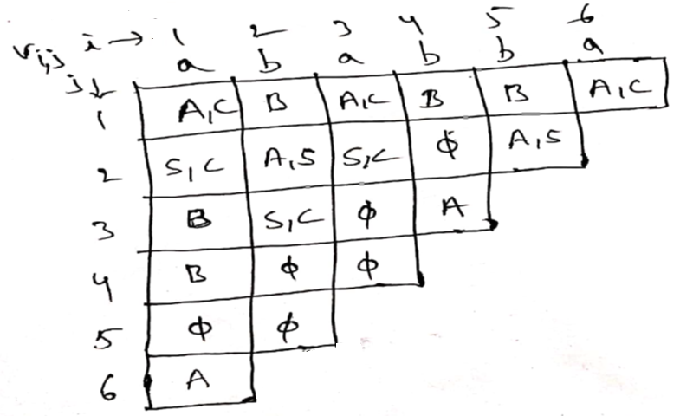
2. Consider the following grammar {S→AB|BC, A→BA|a,B→CC|b,C→AB|a} check whether the following string “ababba” is a member of L(G) or not

Slide 12
Similarly we find V_{1,5},V_{2,5} and V_{1,6}
V_{1,6} is having only A, it doesn’t have S (start Symbol) so the given string ”ababba” is not in L(G).

Slide 13
Home Work
Grammar is:
S→AS|SB|0|1
A→AA|0
B→BB|1
check the following string are in given language grammar or not
i) 011000
ii) 100100

