Slide 1
Push Down Automata

Slide 2
Emptiness property of a CFL
In order to check whether a CFL is empty or not, consider the CFG for CFL and if the starting symbol of the grammar does not generate any string, then we say that CFL is empty.

Slide 3
Finiteness of a CFL
To check whether a CFL is finite or not we design a grammar G=(V,T,P,S) for CFL and then convert it into CNF G’=(V’,T’,P’,S’).
Then draw the directed graph with vertex for each variable and an edge from A to B if there is a production in the form A→BC or A→CB.
If the graph contains any loop then it is infinite otherwise it is finite.

Slide 4
Ex:

Slide 5
Rank of a Variable:
For a graph with no cycles, the rank of a variable A is the length of the longest path beginning at A.

Slide 6
Push Down Automata (PDA)
A PDA is a way to implement a “CFG” in a similar way, we design a DFA for a regular grammar.
The DFA can remember a finite amount of information but a PDA can remember an infinite amount of information.
Basically a PDA is a FSM + Stack

Slide 7
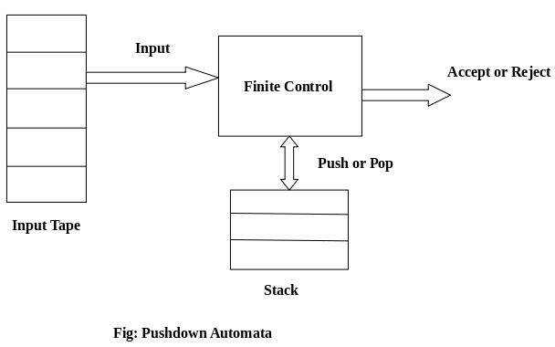
PDA
A PDA has three components, they are
1. Input tape 2. Control unit 3. A stack with infinite size

Slide 8
PDA
A PDA may or may not read a input symbol, but it has to read top of stack in every transition.
The stack head scans the top of the stack.
The stack contains two operations: Push and Pop

Slide 9
PDA Formalism
A PDA can be formally described as a seven tuple (Q, Σ, δ, q_{0,}F, Γ, Z₀₎
A finite set of states (Q, typically).
An input alphabet (Σ, typically).
A stack alphabet (Γ, typically).
A transition function (δ, typically).
A start state (q₀, in Q, typically).
A start symbol of stack (Z₀, in Γ, typically).
A set of final states (F ⊆ Q, typically).

Slide 10
The Transition Function
Takes three arguments:
A state, in Q.
An input, which is either a symbol in Σ or ε.
A stack symbol in Γ.
δ(q, a, Z) is a set of zero or more actions of the form (p, α).
p is a state; α is a string of stack symbols.

Slide 11
Actions of the PDA
If δ(q, a, Z) contains (p, α) among its actions, then one thing the PDA can do in state q, with a at the front of the input, and Z on top of the stack is:
Change the state to p.
Remove a from the front of the input (but a may be ε).
Replace Z on the top of the stack by α.

Slide 12
Types of PDA
A PDA is divided into two types:
1. Deterministic PDA
2. Non-Deterministic PDA
DPDA: If at each stage there exists exactly one choice of move then it is a DPDA.
A move in DPDA is δ: Q x {Σ U ε} x Γ → {Q x Γ*}
NPDA: If at each stage there exists more than one choice of move then it is a non deterministic PDA(NPDA).
A move in NPDA is: δ: Q x {Σ U ε} x Γ → {2^{Q} x Γ*}

Slide 13
Instantaneous Description of PDA:
The internal configuration of PDA at some particular instant of time is called Instantaneous Description.
The ID of PDA is denoted as (q,w,y)
q - current state
w - remainder of the input (i.e., unconsumed part)
y - current stack contents as a string from top to bottom of stack
If δ(q,a, X)={(p, A)} is a transition, then the following are also true:
(q, a, X ) |--- (p,ε,A)
(q, aw, XB ) |--- (p,w,AB)
|--- sign is called a “turnstile notation” and represents one move
|---* sign represents a sequence of moves

Slide 14
Acceptance of a PDA
There are two types of PDAs that one can design: those that accept by final state or by empty stack.
PDAs that accept by final state:
After processing all the input symbols, the PDA enters into one of the accepting state.
here the content of the stack is irrelevant.
L(w) = { w | (q₀, w , z₀) |---* (p, ε, α) where p € F.
PDAs that accepted by empty stack:
After processing all the input symbols, the PDA will be in same state ‘p’ by emptying the contents of stack.
L(w) = { w | (q₀, w , z₀) |---* (p, ε, ε) where p € Q.

