Slide 1
UNIT-IV Undecidability & Context Sensitive Grammar

Slide 2
Introduction:
A procedure for solving a problem is a sequence of instructions which can be mechanically carried out on a given input.
An algorithm is a procedure that terminates after finite number of steps, for any input.
An algorithm must be terminated but procedure may or may not terminate.
A set X is recursive, if we have an algorithm to determine whether the given element is belongs to X or not.
A set X is recursively enumerable, if we have a procedure to determine whether the given element is belongs to X.
Note: A recursive set is recursively enumerable.

Slide 3
Recursive Language
A language is a recursive if there exists a TM, that satisfies the following two conditions:
1. TM Halt & Accepts the string which belongs to the language.
2. TM Halt & Rejects the string which is not belongs to the language.
Accept
Input W
TM
Reject

Slide 4
Recursive Enumerable Language
A language is a recursive enumerable if there exists a TM that satisfies the following conditions:
1. TM Halt & Accepts for the string which belongs to the language.
2. TM Halt & Rejects (or) never halt for the string which is not belongs to the language.
TM
Accept
Input W

Slide 5
A problem whose language is recursive is said to be a decidable problem otherwise the problem is undecidable.
A decidable problem is a solvable problem and an undecidable problem is a unsolvable problem.
The theory of undecidability is concerned with the existence or non existence of algorithms for solving problems with an infinity of instances.

Slide 6
Closure Properties of Recursive and Recursive Enumerable Languages
Both closed under union, concatenation, star, reversal, intersection, inverse homomorphism.
Recursive closed under difference, complementation.

Slide 7
1. The complement of a recursive language is recursive
Let L be the recursive language and M a TM that halts on all inputs and accepts L.
Construct M’ from M so that if M enters a final state on input w, then M’ halts without accepting. If M halts without accepting, M’ enters a final state.
Since one of these two events occurs, M’ is an algorithm. Clearly L(M’) is the complement of L and thus the complement of L is a recursive language.
Accept
M
Accept
M’
M’
M
Input W
Reject
Reject

Slide 8
2. The union of two recursive languages is recursive
Let L₁ and L₂ be recursive languages accepted by algorithms M₁ and M₂.
We construct M, which first simulates M₁. If M₁ accepts, then M accepts. If M₁ rejects, then M simulates M₂ and accepts if and only if M₂ accepts.
Since both M₁ and M₂ are algorithms, M is guaranteed to halt. Cleary M accepts L₁ U L₂.
M
M
Accept
Accept
M₁
Accept
Input W
Start
Reject
M₂
Reject

Slide 9
3. The union of two recursively enumerable languages is recursively enumerable
Let L₁ and L₂ be recursively enumerable languages accepted by procedures M₁ and M₂.
We construct M, in which if M₁ and M₂ accepts then M accepts.
Since both M₁ and M₂ are procedures, M is guaranteed to accept. Cleary M accepts L₁ U L₂.
M
M
Accept
M₁
Accept
Input W
M₂
Accept

Slide 10
4. If a language L and its complement L^{l} are both recursively enumerable, then L is recursive.
Let M₁ and M₂ accept L and L^{l} respectively.
Construct M , to simulate simultaneously M₁ and M₂. M accepts w if M₁ accepts w and rejects w if M₂ accepts w.
Since w is in either L or L^{l}, we know that exactly one of M₁ or M₂ will accept. Thus M will always say either “accept” or “reject”, but will never say both.
Since M is an algorithm that accepts L, it follows that L is recursive.
M
M
Accept
M₁
Accept
Input W
M₂
Reject
Accept

Slide 11
Post Correspondence Problem
The Post Correspondence Problem (PCP), introduced by Emil Post in 1946
It is an undecidable decision problem.
The PCP problem over an alphabet ∑ is stated as follows −
Given the following two lists, M and N of non-empty strings over ∑ −
M = (x₁, x₂, x₃,………, x_{n})
N = (y₁, y₂, y₃,………, y_{n})
We can say that there is a Post Correspondence Solution, if for some i₁,i₂,………… i_{k}, where 1 ≤ i_{j} ≤ n, the condition x_{i1} …….x_{ik} = y_{i1} …….y_{ik} satisfies.

Slide 12
Example 1
Find whether the lists M = (abb, aa, aaa) and N = (bba, aaa, aa)
have a Post Correspondence Solution?
Solution:
M is N is
Here, 2 1 3
x₂x₁x₃ = ‘aaabbaaa’ and y₂y₁y₃ = ‘aaabbaaa’ aa abb aaa
We can see that x₂x₁x₃ = y₂y₁y₃ aaa bba aa
Hence, the solution is i = 2, j = 1, and k = 3.
x₁ | x₂ | x₃
abb | aa | aaa
y₁ | y₂ | y₃
bba | aaa | aa

Slide 13
Example 2
Find whether the lists M = (ab, bab, bbaaa) and N = (a, ba, bab) have a Post Correspondence Solution?
Solution:
M is N is
In this case, there is no solution because −
| x₂x₁x₃ | ≠ | y₂y₁y₃ | (Lengths are not same)
Hence, it can be said that this Post Correspondence Problem is undecidable.
x₁ | x₂ | x₃
ab | bab | bbaaa
y₁ | y₂ | y₃
a | ba | bab

Slide 15
Universal Turing Machine
The universal TM is the one which is represented in a binary coded form.
In order to code the TM first we need to code every move of the TM.
For convenience we represent the input symbols by X₁ ,X₂, ……..X_{n}.
If the symbols are 0,1,B then they are represented as X₁ ,X₂, X₃ respectively.
The directions L,R are represented as D₁,D₂ respectively .

Slide 16
Then a generic move ⸹(q_{i},X_{j}) = (q_{k},X_{l,}D_{m}) is encoded by the binary string 0^{i}10^{j}10^{k}10^{l}10^{m}
Ex: ⸹(q₁,1) = (q₃,B,L) → 0¹10²10³10³10¹
Now the binary code for the TM M is
111 code-1 11 code-2 11 code-3 11………..11 code-r 111
where each code-i is the string of the form 0^{i}10^{j}10^{k}10^{l}10^{m}.
Each code-i is the separated by 11. The begin and end of the TM has 111.

Slide 17
Consider the following example and convert it into Universal TM
M=({q₁,q₂,q₃}, {0,1}, {0,1,B}, ⸹,q₁,B,{q₃})
⸹(q₁,1) = (q₃,0,R), ⸹(q₃,0) = (q₁,1,R),
⸹(q₃,1) = (q₂,0,R), ⸹(q₃,B) = (q₃,1,L).
Solution:
⸹(q₁,1) = (q₃,0,R) → 0¹10²10³10³10²
⸹(q₃,0) = (q₁,1,R) → 0³10¹10¹10²10²
⸹(q₃,1) = (q₂,0,R) → 0³10²10²10¹10²
⸹(q₃,B) = (q₃,1,L) → 0³10³10³10²10¹
Universal TM is: 111 0¹10²10³10³10² 11 0³10¹10¹10²10² 11 0³10²10²10¹10² 11 0³10³10³10²10¹ 111

Slide 18
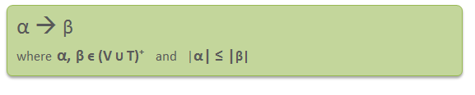
Context Sensitive Grammar
A Context-sensitive grammar is a formal grammar in which all the productions are of form –
Where α and β are strings of non-terminals and terminals.
Context-sensitive grammars are more powerful than context-free grammars because there are some languages that can be described by CSG but not by context-free grammars and CSL are less powerful than Unrestricted grammar.
That’s why context-sensitive grammars are positioned between context-free and unrestricted grammars in the Chomsky hierarchy.

Slide 19
Context-sensitive grammar has 4-tuples. G = {N, T, P, S},
Where
N = Set of non-terminal symbols T = Set of terminal symbols S = Start symbol of the production P = Finite set of productions All rules in P are of the form α₁ A α₂ –> α₁ β α₂

Slide 20
Context-sensitive Language
The language that can be defined by context-sensitive grammar is called CSL.
CSL does not allow epsilon.
Properties of CSL are :
Union, intersection and concatenation of two context-sensitive languages is context-sensitive.
Complement, positive closure of a context-sensitive language is context-sensitive.
CSLs are not closed under Kleene closure.

Slide 21
Example:
Consider the following CSG. S → abc/aAbc Ab → bA Ac → Bbcc bB → Bb aB → aa/aaA What is the language generated by this grammar?
Solution:
The language generated by this grammar is {a^{n}b^{n}c^{n} | n≥1}.
S → aAbc → abAc → abBbcc → aBbbcc → aaAbbcc → aabAbcc | → aabbAcc → aabbBbccc → aabBbbccc → aaBbbbccc → aaabbbccc

Slide 22
L={a^{n}b^{n}c^{n} | n≥0} is CSL?
L is not CSL because
L={ϵ,abc,aabbcc,……}
CSL does not allow ϵ,but in L we have ϵ.

Slide 23
Linear Bounded Automata
A LBA is a nondeterministic TM satisfying the following two conditions:
1. Its input alphabet includes two special symbols ₵ and $, the left and right end markers, respectively.
2. The LBA has no moves left from ₵ or right from $, nor may it print another symbol over ₵ or $.
The computation is restricted to the constant bounded area. The input alphabet contains two special symbols which serve as left end markers and right end markers.
A deterministic linear bounded automaton is always context-sensitive and the linear bounded automaton with empty language is undecidable.

Slide 24
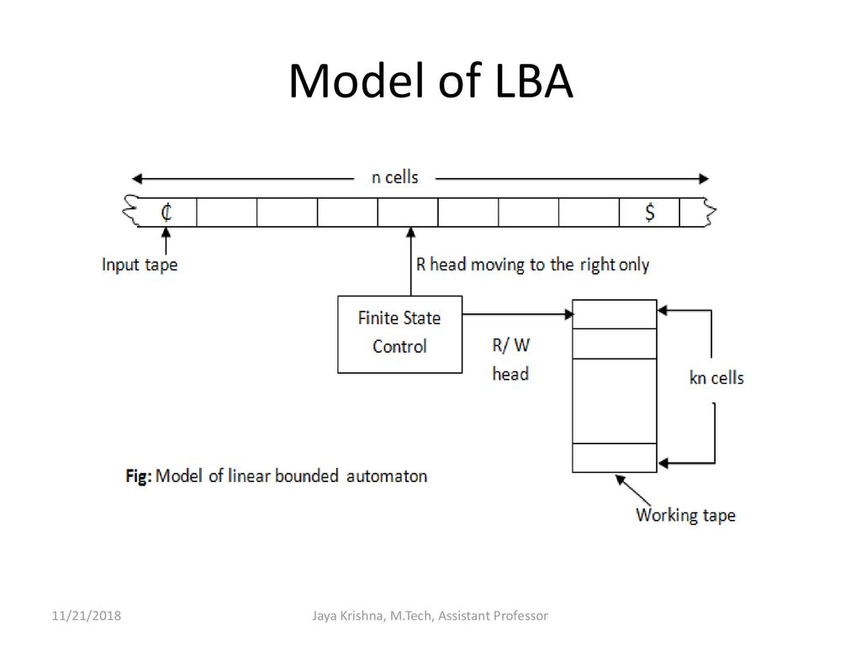
LBA = NTM + Bounded Tape + Tape length is a Linear function of input string

Slide 25
A linear bounded automaton can be defined as an 8-tuple
(Q, X, ∑, q₀, ₵ , $, δ, F) where −
Q is a finite set of states
X is the tape alphabet
∑ is the input alphabet
q₀ is the initial state
₵ is the left end marker
$ is the right end marker
δ is a transition function
F is the set of final states

Slide 26
Undecidable Problem about Turing Machine
Reduction
Reduction is a technique in which if a problem P1 is reduced to a problem P2 then any solution of P2 solves P1.
In general, if we have an algorithm to convert an instance of a problem P1 to an instance of a problem P2 that have the same answer then it is called as P1 reduced P2.
Hence if P1 is not recursive then P2 is also not recursive. Similarly, if P1 is not recursively enumerable then P2 also is not recursively enumerable.

Slide 27
Theorem: if P1 is reduced to P2 then 1. If P1 is undecidable, then P2 is also undecidable. 2. If P1 is non-RE, then P2 is also non-RE.
Proof:
1.If P1 is undecidable, then P2 is also undecidable.
Consider an instance w of P1. Then construct an algorithm such that the algorithm takes instance w as input and converts it into another instance x of P2.
Then apply that algorithm to check whether x is in P2. If the algorithm answer 'yes' then that means x is in P2, similarly we can also say that w is in P1. Since we have obtained P2 after reduction of P1.
Similarly if algorithm answer 'no' then x is not in P2, that also means w is not in P1. This proves that if P1 is undecidable, then P2 is also undecidable.

Slide 28
2. If P1 is non-RE, then P2 is also non-RE.
We assume that P1 is non-RE but P2 is RE.
Now construct an algorithm to reduce P1 to P2, but by this algorithm, P2 will be recognized.
That means there will be a Turing machine that says 'yes' if the input is P2 but may or may not halt for the input which is not in P2. As we know that one can convert an instance of w in P1 to an instance x in P2.
Then apply a TM to check whether x is in P2. If x is accepted that also means w is accepted. This procedure describes a TM whose language is P1 if w is in P1 then x is also in P2 and if w is not in P1 then x is also not in P2.
This proves that if P1 is non-RE then P2 is also non-RE.

Slide 29
Equivalence of LBA’s and CSG’s
Theorem-1: A language is accepted by LBA iff it is context sensitive language.
Proof:
If L is a CSL it is accepted by a LBA.
We can construct a Turing Machine for L which will take the string as input that randomly tries to apply productions backwards to get finally S.
Now the productions are of the form α → ß where | α | <= | ß | so at every stage the length of string in tape will be non increasing so none of the cells beyond the initial input string cells will be required. This is the required condition for LBA, so we can have a LBA for context sensitive language.

