Slide 1
Trust Score
?
Judge the source, not the content
Content detectors are collapsing against LLM-written bots. Who an account is connected to is much harder to fake.
We give every account a score from 0 (bot-like) to 1 (trusted) computed only from its position in the network.
Step 1 of 3: prove it on open, labelled Twitter data before moving to Reddit and a browser overlay.
?
?
Harvard · September 2026
● human seed ● bot seed ● unknown, scored by neighbours
Notes:
Why network-based: Fox8 LLM botnet had near-zero recall with Botometer; PageRank and degree alone still reach F1 0.72 on LLM agents. We never read post text.

Slide 2
The idea: trust leaks along connections
−½
1
Plant seeds
Known humans get −½, known bots get +½. Every other account starts at a small guess from its profile.
−½
−½
mutual w=0.88
Let it diffuse
mutual w=0.88
mention w=0.64
2
Each account averages its neighbours' values over typed edges: mutual follows, replies, mentions, quotes, shared links.
?
3
Read off trust
reply w=0.92
follow w=0.61
The fixed point is unique. Trust = ½ − residual. Because the solution is linear, every score splits exactly into prior + per-neighbour terms.
+½
+½
r = (1 − α)·q + α·P·r
q: seed evidence P: weighted neighbour average trust = ½ − r (α = 0.8 chosen on seeds only)
Three trusted, two bot-like neighbours. Reply and mutual-follow edges carry more weight than one-way follows, so this account lands mildly trusted: about 0.6.
Notes:
Edge weights are the label homophily of each relation measured on seed-seed edges (phi coefficient), blended with a hand prior. Hub senders are damped by 1/sqrt(degree).

Slide 3
The data: MGTAB
Which connections carry signal
10,199
2,748
Learned homophily weight per relation (1 = endpoints always share a label, 0 = no information)
accounts, every one hand-labelled by experts
bots (27%), 7,451 humans
1.7 M
20 + 24
edges across 7 relation types
profile features + structural features we compute; the 768-dim text embedding is left unused
Open (CC BY-NC-ND), GraphDetec 2023. A second dataset, cresci-2015, is used as a sanity check but is too easy: every method scores 0.999.
Direct conversation (replies, reciprocal follows) is the strongest evidence. Sharing a hashtag says almost nothing.
Notes:
Weights are phi coefficients on seed-seed edges blended with a hand prior (pseudo-count 50). Values from the 12 Sept 2026 MGTAB run.

Slide 4
The pipeline, six steps
1
2
3
4
5
6
Load
Features
Local prior
Weights
Propagate
Calibrate & explain
7 raw edge types become 6 relations; the follow direction is inferred from the overlap of the two follow lists.
›
44 numbers per account: degrees, reciprocity, PageRank, clustering, plus the 20 profile fields.
›
A Random Forest on those features gives a first P(bot). It is softened to ±¼ so it never outweighs a seed.
›
Each relation gets a weight from how often seed-to-seed edges join same-label accounts.
›
Solve r = (1−α)q + αPr. Converges in 54 iterations. α and the prior strength are picked by cross-validation on seeds.
›
A logistic fit maps r to P(bot). Each score is decomposed into prior, per-relation and per-neighbour terms for the dashboard.
Honest evaluation: 5-fold cross-fitting, so every account is scored by a model that never saw its label. Then two stress tests: fewer seeds (1% to 50%) and wrong seeds (0% to 30% flipped).
Everything is served by a FastAPI backend to a React dashboard: network explorer, per-account explanation card, communities and dense co-following blocks.
Notes:
Baselines run alongside: Random Forest alone, propagation without the prior, hand-set weights, TrustRank minus Anti-TrustRank, and a 2-hop simplified graph convolution.

Slide 5
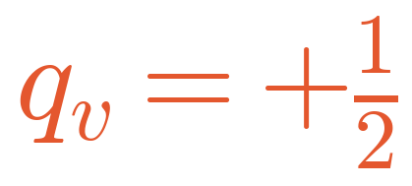
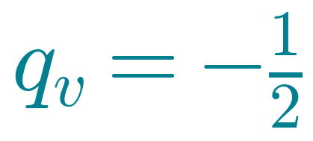
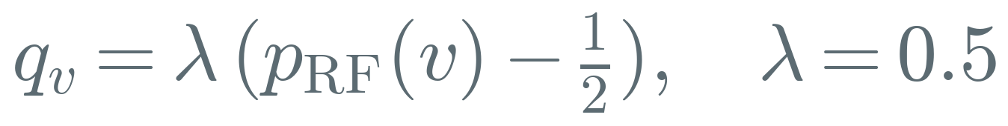
Math 1: every account starts with a prior q
q is one number per account. Positive means evidence of bot, negative means evidence of human.
Known bot
The vector q
Labelled seed. Fixed, never changes during propagation.
+½
acct 0
−½
acct 1
Known human
+0.12
acct 2
Labelled seed. Fixed, never changes during propagation.
−0.20
acct 3
−½
acct 4
Everyone else
+0.05
acct 5
?
A soft guess from the Random Forest on profile and structure. λ = 0.5 keeps it within ±¼, so a guess can never outweigh a real label.
+½
acct 6
−0.23
acct 7
10,199 entries on MGTAB

Slide 6
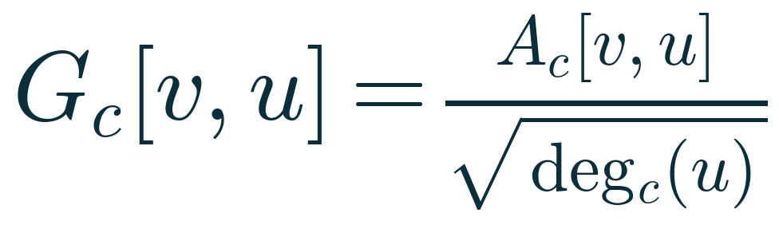
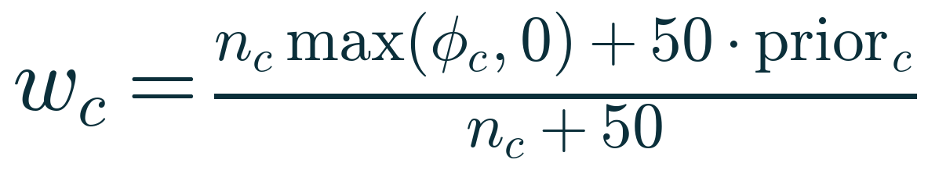
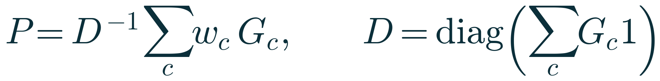
Math 2: connections become a matrix P
P[v,u] is how much account v listens to account u. Each row is a weighted average over v's neighbours.
1
0
1
2
3
1
Damp the hubs
0
mutual
0
0
0.54
0.46
0
1
0.65
0
0
0.35
follow
→
An account followed by thousands passes on only 1/√degree of its value to each.
reply
2
0.62
0
0
0.38
2
Weight each relation
3
3
0
0.45
0.55
0
2
mention
φ = label correlation on seed–seed edges (replies 0.92, hashtags 0.12). The 50 pulls sparse channels toward the hand prior.
4 accounts, 4 typed edges
P: rows sum to 1. Row 0 listens 54% to account 1 (mutual follow) and 46% to account 2 (reply).
3
Average over neighbours
Sum the weighted channels and divide by the total incoming weight D.

Slide 7
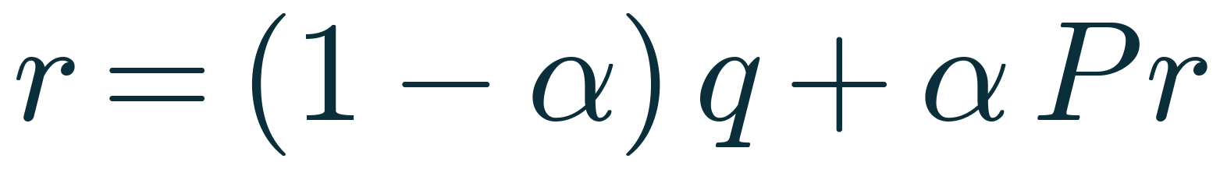
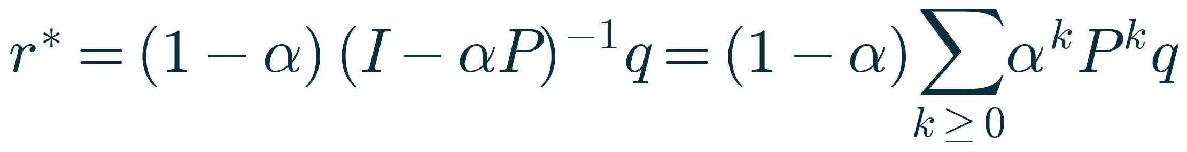

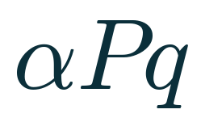
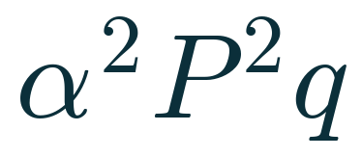
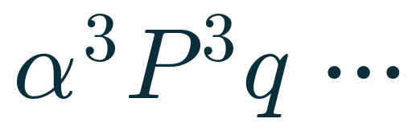
Math 3: solve for the fixed point
Each account's residual is a blend of its own prior and the average of its neighbours' residuals.
keep 20% of your own prior
take 80% from neighbours
Unrolled, the solution is a sum over hops. Each hop is discounted by α = 0.8, so distant seeds matter less.
+
+
+
✓
Unique
P is row-stochastic, so the map is a contraction with rate α. One answer, reached in 54 iterations.
✓
Bounded
itself
1 hop away
2 hops away
3 hops and beyond
|q| ≤ ½ implies |r*| ≤ ½, so trust always lands in [0, 1] without clipping.
weight 1.0
Each further hop is multiplied by α = 0.8 again: 0.8, 0.64, 0.51, … Seeds far away still count, but less.
✓
Explainable
r* is linear in q: every score splits exactly into prior + per-relation + per-neighbour terms.

Slide 8
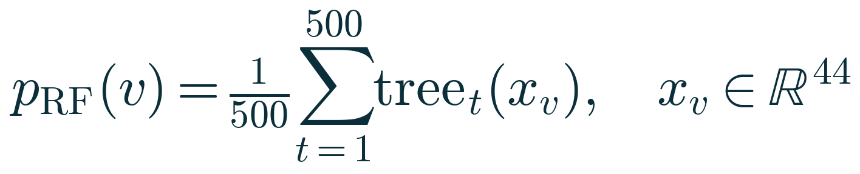
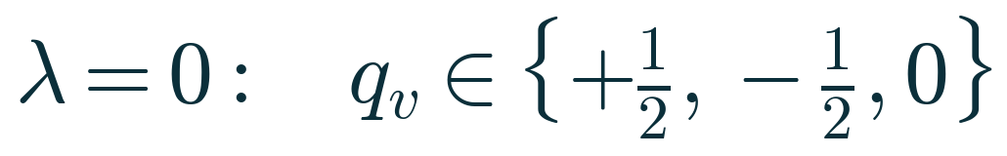
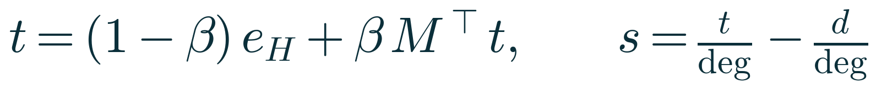
The four baselines we compare against
Same seeds, same cross-fitting, different formula.
1
Random Forest, profile only
2
Propagation only
Our formula with the Random Forest switched off. Only the ±½ seeds spread.
No graph at all. 500 trees on 44 numbers per account.
3
TrustRank − Anti-TrustRank
4
Simplified graph convolution
Smooth the features twice over the graph, then a logistic regression.
Two random walks with restart: trust from human seeds along follows, distrust from bot seeds against follows. β = 0.85, degree-normalised.

Slide 9
Results on MGTAB
5-fold cross-fit: every account is scored by a model that never saw its label.
Method | AUC | AP | F1 | Prec. | Rec.
Trust score (ours) | 0.956 | 0.875 | 0.795 | 0.797 | 0.792
Random Forest | 0.955 | 0.869 | 0.803 | 0.770 | 0.838
Propagation only | 0.604 | 0.457 | 0.066 | 0.864 | 0.035
ROC curve: bots caught vs humans wrongly flagged
F1, precision and recall at P(bot) > 0.5 after Platt calibration.
Reading it. The graph alone (propagation only) is weak on MGTAB: bots here mostly connect to humans. Combined with the profile prior it equals the Random Forest on AUC, and adds what the forest cannot give: robustness with few labels and an exact explanation per account.

Slide 10
Robustness: fewer labels, wrong labels
AUC on held-out accounts, averaged over 5 random seed draws.
Share of labels used as seeds
Share of seed labels deliberately flipped
With 1% of labels (about 100 accounts) the trust score already reaches 0.88.
With 30% of the seeds mislabelled, AUC stays at 0.86. TrustRank and pure propagation collapse.

Slide 11
Where we are, and what comes next
AUC on MGTAB: probability a random bot ranks below a random human (0.5 = coin flip)
0.88
0.86
AUC with only 1% of labels as seeds
AUC with 30% of seed labels deliberately wrong
Honest reading: the graph adds little over a good profile model on this dataset. The value is robustness to few and noisy labels, and explanations that a profile model cannot give.
Next, following the research brief
1
Coordination layer
2
Uncertainty
3
Harder data, then Reddit
Inject detected clusters as an edge type and a distrust prior, not just a display.
Show 'unknown' for accounts with little evidence instead of 'trusted'.
TwiBot-22 benchmark, synthetic Sybil attacks, then the Reddit reply graph.
Notes:
Numbers from the 12 Sept 2026 MGTAB run, 5-fold cross-fit. Trust score 0.956, Random Forest 0.955, SGC 0.858, TrustRank 0.737, propagation-only 0.604. Seed sweep at 1%: 0.877. Noise sweep at 30%: 0.861.

