Slide 1
Wordcount
Winkler & Gazzia

Slide 2
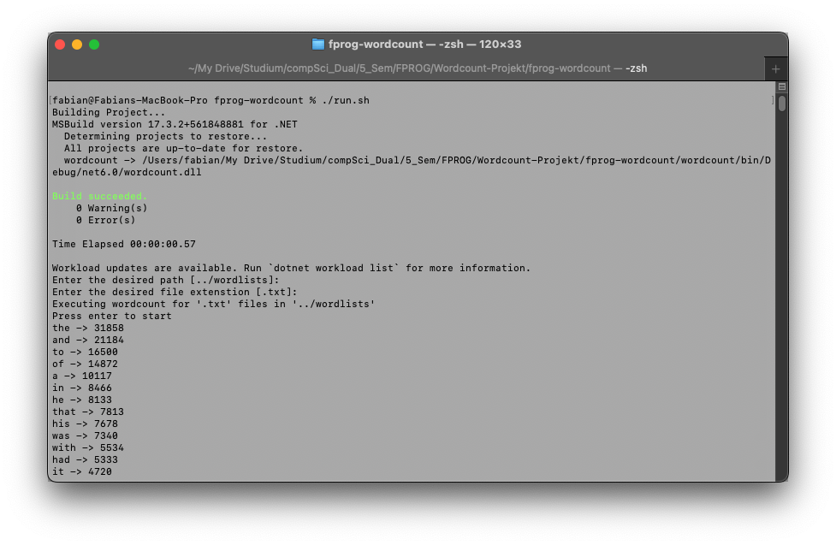
Program & test run

Slide 3
OOP vs. FP

Slide 4
Lessons learned
Functional concepts
Purity
Lamdas
Higher-Order Functions
No try/catch errorhandling
Small mistakes – forgetting “*”
Regex

Slide 5
Non functional parts

