Slide 1

Vel Tech Rangarajan Dr. Sagunthala R&D Institute of Science and Technology
School of Computing
Department of Computer Science and Engineering
10211CS224 / FULL STACK APPLICATION DEVELOPMENT (JAVA)
PROJECT REVIEW : MILESTONE PROJECT – 1
Date: 25-03-2026
Full-Stack Skill Learning Academy Marketplace with Secure Authentication
SDG: SDG No- 4 – Quality Education
Presented By:
B.SRIDHAR – VTU26553 – 23UECS0078
Courses Handling Faculty:
Dr. M. MAGESHWARI – M.E, Ph.D.,

Slide 2
INTRODUCTION
1
The rapid growth of online education has increased the demand for centralized skill-learning platforms.
Many existing platforms are complex, expensive, or not user-friendly for beginners.
Learners need an easy way to discover, compare, and enroll in relevant courses.
A streamlined marketplace improves accessibility to quality digital education.
Such systems support continuous learning and professional upskilling in the modern world.
The project focuses on creating a clean, responsive, and intuitive user interface.
Users can browse courses, view detailed information, and simulate enrollments efficiently.
Overall, the system demonstrates how a modern learning marketplace can enhance user engagement and learning experience.
2
3
4
5
6
7
8
9

Slide 3
PROBLEM STATEMENT
1
2
The rapid expansion of online learning has made it difficult for users to find suitable skill-based courses efficiently.
Many existing platforms are cluttered, slow, or not designed with beginner-friendly navigation.
Users often face challenges in comparing courses, understanding details, and completing enrollment smoothly.
There is a need for a clean and responsive marketplace that simplifies course discovery.
Current systems may lack an intuitive interface that works well across devices.
Learners require a unified platform to browse, view, and select courses easily.
Without streamlined workflows, user engagement and learning adoption can decrease.
Therefore, a modern Skill Learning Academy Marketplace is needed to provide an accessible and user-friendly course enrollment experience.
3
4
5
6
7
8
9

Slide 4
OBJECTIVE(S)
1
To design and develop a modern Skill Learning Academy Marketplace that enables users to browse and explore courses through a responsive and user-friendly interface.
To implement a secure and smooth user authentication simulation using local storage for login and signup functionality.
To improve course discovery by providing search, filtering, and detailed course information features.
To implement an automated enrollment and mock payment workflow for better user interaction.
To evaluate the performance and responsiveness of the system across different devices and screen sizes.
To evaluate the performance and responsiveness of the system across different devices and screen sizes.
To enhance user experience through modern UI/UX design with smooth navigation and visual feedback.
To ensure code modularity and reusability using well-structured React components and routing.
2
3
4
5
6
7
8
9

Slide 5
PROPOSED SYSTEM
1
The proposed system is a modern Skill Learning Academy Marketplace developed using React.js with a clean and responsive user interface.
It provides a centralized platform where users can easily browse, view, and enroll in skill-based courses.
The system solves existing issues by offering simple navigation, faster course discovery, and an intuitive enrollment workflow.
Unlike many complex platforms, this solution focuses on beginner-friendly design and smooth user interaction.
It improves accessibility by being fully responsive across mobile, tablet, and desktop devices.
The platform uses modular React components, making the system scalable and easy to maintain.
The mock authentication and payment simulation allow safe testing without real transaction risks.
Overall, the proposed system offers better usability, performance, and user experience compared to traditional learning platforms.
2
3
4
5
6
7
8
9

Slide 6
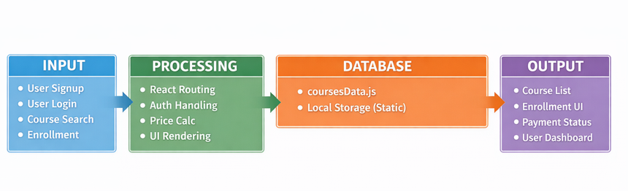
PROPOSED SYSTEM ARCHITECTURE
1
2
3
4
5
6
Input: The system accepts user actions such as signup, login, course search, and enrollment details through the web interface.
Processing: React components and routing handle user requests, perform price calculations, manage authentication simulation, and dynamically render the UI.
Database: The application uses static JSON files (coursesData.js) and browser localStorage to temporarily store course and user-related data.
Output: The system displays course listings, enrollment confirmations, payment status, and user dashboard information through a responsive interface.
7
8
9

Slide 7
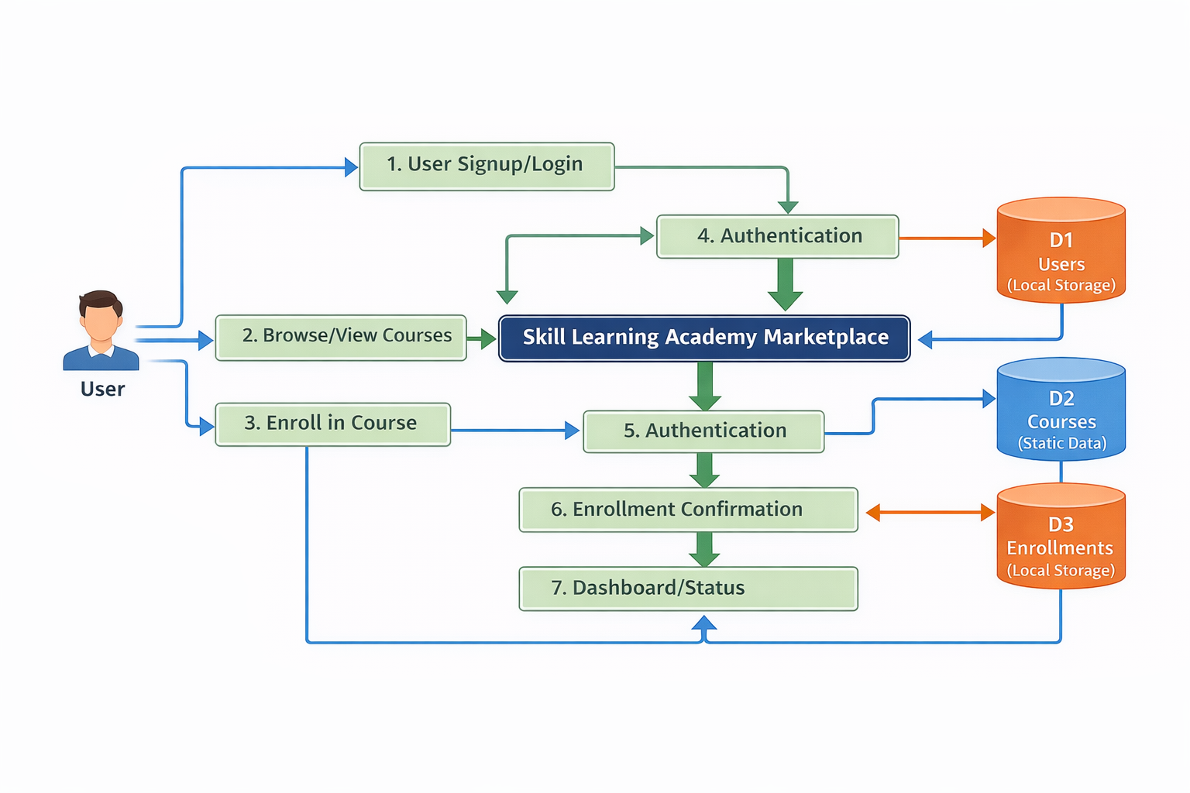
WORKFLOW
1
2
3
4
5
6
The Data Flow Diagram illustrates how user data moves through the Skill Learning Academy Marketplace system from input to final output.
It shows the interaction between the user, core processes such as authentication and enrollment, and data stores like users, courses, and enrollments.
The diagram helps in understanding how the system manages course browsing, login validation, and enrollment confirmation efficiently.
Overall, the DFD provides a clear visual representation of the system workflow, improving system analysis, design clarity, and future scalability.
7
8
9

Slide 8
TECHNOLOGIES USED
Frontend:
React.js (Functional Components, Hooks)
React Router DOM
Tailwind CSS
HTML5, CSS3, JavaScript (ES6+)
Backend:
Node.js
Express.js
RESTful API development
Database:
Firebase
User Collection
Courses Collection
Enrollments Collection
1
2
3
4
5
6
7
8
9

Slide 9
TECHNOLOGIES USED
Hardware/Software Requirements:
Minimum 4 GB RAM, Dual-Core Processor
Windows/Linux/macOS Operating System
Modern Web Browser (Chrome/Edge/Firefox)
Node.js installed for development
Internet connection for deployment and package installation

Slide 10
MODULE DESCRIPTION
1
2
Module 1: User Management
Handles user registration with input validation.
Manages user login and logout functionality.
Simulates secure authentication using local storage.
Maintains user session state during application usage.
Allows users to view and manage basic profile details.
Ensures protected access to enrollment and dashboard pages.
3
4
5
6
7
8
9

Slide 11
MODULE DESCRIPTION
Module 2: Core Processing
Processes user inputs such as search, enrollment, and payment details.
Implements business logic for course selection and navigation.
Calculates total enrollment cost based on selected quantity.
Manages routing between different pages using React Router.
Controls application state using React hooks. Ensures smooth workflow from browsing to confirmation.

Slide 12
MODULE DESCRIPTION
Module 3: Database Management
Stores course information using static JSON data.
Manages user and enrollment data in browser local storage.
Retrieves stored data for dashboard and confirmation display.
Maintains data consistency during user interactions.
Handles temporary storage without external database integration.
Ensures structured data handling for scalability.

Slide 13
MODULE DESCRIPTION
Module 4: Reporting & Analytics
Displays enrollment confirmation details to users.
Shows summary of selected courses and total payment.
Provides a user dashboard with enrolled course information.
Tracks basic user activity within the application.
Presents data in a clear and organized format.
Supports evaluation of system usability and performance.

Slide 14
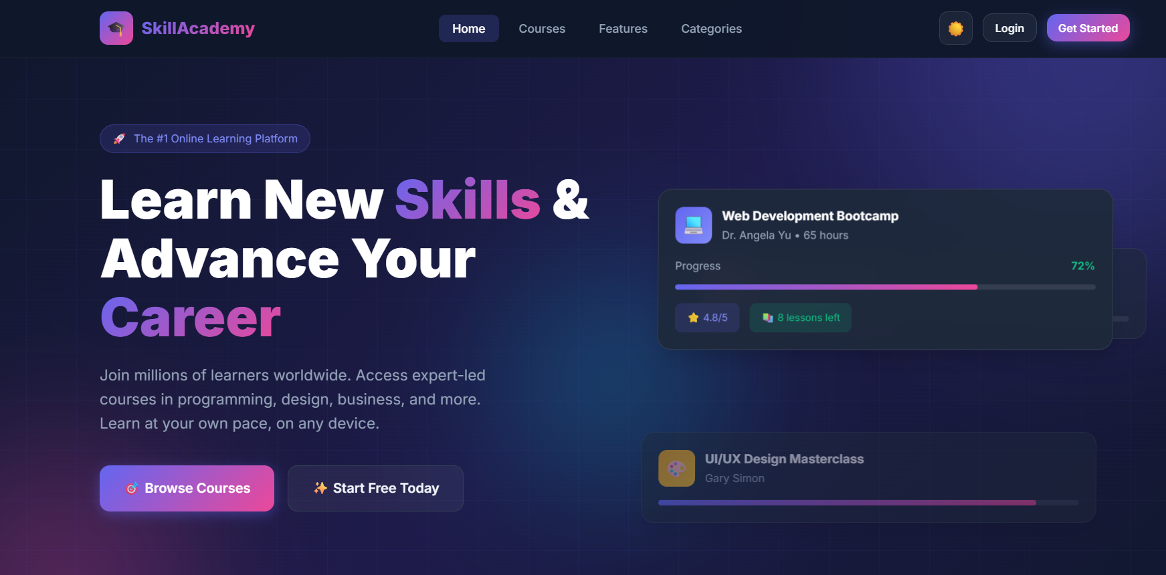
IMPLEMENTATION SCREENSHOTS
1
Home Page
The Home Page serves as the landing page of the Skill Learning Academy Marketplace.
It features an eye-catching hero section with a tagline highlighting skill development and learning opportunities.
A search bar is provided to help users quickly find relevant courses.
The page displays featured courses with images, titles, prices, and duration details.
It provides smooth navigation to course listing, login, and signup pages.
The layout is fully responsive and designed with a modern, user-friendly interface to enhance user engagement.
2
3
4
5
6
7
8
9

Slide 15
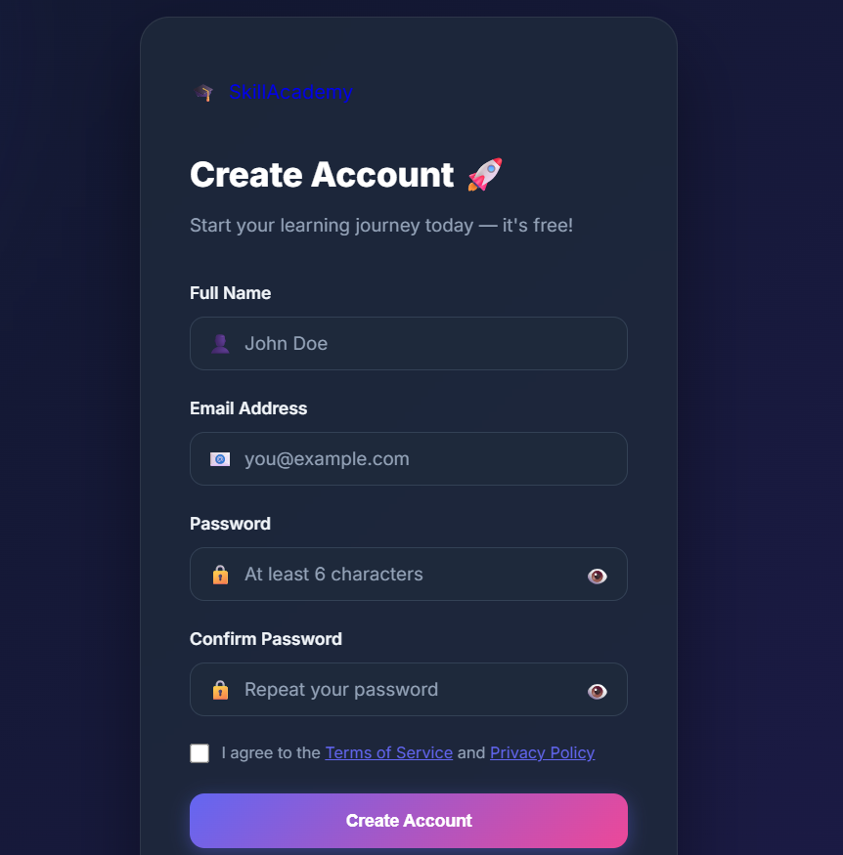
IMPLEMENTATION SCREENSHOTS
1
Signup Page
The Signup Page allows new users to create an account on the Skill Learning Academy Marketplace.
It contains input fields such as full name, email address, password, and confirm password.
Form validation ensures that all required fields are correctly filled before submission.
Password confirmation helps prevent user input errors.
User details are stored in local storage to simulate authentication.
After successful registration, users are redirected to the login page to access their account
2
3
4
5
6
7
8(A)
9

Slide 16
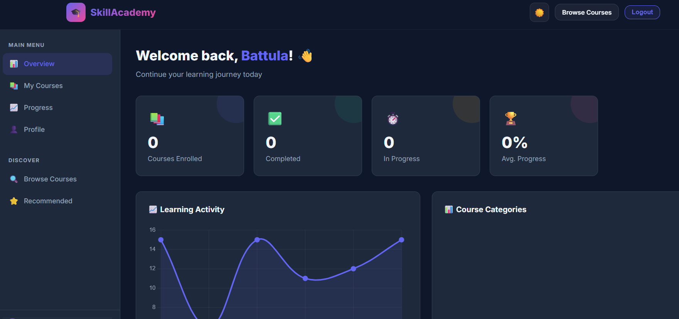
IMPLEMENTATION SCREENSHOTS
1
Profile Page
The Profile Page displays the registered user’s personal information such as name and email.
It allows users to view their account details after successful login.
The page retrieves user data from local storage for display.
It provides an organized layout for better readability of user information.
Users can navigate to enrolled courses or dashboard from this page.
The design is responsive and maintains a clean, user-friendly interface.
2
3
4
5
6
7
8(B)
9

Slide 17
IMPLEMENTATION SCREENSHOTS
1
Enrollment Successful
The Enrollment Successful page confirms that the user has successfully enrolled in the selected course.
It displays important details such as course name, user name, number of seats, and total amount paid.
A unique booking or enrollment ID is generated for reference.
The page provides a clear confirmation message to assure the user of successful processing.
It may include options to view enrolled courses or navigate to the dashboard.
The layout is designed in a modern card style to enhance clarity and user satisfaction.
2
3
4
5
6
7
8(C)
9

Slide 18
ADVANTAGES & LIMITATIONS
1
ADVANTAGES:
Provides a clean and user-friendly interface for easy course browsing.
Fully responsive design compatible with mobile, tablet, and desktop devices.
Simple and smooth enrollment workflow improves user experience.
Uses modular React components, making the system scalable and maintainable.
Fast performance due to frontend-based processing.
Safe testing environment with mock authentication and payment simulation.
LIMITATIONS:
No real backend integration for secure data handling.
Data is stored only in local storage, which is not suitable for large-scale systems.
Mock payment system does not support real financial transactions.
No real-time database updates or multi-user synchronization.
Limited security compared to full-stack applications.
Not suitable for production-level deployment without backend enhancement.
2
3
4
5
6
7
8
9

Slide 19
Thank you

