Slide 1
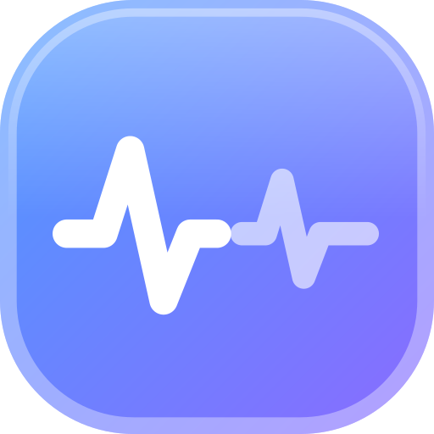
Can sleep recordings be trusted to show reactivation?
ReacDetect
Claude Impact Lab · CIC Berlin · 7 Nov 2026
An open toolbox that tests each method on planted truth before it lets the method answer.
Shift Happens
Zixi Tang (research question, verdict) · Batu (loader, M1, M2) · Youssef (N1 null, M3, M4)
Notes:
We are Shift Happens. Our question: when an animal sleeps after doing something, do its neurons replay the patterns from that waking time? The methods for this were built for sparse spikes, and nobody has checked whether they hold up on slow calcium data. We built an open toolbox that only lets a method vote if it first passes tests on data where we planted the answer.

Slide 2
Does sleep after a task replay the task?
PRE
sleep before
NREM frames
TASK
awake, doing something
co-active cell groups
POST
sleep after
NREM frames
Why it is hard
The methods were built for sparse electrophysiology spikes.
Calcium imaging is slow: neighbouring frames are correlated.
Tests that assume independent bins become too lenient.
Tingley & Peyrache (2020) list this as open.
Reactivation = POST resembles TASK more than PRE does, in the same neurons.
Data: RIKEN mouse cortex, two-photon calcium, 6,920 cells, CC BY 4.0 (Zenodo 17667863). No real task: a wake bout between two NREM periods stands in for TASK.
Notes:
Reactivation is tested on the same neurons in three periods: sleep before, the task, and sleep after. It means sleep after looks more like the task than sleep before. The catch: these methods come from spike data, and calcium is slow, so the usual significance tests can be too lenient.

Slide 3
Answer key first, then the loop
1
2
3
4
Answer key
One number, unit and yes-threshold per method, committed before any result
Referee
Synthetic calcium with planted truth: reactivation, noise, pre-existing patterns
Loop
Read, predict, run, judge, record. Prediction committed before the run
Vote
A method counts only if it is eligible and passes its own tests
One null for every method. N1 shifts each neuron's trace by its own random circular offset, 500 times. It keeps each neuron's own timing and breaks only the co-activity between neurons.
Notes:
Before any result we wrote the question, then one number, one unit and one yes-threshold per method. Then the referee: synthetic calcium sessions with planted truth. A method that cannot tell those apart does not get a vote. Every loop step is read, predict, run, judge, record; the prediction is committed before the run, and the journal keeps failures too.

Slide 4
The spike-era test is too lenient for calcium
50 / 50
2 / 50
Marchenko-Pastur bound
Pure-noise runs with 5 or more false assemblies. The standard analytical bound assumes independent bins.
Our N1 shuffle bound
Pure-noise runs with any false assembly. It still finds planted assemblies in 48 to 50 of 50.
Synthetic calcium-like sessions: 50 cells, 6,000 TASK frames, 1 s time constant, no assemblies. Test T-N1-8, 50 seeds.
Notes:
First finding, before touching real data. The analytical Marchenko-Pastur bound, the standard way to count assemblies in spike data, finds false assemblies in 50 of 50 pure-noise calcium runs. Our shuffle bound finds them in 2 of 50. Calcium is slow, and that alone breaks the spike-era test.

Slide 5
It says yes where reactivation is known
Sessions saying yes
8 / 8
M3 PCA
8 / 8
M4 ICA
7 / 8
M2 EV vs REV
6 / 8
M1 pair correlation
DANDI:000044 (Grosmark & Buzsáki 2016, rat CA1 ephys, CC BY 4.0): positive control only. Pass rule fixed before each run: yes in 6 of 8 or more.
Notes:
Does the toolbox find reactivation where it is known to exist? On eight rat hippocampus sessions from Grosmark and Buzsaki, PCA and ICA reactivation strength are positive in all eight, at the smallest p 500 shuffles allow. Explained variance agrees in 7 of 8, cell-pair correlation in 6 of 8. So when the calcium data says no, it is the data, not a toolbox that cannot say yes.

Slide 6
On calcium, every Split A score is negative
Split B (shorter wake bout)
M1 +0.006, p = 0.19, not significant
M2 +0.002, p = 0.002, but M2 fails its own control, so it does not vote
M3, M4 ineligible: 651 TASK frames, 1,500 needed for 300 cells
M4 also fails one locked test (T-M4-1), so it never votes.
0 / 4
methods saying yes in Split A
Notes:
Real data, one line per method. Cell-pair correlation finds task pairs closer to sleep before than after in Split A, minus 0.069, p 1.0. Explained variance points the wrong way. PCA finds fifteen real assemblies, but they are stronger in sleep before than after, minus 0.146. ICA the same direction, and ICA failed one of its own tests, so it does not vote. Split B is too short for PCA and ICA.

Slide 7
Not enough evidence
Verdict, RIKEN mouse05
The rule needs two counted methods. Only cell-pair correlation is eligible and tested in both splits, and it says no in both.
The patterns are real in sleep but not specific to sleep after waking. Expected: this recording has no task, so nothing was learned.
Notes:
The verdict rule needs at least two methods that are eligible and pass their tests. Only cell-pair correlation qualifies in both splits, so the verdict is: not enough evidence, and no counted method says yes in either split.

Slide 8
Where we got stuck, and what comes next
Stuck
One public calcium session, one mouse
No real task: a wake bout stands in for it
M2 and M4 fail their own tests; no threshold moved
Split B too short for PCA and ICA
Next
Calcium sessions with a real learning task
Several animals, so EV vs REV has sessions to compare
A null that fixes M2, and a seed sweep for M4
Replay methods once timing allows
Run it from a fresh clone
uv run python run.py --data sleep_data.mat --seed 0
uv run --with remfile python scripts/run_dandi.py --seed 0
Notes:
Where we got stuck: one public session, no real task, M2 and M4 failing their own tests, and a short second split. We kept every failure as a failure and moved no threshold. Next: sessions with a real learning task, several animals, and a null that fixes M2. Clone, download one zip from Zenodo, and these two commands give every number we showed. Code Apache 2.0, text CC BY 4.0.

