Slide 1
VerySimpleCPU with RS232

Slide 2

Design Behavior:
Address, Write and Read commands and data are entered from Hyperterminal to RAM
Dual Port RAM
If not reset, CPU takes instructions and data from RAM and writes data back to RAM.
CPU
For Read command the data in the RAM address is returned
Stop command to stop CPU is sent from Hyperterminal to CPU

Slide 3
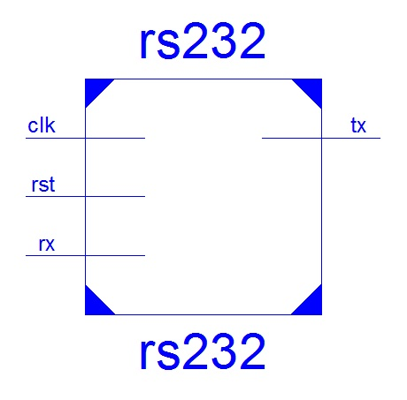
Top Level:

Slide 4
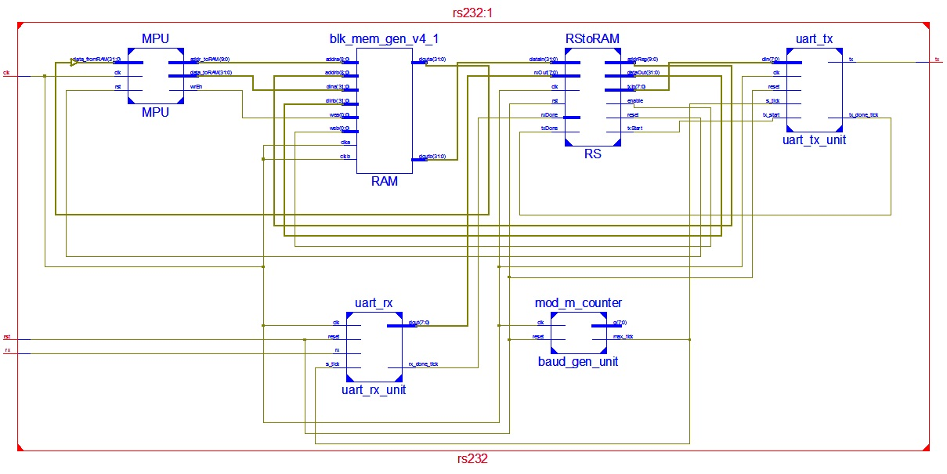
Design Submodules:

Slide 5
Design Submodules:
MPU is a VerySimpleCPU.
RAM is a true dual-port RAM that has 2 ports.
uart_rx_unit deserializes data received from RS232 port.
uart_tx_unit serializes the data to be sent back to RS232 port.
baud_gen_unit handles the sampling rate of the serial data sent to or received from RS232 port.
RS is the port that translates the command sent from terminal to RAM and MPU.

Slide 6
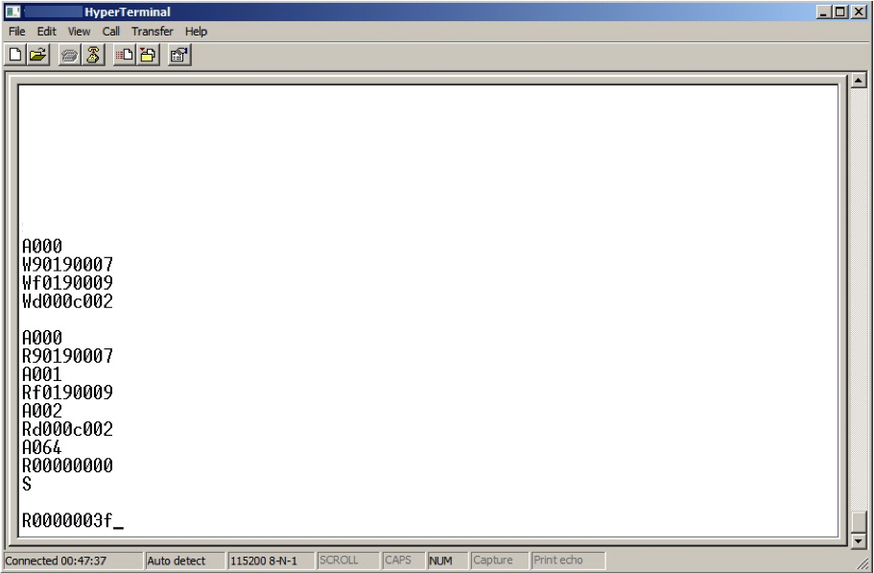
Communication Protocol:
The commands entered here:
Sets address to 0
Write instructions below to addresses 0, 1, 2
Writes number 7 to address 100
Multiplies 9 with the number in address 100 and writes the result back to 100
Loops on address 2
Check the data on addresses 0, 1, 2, 100 (h064)
Starts the CPU
Reads the data on address 100 (h064) which is 7 * 9 = 63 (h3f)

Slide 7
Communication Protocol:
There are four commands in total, that are Address, Write, Read and Start/Stop CPU. All commands are capital letters.
All numbers should be entered in hex (0123456789 and abcdef lowercase).
Address should be entered as three hex digits, even if it is not three digits long.
Data should be entered in eight hex digits, even if it is not eight digits long.
When data is entered to a memory address using Write, new address location will be updated to ‘address + 1’ which will enable uninterrupted data writing.
CPU can be stopped or started by using Start/Stop command. It is necessary to stop CPU while writing into RAM.
Read command reads the data in the current address.

