Slide 1
GloBox A/B Test

Slide 2
Starting Point
The experiment is only being run on the mobile website.
The experiment run between 25 Jan 2023 and 6 Feb 2023.
Visitors of main page is randomly assigned to either the control or test group.
Users in test group see the banner and users in the control group don’t.
Users that make one or more purchases considered a “conversion”.

Slide 3
Data Processing Steps
No duplicate rows found.
Changed nulls and blank device types to unknown.
Changed blank country and gender to unknown.
Data types corrected.
Number and date formats standardized.

Slide 4
Average Spent Analysis

Slide 5
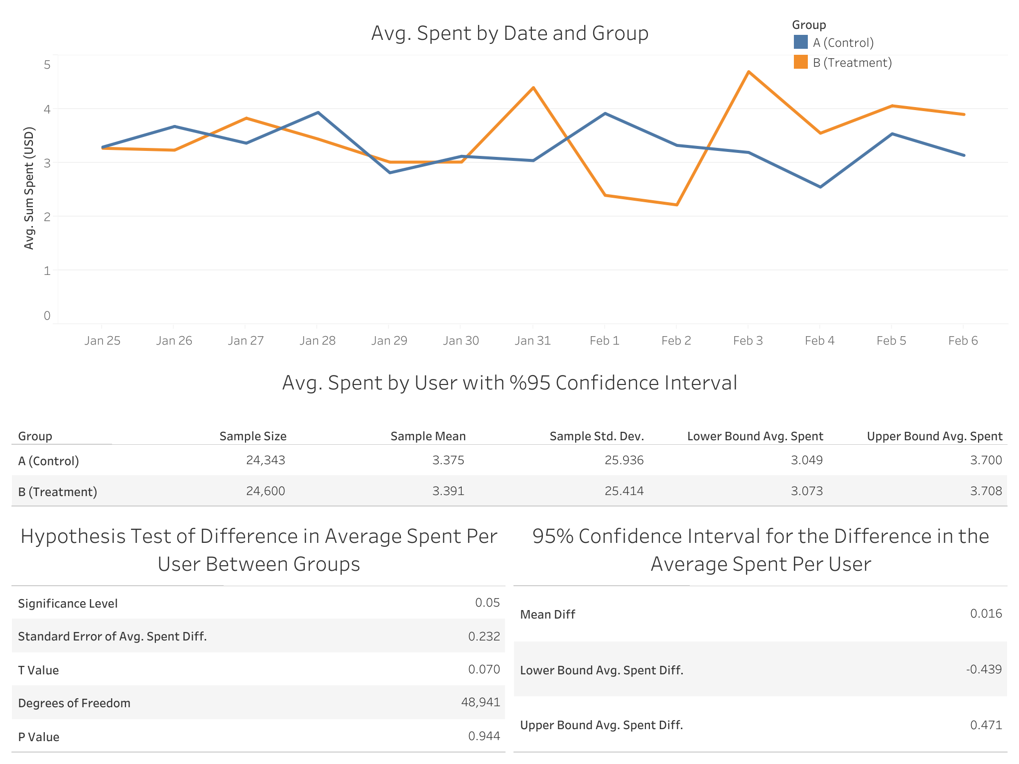

Slide 6
Analysis Results

Slide 7
Conversion Rate Analysis

Slide 8
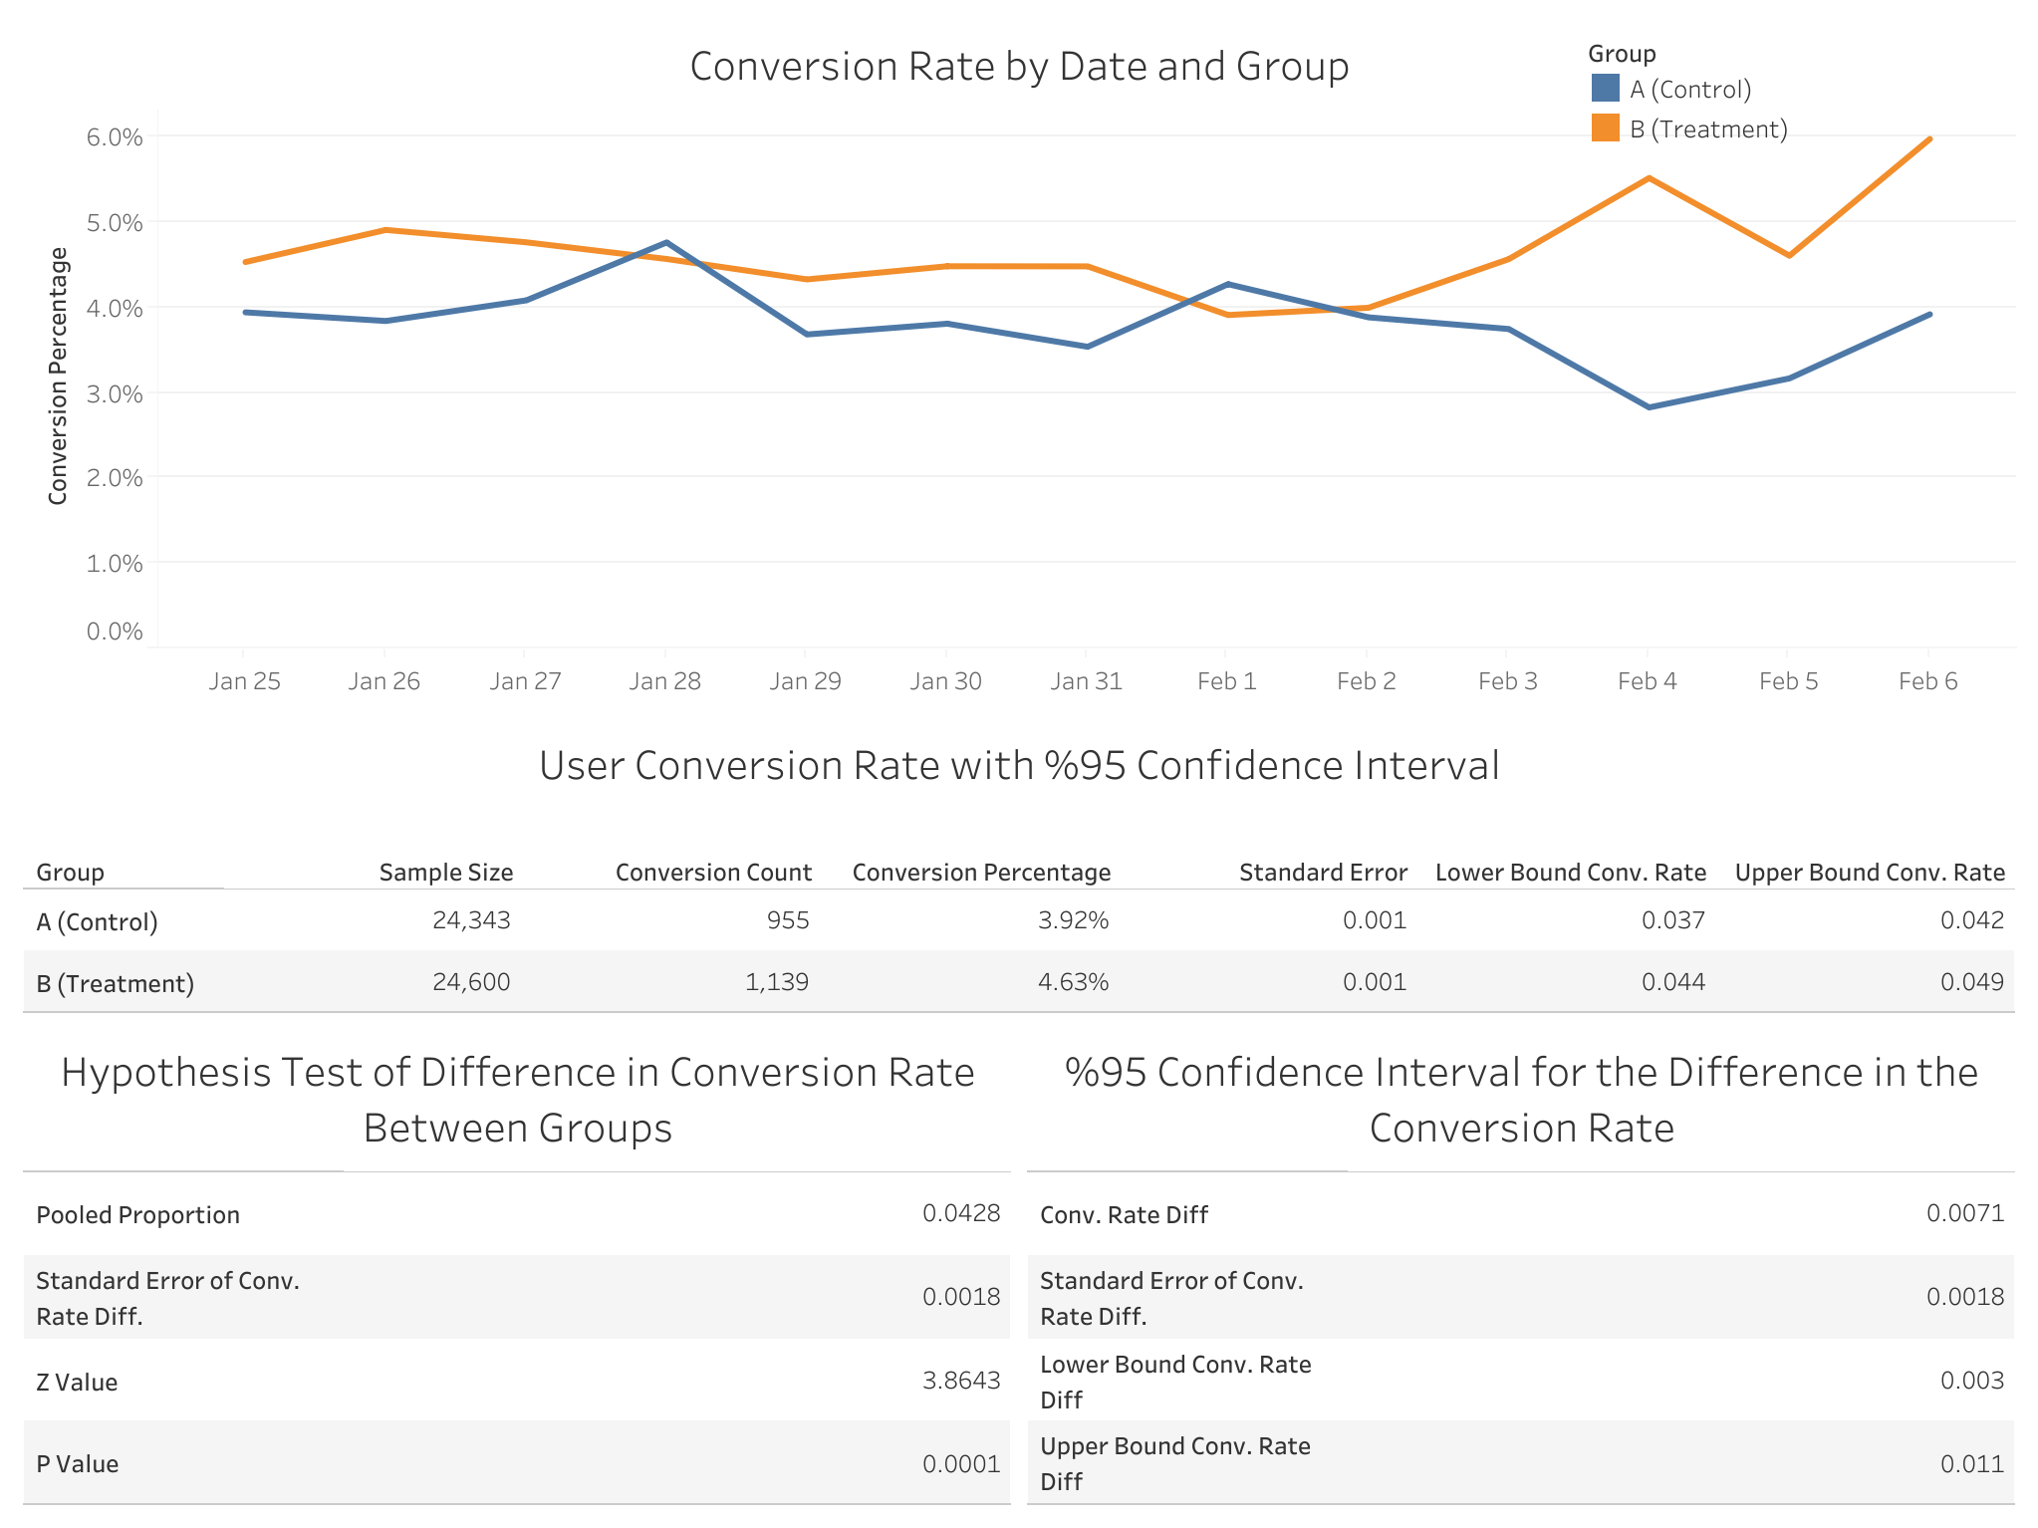

Slide 9
Analysis Results

Slide 10
Suggestions for Further Analysis and Improving Accuracy

