Slide 1
GloBox A/B Test

Slide 2
Starting Point
The experiment is only being run on the mobile website.
The experiment runs between 25 Jan 2023 and 6 Feb 2023.
Main page visitors are randomly assigned to either the control or test group.
Users in the test group see the banner and those in the control group don’t.
Users that make one or more purchases are considered a “conversion”.

Slide 3
Data Processing Steps
No duplicate rows were found.
Changed nulls and blank device types to unknown.
Changed blank country and gender to unknown.
Outliers in the amount spent are included.
Data types were corrected, and formats were standardized.

Slide 4
Average Spent Analysis

Slide 5
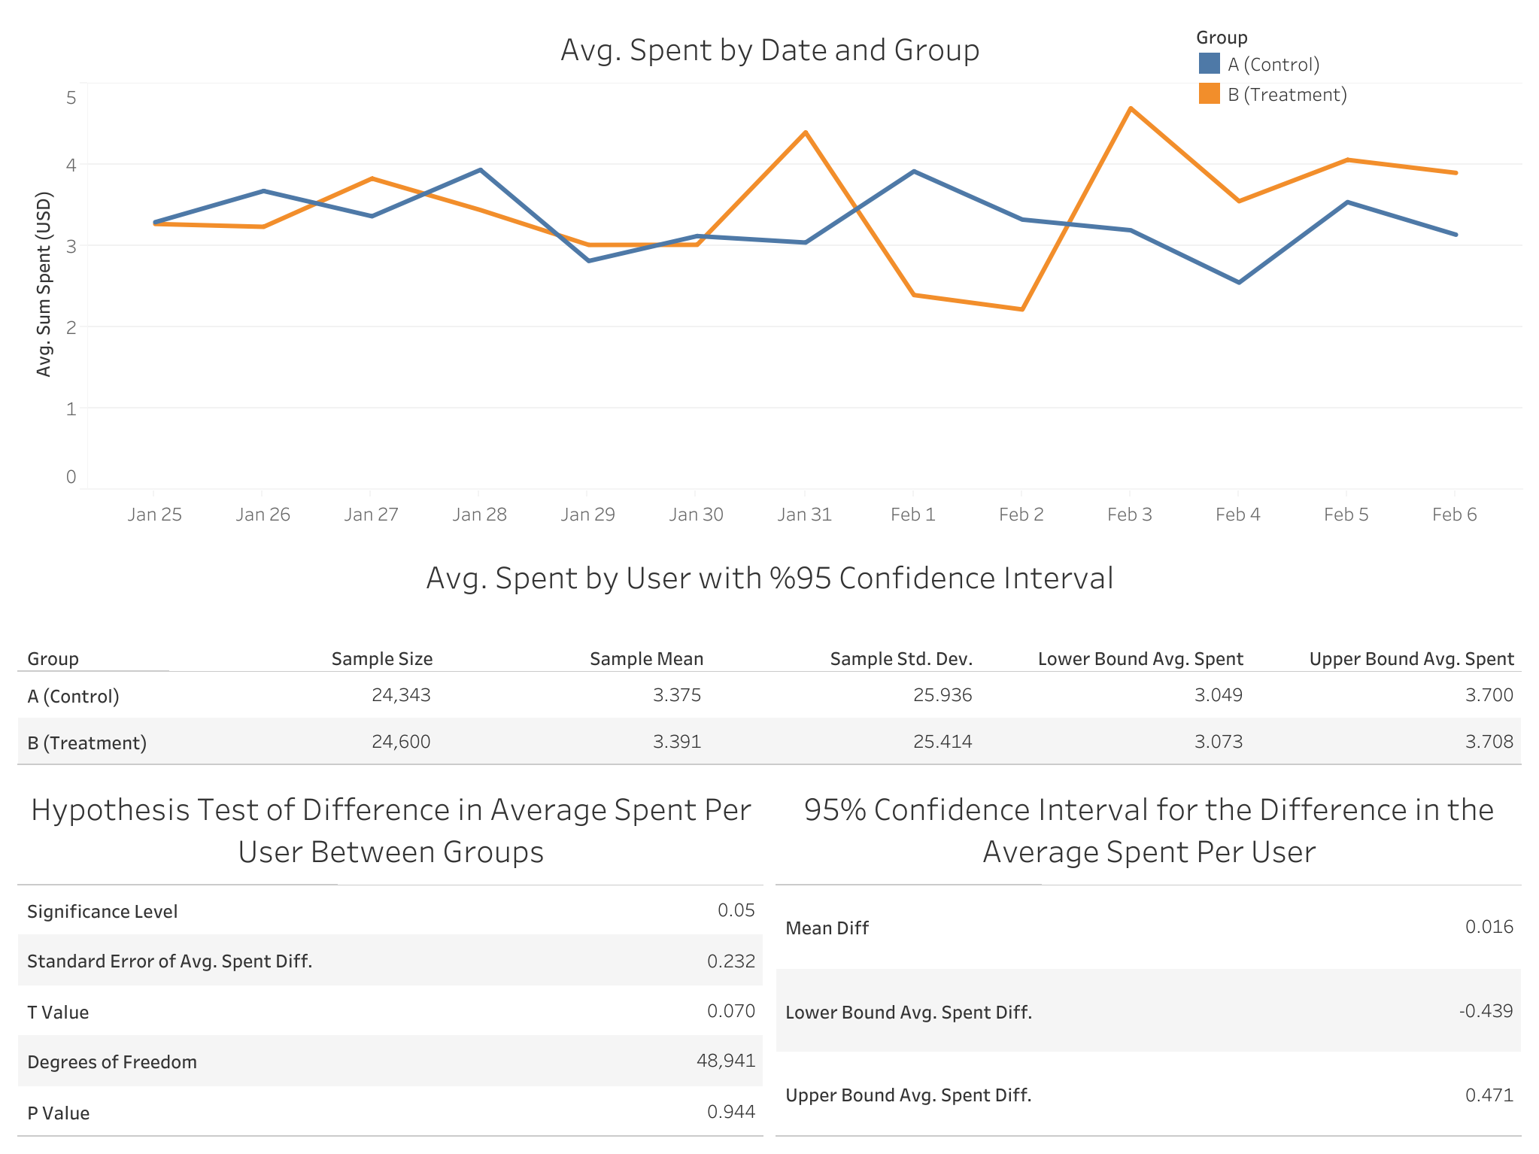

Slide 6
Analysis Results
Avg. spent per user is 3.375 USD for the control group and 3.391 USD for the treatment group.
95% CI for the avg. spent per user in the control is (3.049, 3.700) and in the treatment is (3.073, 3.708).
95% CI for the difference in the avg. spent per user is (-0.439, 0.471).
Hypothesis test of difference in the avg. spent between groups suggests that there is not enough evidence to suggest a statistically significant difference between groups.

Slide 7
Conversion Rate Analysis

Slide 8
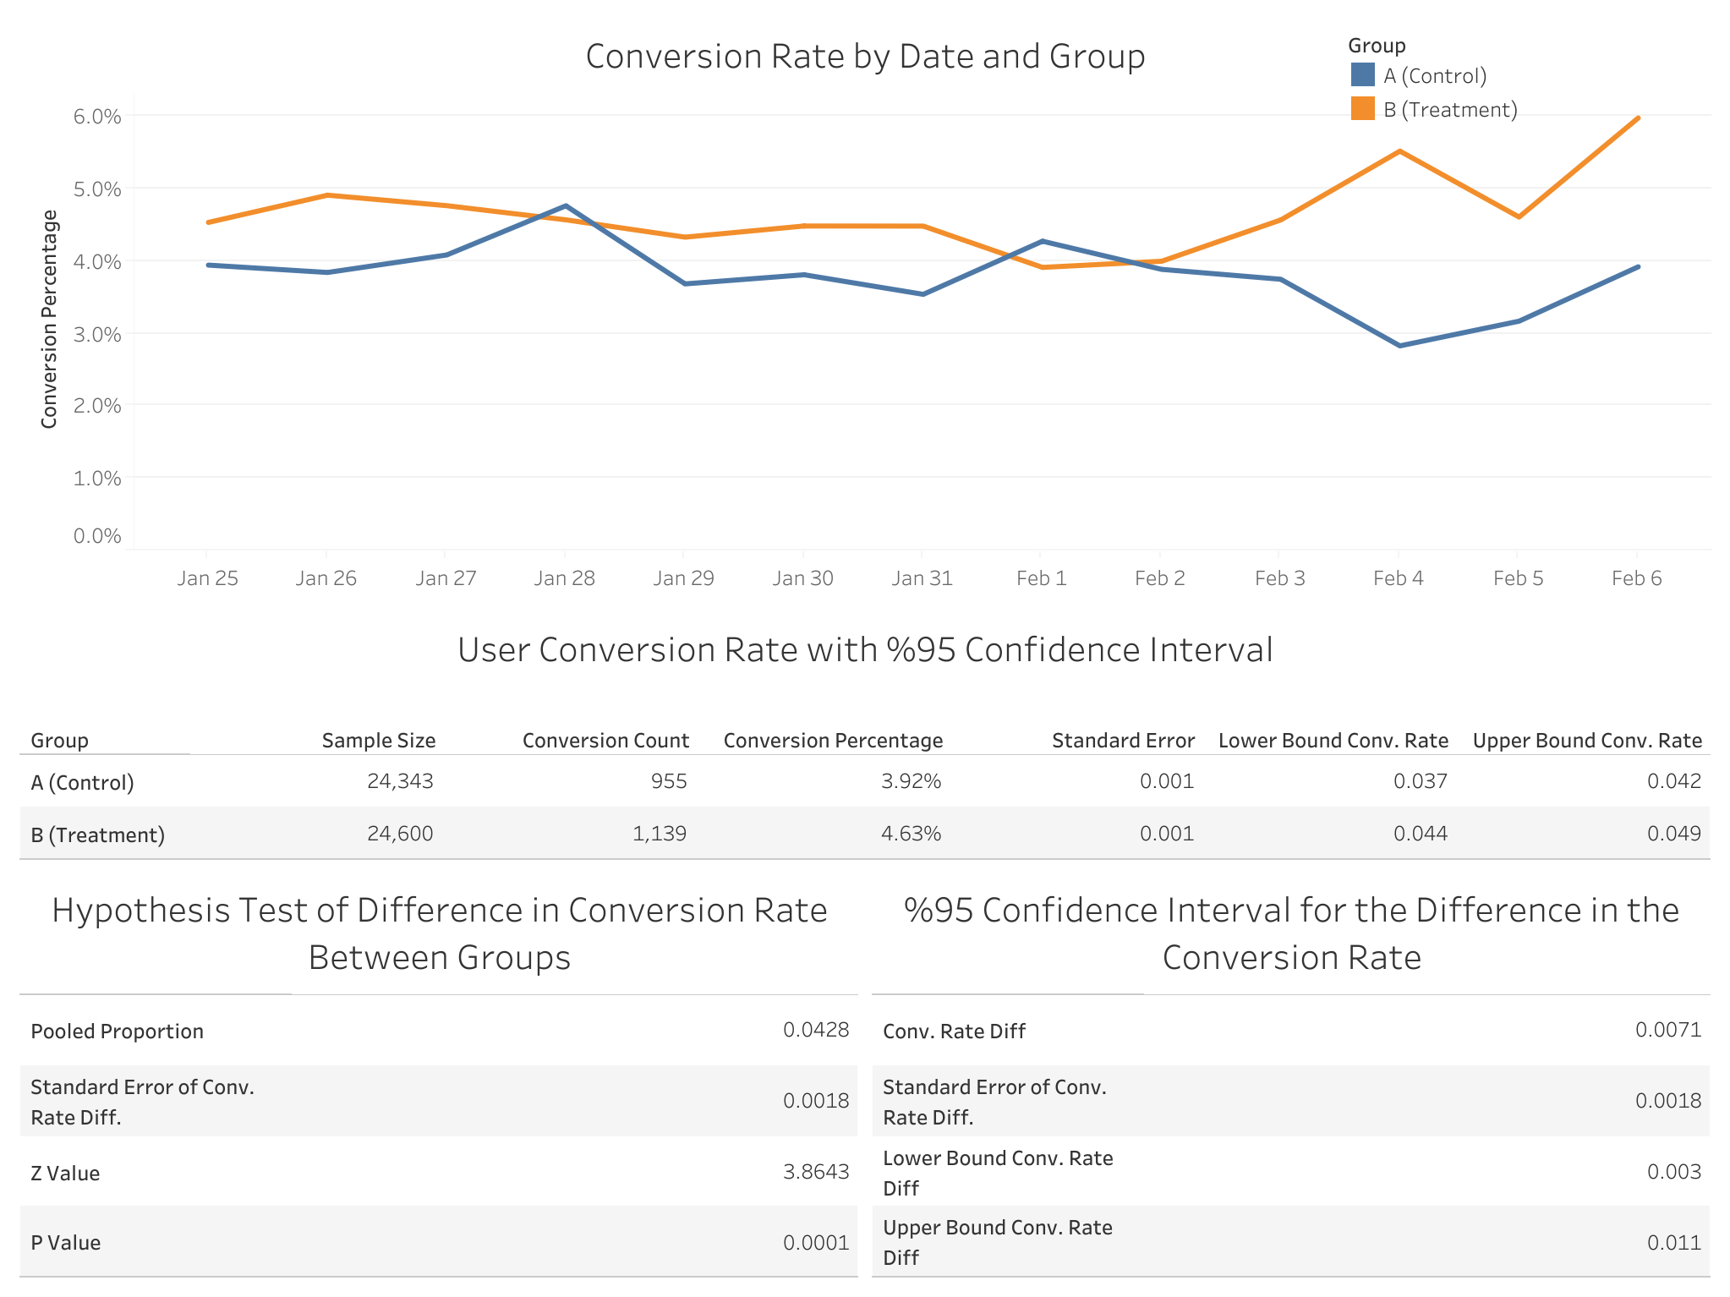

Slide 9
Analysis Results
The conversion rate is %3.92 for the control group and %4.63 for the treatment group.
95% CI for the conversion rate in the control is (0.037, 0.042) and in the treatment is (0.044, 0.049)
95% CI for the difference in the conversion rate is (0.003, 0.011).
Hypothesis tests of difference in the conversion rate between groups suggest that there is enough evidence to suggest a statistically significant difference between groups.

Slide 10
A/B Test Result
Banner doesn’t affect avg. spent by users statistically.
Banner increases conversion rate statistically.
It can be concluded that applying a banner on our webpage has a positive impact on the business.

Slide 11
Suggestions for Further Analysis and Improving Accuracy
Extending test period.
Extracting additional data such as age.
Analyzing results by country, gender, device type, and age group.
Running tests on alternative banner designs.

Slide 12
Q & A

Slide 13
Thanks for listening!

Slide 14
Related Links
Github:
https://github.com/BatuSengezer/GloBox_A-B_Data_Analysis
Tableau:
https://public.tableau.com/views/GloBox_A_B_Data_Analysis/Story1?:language=en-US&:display_count=n&:origin=viz_share_link

