Slide 1
ABCD Smart Home Automation System
CTIS 417 – Software Design Patterns
Spring 2024–25
Team 1
Alper Çelik 21903022
Batu Uzun 22103810
Doruk Akabay 22001714
Zeynep Yıldız 22101745

Slide 2
Project Description
ABCD Smart Home Automation System is a console-based smart home simulator built using object-oriented programming and software design patterns.
It allows multiple user types (Admin, Registered Users, Unregistered Users) to interact with smart devices such as a thermostat, air conditioner, lights, and security cameras.
The system operates in different modes (Active, Away, Pet), which dynamically affect the behavior of devices and notification delivery.
It aims to improve home convenience and security via centralized automation.

Slide 3
Project Scope
Console-based (no GUI or database) Only one Control Panel instance (Singleton) Users can control devices through the panel Devices have common (on/off) and unique commands Admin always receives system notifications Different user permissions and smart modes Extensible for new devices or features Full OOP and pattern-based design.

Slide 4
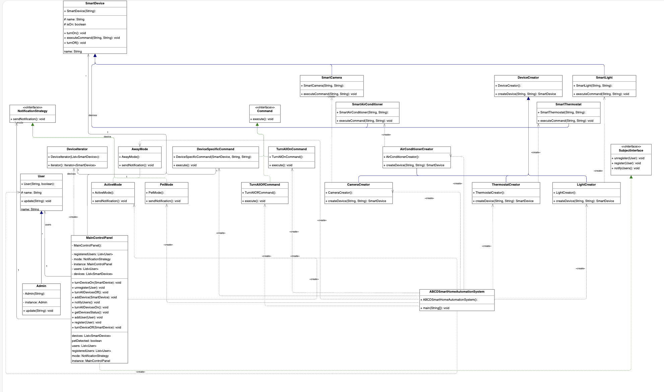
Class Diagram

Slide 5
Singleton Pattern - Usage & Implementation
🔹 Where it's used: The MainControlPanel class is a central component that manages users, devices, and system modes. To prevent conflicts or duplicated system states, only one instance of this control panel should exist at any time during the program's execution.
🔹 Why it's used: To enforce a single point of control over the smart home system and conserve system resources.
🔹 How it's implemented:
A private static instance of the control panel is declared.
The constructor is made private to prevent external instantiation.
A synchronized static method getInstance() is used for lazy initialization, ensuring thread-safe, on-demand creation.

Slide 6
Singleton Pattern – Code & Output
[Code] // MainControlPanel.java private static MainControlPanel instance; private MainControlPanel() {} public static synchronized MainControlPanel getInstance() { if (instance == null) { instance = new MainControlPanel(); } return instance; }
[Console Output] --- Demonstrating Singleton Pattern (MainControlPanel) --- Attempting to get instance of MainControlPanel. MainControlPanel instance obtained: 292938459 Second MainControlPanel instance obtained: 292938459

Slide 7
Factory Method Pattern – Usage & Implementation
🔹 Where it's used: Smart devices such as SmartLight, SmartCamera, SmartThermostat, and SmartAirConditioner are instantiated using device creator classes.
🔹 Why it's used: To decouple the instantiation logic of different devices from the control panel logic, and to allow easy extension for new device types.
🔹 How it's implemented:
An abstract class DeviceCreator defines the createDevice method.
Concrete creator classes (e.g., ThermostatCreator, CameraCreator) implement this method and instantiate the corresponding device with specific attributes (like brightness, resolution, etc.).

Slide 8
Factory Method Pattern – Code & Output
[Code] // LightCreator.java public class LightCreator extends DeviceCreator { public SmartDevice createDevice(String name, String brightness) { return new SmartLight(name, brightness); } }
[Console Output] --- Demonstrating Factory Method Pattern (Device Creation) --- ThermostatCreator instantiated. ThermostatCreator produced: Living Room Thermostat (SmartThermostat) LightCreator instantiated. LightCreator produced: Kitchen Light (SmartLight) AirConditionerCreator instantiated. AirConditionerCreator produced: Bedroom AC (SmartAirConditioner) CameraCreator instantiated. CameraCreator produced: Hall Camera (SmartCamera)

Slide 9
Observer Pattern – Usage & Implementation
🔹 Where it's used: The notification system uses the Observer pattern to notify registered users about events such as motion detection.
🔹 Why it's used: To dynamically manage user subscriptions to system events and allow efficient, decoupled broadcasting of notifications.
🔹 How it's implemented:
MainControlPanel implements the SubjectInterface with methods register, unregister, and notifyUsers.
User and Admin classes act as observers.
The notifyUsers() method calls update() on each registered user.
Admin always receives notifications, even if not registered explicitly.

Slide 10
Observer Pattern – Code & Output
[Code] // SubjectInterface.java public interface SubjectInterface { void register(User user); void unregister(User user); void notifyUsers(); }
[Console Output] --- Demonstrating Observer Pattern (User Registration) --- Registering users with the MainControlPanel to receive notifications. (Charlie is not registered as an observer since he is a child) Alice is registered as an observer. Bob is registered as an observer. Charlie is a child and is not registered as an observer.

Slide 11
Command Pattern – Usage & Implementation
🔹 Where it's used: User actions like turning all devices on/off or adjusting specific device settings (e.g., changing thermostat interval) are handled using command objects.
🔹 Why it's used: To encapsulate actions as objects, allowing for clear separation between the requester and executor of an action.
🔹 How it's implemented:
A Command interface defines an execute() method.
Concrete command classes (TurnAllOnCommand, TurnAllOffCommand, DeviceSpecificCommand) implement specific device operations.

Slide 12
Command Pattern – Code & Output
[Code] // TurnAllOnCommand.java public void execute() { MainControlPanel.getInstance().turnAllDevicesOn(); }
[Console Output] --- Demonstrating Command Pattern (Bulk Operations) --- Executing 'Turn All Devices ON' Command: Living Room Thermostat is turned ON. Kitchen Light is turned ON. Bedroom AC is turned ON. Hall Camera is turned ON. --- Demonstrating Command Pattern (Device-Specific Operations) --- Executing 'Set Temperature' Command for Living Room Thermostat: Living Room Thermostat set temperature check interval to 5 'changeCheckInterval' Command executed. Executing 'Set Resolution' Command for Hall Camera: Hall Camera resolution set to 1080p 'Set Resolution' Command executed.

Slide 13
Strategy Pattern – Usage & Implementation
🔹 Where it's used: Notification logic changes based on the active smart mode: Active, Away, or Pet. Each mode defines its own strategy for sending notifications.
🔹 Why it's used: To swap notification behaviors dynamically at runtime depending on the selected home mode, without modifying the control panel logic.
🔹 How it's implemented:
A NotificationStrategy interface defines sendNotification().
Concrete classes (ActiveMode, AwayMode, PetMode) implement the interface with different behaviors.
MainControlPanel holds a reference to the current strategy and delegates notifyUsers() calls to the strategy object.

Slide 14
Strategy Pattern – Code & Output
[Code] // AwayMode.java public void sendNotification() { for (User user : panel.getRegisteredUsers()) { user.update("Notification(Away Mode): Someone is detected in your home!"); } Admin.getInstance().update("Notification(Away Mode -> Admin Only): ..."); }
[Console Output] --- Demonstrating Strategy Pattern (Control Panel Modes) --- Switching to AWAY MODE: AwayMode Strategy: Full notifications for registered users if camera detects movement. Admin always notified. MainControlPanel System Update: Away mode activated! Alice (User): Away mode activated! Bob (User): Away mode activated! Camera is detecting movement. Alice (User): Notification(Away Mode): Someone is detected in your home! Bob (User): Notification(Away Mode): Someone is detected in your home! admin (Admin): Notification(Away Mode -> Admin Only): Someone is detected in your home! Switching to PET MODE: Camera is detecting movement of a pet. admin (Admin): Notification(Pet Mode -> Admin Only): Someone is detected in your home! Camera is detecting movement of something other than a pet. Alice (User): Notification(Pet Mode): Someone is detected in your home! Bob (User): Notification(Pet Mode): Someone is detected in your home! admin (Admin): Notification(Pet Mode -> Admin Only): Someone is detected in your home! Switching to ACTIVE MODE: admin (Admin): Notification(Active Mode -> Admin Only): Something is detected in your home!

Slide 15
Iterator Pattern – Usage & Implementation
🔹 Where it's used: The MainControlPanel needs to perform bulk operations on a collection of smart devices — such as turning them all on or off, or reporting their current statuses.
🔹 Why it's used: To traverse a list of devices (or users) without exposing the underlying data structure (like List<SmartDevice>). It keeps the loop logic clean and encapsulated, and makes the system easier to extend if the internal collection changes.
🔹 How it's implemented:
A custom DeviceIterator class is created, which implements Iterable<SmartDevice>.
It wraps the internal list of devices.
This allows the use of enhanced for-each loops in a clean, abstracted way.
The MainControlPanel uses for (SmartDevice d : new DeviceIterator(devices)) instead of handling raw indexing or iterators directly.

Slide 16
Iterator Pattern – Code & Output
[Console Output] --- Demonstrating Iterator Pattern (Listing Devices) --- Turning off smart light: Kitchen Light is turned OFF. Iterating through all registered devices to display their status/info: Device: SmartThermostat - Living Room Thermostat | Status: ON Device: SmartLight - Kitchen Light | Status: OFF Device: SmartAirConditioner - Bedroom AC | Status: ON Device: SmartCamera - Hall Camera | Status: ON Total devices iterated: 4 Turning off all devices: Living Room Thermostat is turned OFF. Kitchen Light is turned OFF. Bedroom AC is turned OFF. Hall Camera is turned OFF. Iterating through all registered devices to display their status/info: Device: SmartThermostat - Living Room Thermostat | Status: OFF Device: SmartLight - Kitchen Light | Status: OFF Device: SmartAirConditioner - Bedroom AC | Status: OFF Device: SmartCamera - Hall Camera | Status: OFF Total devices iterated: 4
[Code] // DeviceIterator.java public class DeviceIterator implements Iterable<SmartDevice> { public Iterator<SmartDevice> iterator() { return devices.iterator(); } }

Slide 17
Mode Behavior Descriptions
🔹 Active Mode (Do Not Disturb)
Designed for when the house is actively in use.
All user notifications are disabled (registered or not).
Only the Admin receives notifications (e.g., motion detection logs).
Strategy: ActiveMode.sendNotification() only notifies admin.
🔹 Away Mode
Used when no one is home.
All registered users receive notifications when motion is detected.
Admin always receives notifications.
Strategy: AwayMode.sendNotification() loops through all registered users and the admin.
🔹 Pet Mode
Used when pets are home alone.
Suppresses notifications if a pet is detected moving (to avoid false alarms).
If the movement is not a pet, registered users and admin are notified.
Strategy: PetMode.sendNotification() checks MainControlPanel.isPetDetected() before notifying users.

Slide 18
Demo Summary
All 6 patterns implemented and verified Console output confirms correct functionality Design is modular, extensible, and pattern-compliant Patterns demonstrated: Singleton, Factory, Observer, Command, Strategy, Iterator
These patterns were not only chosen for academic demonstration, but because they accurately model real-world behavior in modular, scalable software. Each pattern contributes to code clarity, maintenance, and future extensibility.

Slide 19
Thank You!
Questions?

