Slide 1

Bank Marketing Campaign – Term Deposit Product Subscription
Company Name : ABC Bank Location: Portugese Team: Datarpher Date: 16-August-2023

Slide 2

Agenda
Executive Summary
Problem Statement
Data Description
EDA
Hypothesis Creation
Recommendation
Model Approach ( Technical )

Slide 3
Description:
ABC Bank wants to sell it's term deposit product to customers and before launching the product they want to develop a model which help them in understanding whether a particular customer will buy their product or not (based on customer's past interaction with bank or other Financial Institution).
Bank wants to use ML model to shortlist customer whose chances of buying the product is more so that their marketing channel (tele marketing, SMS/email marketing etc) can focus only to those customers whose chances of buying the product is more.
This will save resource and their time ( which is directly involved in the cost( resource billing)).
The Analysis include :
Data Understanding,
Data Visualization,
Creating multiple hypothesis,
Proposing the approaches for finding the best fid model based on Accuracy, Precision and F1-Score.

Slide 4
Data Preparation:
There is «1» (single) dataset:
Bank-full.csv – Includes the details of each customer with about 40 thousand of records ( age, salary, gender, location…etc).
Each of the dataset’s features will be investigated.
Exceptional cases will be handled.

Slide 5
EXPLORATORY DATA
ANALYSIS

Slide 6
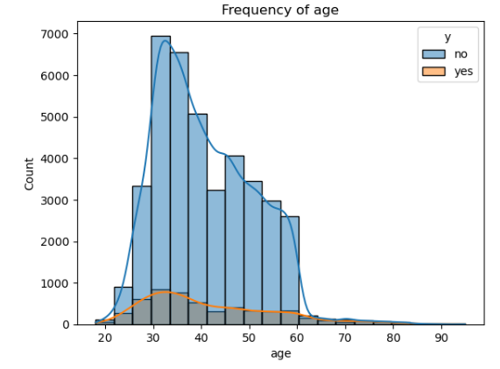
Distribution of Ages of Customers
Age of the customers who subscribe to the term deposit product range from 20 to 85 year-old.

Slide 7
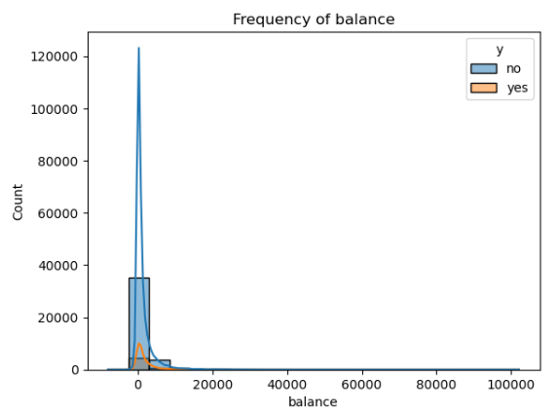
Distribution of Account Balances of Customers
Account balance of subscribed customers are between 0 and 10 000€.

Slide 8
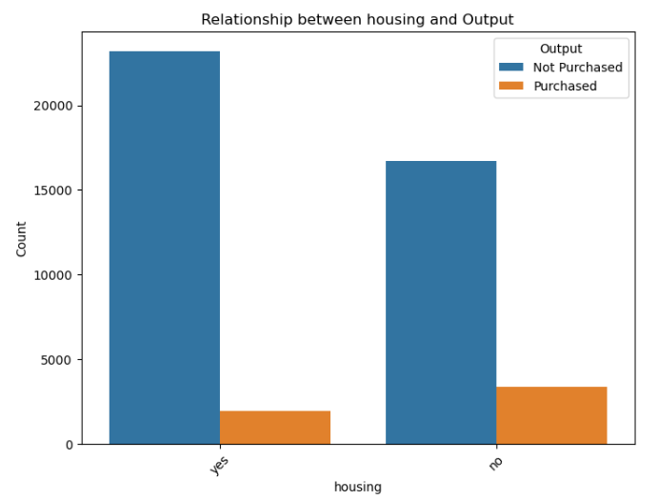
Distribution of Customers with Housing Loan
Customers with and without a housing loan both subscribe to the product.
Majority of customers who have subscribed the term deposit product do not have housing loan.

Slide 9
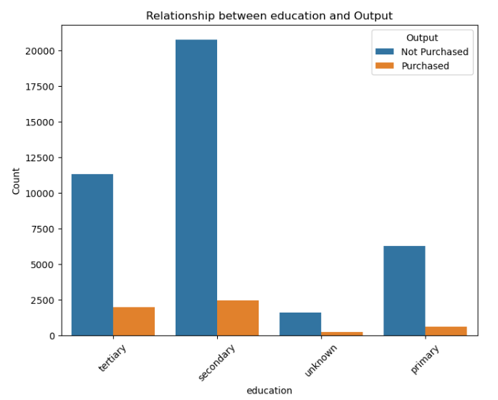
Education Levels of Customers
Customers with ‘secondary’ education level have the highest subscription rate followed by ‘tertiary’ education level for the term deposit product.

Slide 10
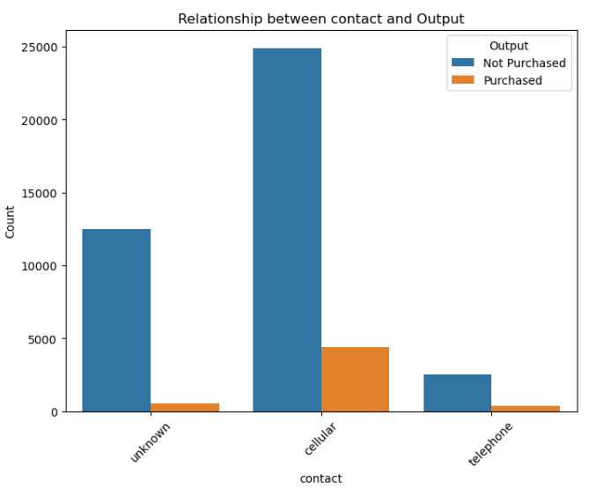
Contact Type with Customers
Most preferred contact type for the customers is ‘cellular’.

Slide 11
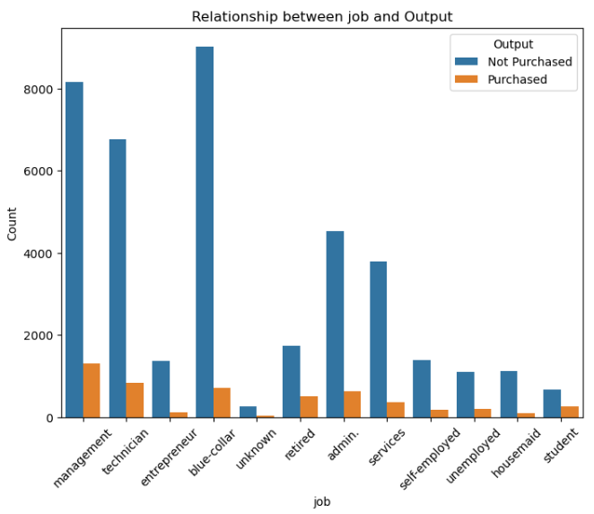
Occupations of Customers
‘Management’ job type have the highest subscription rate followed by ‘technician’ and ‘blue-collar’.

Slide 12
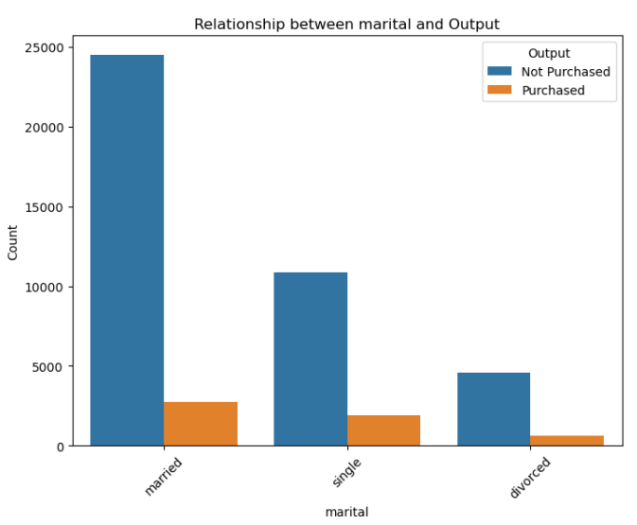
Marital Status of Customers
Most subscription comes from the married people followed by single people with a slight difference.
Divorced people have the least subscription count.

Slide 13
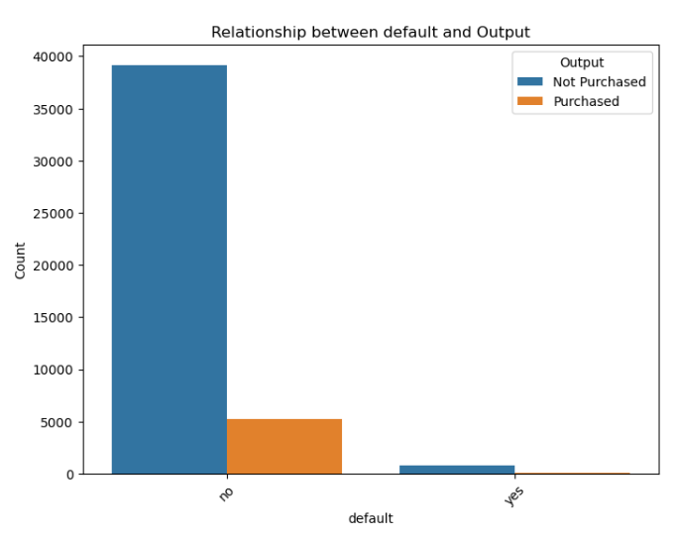
Customers with Default Credits
Customers with default credit have almost no subscriptions whilst people with no default credit have significantly higher number of subscriptions.

Slide 14
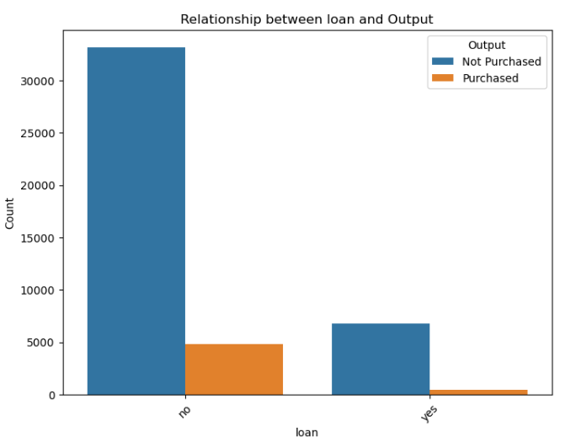
Customers with Personal Loan
Customers with no personal loans are significantly more than customers with personal loan.
Customers with personal loan have rare subscriptions while customers with no personal loan have significantly more subscriptions.

Slide 15
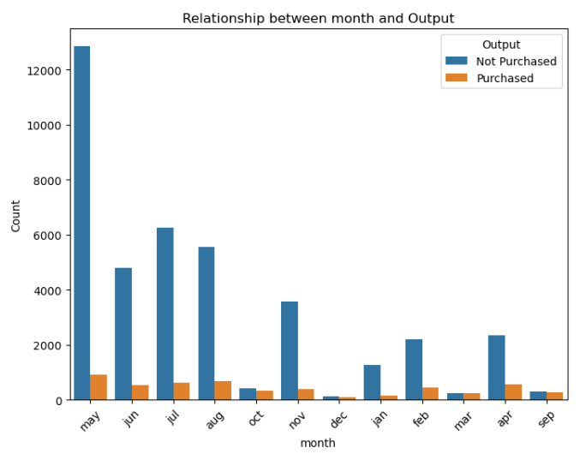
Bank's Contact Month of Year With the Customer
Most product subscriptions occured during the ‘spring’ and ‘summer’ seasons.
Specifically in the months:
April,
May,
June,
July,
August

Slide 16
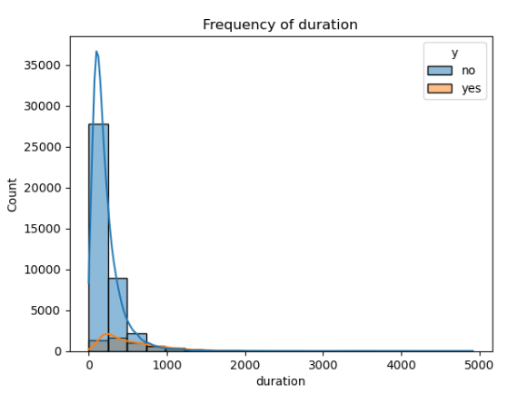
Duration of Contact with the Customer
Customers with 0 second of duration never subscribed to the product.
Most subscription occur when the customer and bank contacts around ~100 – ~800 seconds.

Slide 17
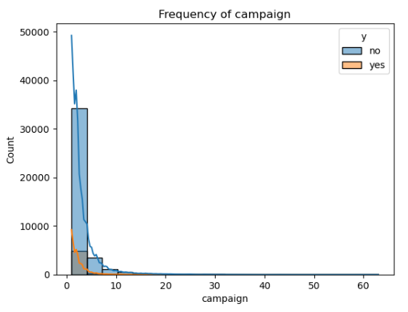
Calls From Bank to the Customer per campaign
When the number of calls from bank to the customer per campaign increases, number of subscription for that campaign decreases.
Relation between the campaign and subscription number is linear.

Slide 18
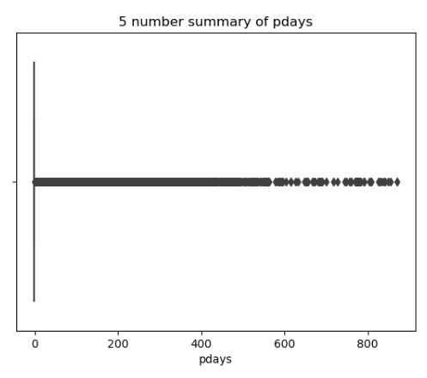
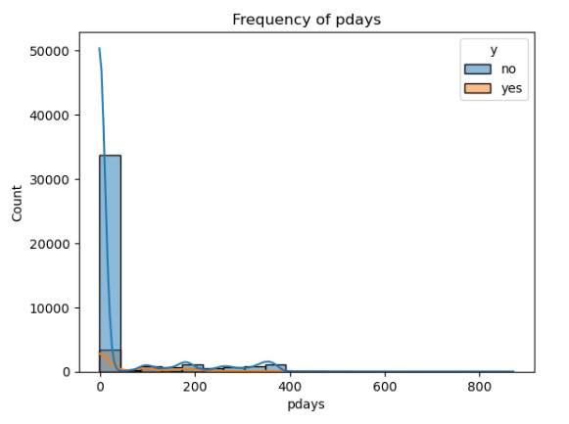
Number of days passed after last contact with customer
Number of days passed have same amount of subscription except for the first 2 months as of last call.

Slide 19
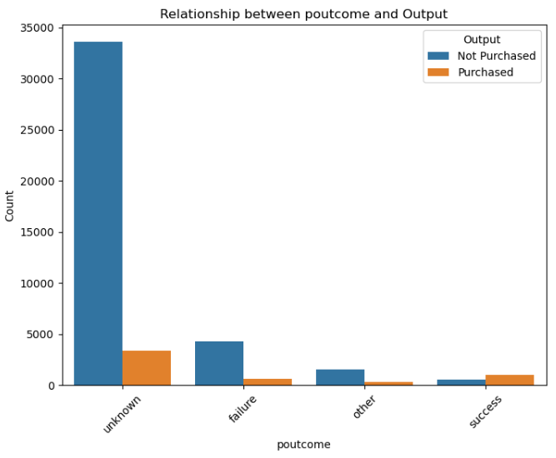
Outcome of previous campaign
Customers whose outcomes for the previous campaign is ‘unknown’ have the highest subscription number.
Can be left like this as the machine will treat it as an another unique category.

Slide 20
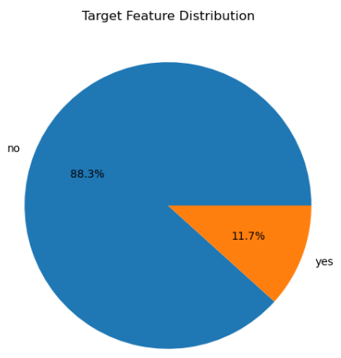
Rate of Customers for subscription
89 % of customers have not subscribed to the term deposit product.
11 % of customers have subscribed to the term deposit product.

Slide 21
Hypothesis Creation

Slide 22
Null Hypothesis (H0):
There is no significant difference in the likelihood of subscribing to the term deposit between customers aged 35 or younger and customers older than 35.
1
Null Hypothesis (H0):
There is no significant difference in the likelihood of subscribing to the term deposit between customers with a balance between -2000 and 6000 (inclusive) and customers with balances outside this range.
2

Slide 23
Null Hypothesis (H0):
There is no significant difference in the likelihood of subscribing to the term deposit between customers with different marital statuses.
3
Null Hypothesis (H0):
There is no significant difference in the likelihood of subscribing to the term deposit between customers with different conversation duration ranges.
4

Slide 24
Null Hypothesis (H0):
There is no significant difference in the likelihood of subscribing to the term deposit between customers with different job categories.
5

Slide 25
Recommendations

Slide 26
Customers whose ages are around 25 – 40 can be chosen to introduce campaigns as they make up the big portion of subscribers.
Customers who are over 60 year-old can be ignored as their potentials for subscribing is relatively less than teenagers.
Customer with a balance between around ‘-2000 €’ and ‘8000 €’ can be focused as they make up the big portion of subscribers. Especially, those customers who are in minus balance level can be taken as priority.
Customers with no housing loan are more likely to subscribe as they make up the big portion of subscribers.
Customers with ‘secondary’ education level can be focus point as they generally show more tendency for subscribing the products.

Slide 27
There is no single customer who have subscribed the term deposit product without at least 1 contact from the bank. All the customers must have been called at least for once.
As the number of contact increase per customer, customers become less likely to subscribe the product as they feel pressure from bank. After around 5 contacts for the same customer, subscription number decreases significantly. Such cases should be avoided to increase the subscription chance.
Customers mostly prefer to be contacted as cellular rather than other methods.
Divorced people are quite less likely to subscribe compared to the married people. Financial comfort of married people can lead to a successfull subscription for bank.

Slide 28
Customers with the jobs ‘management, technician and blue-collar’ should be first considered as they subscribed in the previously campaign.
Customers whose outcomes for the previous campaign is subscribed should be contacted first.
Customer with no default credit should be considered first and customers already with a default credit can be ignored as they almost %100 neglect the subscriptions.
Customer should be contacted during the summer and spring seasons as number of subscriptions always increase in these seasons.
Good luck… ☺

Slide 29
Model Approach (Technical)

Slide 30
Feature Extraction - Preprocessing
→As there are no missing values, only outliers were handled with ‘4’ different techniques:
• IQR ( Interquartile Range ),
• Winsorization,
• StandardScaling ( Z-Score ),
• MinMax Scaling
→’Unknown’ values in categorical features are left untouched as they contribute to a big portion of the output feature.
‘pdays’ and ‘previous’ features were removed as they make no contribution to the output of dataset in any way.
‘Duration’ feature has a strong correlation with subscription status. So, 2 model for each algorithm will be created one having the duration feature and other one not.

Slide 31
Imbalanced Output Problem
89 % of target feature is ‘yes’ while the 11 % is ‘no’.
To handle this imbalanced status:
→ - Sampling
• Under sampling: Randomly reduces number of features in the majority class to acquire balance between classes.
~ prevents model from being biased towards majority class.
•Over sampling: Increases number of instances in minority class by duplicating or generating new instances.
~ provides more data to learn for minority class
- Class Weights
During the object creation from ML libraries, weights can be assigned according to the distribution of classes to
acquire balance between classes. ( 8-9: ‘yes’ , 1-2: ‘no’)

Slide 32
- Different Models
Some Machine learning models such as:
• Gradient boosting algorithms (e.g: XGBoost, LightGBM..etc)
• SVM,
• Neural networks,
• Naive Bayes
• Decisiton Trees
• Ensemble methods (e.g: random forest)
are relatively less influenced by unbalanced classes.
- Different evaluation metrics
• Using different evaluation metrics to evaluate the performance of the models from different perspectives will give us a better idea about specific characteristics of data.
- Cross validation
• CV helps us to asses how well the model will generalize to new, unseen data. It can be a useful way to see if the overfitting and class unbalance problem is resolved.

Slide 33
Machine Learning Models That Will Be Used:
→Logistic Regression,
Support Vector Machine,
Random Forest,
XGBoost.
Each model will have been created for each dataset by applying hyper-parameter tuning to obtain the best combination.
Based on the precision, accuracy and F1-Score models’ performances will be evaluated after Cross validation. ( E.g: 5 folds with 70-15-15)
Model will be ready for deployment and for further usage.

Slide 34
Team of Datarpher
Thank You

