Slide 1

Bank Marketing Campaign – Term Deposit Product Subscription
Company Name : ABC Bank Location: Portugese Team: Datarpher Date: 16-August-2023

Slide 2

Agenda
Selected Algorithms for Models
Algorithm Comparsion
Classification Report Comparison
ROC and AUC Comparison
Comments on Best Trained Model
Conclusion

Slide 3
Description:
ABC Bank wants to sell it's term deposit product to customers and before launching the product they want to develop a model which help them in understanding whether a particular customer will buy their product or not (based on customer's past interaction with bank or other Financial Institution).
Bank wants to use ML model to shortlist customer whose chances of buying the product is more so that their marketing channel (tele marketing, SMS/email marketing etc) can focus only to those customers whose chances of buying the product is more.
This will save resource and their time ( which is directly involved in the cost( resource billing)).
The Analysis include :
Data Understanding,
Data Visualization,
Creating multiple hypothesis,
Proposing the approaches for finding the best fid model based on Accuracy, Precision and F1-Score.

Slide 4
Selected Algorithms for Models
Logistic Regression
• It models the probability that an instance belongs to a particular class using a logistic function. It's simple yet effective, providing a linear decision boundary to separate classes.
Random Forest
• an ensemble machine learning algorithm that combines multiple decision trees to make predictions. It creates a "forest" of diverse trees by introducing randomness in tree-building, leading to improved accuracy and generalization.
XGBoost
• an advanced gradient boosting algorithm that focuses on boosting decision trees. It optimizes a loss function while adding new trees sequentially, addressing both bias and variance issues, making it highly efficient and accurate.

Slide 5
Algorithms Comparison
for an Imbalanced Dataset

Slide 6
→ It can perform reasonably well on imbalanced datasets when combined with techniques like class weighting or oversampling the minority class. However, its simplicity might not capture complex relationships in highly imbalanced data. It might struggle to identify the minority class due to its linear nature.
Logistic Regression
Random Forest
→ Has the ability to handle imbalanced datasets quite well due to its ensemble nature. It's less prone to overfitting and can capture nonlinear relationships.
XGBoost
→ Can adapt to complex relationships and prioritize learning from the minority class.
→ Incorporates regularization techniques and handles class imbalances by assigning higher weights to misclassified instances. It can create strong predictive models even in the presence of class imbalance.

Slide 7
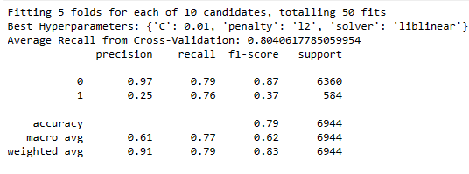
Classification Reports of Models
→ Since there are multiple models, best performed version of each model upon the dataset is chosen.
→ For logistic regression, when undersampling with different outlier handling methods, classification reports are as followed:
Undersampling – logistic regression
→ Undersampling aims to balance class distribution by reducing the number of instances in the majority class. This can help mitigate class imbalance issues but might result in a loss of information.

Slide 8
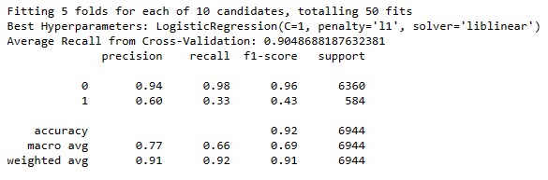
Classification Reports of Models
→ For logistic regression, when undersampling with different outlier handling methods, classification reports are as followed:
Oversampling – logistic regression
→ Oversampling aims to balance class distribution by increasing the number of instances in the minority class. This can help address class imbalance issues but might lead to overfitting or redundancy in the training data.

Slide 9
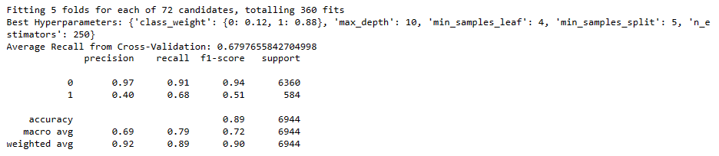
Classification Reports of Models
→ For random forest, classification report after hyper-parameter tuning is as followed:
Random Forest
→ Since the random forest itself is a robust algorithm against imbalanced datasets, only a class weight distribution adjustment is performed during hyper-parameter tuning.

Slide 10
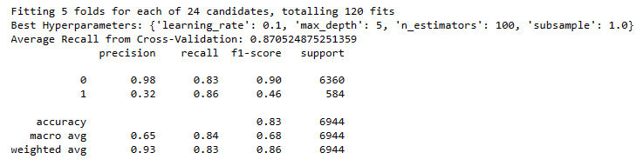
Classification Reports of Models
→ For XGBoost, same path in the logistic regression is followed and classification reports are created:
UnderSampling XGBoost
→ Just as the the random forest , XGBoost is alsois a robust algorithm against imbalanced datasets, however different sampling results with class weight distribution adjustment is performed during hyper-parameter tuning for it as well.

Slide 11
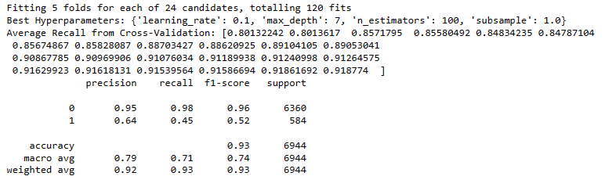
Classification Reports of Models
→ For XGBoost, same path in the logistic regression is followed and classification reports are created:
OverSampling XGBoost
→ Just as the the random forest , XGBoost is alsois a robust algorithm against imbalanced datasets, however different sampling results with class weight distribution adjustment is performed during hyper-parameter tuning for it as well.

Slide 12
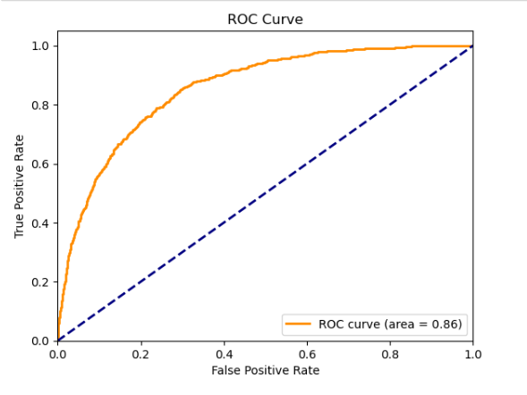
ROC and Precision – Recall Curve of Algorithms
→ Logistic Regression
Under Sampling

Slide 13
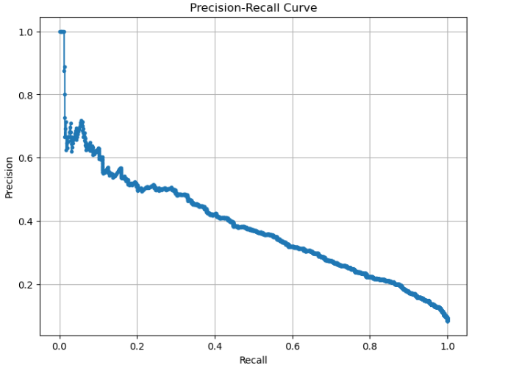
ROC and Precision – Recall Curve of Algorithms
→ Logistic Regression
Under Sampling

Slide 14
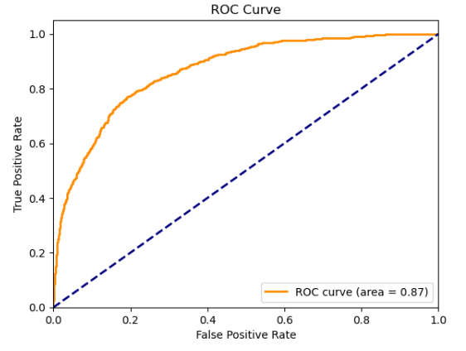
ROC and Precision – Recall Curve of Algorithms
→ Logistic Regression
Over Sampling

Slide 15
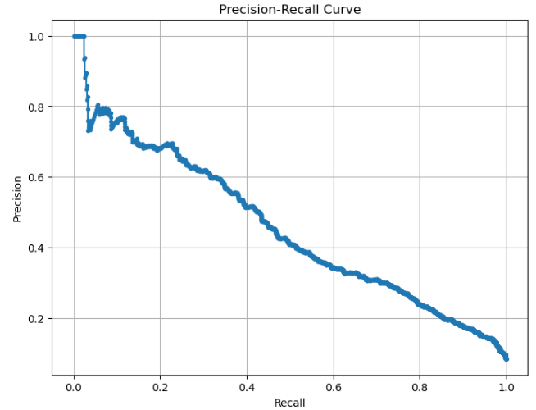
ROC and Precision – Recall Curve of Algorithms
→ Logistic Regression
Over Sampling

Slide 16
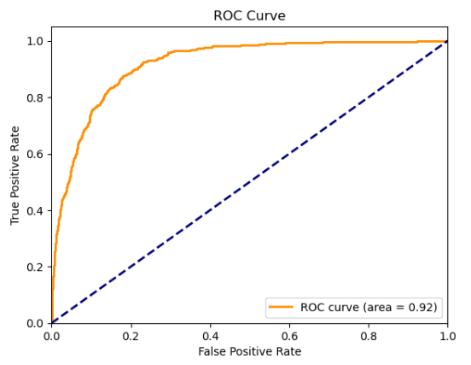
ROC and Precision – Recall Curve of Algorithms
→ XGBoost Classifier
Under Sampling

Slide 17
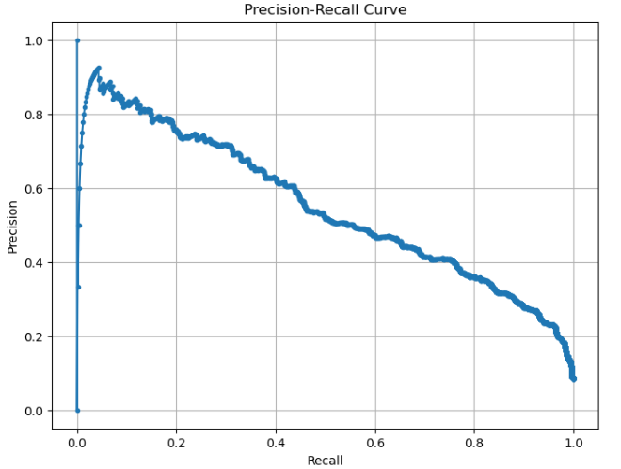
ROC and Precision – Recall Curve of Algorithms
→ XGBoost Classifier
Under Sampling

Slide 18
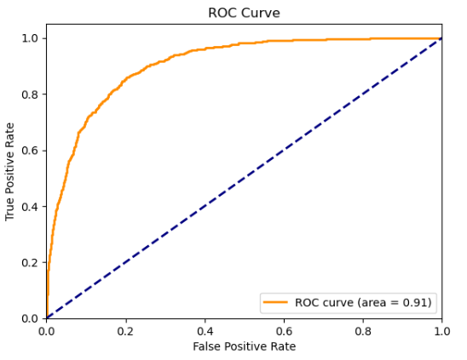
ROC and Precision – Recall Curve of Algorithms
→ Random Forest

Slide 19
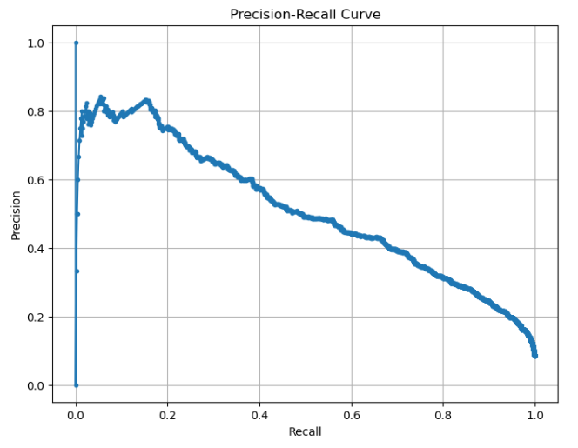
ROC and Precision – Recall Curve of Algorithms
→ Random Forest

Slide 20
→ As the average evaluation metric score shows in each classification report, models are not overfitted due to the correct implementation of model parameters and cross-validation.
→ Random Forest and XGBoost is mostly performing better, especially for f-1 score.
→ In case of such an imbalanced dataset, f-1 score can be a good indicative of the balance between the precision and recall ( positive and negative true-false values.)
→ As indicated in note, within 24 hours, summary will be completed for the rest of the presentation.

Slide 21
Team of Datarpher
Thank You

