Slide 1

G2M insight for Cab Investment firm
Company Name : XYZ Location: The US Team: Data Science Date: 21-June-2023

Slide 2

Agenda
Executive Summary
Problem Statement
Approach
EDA
Hypothesis Creation
Recommendation

Slide 3
Description:
XYZ is a private equity firm in US. Due to remarkable growth in the Cab Industry in last few years and multiple key players in the market, it is planning for an investment in Cab industry.
Provide actionable insights to help XYZ firm in identifying the right company for making investment.
Cab Companies:
Yellow Cab
Pink Cab
The Analysis include :
Data Understanding,
Data Visualization,
Creating multiple hypothesis,
Building models and finding the best fit model based on Accuracy.

Slide 4
Data Preparation:
There are 5 datasets:
Cab_Data.csv – this file includes details of transaction for 2 cab companies.
Customer_ID.csv – this is a mapping table that contains a unique identifier which links the customer’s demographic details.
Transaction_ID.csv – this is a mapping table that contains transaction to customer mapping and payment mode.
City.csv – this file contains list of US cities, their population and number of cab users.
US_Holidays.csv – this file includes details of holiday dates in the US.

Slide 5
EXPLORATORY DATA
ANALYSIS

Slide 6
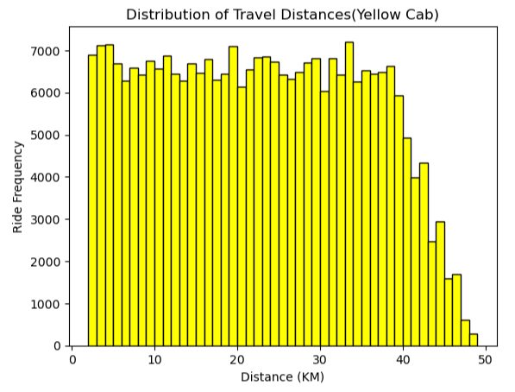
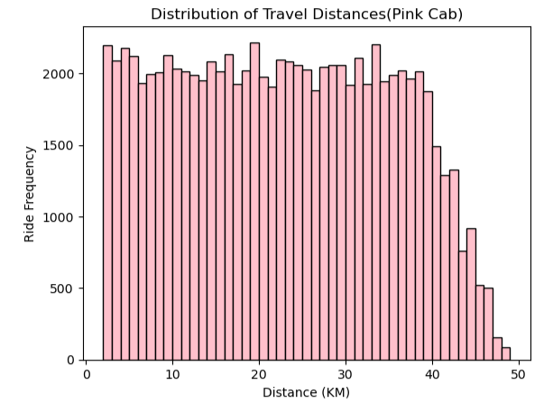
Distribution of Travel Distances (KM)
Based on the şnformation on these graphs, we can say that both companies ( Pink and Yellow Cab ) performs their rides approximately between 2 - 48 KM.

Slide 7
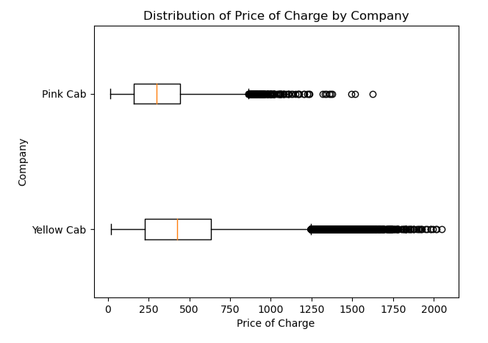
Distribution of Price Charged
The Price Charge range for Yellow cab is more than the Pink cab.
The outliers are mostly due to use of high-end cars.

Slide 8
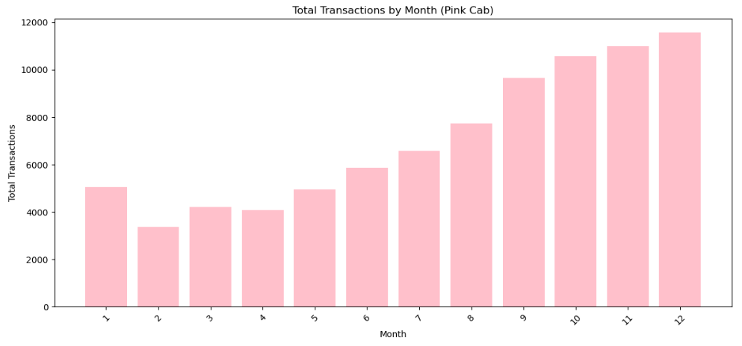
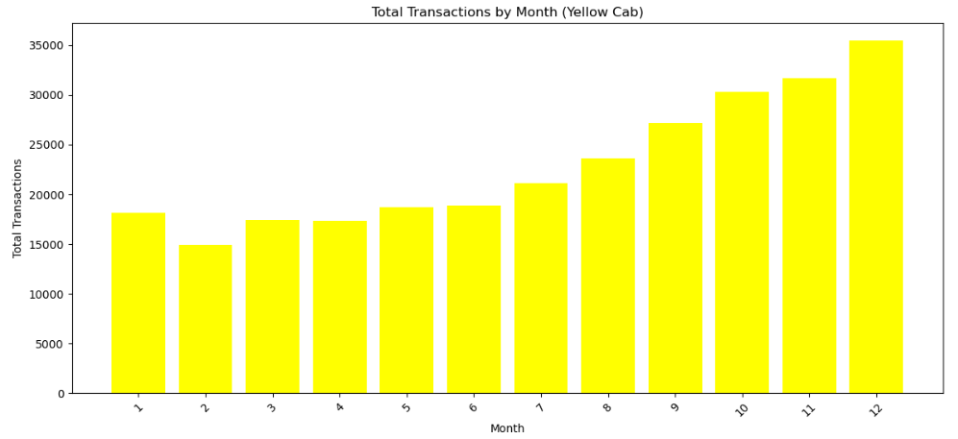
Travel Frequency per Month:
Yellow Cab performs more transactions (35000) in December December which is the holiday season compared to Pink Cab (11000).

Slide 9
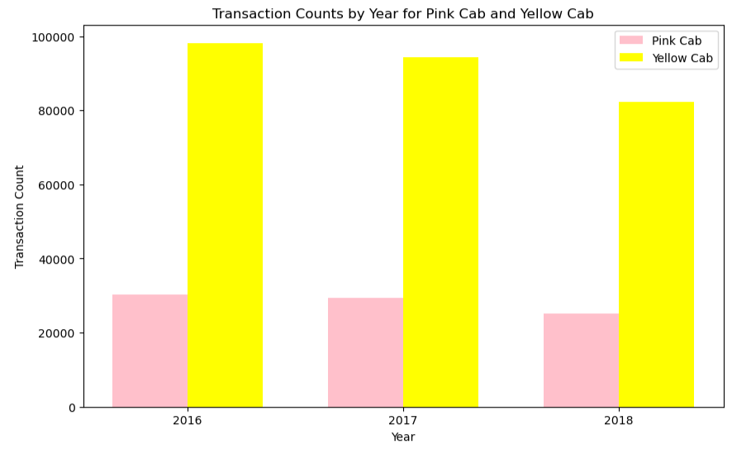
Transaction per Year
Based on years, number of yearly transactions for Yellow cab is higher than Pink cab.

Slide 10
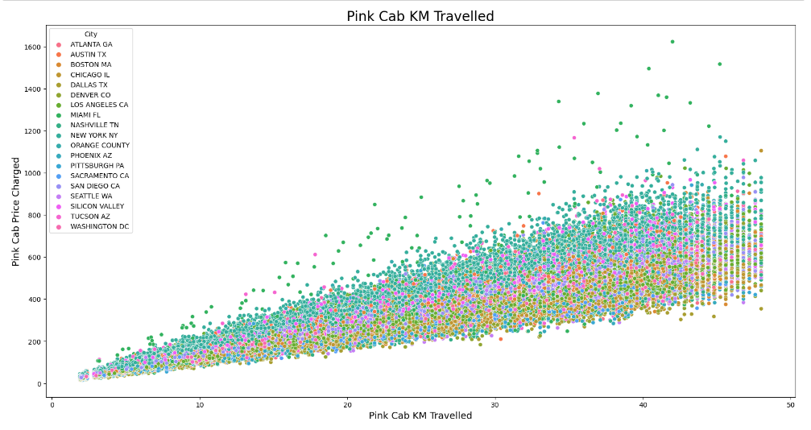
Price Charged based on Travel Distances per City ( Pink Cab )
All cities have the same increase in price depending on the increase in distance.

Slide 11
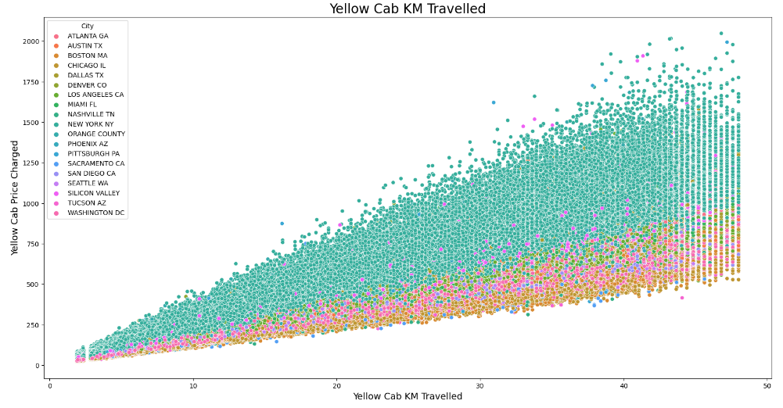
Price Charged based on Travel Distances per City ( Yellow Cab )
In New York City the Price charged is more than other cities for Yellow Cab.

Slide 12
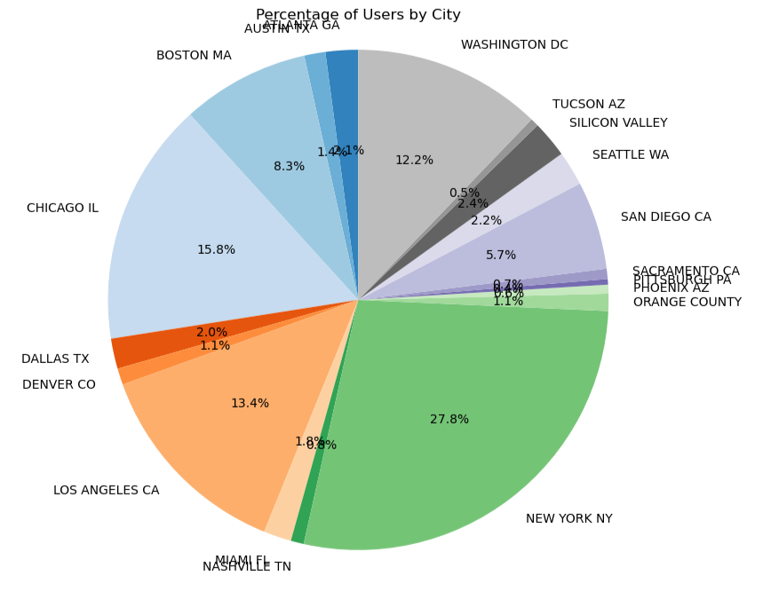
Cab User Distribution Per City
New York City has the highest Cab users with 28%. 2. city with the highest user is Chicago by 16% followed by Los Angeles with 13%.

Slide 13
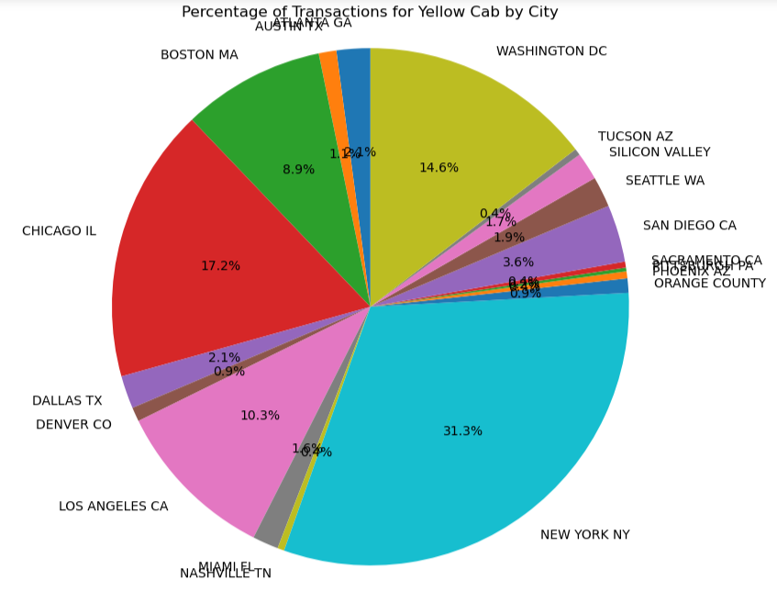
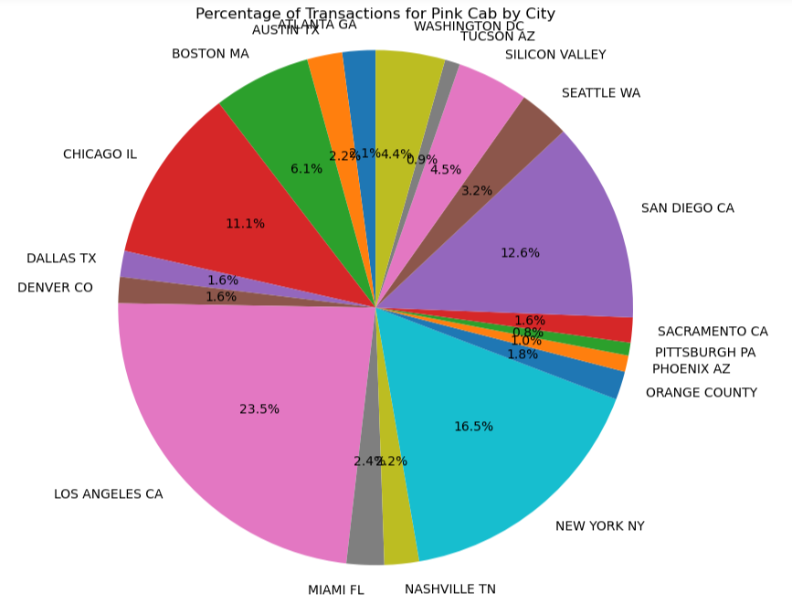
Transaction per City for both Cabs
For Yellow Cab transaction count is highest in New York City(31%), we shall recall that New York is the city that has the most Yellow Cab user.
For Pink Cab transaction count is highest in Los Angeles City.

Slide 14
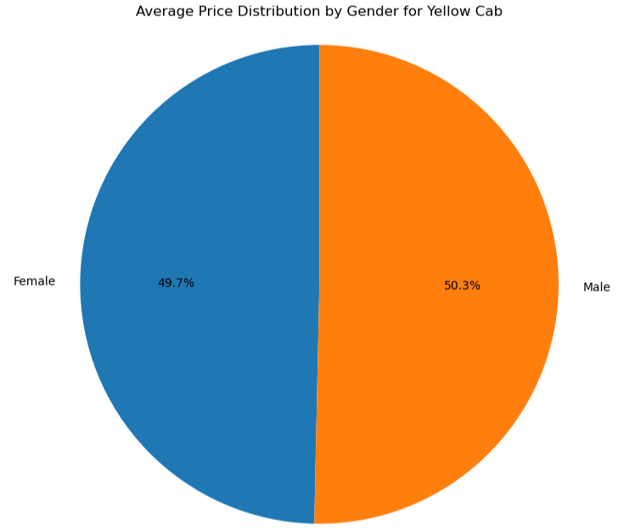

Price Charged Based on Gender
Yellow Cab charge less price for Female Customers
while Pink Cab charges same price for both genders.

Slide 15
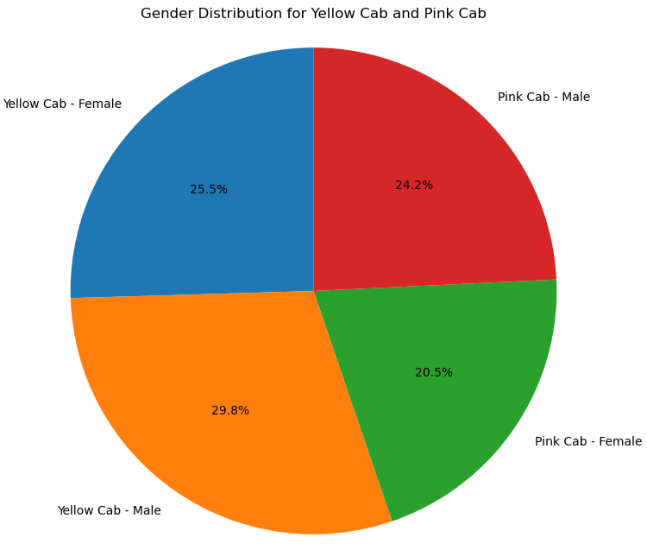
Customer Distribituons Based on Gender for Both Companies
Number of Female Customers in Yellow Cab(25.5%) is higher than Pink Cab (20.5%).
We shall recall that yellow cab charges less price from females.

Slide 16
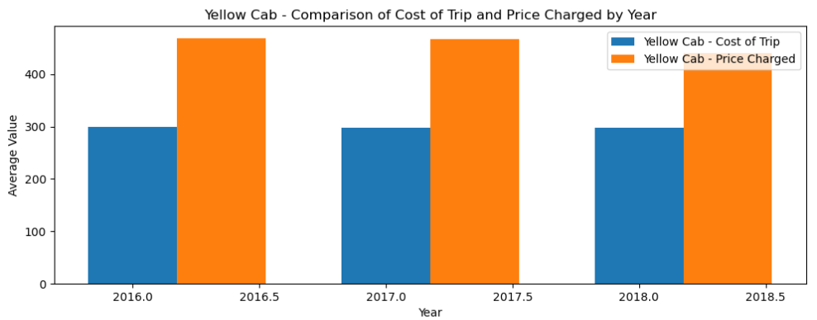
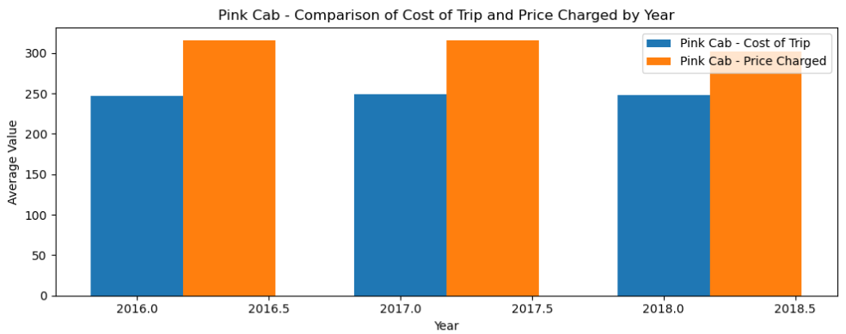
Profit Margin per year for Both Companies
Yellow cab has higher Profit Margin than that of the Pink cab.
Profit Margin = Price Charged – Cost of the Trip

Slide 17
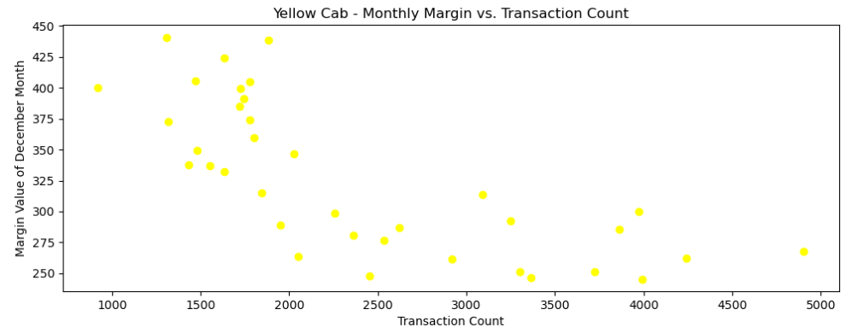
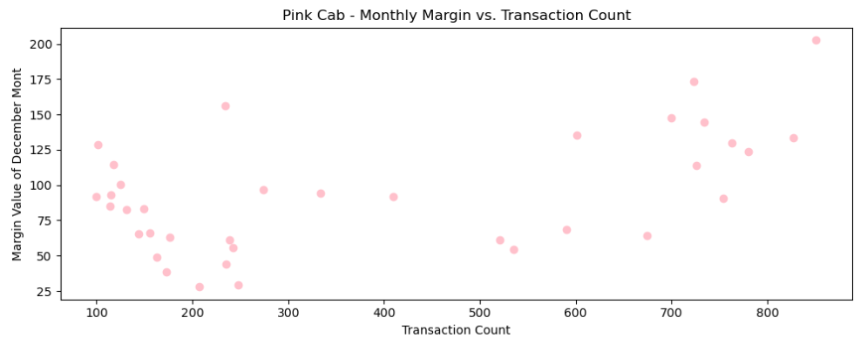
Margins per Transactions
Pink Cab company shows increasement in margins as the number of transactions increases.
Yellow Cab company shows decreasement int Margins as the number of transactions increases.

Slide 18
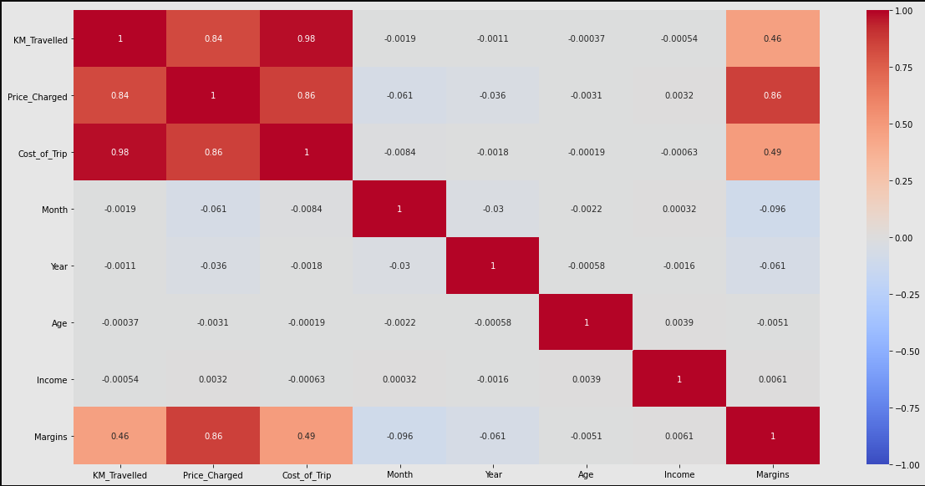
Correlation
According to the graph →
There is a positive correlation between Margin and Price Charged

Slide 19
Hypothesis Creation

Slide 20
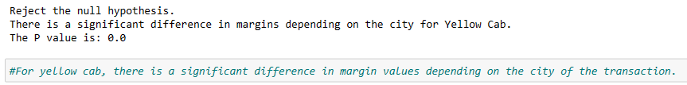
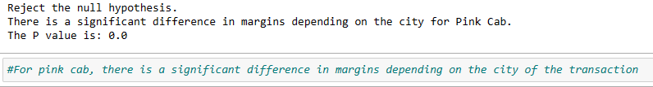
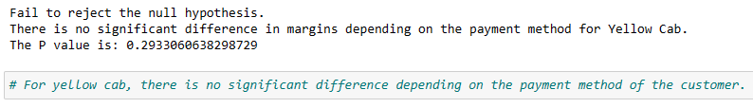
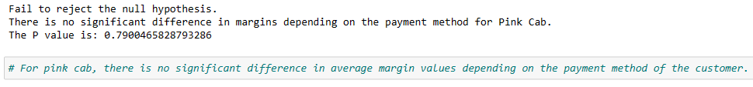
Hypothesis → Average margin does not change depending on the city for both pink cab and yellow cab companies
Hypothesis → Average margin does not change depending on the payment method for both pink and yellow cab companies.

Slide 21
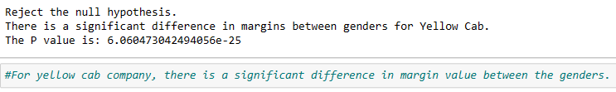
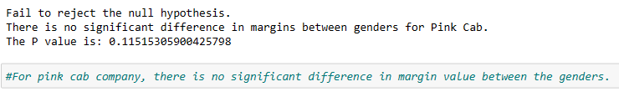
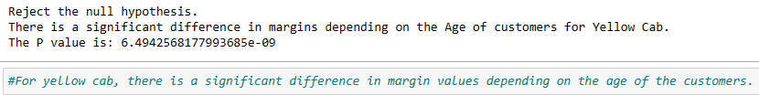
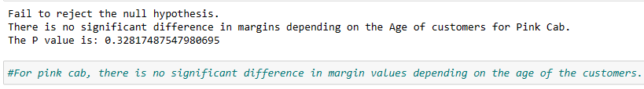
Hypothesis → Average margin does not change depending on the gender for both pink cab and yellow cab companies
Hypothesis → Average margin does not change depending on the age for both pink cab and yellow cab companies

Slide 22
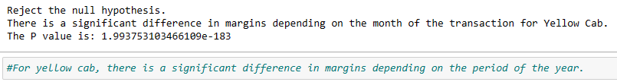
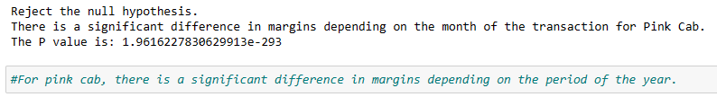
Hypothesis → Average margin does not change depending on in which month transaction is performed for both yellow and pink cab company
On the basis of analyzes done and results of hypotheses;
Yellow Cab Company is recommended for Investment.

Slide 23
Thank You

