Slide 1
TRAFFIC ESTIMATION MODEL
Traffic estimation model in the context of smart city development within the Istanbul city.

Slide 2
PURPOSE OF THE PROJECT
Developing a robust traffic estimation model leveraging data science techniques for enhanced urban mobility insights.
Efficient Traffic Management
Optimized Urban Mobility
Improved Quality of Life
Sustainable Transportation
Responsive Infrastructure
Proposing an LSTM architecture in PyTorch as an alternative to traditional ensemble methods in the literature.

Slide 3
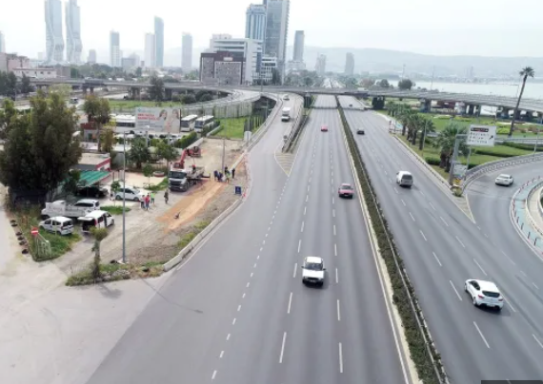
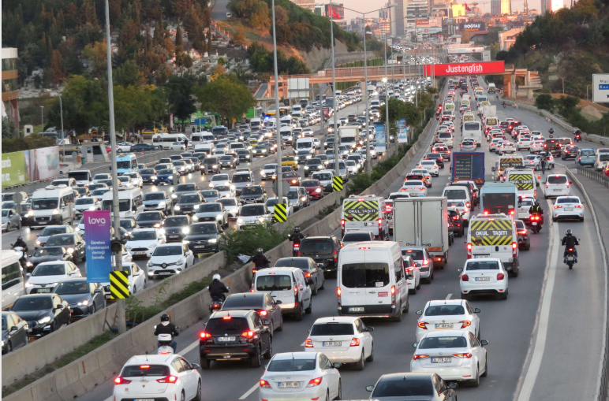
PURPOSE OF THE PROJECT

Slide 4
Dataset
Over 1.5 million records
2020-01-01 and 2020-01-02 ( 1 month ) ( prophet )
Date
Latitude, longitude
Geohash (ohe)
Min-max- avg speed ( km/h)
Number of vehicles
IBB.GOV.TR

Slide 5
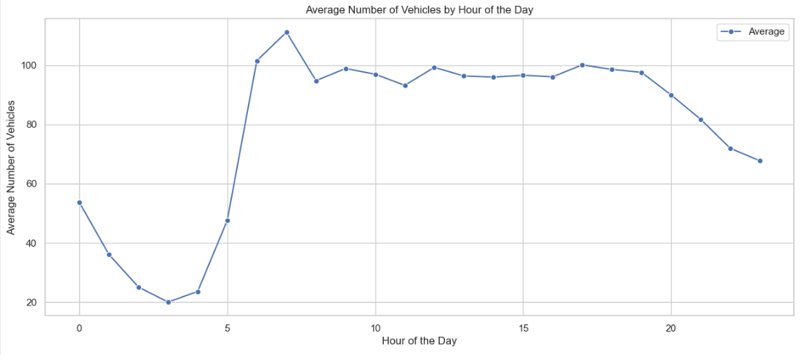
DATA ANALYSIS

Slide 6
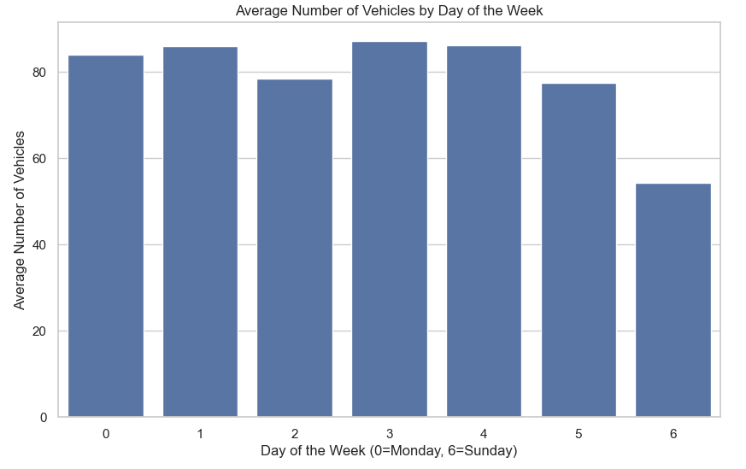
DATA ANALYSIS

Slide 7
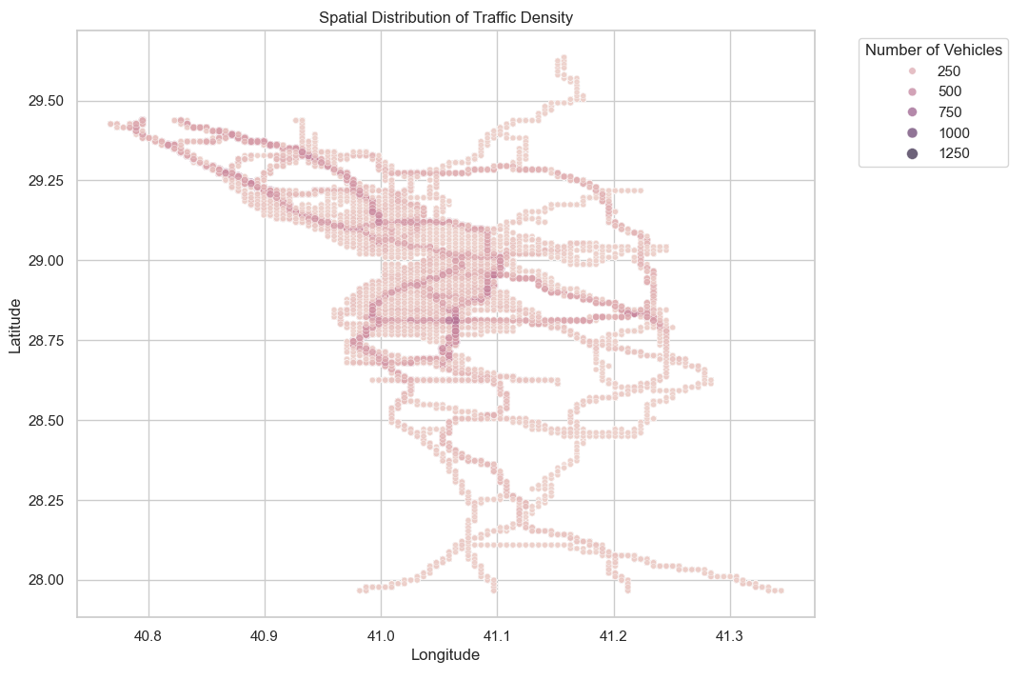
DATA ANALYSIS

Slide 8
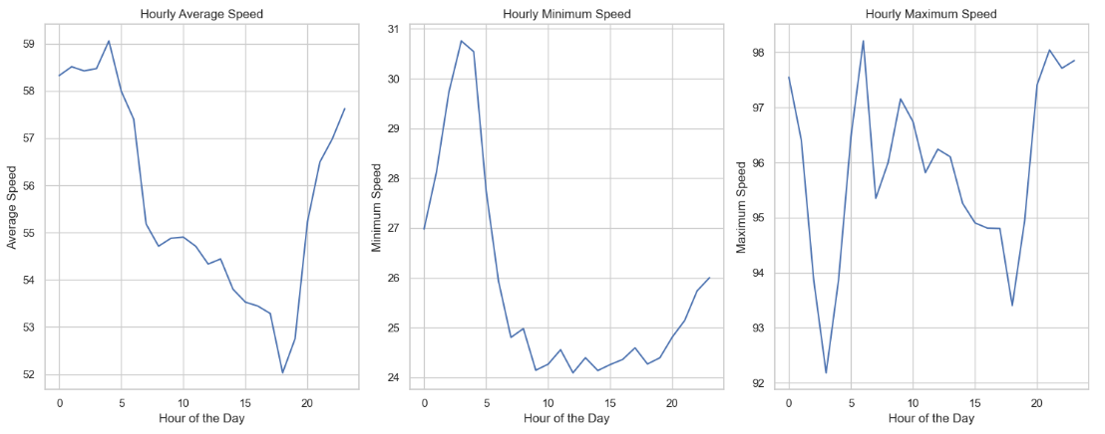
DATA ANALYSIS

Slide 9
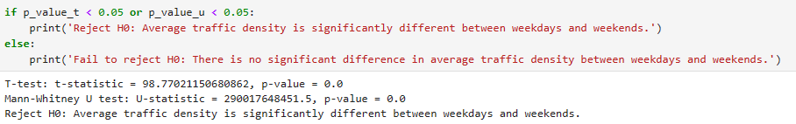
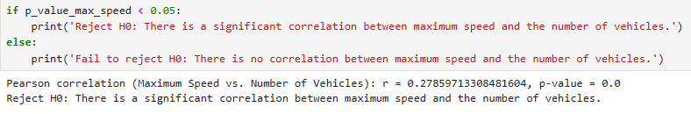
HYPOTHESIS TESTS

Slide 10
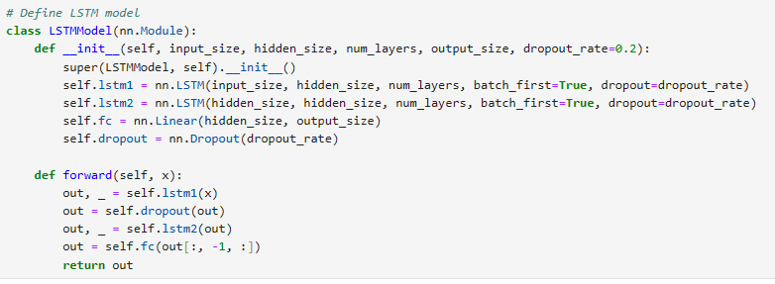
PROPOSED MODELS
LSTM model in PYTORCH

Slide 11
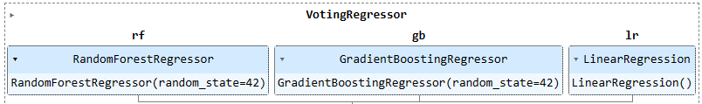
PROPOSED MODELS
ENSEMBLE MODEL IN ML

Slide 12
CONCLUSION AND FUTURE WORK
ENSEMBLE PERFORMED BETTER THAN PROPOSED LSTM
OUTCOMES AND TESTS REGARDING THE DATASET CAN BE USED FOR FURTHER IMPROVEMENTS OF THE MODEL.

Slide 13
BATUHAN YILMAZ
THANK YOU FOR YOUR ATTENTION

