Slide 1
The Impact of Socio-Political Events on My Twitter Usage
An Analytical Approach to Understanding Behavioral Patterns
Batuhan Kızıltaş 31991
Sabancı University

Slide 2
Motivation
Purpose of the Study:
The primary purpose of this study is to fulfill the requirements of my course project. It serves as an opportunity to apply data analysis techniques in a practical context, combining theoretical knowledge with real-world data. By investigating the relationship between socio-political events and my Twitter usage, I aimed to demonstrate my ability to extract, clean, analyze, and interpret data systematically.
Personal Connection:
Whilst I don’t have a deep personal connection to the topic, Twitter is a platform I actively use, and socio-political events often dominate discussions there. This project allowed me to explore whether significant events unconsciously influenced my own behavior on the platform. Even though my primary motivation is academic, the insights gained from this analysis might offer an interesting reflection on how external events shape my digital habits.

Slide 3
Research Question:
Is there a measurable correlation between socio-political events and my Twitter activity?
Null Hypothesis:
There is no correlation between socio-political events and my Twitter usage.
Alternative Hypothesis:
There is a positive correlation between socio-political events and my Twitter usage.

Slide 4
Data Source
Data Origin:
The data is obtained from the Twitter (X) personal account archive by demanding my personal data from Twitter.
Time Frame:
The data covers the dates between and including 21-06-2021 and 25-11-2024.
Variables Extracted:
Number of Tweets posted in a day, with dates.
Number of Retweets posted in a day, with dates.
Event Data
A few days around the date of socio-political events (namely the 2023 presidential elections, the 2024 municipal elections, and the February 6th earthquakes in Turkey).

Slide 5
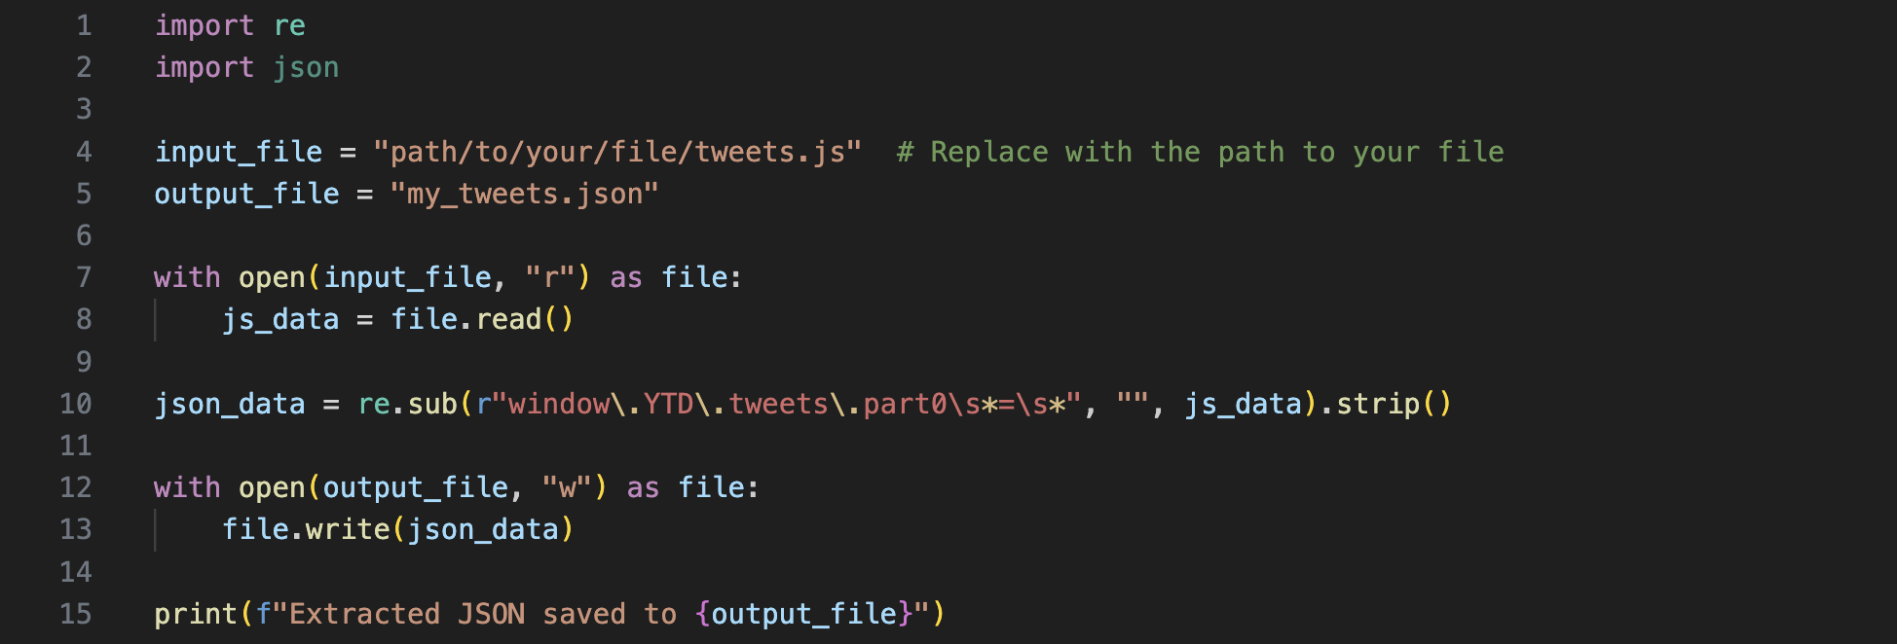
Data Analysis: Visualiztion
Downloading the archive:
I first downloaded my archive provided by Twitter (X) from my account.
Unwrapping my tweets.js file:
I refactored my .js file into a .json file, transitioning from a dynamic JavaScript data structure to a static JSON format (see this link):

Slide 6
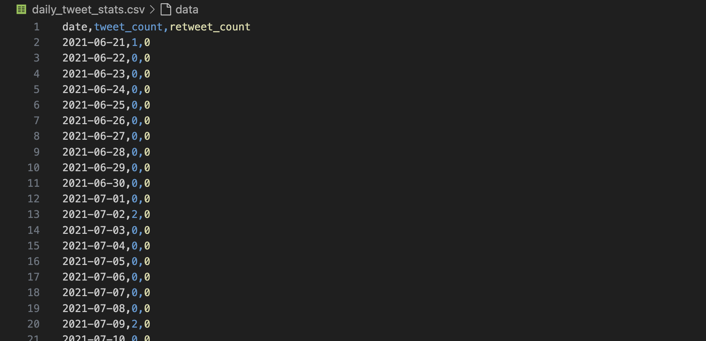
Data Analysis: Visualiztion
Extracting data:
Using EDA, I extracted the data of number of tweets and retweets posted in a day from 21-06-2021 to 25-11-2024 and saved it to a file (see this link):

Slide 7
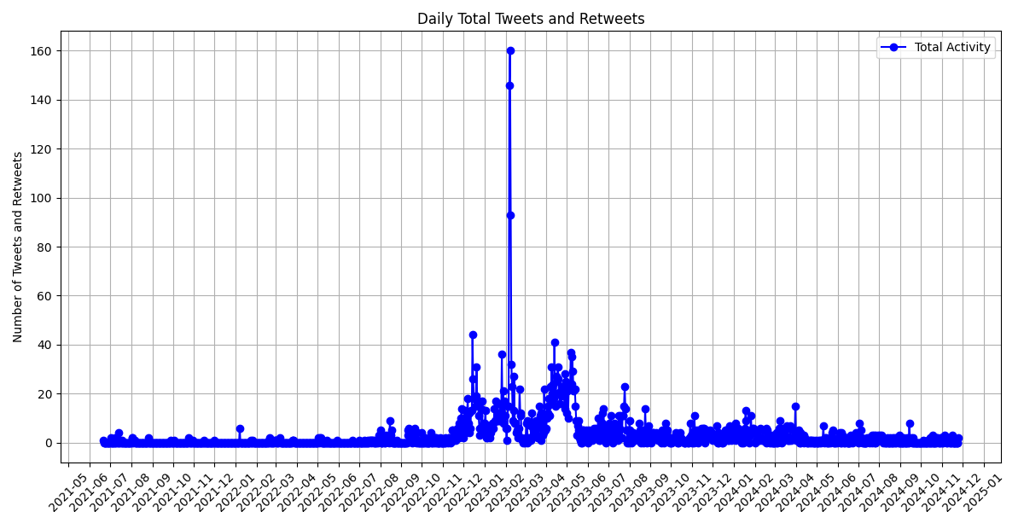
Data Analysis: Visualiztion
Plotting the whole data:
Then I plotted the whole data, using Pandas and Matplotlib Python libraries to do so (see this link):

Slide 8
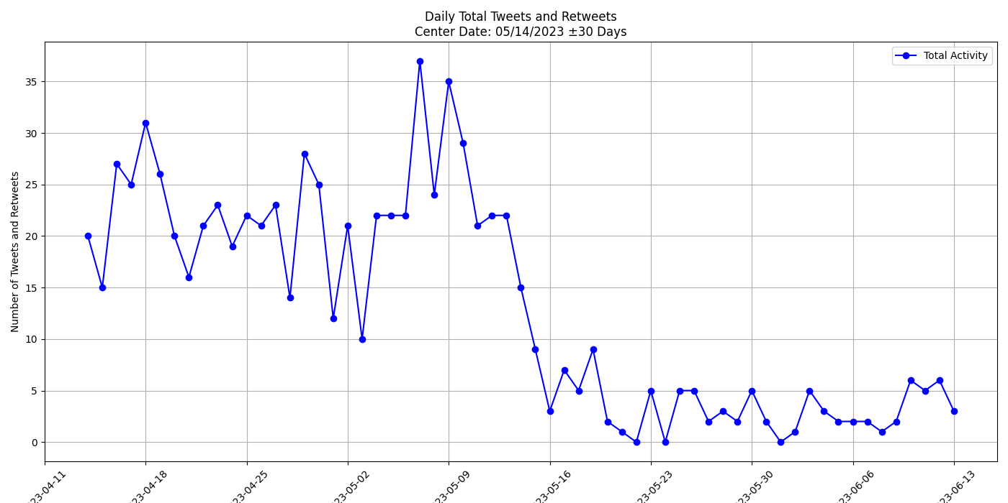
Data Analysis: Visualiztion
Plotting a part of the data:
To better see how my Twitter usage changes in a shorter timeframe and be less prone to long term Twitter usage patterns, I plotted sub-graphs that essentially zooms in the whole data (see this link):
My Twitter usage plummets after the conclusion of the first round of the presidential elections.

Slide 9
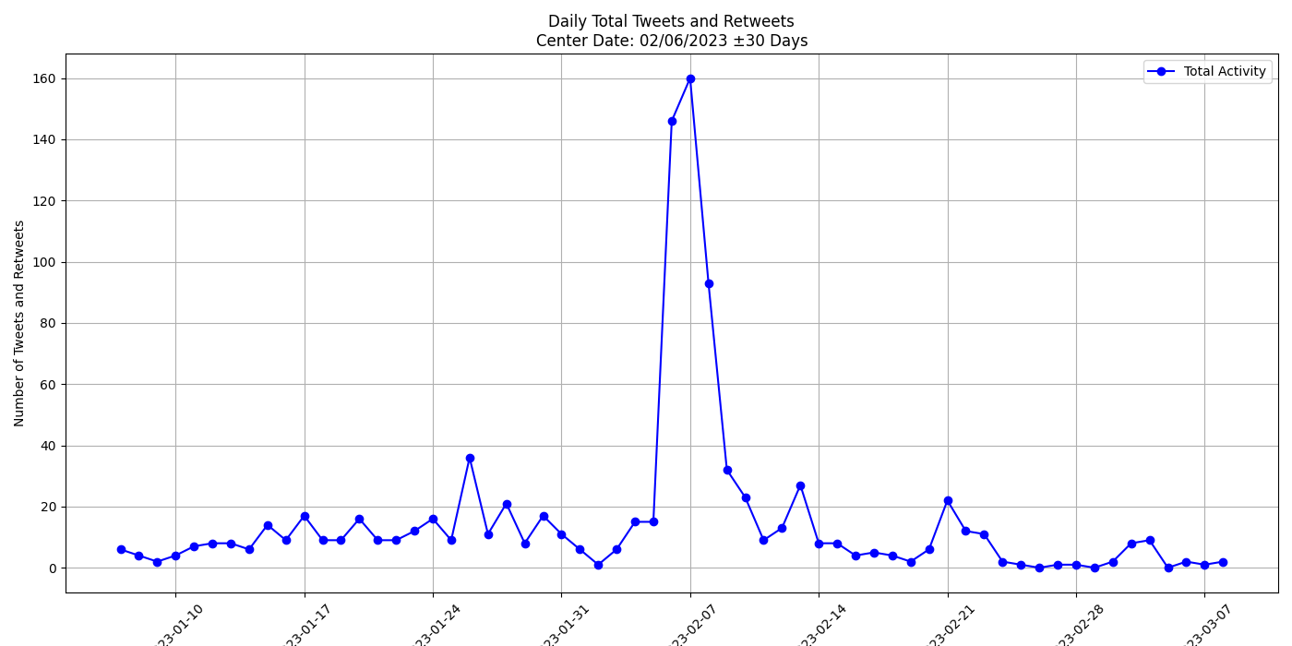
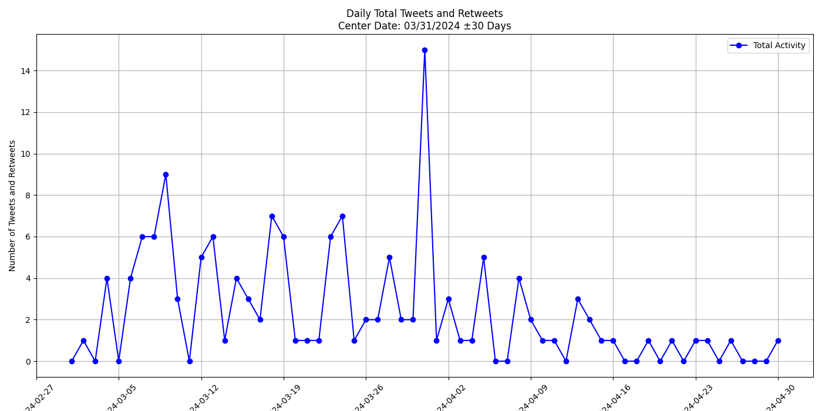
Data Analysis: Visualiztion
Two more plots:
The number of tweets and retweets posted in a day spikes sharply on and after the 6th of February 2023 earthquakes before declining.
A decreasing trend in the number of tweets and retweets per day follows the municipal elections of 2024.

Slide 10
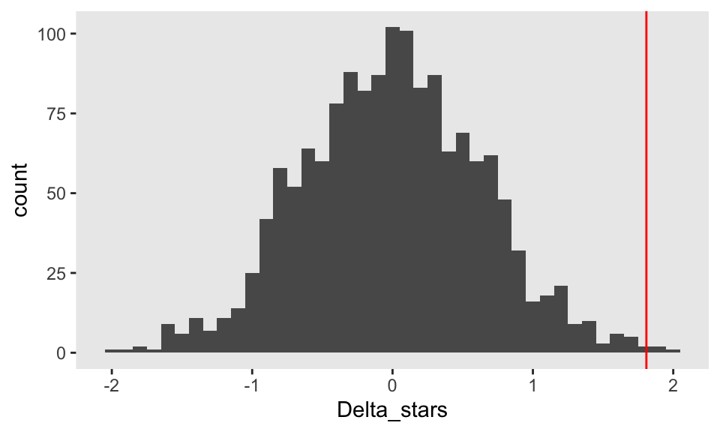
Data Analysis: Testing
Need for statistical testing:
Thus far I only visualized the data and made some observations and relied solely on basic human intuition to make some conclusions. However, to ensure the validity and reliability of my findings, I plan to use a p-test, specifically a randomization (permutation) test, to statistically assess whether the observed patterns in my Twitter usage during socio-political events are statistically significant or simply a result of random chance, providing a more objective basis for my conclusions.
How a randomization p-value test looks
Randomization p-test, 2021, https://www.rdatagen.net/post/2021-03-02-randomization-tests/

Slide 11
Data Analysis: Testing
Randomization p-test:
In my case, the randomization test involves comparing the average tweet counts during specific windows around socio-political events to broader control periods. For events like elections, I focus on pre-event and post-event windows (e.g., -20 to +5 days vs. -20 to +30 days) to capture the buildup and aftermath of activity. For more sudden events like natural disasters, I compare the immediate impact period (e.g., 0 to +5 days) against a broader baseline (-20 to +20 days) to highlight short-term spikes. By shuffling the labels of tweet counts across these windows, I test whether the observed differences are statistically significant (at 5% significance level) or due to chance, tailoring the approach to each event’s unique characteristics.

Slide 12
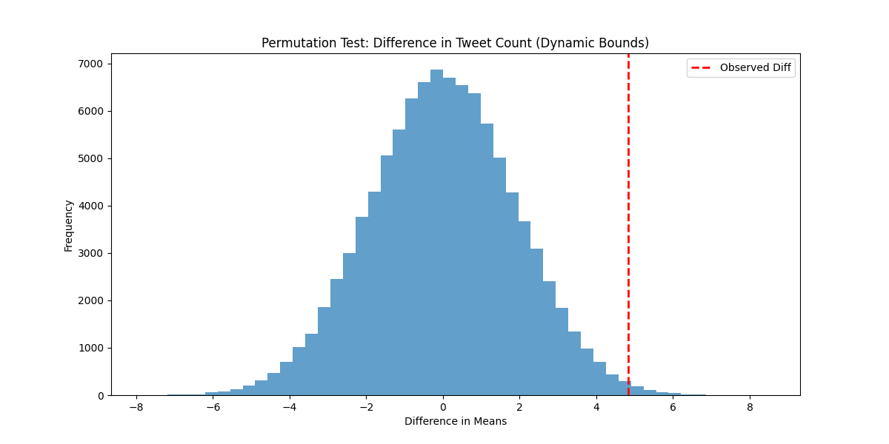
Data Analysis: Testing
p-test for Presidential Elections (May 14th, 2023):
Here, the baseline is defined as 30 days before and after the elections, while the comparison window spans 20 days before and 10 days after the election.
see this link for the script
Mean (Small Window): 12.290322580645162
Mean (Large Control Window excluding Small Window): 7.466666666666667
Observed Difference: 4.823655913978495
P-value: 0.01130
Total of 100.000 permutations.

Slide 13
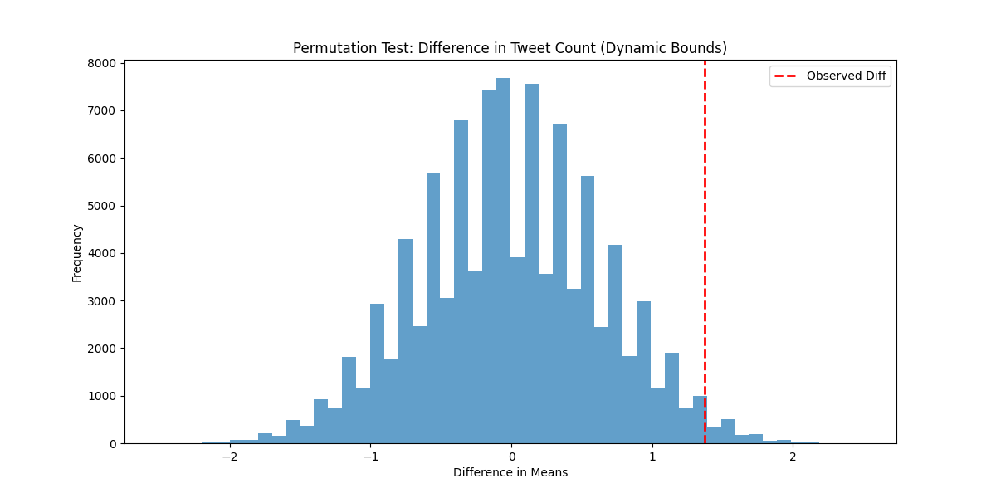
Data Analysis: Testing
p-test for Municipal Elections (March 31st, 2024):
Here again, the baseline is defined as 30 days before and after the elections, while the comparison window spans 20 days before and 10 days after the election.
see this link for the script
Mean (Small Window): 2.870967741935484
Mean (Large Control Window excluding Small Window): 1.5
Observed Difference: 1.370967741935484
P-value: 0.03653
Total of 100.000 permutations.

Slide 14
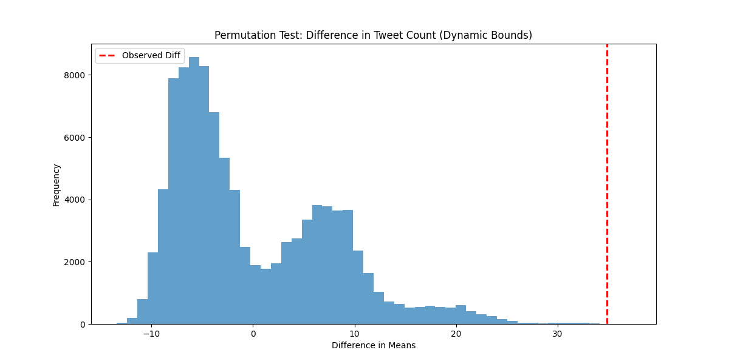
Data Analysis: Testing
p-test for February 6th Earthquakes in Turkey (2023):
Here, the baseline is defined as 20 days before and after the earthquakes, while the comparison window spans from the date of the disasters to 5 days afterward.
see this link for the script
Mean (Small Window): 43.333333333333336
Mean (Large Control Window excluding Small Window): 8.514285714285714
Observed Difference: 34.81904761904762
P-value: 0.00000 (no combination as or more extreme as observed is obtained)
Total of 100.000 permutations.

Slide 15
Data Analysis: Conclusions
What do these p-values say:
For Presidential Elections:
Observed p-value: 0.01136 < 0.05, so I reject the null hypothesis.
For Municipal Elections:
Observed p-value: 0.03605 < 0.05, so I reject the null hypothesis.
For February 6th Earthquakes:
Observed p-value: 0.00000 < 0.05, so I reject the null hypothesis.
Conclusion:
There is a positive correlation between socio-political events and my Twitter usage.

Slide 16
Data Analysis: Conclusions
P-Values and Interpretation
Presidential Elections:
The observed p-value is 0.01136, which is less than the threshold of 0.05.
This result leads to the rejection of the null hypothesis, suggesting a significant correlation between the presidential elections and my Twitter activity.
Municipal Elections:
The observed p-value is 0.03605, which is also below 0.05.
Therefore, I reject the null hypothesis, indicating a significant relationship between the municipal elections and my Twitter usage.
February 6th Earthquakes:
The observed p-value is 0.00000, far below 0.05.
This strongly supports rejecting the null hypothesis, showing a clear link between the earthquake and heightened Twitter activity.
Conclusion
The analysis demonstrates a positive correlation between my Twitter usage and major socio-political events, as all observed p-values fall below the significance threshold of 0.05, confirming the impact of these events on my engagement levels.

Slide 17
Findings
What have I learned about myself?
Through this project, I’ve gained a deeper understanding of how external events influence my behavior and engagement on social media. I’ve learned that during significant socio-political events, my Twitter activity often reflects a desire to stay informed, share information, and engage in conversations that matter to me and the wider community. This highlights my tendency to be responsive to the world around me and my use of social media as a tool for connection and awareness.

Slide 18
Limitations and Future Work
What could be done better?
The analysis could be improved by incorporating daily like counts, which are not available in the Twitter archive, to provide a more comprehensive understanding of engagement patterns. Additionally, expanding the study beyond my own Twitter usage to include data from a broader population would make the findings more generalizable.
Future Plans:
I plan to expand the analysis by incorporating additional metrics and applying the approach to a broader dataset, enabling more comprehensive and generalizable insights into social media behavior.

Slide 19
Thank you for your time and attention

