Slide 1
Control Flow
Lasch Tobias

Slide 2
Was ist Control Flow?
while loops
if, guard und switch statements
break und continue
for-in loops
Notes:
If guard und switch um gewisse branches von code unter gewissen bedingungen auszuführen

Slide 3
For-In Loops
let names = ["Anna", "Alex", "Brian", "Jack"]
for name in names {
print("Hello, \(name)!")
}
// Hello, Anna!
// Hello, Alex!
// Hello, Brian!
// Hello, Jack!

Slide 4
For-In Loops
let numberOfLegs = ["spider": 8, "ant": 6, "cat": 4]
for (animalName, legCount) in numberOfLegs {
print("\(animalName)s have \(legCount) legs")
}
// ants have 6 legs
// cats have 4 legs
// spiders have 8 legs
Notes:
constants

Slide 5
For-In Loops
for index in 1...5 {
print("\(index) times 5 is \(index * 5)")
}
// 1 times 5 is 5
// 2 times 5 is 10
// 3 times 5 is 15
// 4 times 5 is 20
// 5 times 5 is 25

Slide 6
For-In Loops
let base = 3
let power = 10
var answer = 1
for _ in 1...power { // _ is called wildcard pattern
answer *= base
}
print("\(base) to the power of \(power) is \(answer)")
// Prints "3 to the power of 10 is 59049"

Slide 7
For-In Loops
let minutes = 60
for tickMark in 0..<minutes {
// render the tick mark each minute (60 times)
}
let minuteInterval = 5
for tickMark in stride(from: 0, to: minutes, by: minuteInterval) {
// render the tick mark every 5 minutes (0, 5, 10, 15 ... 45, 50, 55)
}

Slide 8
For-In Loops
let hours = 12
let hourInterval = 3
for tickMark in stride(from: 3, through: hours, by: hourInterval) {
// render the tick mark every 3 hours (3, 6, 9, 12)
}

Slide 9
While Loops
while condition {
statements
}
var currentLevel = 0, finalLevel = 5
while currentLevel <= finalLevel {
print("You have passed level \(currentLevel)")
currentLevel += 1
}

Slide 10
Repeat While
repeat {
statements
} while condition
var currentLevel = 0, finalLevel = 5
repeat {
print("You have passed level \(currentLevel)")
currentLevel += 1
} while currentLevel <= finalLevel

Slide 11
If
var temperatureInFahrenheit = 30
if temperatureInFahrenheit <= 32 {
print("It's very cold. Consider wearing a scarf.")
}
// Prints "It's very cold. Consider wearing a scarf."

Slide 12
If
temperatureInFahrenheit = 90
if temperatureInFahrenheit <= 32 {
print("It's very cold. Consider wearing a scarf.")
} else if temperatureInFahrenheit >= 86 {
print("It's really warm. Don't forget to wear sunscreen.")
} else {
print("It's not that cold. Wear a t-shirt.")
}
// Prints "It's really warm. Don't forget to wear sunscreen."

Slide 13
Switch
switch some value to consider {
case value 1:
respond to value 1
case value 2,
value 3:
respond to value 2 or 3
default:
otherwise, do something else
}

Slide 14
Switch
let someCharacter: Character = "z"
switch someCharacter {
case "a":
print("The first letter of the alphabet") // Prints "The last letter of the alphabet"
case "z":
print("The last letter of the alphabet")
default:
print("Some other character")
}

Slide 15
Switch
let anotherCharacter: Character = "a"
switch anotherCharacter {
case "a": // Invalid, the case has an empty body
case "A":
print("The letter A")
default:
print("Not the letter A")
}
// This will report a compile-time error.

Slide 16
Switch
let anotherCharacter: Character = "a"
switch anotherCharacter {
case "a", "A": // Compound Case
print("The letter A")
default:
print("Not the letter A")
}
// Prints "The letter A"
Notes:
Compund cases können sich auch über mehrere zeilen erstrecken

Slide 17
Switch - Interval Matching
switch approximateCount {
case 0:
naturalCount = "no"
case 1..<5:
naturalCount = "a few"
case 5..<12:
naturalCount = "several"
default:
naturalCount = "many"
} print("There are \(naturalCount) \(countedThings).")
// Prints "There are several of moons orbiting Saturn."
let approximateCount = 7
let countedThings = "moons orbiting Saturn"
let naturalCount: String

Slide 18
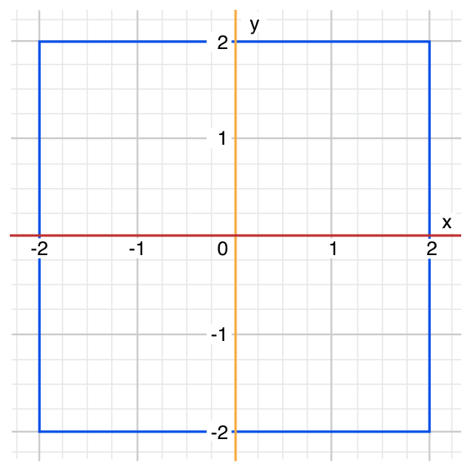
Switch - Tuples
let somePoint = (1, 1)
switch somePoint {
case (0, 0):
print("\(somePoint) is at the origin")
case (_, 0):
print("\(somePoint) is on the x-axis")
case (0, _):
print("\(somePoint) is on the y-axis")
case (-2...2, -2...2):
print("\(somePoint) is inside the box")
default:
print("\(somePoint) is outside of the box")
}
// Prints "(1, 1) is inside the box"

Slide 19
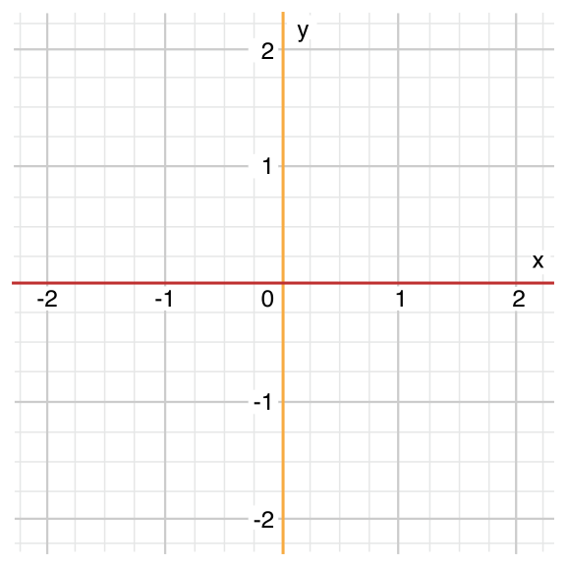
Switch - Tuple
let anotherPoint = (2, 0)
switch anotherPoint {
case (let x, 0):
print("on the x-axis with an x value of \(x)")
case (0, let y):
print("on the y-axis with a y value of \(y)")
case let (x, y): // Prints "on the x-axis with an x value of 2"
print("somewhere else at (\(x), \(y))")
}

Slide 20
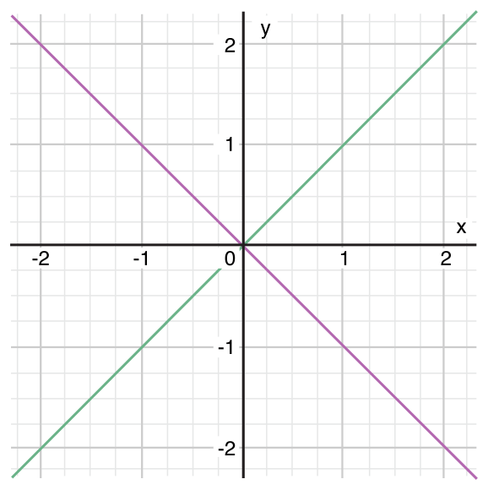
Switch - Tuple
let yetAnotherPoint = (1, -1)
switch yetAnotherPoint {
case let (x, y) where x == y:
print("(\(x), \(y)) is on the line x == y")
case let (x, y) where x == -y:
print("(\(x), \(y)) is on the line x == -y")
case let (x, y): // Prints "(1, -1) is on the line x == -y"
print("(\(x), \(y)) is just some arbitrary point")
}

Slide 21
Continue
let puzzleInput = "great minds think alike"
var puzzleOutput = ""
let charactersToRemove: [Character] = ["a", "e", "i", "o", "u", " "]
for character in puzzleInput {
if charactersToRemove.contains(character) { // Prints "grtmndsthnklk"
continue } puzzleOutput.append(character)
}
print(puzzleOutput)

Slide 22
Break
beendet Durchführung von Control Flow Statement auf der Stelle
Break in Loops
bricht aus Schleife aus
macht weiter bei “ } ”
Break in Switch
bricht aus Switch aus
macht weiter bei “ } ”
kann verwendet werden um cases zu ignorieren

Slide 23
Fallthrough
let integerToDescribe = 5
var description = "The number \(integerToDescribe) is"
switch integerToDescribe {
case 2, 3, 5, 7, 11, 13, 17, 19:
description += " a prime number, and also"
fallthrough // Prints "The number 5 is a prime number, and also an integer."
default:
description += " an integer."
}
print(description)

Slide 24
Labeled Statements
Verschachtelung von Schleifen und Statements
Verwendung von break oder continue z.B.
Schleifen bekommen Labels
label name: while condition {
statements
}

Slide 25
Labeled Statements
fancylabel: for each in array {
for eachSubItem in subArray {
switch someCharacter {
case one:
continue fancylabel
…
}
…
}
…
}

Slide 26
Guard
greet(person: ["name": "John"])
// Prints "Hello John!"
// Prints "I hope the weather is nice near you."
greet(person: ["name": "Jane", "location": "Cupertino"])
// Prints "Hello Jane!"
// Prints "I hope the weather is nice in Cupertino."
func greet(person: [String: String]) {
guard let name = person["name"] else {
return
}
print("Hello \(name)!")
guard let location = person["location"] else {
print("I hope the weather is nice near you.")
return
}
print("I hope the weather is nice in \(location).")
}

Slide 27
Checking API Availability
if #available(iOS 10, macOS 10.12, *) {
// Use iOS 10 APIs on iOS, and use macOS 10.12 APIs on macOS
} else {
// Fall back to earlier iOS and macOS APIs
}

Slide 28
Übung
let names = ["Anna", "Alex", "Brian", "Jack"]
Über die Namen mit einer for-in Schleife iterieren und für jeden Namen individuell mit einem switch überprüfen ob er Brian oder Anna entspricht. Default case soll ignoriert werden.
Sollte dies zutreffen, sollten mit einer for-in Schleife in Verbindung mit einem continue statement folgende Buchstaben aus den Namen entfernt werden: ["a", "e", "i", "o", "u"]
Anschließend sollen die Namen ausgegeben werden.

