Slide 1
Project Development (SYP)
Configuration Management (CM)
Unit 3

Slide 2
Non-linear Process
Problem
Phenomena
Counter Measures
Project development is a NON-linear process
Document changes (when, who, why)
Wrong decisions
Bugs
Switch back to old versions

Slide 3
Team Work
Problem
Phenomena
Counter Measures
Project development is team work
Document changes (when, who, why)
Parallel work
… on different files
Share changes easily

Slide 4
Manage Different Versions
Problem
Phenomena
Counter Measures
Proj. dev. is management of different versions
Stable releases
Control development and integration
… while development continues
Control variants
Variants needed

Slide 5

Aim of Configuration Management
Analysis
Design
Implementation
Test
Maintenance
CM manages ALL files to create, implement, and improve software
Source code
Build scripts
Requirements
Designs
Test scripts
Images
Docu
Specs
Guidelines
Estimations
Schedules
…

Slide 6
CM Activities
Identify artifacts to be controlled
Which files will be generated?
How will they be organized?
Variant management
Which / How many versions do co-exist?
Which branches to maintain?
Release Management
Baseline your development
Create versions for customer
Change Management
Where to store change requests (CRs)?
Why and when to implement a CR?

Slide 7
Content of a CM Plan
Versioning methods & tools
Which tools do you use? svn, git
Do you have all documents under version control?
If not, why not and how do you monitor changes?
Organization of artifacts
Variant management
Release management
Change management

Slide 8
Organization of Artifacts – Proposal
01_ProjectPlanning: Effort estimations, schedules
02_Requirements
03_Source Code
04_Testing
05_ReleaseDocs: Feature Lists, Change Logs, …
06_Meeting Minutes
07_Templates
08_MiscDocs: Design Docs, Project Proposal, Customer Info, …

Slide 9
Variant Management
How to organize different versions and branches?
Where are different versions stored?
When to open a new branch?
How to name new project versions?
Easy to remember: Yosemite, Nougat, etc.
Structured: v5.4.12
Mix of the above variants?

Slide 10
Working with Subversion

Slide 11
Possible Server
subversionneu.htl-leonding.ac.at

Slide 12
Organization of Tags and Branches
/trunk
/tags
/branches

Slide 13
Version Control with SVN – trunk, tags, and branches
Three directories which are created by convention
trunk
Means the main development line
tags
Holds all frozen states of the project’s artifacts
branches
Holds development lines of project variants

Slide 14
Tag Names
Tags are basically aligned with project milestones
<PROJECT_ALIAS>_xx.yy.zz
Example: SIRIUS_01.00.00
In svn this is a smart copy from /trunk into
/tags/<PROJECT_ALIAS>xx.yy.zz

Slide 15
Version Control with SVN – Terminology
Repository
Central store on server holding all artifacts of your project
Working Copy
Local “sand-box” on individual computer
Revision
State of a project’s artifacts in the repository

Slide 16
Version Control with SVN –
Basic Operations
Check-out
Initial transfer of project artifacts from repository to working copy
Commit
Storing back changed artifacts from working copy to repository
Update
Synchronize working copy with latest revision of repository

Slide 17
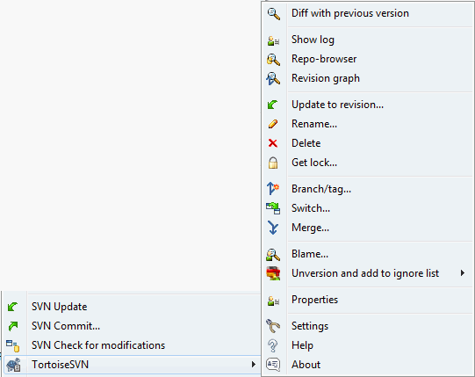
Version Control with SVN – Characteristics
Never rename a file without svn in a working copy
svn rename <file>
Never delete a file without svn in a working copy
svn rm <file>
Never move a file without svn in a working copy
svn mv <file>
Right drag

Slide 18
Working with git

Slide 19
Possible Servers
GitLab: https://gitlab.htl-leonding.ac.at
preferred – check out if working and sign-up if available
GitHub: https://github.com
BitBucket: https://bitbucket.org/account/signin/

Slide 20
Optional Exercise: Play Around With Git

Slide 21
Create a New Repository
New repository, Name == 3BHIF_Test_Rep
Initialize with README.md
No .gitignore: will come later
License file: None – or GNU?
Project Lead shall add collaborators („+“ Menu)
e-mail: follow link and accept invitation

Slide 22
A Short Tour through GIT
Install SourceTree (https://www.sourcetreeapp.com/)
Collaborator: SourceTree->Neu/Klonen have to clone the repository (SourceTree Remote)
Klick on Globe on the right side of „Source Pfad/URL“
Klick on „Clone“ and the repository will be copied to your local drive.

Slide 23
Round Trip I
PL creates in local Repository a simple Text File
Stage, Commit and Push on Repository
Stage: Collect Files for Commit
Commit: Commit Files to local Repository
Push: Upload File to Repository at e.g. www.github.com
Collaborator pull this file from Repository
Pull: Copy File from Web Repository to local Repository

Slide 24
Round Trip II
Collaborator shall create a new Text File:
Stage, Commit, Push
PL shall pull new File from Web Repository
PL and Collaborator edit same File:
Collaborator pushes File first
PL tries to push the File afterwards
GitHub refuses push

Slide 25
Round Trip III
PL has to solve Merge Conflict
Use Mine/Theirs or Merge manually
After Merge Commit and Push is allowed
Collaborator to pull merged version

Slide 26
Exercise I
Create a test Repository on GitHub.com
Create accounts for PL and collaborator
Do the Round Trip
PL: Create, stage, commit, push of simple text file
Collaborator: Create, stage, commit, push of simple text file
PL & Collaborator: Pull Files of your counterpart

Slide 27
Exercise II
PL and Collaborator edit same file
Collaborator pushes first
PL has to solve merge Conflict
Collaborator has to pull merged version

Slide 28
.gitignore
Build artifacts which should be ignored
.o, .war, .jar, .exe, .mdb, etc.
.gitignore is in the root directory of your project
https://www.gitignore.io helps to set up
Input: Used OS, used IDEs, Tools, etc.

Slide 29

Branching in git
v1.0
master
release/1.0
develop
feature/a
feature/b
https://blog.sourcetreeapp.com/2012/08/01/smart-branching-with-sourcetree-and-git-flow/

Slide 30
Assignment
Create a configuration management plan for your project
It should contain at least
Versioning methods & tools
Which tools do you use? svn, git
Do you have all documents under version control?
If not, why not and how do you monitor changes?
Organization of artifacts
Variant management

