Slide 1
Project Development (IV_SYP_PRE)
UML – Use Case Diagrams
Unit 5

Slide 2
Overview
Use cases: Describe what a system is supposed to do
Use case diagram
Tool to describe use cases in a graphical way
Standardized elements having a defined meaning
Supports developer – developer communication
Supports developer – customer communication

Slide 3

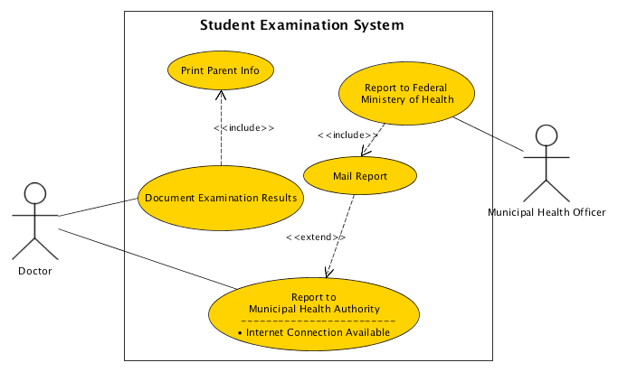
Main Elements
System Boundary
Use Case
Association
Association
Associations
Actor
Actor
Use Case
Use Cases
Use Case
Use Case
Notes:
Ad System Boundary: Could be more boundaries to show different sub systems, different releases, etc.

Slide 4
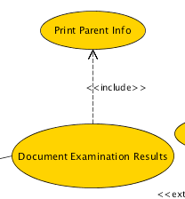
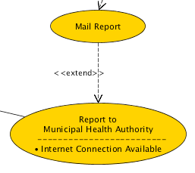
How To Read <<include>>
and <<extend>>
Read from arrow end to arrow head
Document Examination Results
includes
Print Parent Info
Again from arrow end to arrow head
Mail Daily Report
extends
Print Daily Report

Slide 5
The Meaning of <<include>>
For common parts of behavior of two or more use cases
Base use case is usually not complete in itself
Direction of the relationship indicates that base use case depends on the addition but not vice versa.
Allows
hierarchical composition of use cases
reuse of use cases

Slide 6
The Meaning of <<extend>>
Extending Use Case
When there is additional behavior that should be added
Possibly conditional, to the behavior defined in one or more use cases.
Extended use case
Is defined independently of the extending use case
Is meaningful independently of the extending use case.
Extending use case
Typically defines behavior that may not necessarily be meaningful by itself.
Defines a set of modular behavior increments that augment an execution of the extended use case under specific conditions
Extended Use Case

Slide 7
How to Proceed?
Find the actors
Persons, Roles
Find the central use case
What is the “main thing” to be done?
Wording: “<<Role>> uses the system in order to <<goal>>”
Refine this use case
Check for common parts

Slide 8
Try yourself
Trip booking
When booking a trip in a travel agency a flight and a hotel are booked. Some hotels offer a wellness program which can be booked in advance. Furthermore the customer has the possibility to take a travel insurance.

Slide 9
Summary
Actor: Person or process who/which interacts with a system
Association: Relation between actor and use case
Use Case: Activity including the actor(s)
include: Special relation between two use cases (extract common parts)
extends: Special relation between two use cases (optional)
Frame: System boundary

