Slide 1
Project Development (IV_SYP_PRE)
UML Class Diagrams
Unit 7

Slide 2
Purpose
Helps to document software designs
Describes static structure of software
Graphical representation of designs
Developer – developer communication

Slide 3

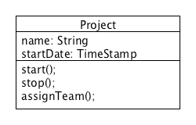
Classes
Name
Attributes
Operations

Slide 4
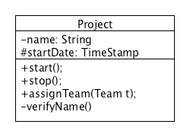

Different Levels of Detail
Name only
Design
Implementation

Slide 5
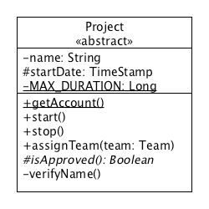
Symbols and Meanings
Stereotype
- Private
Class variable
# Protected
Class method
+ Public
Data Type
Parameter
Abstract
Return type

Slide 6
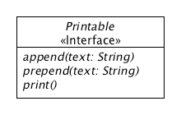
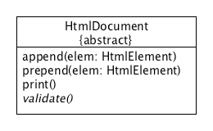
Abstract Classes and Interfaces
Stereotype
Interface
Everything is written in italic
Everything is written in italic
Oops, what’s this? Sorry, we came out with this too early. Will disappear immediately!
Optional
Abstract Class
Abstract method is written in italic

Slide 7
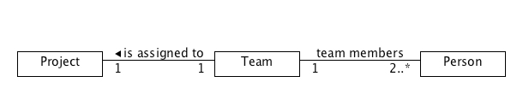
Associations
Relate instances of classes
Explanatory text
Explanatory text
Multiplicity
Multiplicity
Multiplicity
Multiplicities

Slide 8
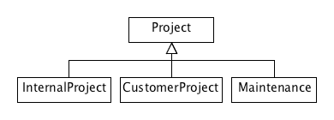
Inheritance
Big arrowhead

Slide 9
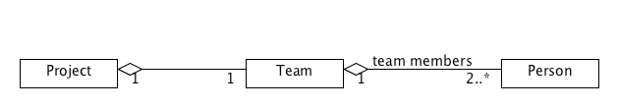
Aggregations
“Is part of …”-relation
Team is part of a Project
Person is part of a Team
Specialization of a general association
Empty diamond

Slide 10
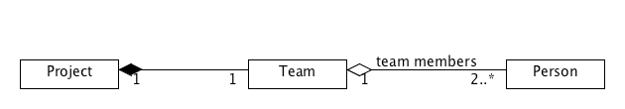
Compositions
“Is exclusive part of …”-relation
Team is exclusive part of a Project
Would imply that team will be canceled if project is canceled
Specialization of a general association
Filled diamond

Slide 11
Give it a Try
Model the application domain of your project
How to approach?
Analyze when you talk
All nouns are candidates for classes
All verbs are candidates for methods
Then look how the classes are related to each other

