Slide 1
Project Development (IV_SYP_PRE)
UML Activity Diagrams
Unit 8

Slide 2
Purpose
Verify the mental model of a use case
Model the flow of events of a use case
Validate the use case by reviewing the activity diagram with the project stake holders
Describes dynamic behavior of the system
Developer – customer communication
Developer – developer communication

Slide 3
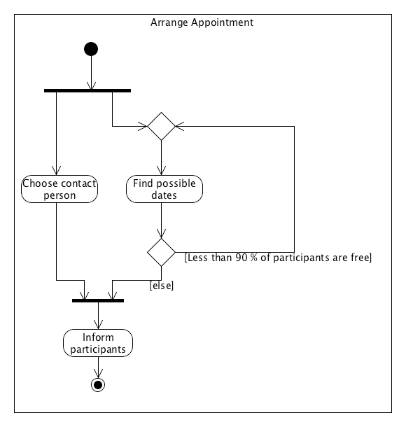

Basic Elements
Name of activity
Flow of activity
Start node
Merge node
Fork bar
Action
Activity
Branch node
Join bar
Guard condition
Stop node

Slide 4
Actions vs. Activities
Both nodes take the same notation
An activity can be subdivided into other activities or actions
An action is an atomic node which can’t be subdivided in the current context

Slide 5
Token-Based Semantics
After fork the tokens run independently and in parallel
Join bar blocks until all parallel threads arrive

Slide 6
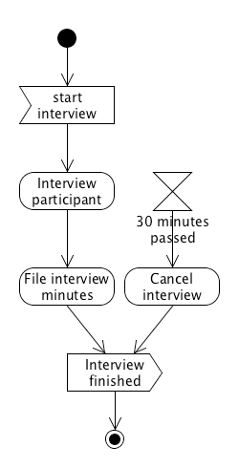
Signals and
Interruptible Activity Regions
Receive signal
Interruptible activity region
cancel interview region
If canceled this token “dies”
If 30 minutes are passed the activity “Interview participant” is canceled.
Send signal

Slide 7
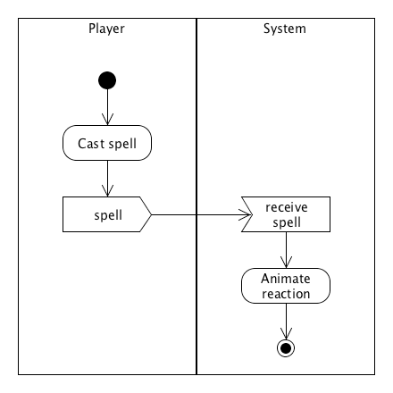
Partitions
Used for grouping
Criteria for groups may be chosen freely
Notation
Swim lanes

Slide 8
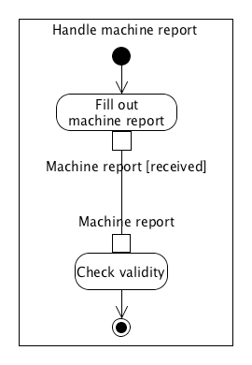
Passing Objects between
Actions or Activities
A pin is a connection point of an action or activity for input or output
The name of the pin denotes the object being passed
Pin

Slide 9
Give it a Try
Model activities in your use cases

Slide 10

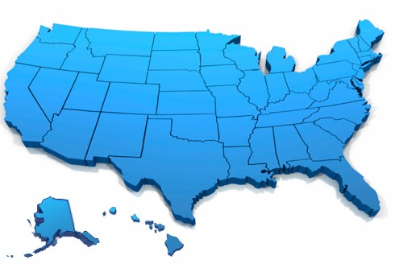


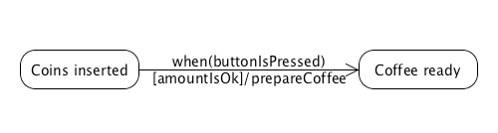
Reasoning about States
Most objects have states
For some it makes sense to describe their behavior relative to external stimuli

Slide 11
Purpose
Verify the mental model of a use case
Model the flow of states according to external stimuli of a use case
Validate the use case by reviewing the state diagram with the project stake holders
Describes dynamic behavior of the system
Developer – customer communication
Developer – developer communication

Slide 12
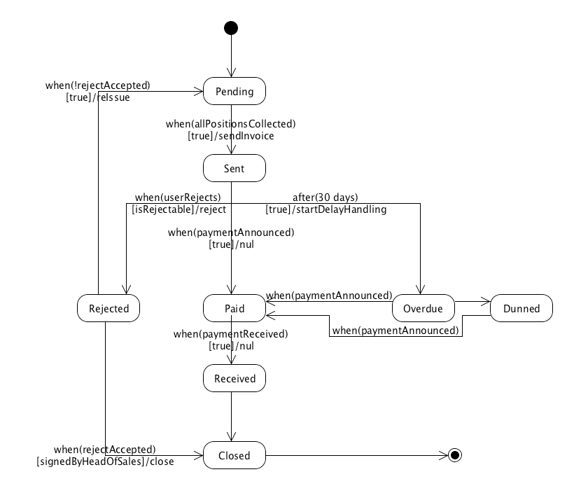
Parts of a UML State Diagram – States of an Invoice
State node
Initial state
Final state
State transitions

Slide 13
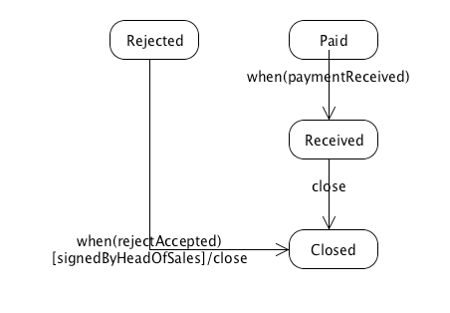
Transitions
Transition triggers
Triggering events
Guard conditions
Actions

Slide 14
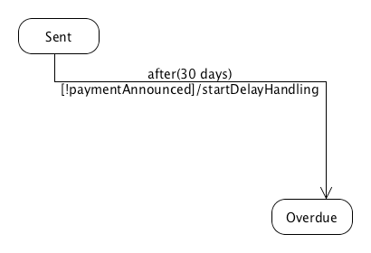
After Event
Events that should occur after a period of time are shown by using an after trigger event.
To fire a transition after,e.g., 30 days, specify the event on the transition as after(30 days).
This event is often used for timeouts.

Slide 15
Give it a Try
Model states in your use cases

