Slide 1
Project Development (IV_SYP_PRE)
Software Development Process
Unit 9

Slide 2
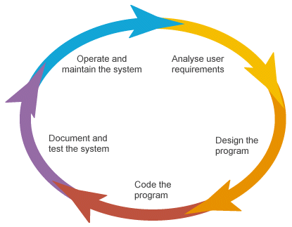
The Software Development Life Cycle(s)
SDLC
Compare with your book
There is not only one

Slide 3
Milestones
Separate the phases of the SDLC
In theory
Mark important check points of a project
In practical work

Slide 4
Process Models – Overview
Classical models
Waterfall model
Spiral model
V model
Rational Unified Process
Agile Models
Extreme Programming
Scrum
Feature Driven Development
Agile Unified Process

Slide 5
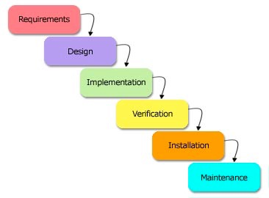

Waterfall Model

Slide 6
Spiral Model

Slide 7
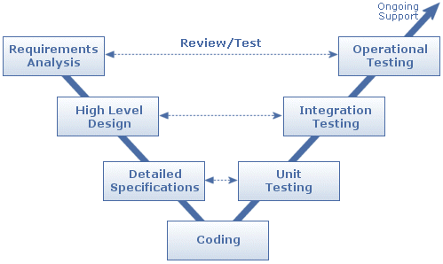
V-Model

Slide 8
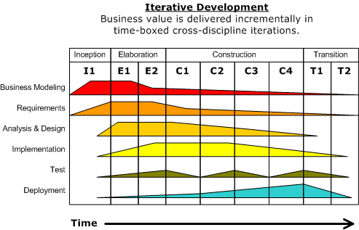
RUP
Iterations
4 Phases
4 Processes

Slide 9
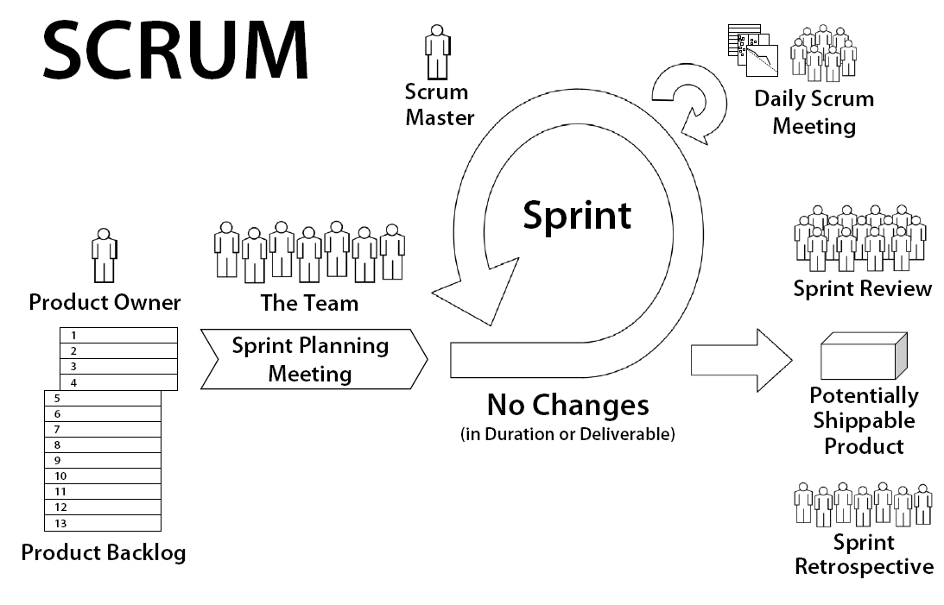
SCRUM
copyright: www.goodagile.com

