Slide 1
Project Development (IV_SYP_PRE)
Effort Estimation
Unit 10

Slide 2
Effort Estimation vs. Scheduling

Slide 3
Effort vs. Scheduling – A Very Rough Sketch (1)
Pre-work: Define a tasks to be done and one or more criteria per task to be satisfied in order to clearly indicate that the task is finished
Effort
Ask one or more experts: “How much time would one single person need to accomplish this task?”
Align these estimations to get a single and plausible number
Alternatively ask: “How much time took this (or a similar) task in another project we did in our company (multiply by the number of people working in parallel on this task)
Do this for all of your tasks in your project

Slide 4
Effort vs. Scheduling – A Very Rough Sketch (2)
Time
Define a start time for your project
Analyze the dependencies between your tasks
Analyze the availability of resources (team members, machines, etc.) in your project
Arrange your tasks according to the dependencies and resources

Slide 5
A Graphical Example
A
30
A
30
B
25
B
25
C
10
C
10
D
5
D
5
E
17
E
17
F
42
F
42
G
21
G
21
H
33
H
33
Total effort: 183 person hours
Total effort: 188 person hours
Total effort: 188 person hours
Total effort: 188 person hours
Total effort: 188 person hours
Total effort: 188 person hours
Total effort: 188 person hours
Total effort: 188 person hours
Duration: 183 hours

Slide 6

A Graphical Example
A
30
B
25
C
10
D
5
E
17
F
42
G
21
H
33
Duration: 183 hours
B
25
C
10
D
5
G
21
H
33
A
30
E
17
F
42
Duration: 143 hours

Slide 7
Effort Estimation in Little

Slide 8
A Simple Planning and Monitoring Sheet (PM-Sheet)
Task | Orig. Est. | Curr. Est. | Effort | Remain | Responsible

Slide 9
A Small Exercise to Start With
Sit down in your team
Agree on the most important things to be accomplished in your project (tasks) in the next week
Make sure that every team member understands every task
Agree on one or more criteria per task which have to be fulfilled in order to indicate whether this task is finished (acceptance criteria)
Prioritize the tasks roughly
Document the tasks, their acceptance criteria and prios

Slide 10
A Small Exercise to Start With – cont’d
Find out, how many person hours your team can spend on your project during the next week (hours pool)
Estimate the effort (in person hours) to accomplish these tasks
Start your estimations with the highest prio tasks and go along the way down following the falling prios
Stop the effort estimation as soon as your estimations reach the hours pool
Document the effort estimations and your hours pool in the PM-Sheet

Slide 11
During the Week
Every team member
When you take over a task out of the PM-sheet write your name as responsible to this task
Monitor your working time on the project in the PM-sheet
Re-estimate the remaining time necessary to accomplish the task you are currently working on
Project lead
If a new tasks comes up or a tasks becomes obsolete, update the PM-sheet

Slide 12
A Small Exercise to Start With – One Week Later
Check, whether your planned tasks are finished by testing the actual results against the acceptance criteria
Compare these results with the remaining time as monitored in your planning sheet
Analyze the entries for every planned task
Does the original estimation differ from the current estimation?
If so: why did it grow or shrink?

Slide 13
A Small Exercise to Start With – Retrospective
What did you learn for a next iteration?
What went good? Why?
What went bad? Why?
Which things have to happen again in the next iteration?
Which things must not happen again in the next iteration?

Slide 14
Structuring the Whole Project

Slide 15
A Bigger Picture
So far we only estimated small entities
If we estimate a complete project on this basis, we would never end
Try a slightly different approach

Slide 16
There Is Nothing Without Requirements
Collect the requirements in a product backlog
Basis should be the requirements documented in the system spec
ID | Prio | Epic | User Story | COS (Criteria of Satisfaction) | Effort
CAL01 | 1 | Calendar | As a student I want to add an internal event | Invalid values: start after end, empty title, notification e-mail to be sent to all class mates | 3
CAL02 | 2 | Calendar | As a student I want to cancel an internal event | Notification mail to all class mates | 1
CAL03 | 2 | Calendar | As a teacher I want to add an internal event | Only classes which are assigned to teacher may be selected; all acceptance criteria from CAL01 have to be fulfilled | 5
… | … | … | … | … | …
… | … | … | … | … | …

Slide 17
User Story
One to two sentences
Criteria of satisfaction
INVEST
Independent
Negotiable
Valuable
Estimable
Small
Testable

Slide 18
User Stories have Different Levels of Detail
User stories with high priority have a high level of detail
User stories with low priority have a low level of detail
Over time user stories evolve and get a higher level of detail
At the very beginning its maybe only the Epic
As a student I want to select the classes which are to be invited
As a student I want to add an event
As a student I want to get suggestions when the invited classes have a common time slot.
Calendar

Slide 19
An Even Bigger Picture
It is difficult to describe a complete project even on this level of detail
The next three sprints are maybe fine with this approach but then?
Let’s start off with something rougher
Work breakdown structure
Story map

Slide 20


Work Breakdown Structure
Function oriented
Solar Mobil
R & D
Engineering
Production
Mounting
Collector
E-Engine
Chassis
Board Electr.
Object oriented
Analysis
Implement.
Time oriented
Design
Test

Slide 21
Story Maps
Calendar | Forum | FTP | Epic | Epic … | Epic
CAL01 | FOR01 | FTP01 | STORY | STORY | STORY
CAL02 | FOR02 | FTP02 | STORY | STORY | STORY
CAL03 | FOR03 | FTP03 | STORY | STORY | STORY
CAL04 | FOR04 | FTP04 | STORY | STORY | STORY
CAL05 |  | FTP05 | STORY |  | STORY
… |  | … |  |  | …
Time

Slide 22
Effort Estimation for the Whole Project

Slide 23
Effort Estimation of the Bigger Entities
The bigger entities can’t be estimated in hours
Estimation in days or story points

Slide 24
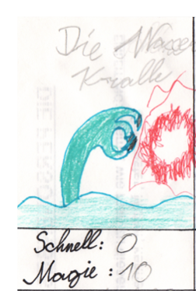
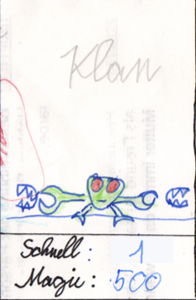
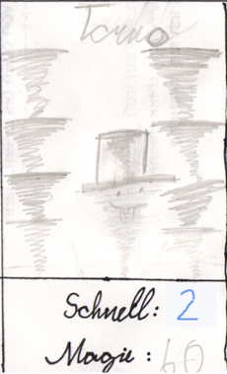
Story Points
Small effort: approx. double of a very small effort
No effort
Very small effort

Slide 25
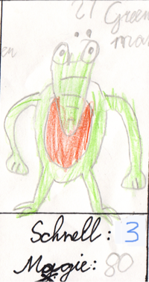

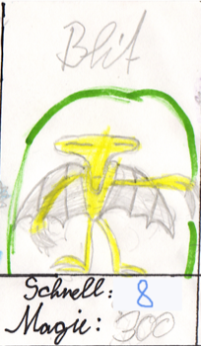
Story Points – continued
Very large effort: Middle + large effort
Middle effort: Very small + small effort
Large effort: Small + middle effort

Slide 26
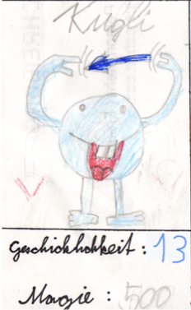
Story Points – finished
Huge effort: Large + very large effort

Slide 27
Distance of Story Points
0, 1, 2, 3, 5, 8, 13
The Fibonacci Sequence
Increasing distances
Reliefs the team from guessing around whether a specific story has an effort of 21 or 25 hours
ATTENTION: If effort is 13 for a high number of stories, the team most probably doesn’t understand a large part of the project

Slide 28
Story Points – Characteristics
Team specific
Different teams will estimate a different amount of points
Relative
One estimation has no meaning

Slide 29
Effort Estimation w/ Story Points – The Planning Poker
Prerequisite: Every team member has a stack of cards (one from each kind)
Select a small story at first
Product Owner explains story
Team clarifies story (ask and discuss)
Every team member selects a card from his / her stack reflecting his opinion concerning the effort
All team members unhide their cards at the same time

Slide 30
The Planning Poker – continued
If all team members estimate the same effort, we are done
If not
The member with the smallest estimate explains his/her reasons
The member with the highest estimate explains his/her reasons
Then a new round of estimation starts

Slide 31
Putting it all Together

Slide 32
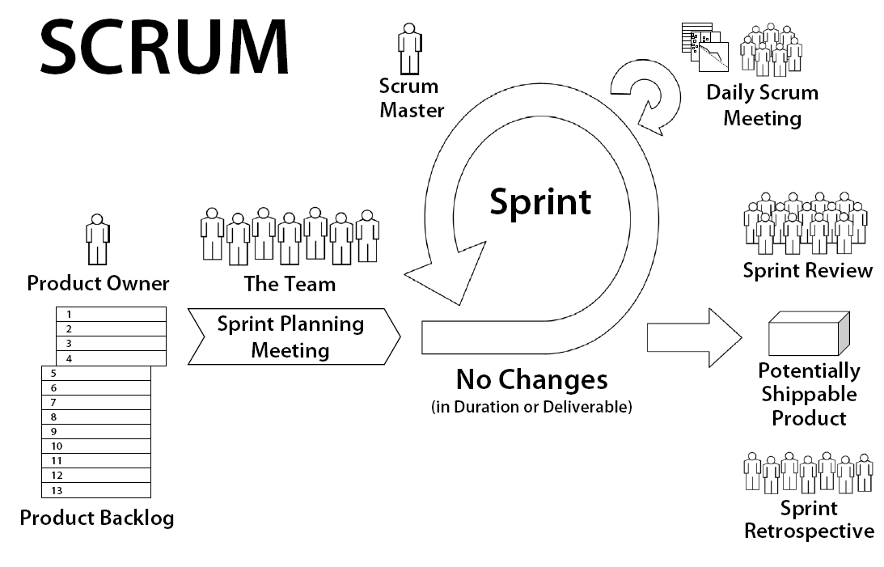
copyright: www.goodagile.com

Slide 33
Product Owner:
has a vision of a product
copyright: www.goodagile.com

Slide 34
Product Backlog:
Holds all features and requirements
copyright: www.goodagile.com

Slide 35
Sprint:
Typical duration (2 - 6 weeks)
Within these features are implemented
copyright: www.goodagile.com

Slide 36
Sprint Planning Meeting:
Product owner and team together
Features in Product Backlog are prioritized
Sprint Backlog is created
Detailed plan of work is done
copyright: www.goodagile.com

Slide 37
No Changes:
Planned features for a sprint must not be changed
copyright: www.goodagile.com

Slide 38
Daily Scrum Meeting:
Daily meeting to exchange progress, next step, impediments (problems)
Progress update in Burndown Chart
copyright: www.goodagile.com

Slide 39
Scrum Master:
Handles organizational issues
Resolves impediments
copyright: www.goodagile.com

Slide 40
Product:
Every sprint results in „shipable“ software
copyright: www.goodagile.com

Slide 41
Sprint Review:
Results of sprint are reviewed
Stakeholders sign off the implemented features
copyright: www.goodagile.com

Slide 42
Sprint Retrospective:
Internal review of work in last sprint
List of Oks and NGs
Continuous improvement of work
copyright: www.goodagile.com

Slide 43
Traditional Methods
Formal estimation models
Function Points
Expert estimations
Group estimation, Work breakdown structure based models
Combination-based estimations
Mechanical combination

Slide 44
Function Points

Slide 45
Group Estimation

Slide 46
WBS-Based Estimation

Slide 47
Mechanical Combination
Average of function points and WBS-based estimations

