Slide 1
Principles of Good Screen Design
- Teil 2 -
Tiefeneindruck erzeugen
Overlapping
Texture Change
Drop Shadows
Color Change
Highlighting/ Lowlighting
Space Change
Shrinking and Growing
Receding Lines
Beveled Edges
Motion Change

Slide 2
GROSSBUCHSTABEN
⇨ nur für Titel und Untertitel
Groß/ Klein (Mixed-Case-Font) ist leichter lesbar - Großbuchstaben ziehen mehr Aufmerksamkeit.

Slide 3
Schriftarten I
Typeface
Use simple, readable fonts.
  Any sans serif such as Helvetica
  Times Roman
Use no more than two families, compatible in terms of line thicknesses, capital letter height, and so on.
  Assign a separate purpose to each family
  Allow one family to dominate
Use no more than:
  Two styles of the same family.
    Standard and italic.
  Use no more than two weights.
    Regular and bold.
Use bold only when you want to call attention or create a hierarchy.
Times Roman
Times Italic
Times Bold
Times Bold Italic
Times Shadow
Times Outline

Slide 4
Schriftarten II
Times Roman
Times Italic
Times Bold
Times Bold Italic
Times Shadow
Size
Use no more than three sizes.
  Consider „X“ height.
Many system use:
  12 point for menus
  10 point for windows
Never change established type sizes to squeeze in more text.
Consistency
Establish a consistent hierarchy and convention for using typefaces, styles and sizes.
Use standard system fonts to achieve consistency
Other
Always consider the visual capabilities of the user.y
Times Outline

Slide 5
Caption I
First Amount:
Last Amount:
This Amount:
That Amount:
Who Cares Amount:
AMOUNT >> First:
Last:
This:
That:
Who Cares:

Slide 6
Caption II
Identify controls with captions or labels.
Fully spell out in a meaningful language to the user.
Display in normal intensity.
Use a mixed-case font.
Capitalize the first letter of each significant word.
End each caption with a colon (:).
Choose distinct captions that can be easily distinguished from other captions. Minmal differences (one letter or word) cause confusion.

Slide 7
Anordnung von Captions
- in Abhängigkeit von der Zahl der Datenfelder -
Sex:
Relation:
Female
Daughter
Names:
Deirda
Karin
Relation:
Daughter
Kim
Lauren
Relation:
Daughter

Slide 8
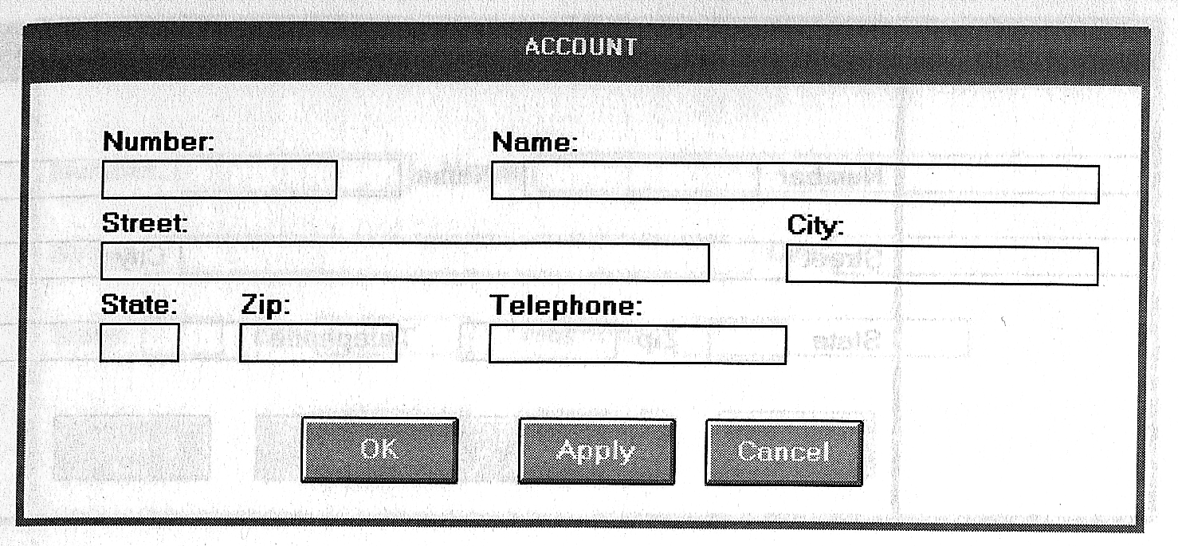
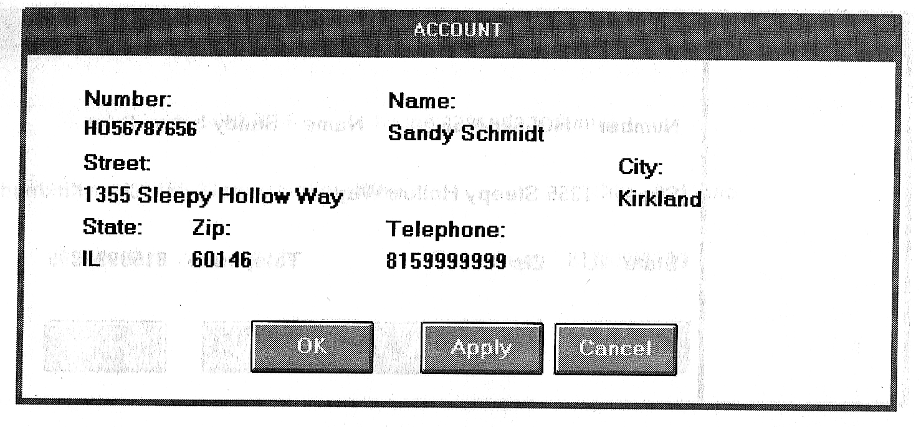
Dateneingabe vs. Datenausgabe

Slide 9
4 Formen der Anordnung
A.
C.
Division:
Division :
Department:
Department:
Title:
Title :
D.
B.
Division:
Division:
Department:
Department:
Title:
Title:

Slide 10
Überschriften
Personnel
Manager:
Employees:
Payroll:

Slide 11
Keystrokes
Minimierung der Tastenanschläge ist als Ziel zu relativieren:
Rhythmus
Entscheidungs- & Lernaufwand
⇨ automatisches Springen vermeiden

Slide 12
Spezialfälle
Eingabe und Änderungsmaske:
logischer Maskenaufbau
explizite Captions
Eingabe von Vorlage
Maske wie Vorlage aufbauen
Abgekürzte Captions
Nur Lesen
Keine Umrahmung
Text links-bündig, Zahlen rechts-bündig
keine „Null-“ Information
Data-Statements
Elefanten: 10
Löwen: 0
10 Elefanten

Slide 13
Darstellung statistischer Daten
Emphasize the data.
Minimize the nondata.
Minimize redundant data.
Show data variation, not design variation.
Provide the proper context for data interpretation.
Restrict the number of information-carrying dimensions depicted to the number of data dimensions being illustrated.
Employ data in multiple ways, whenever possible.
Maximize data density.
Employ simple data density.
Avoid unnecessary embellishment of:
  Grids.
  Vibration.
  Ornamentation.
Fill the graph‘s available area with data.

Slide 14
Interpretation der Darstellung unterstützen
Display a grid on request.
Permit the viewer to click on a data point to display actual values.
Show numeric values automatically for each point or bar.
Permit the viewer to zoom in on an area of the graphic.
Permit the user to change the scale values.
Permit toggling between a graphic and a table.

Slide 15
PIEs
Pie charts sould be used with caution.
If pie charts are used:
  They must add up to 100 percent.
  Use five segments or less.
  Place the largest wedge starting at 12:00
  Each segment should take up at least 5 percent (18 degrees) of the circle.
  Directly label each segment in the normal reading orientation.
  If leaders for labels in small segments are necessary, orient them in as few angles as possible.
  Include numbers with segment labels to indicate percentages of absolute values.
  Textures or colors selected for segments should not emphasize one segment over another (unless it is intended).
  Highlight segments requiring particular emphasis through a contrasting display technique or by „exploding“ it.
  Never tilt a pie.

Slide 16
Step 4: Proper Windows
Eigenschaften von Fenstern
A window is seen to possess the following characteristics:
A name or title, allowing it to be identified.
A size in height and width (which can vary).
A state, whether it is accessible or active or not accessible. (Only active windows can have their contents altered.)
Visibility - the portion that can be seen. (A window may be partially or fully hidden behind another window, or the information within a window may extend beyond the window‘s display area.)
A location, relative to the display boundary.
Presentation, that is, its arrangement in relation to other windows. It may be tiled, overlapping, or cascading.
Management capabilities, methods for manipulation of the window on the screen.
Its highlight, that is, the part that is selected.
The function, task, or application to which it is dedicated.

Slide 17
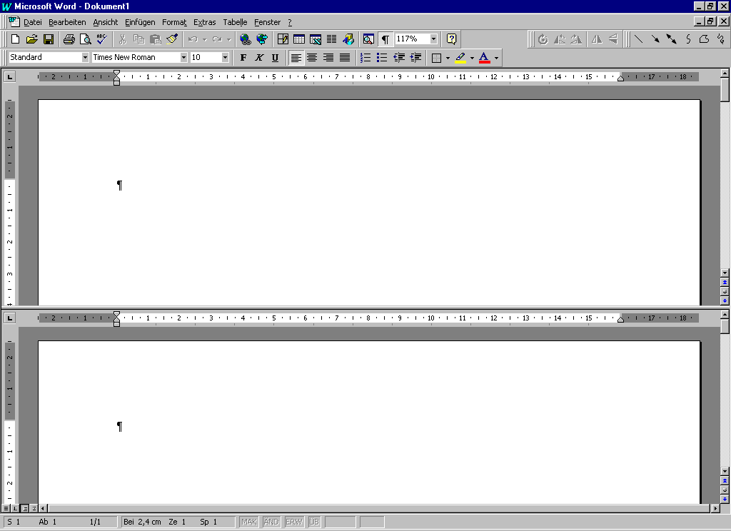
Fenster Componenten
System Menu Button
Title Bar
Menu Bar
Window Sizing Buttons
Work Area
Split Bar
Status Bar
Scroll Bars

Slide 18
Tiled Windows
+
-
Positionierung wird vom System übernommen
alle Fenster sind immer sichtbar
vollständig sichtbar
weniger komplex
besser für Anfänger
begrenzte Anzahl
befremdlicher Größenwechsel
ggf. zu kleine Fenster
Konfiguration und Position kann unpassend sein
unübersichtliche Wirkung

Slide 19
Overlapping Windows
+
-
Tiefeneindruck
mehr Steuerungsmöglichkeit
größere Fenster möglich
feste Größe und Position möglich
weniger Druck, Fenster zu schließen
Komplexität kann reduziert werden
komplexere Steuerung
Information kann verschwinden
Möglichkeit der Unübersichtlichkeit

Slide 20
Cascading Windows
+ Kein Fenster ist jemals komplett versteckt
+ Es ist einfacher ein Fenster vorzuholen
+ sauberer Eindruck
- ...

Slide 21
Arten von Fenstern
Primary Window
Secondary Window
  Property Windows
  Dialog Boxes
  Message Boxes
  Palette Windows
  Pup-Up Windows
Single Document interface
Multiple Document interface
Workspaces
Warkbooks
Projects

Slide 22
Dialog Boxes
Use for presenting brief messages.
Use for requesting specific, transient actions.
Use for performing actions that:
  Take a short time to complete.
  Are not frequently changed.

Slide 23
Modal Dialog Boxes vs. modeless Dialogue Boxes
modal:
Dialog Box kann nicht verlassen werden
? Nachrichten werden ausgegeben
? Input ist gefragt
modeless:
parallele Bearbeitung möglich
⇨ Achtung: Unnötige Restriktion vermeiden

Slide 24
Darstellung von Dialog Boxen I
Cascading
Purpose
To provide advanced options at a lower level in a complex dialog.
Guidelines
Provide a command button leading to the next dialog box with a „To a Window“ indicator, an ellipsis (...).
Present the additional dialog box in cascaded form.
Provide no more than two cascades in a given path.
Do not cover previous critical information.
  Title Bar.
  Relevant displayed information.

Slide 25
Darstellung von Dialog Boxen II
Expanding
Purpose
To provide advanced options at the same level in a complex dialog.
Guidelines
Provide a command button with an expanding dialog symbol (>>).
Expand to right or downward.

Slide 26
Organisation von Fenstern
Organize windows to support user tasks.
Support the most common tasks in the most efficient sequence of steps.
Use primary windows to:
  Begin an interaction and provide top-level context for dependent windows.
  Perform a major interaction.
Use secondary windows to:
  Extend the interaction.
  Obtain or display supplemental information related to the primary window.
Use dialog boxes for:
  Infrequently used or needed information.
  “Nice-to-know” information.

Slide 27
Termin
eintragen
Reiseantrag
erstellen
Schulferien
abgleichen
Eintrag in
ToDo-Liste
Termin genau
spezifizieren

Slide 28
Sizing Windows
Provide large-enough windows to:
  Present all relevant and expected information for the task.
  Avoid hiding important information.
  Avoid crowding or visual confusion.
  Minimize the need for scrolling.
    But less than the full size of the size of the entire screen.
If a window is too large, determine:
  Is all the information needed?
  Is all the information related?
Otherwise, make the window as small as possible.
  Optimum window sizes:
  For text, about 12 lines.
  For alphanumeric information, about 7 lines.

Slide 29
Vor- und Nachteile bzgl. der Fenstergröße
Larger windows seem to have these advantages:
They permit display of more information.
They facilitate learning: Data relationships and groupings are more obvious.
Less window manipulation requirements exist.
Breadth is preferred to depth (based on menu research).
More efficient data validation and data correction can be performed.
Disadvantages include:
Longer pointer movements are required.
Windows are more crowded.
More visual scanning is required.
Parts are more easily obscured by other windows.
It is not as easy to hide inappropriate data.

Slide 30
Maßstab für Fenstergröße
Problem: Wie mißt man die Menge der Information, die maximal auf ein Fenster paßt?
Vorschlag: Abmessungen der kleinsten bedeutungs-unterscheidenden Einheiten identifizieren.

Slide 31
Öffnen eines Fensters (1)
Provide an iconic representation or textual list of available windows.
When opening a window:
  Position in the most forward plane of the screen
  Designate it as the active window.
  Set it off against a neutral background.
When a primary window is opened or restored, position it to the top.
When a dependent secondary window is opened, position it to the top.

Slide 32
Öffnen eines Fensters (2)
When a dependent secondary window is activated, its primary windows and related peer windows should also be positioned at the top.
If more than one object is selected and opened, display each object in a separate window. Designate the last window selected as the active window.
Display a window in the same state as when it was last accessed.
With tiled windows, provide an easy way to resize and move newly opened windows.

Slide 33
Plazierung eines Fensters (1)
General
Position the window so it is entirely visible.
If the window is being restored, place the window where it last appeared.
If the window is new, and a location has not yet been established, place it:
  At the point of the viewer’s attention, usually the pointer or cursor.
  In a position convenient to navigate onto.
  So that it is not obscuring important or related underlying window information.
For multiple windows, give each additional window its own unique and discernible location.
  A cascading presentation is recommended.

Slide 34
Plazierung eines Fensters (2)
If none apply, then:
  Horizontally center a secondary window within its primary window just below the title bar, menu bar, and any button bars.
Do not let the user move a window to a position where it cannot be easily repositioned.
Dialog Boxes
If the dialog box relates to the entire system, center it on screen.
Keep key information on underlying screen visible.
If one dialog box calls another, make the new one movable whenever possible.

Slide 35
Fenstergröße ändern (1)
Permit the user to change the size of primary and secondary windows.
Change the pointer shape to indicate that the resizing selection is successfull.
The simplest operation is to anchor the upper-left corner and resize form the lower-right corner.
  Also permit resizing from any point on the window.
Show the changing window as the pointer moves.
When window size changes and content remains the same:
  Change image size proportionally as window size changes.

Slide 36
Fenstergröße ändern (2)
If resizing creates a window or image too small for easy use, do one of the following:
  Clip (truncate) information arranged in some logical structure or layout when minimum size is attained, or
  Format (restructure) information when no layout considerations exist as size is reduced, or
  Remove less useful information (if it can be determined), or
  When minimum size is attained, replace the information with a message that indicates the minimum size has been reached and that the window must be enlarged to continue working.

Slide 37
Fenster verschieben, Fenster schließen
Moving a Window
Permit the user to change the position of all windows.
Change pointer shape to indicate the move selection is successful.
Move the entire window as the pointer moves.
  If it is not possible to move the entire window, move the window outline while leaving the window displayed in its original position.
Permit moving a window without making it active.
Closing a Window
Close a window when:
  The user requests it to be closed.
  The user performs the action required in the window.
  The window has no further relevance.
If a primary window is closed, also close all of its secondary windows.
When a window is closed, save its current state, including size and position, for use when the window is opened again.

